Slide 1
PARALLEL COMPUTING LAB · MINI-PROJECT EVALUATION · THEME 7
GPU Vector Operations using CUDA
CPU vs GPU performance of element-wise vector addition and multiplication on an NVIDIA Tesla T4
Google Colab · CUDA 13.0 · Tesla T4 (Turing) · 1 October 2026
TEAM
idx = blockIdx.x × blockDim.x + threadIdx.x
<Name>
<USN>
<Name>
<USN>
<Name>
<USN>
<Name>
<USN>
Notes:
Opening. Introduce the team and the theme: Theme 7, vector addition and multiplication with CUDA threads, compared against the CPU. The grid of squares on the right is our launch: one square per thread block; the outlined squares at the end are the extra threads that the idx < n guard switches off.

Slide 2
Same program, same GPU — two opposite answers
GPU KERNEL ONLY
GPU END TO END (WITH PCIe COPIES)
53.8× faster
1.86× slower
than one CPU core at N = 25 million
than the same CPU core at N = 25 million
CPU
125.05 ms
CPU
125.05 ms
GPU kernel
2.33 ms
GPU total
232.72 ms
The gap is the data transfer: 99 % of the GPU's time went into copying data over PCIe. This presentation shows how we measured both numbers, and why they differ.
Notes:
Hook. Same binary, same GPU, same data. If we time only the kernel the GPU is about 54 times faster; if we time what a user waits for, including the copies, the GPU is almost two times slower. Everything that follows explains this gap. Numbers: README Sections 9.1 and 11.4.

Slide 3
Fully parallel, but very little work per element
PROBLEM AND AIM
Three questions we set out to answer
C_add[i] = A[i] + B[i]
C_mul[i] = A[i] × B[i]
for 0 ≤ i < N, FP32
1
How much faster is the CUDA kernel than a sequential CPU loop?
Answered on slides 12–14
No dependence between elements
Each output uses only the two inputs at the same index: no sharing, no ordering, no reduction. All N elements can be computed at once.
2
How much of that advantage survives once data transfer is included?
Answered on slides 15–16
AIM
Perform vector addition and multiplication using CUDA threads and compare CPU and GPU execution.
3
Why do the numbers look the way they do, and what would change them?
Inputs A[i] = 1.0, B[i] = 2.0 → correct outputs are exactly 3.00 and 2.00
Answered on slides 17–19
Notes:
Problem definition. C = A + B and C = A x B, element by element, in single precision. Because each element is independent, the problem is embarrassingly parallel. We fill A with 1 and B with 2 so that the correct answers are known exactly: 3.00 and 2.00. These three questions structure the rest of the talk.

Slide 4
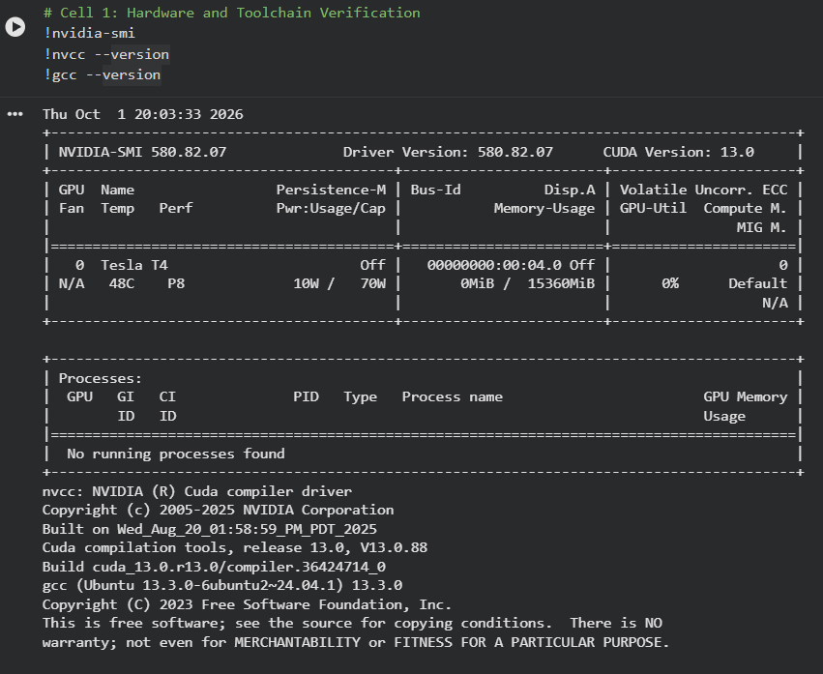
Our platform: an NVIDIA Tesla T4 on Google Colab
EXPERIMENTAL SETUP
Colab · Cell 1 · toolchain check (screenshot 01)
2,560
320 GB/s
CUDA cores (40 SMs × 64)
GDDR6 memory bandwidth
8.1 TFLOPS
PCIe Gen3 x16
peak FP32 compute
≈ 15.75 GB/s per direction
Tesla T4 hardware figures: NVIDIA datasheet
Software / state | Recorded in screenshot 01
CUDA toolkit | NVCC 13.0 (V13.0.88)
NVIDIA driver | 580.82.07 · 15,360 MiB GPU memory
Host compiler | GCC 13.3.0 · both programs built with -O2
Platform | Google Colab VM, Ubuntu 24.04
GPU before run | Idle: P8, 48 °C, 10 W of 70 W
Notes:
Setup. Screenshot 01 is the first cell of our notebook: nvidia-smi shows the Tesla T4 with driver 580.82.07, nvcc is CUDA 13.0, gcc is 13.3.0. The four green cards are datasheet values which we use later in the roofline and bandwidth analysis. The GPU was idle in power state P8 before the run, which is why we added a warm-up launch.

Slide 5
One Colab notebook, executed cell by cell
METHODOLOGY AND WORKFLOW
1
2
3
4
5
6
7
Verify
Set up
Write code
Compile and check
Benchmark
Analyse
Package
Cell 1
Cell 2
Cells 3–4
Cell 5
Cells 6–7
Cells 8–9
Cell 10
nvidia-smi, nvcc, gcc
Project folders, git init
%%writefile the .c and .cu sources
gcc / nvcc -O2, run at N = 10⁷
5 sizes → timing_data.csv
pandas metrics, 9 figures
zip and download
CP1 · CP2
CP2
CP3
CP4
What the run produced
Screenshot 01
src/
Screenshot 02
timing_data.csv
graphs/01–09
GPU and toolchain versions
vector_cpu.c, vector_cuda.cu
3.00 / 2.00 on CPU and GPU
5 sizes × 5 timings
execution time, speedup, PCIe…
In Colab, a leading ! runs a shell command and %%writefile saves a cell as a file, so the whole experiment lives in one notebook (notebook/pgc_codes.ipynb).
Notes:
Methodology. We did not build anything outside the notebook. Cells were run strictly in order: verify the GPU, create folders, write both programs with %%writefile, compile with -O2 and check correctness at ten million, write and run the benchmark script, then compute metrics and draw nine figures with pandas and matplotlib, and finally zip the project. The plotting cells are also exported as scripts/plot_results.py.

Slide 6
The CPU baseline: two simple loops on one core
CHECKPOINT 1 · SEQUENTIAL ALGORITHM
Version | Work W(N) | Span D(N) | Time on P
Sequential CPU | O(N) | O(N) | Θ(N)
Parallel GPU | O(N) | O(1) | O(N/P + 1)
Algorithm 1: Sequential vector operations
Input : A[0..N-1], B[0..N-1]
Output: C_add[0..N-1], C_mul[0..N-1]
1: for i ← 0 to N-1 do C_add[i] ← A[i] + B[i]
2: for i ← 0 to N-1 do C_mul[i] ← A[i] × B[i]
250× data → 241.9× time
Measured CPU time from N = 100 K to 25 M (0.517 → 125.05 ms): linear growth, as Θ(N) predicts.
1
Timed per loop. clock() wraps each loop separately in src/vector_cpu.c.
2
Total CPU time = addition time + multiplication time.
Work-efficient
3
One core, no OpenMP, on purpose: a clean sequential reference T₁ for the speedups.
The GPU version does the same O(N) work as the CPU, with a critical path of one step per thread (Brent's theorem gives O(N/P + 1)).
Notes:
Checkpoint 1, part one. The sequential algorithm is two loops. Complexity is O(N) work and O(N) span on the CPU; on the GPU the work stays O(N) but the span is O(1), because each thread does one operation. Our measured CPU times confirm linear growth: 250 times more data gave 241.9 times more time.

Slide 7
One thread per element, 256 threads per block
CHECKPOINT 1 · PARALLEL DESIGN
Block 0
Block 1
Block 2
Last block
Why 256 threads per block
…
1
8 full warps: 256 is a multiple of 32, so no lane is wasted.
elements 0–255
elements 256–511
elements 512–767
partly idle
Each square = one warp of 32 threads; 8 warps = 256 threads. Dashed = threads with idx ≥ N.
2
Full occupancy: 4 blocks × 256 fill a Turing SM's 1,024-thread limit.
idx = blockIdx.x × blockDim.x + threadIdx.x
3
Not 32: the 16-blocks-per-SM limit would cap 32-thread blocks at 50 %.
Example: thread 17 of block 3 handles element 3 × 256 + 17 = 785.
N | Blocks ⌈N / 256⌉ | Threads launched | Extra (guarded)
100,000 | 391 | 100,096 | 96
1,000,000 | 3,907 | 1,000,192 | 192
10,000,000 | 39,063 | 10,000,128 | 128
25,000,000 | 97,657 | 25,000,192 | 192
Boundary guard
if (idx < n) { … }
The grid is rounded up to whole blocks, so a few threads have no element. The guard stops them reading or writing past the arrays.
Notes:
Checkpoint 1, part two. One thread computes one element. The index formula maps block and thread numbers to an element. We chose 256 threads per block: eight full warps, and four blocks fill a Turing SM's 1,024-thread limit. Because the block count is rounded up, up to 192 extra threads are launched in our sizes; the if (idx < n) guard keeps them from touching memory outside the arrays.

Slide 8
Two kernels and a five-step memory life cycle
CHECKPOINT 2 · CUDA IMPLEMENTATION
__global__ void vectorAddKernel(const float *A,
const float *B, float *C, long n) {
long idx = blockIdx.x * blockDim.x + threadIdx.x;
if (idx < n) C[idx] = A[idx] + B[idx];
}
__global__ void vectorMulKernel(const float *A,
const float *B, float *C, long n) {
long idx = blockIdx.x * blockDim.x + threadIdx.x;
if (idx < n) C[idx] = A[idx] * B[idx];
}
// launch: <<<(N + 255) / 256, 256>>>
1
Allocate
cudaMalloc(&d_A, bytes)
Reserve d_A, d_B and one d_C on the GPU
2
Copy in
cudaMemcpy(…, HostToDevice)
Send A and B over PCIe
3
Compute
kernel<<<⌈N/256⌉, 256>>>
One thread per element
4
Copy out
cudaMemcpy(…, DeviceToHost)
Bring C back over PCIe
5
Free
cudaFree, free, cudaEventDestroy
src/vector_cuda.cu (condensed). __global__ = runs on the GPU, launched from the host; inputs are const, so the kernels only read them.
Release memory and timers
d_C is reused for both operations, so the GPU holds 3 × 4N bytes: 286 MiB at N = 25 M.
Notes:
Checkpoint 2. Here are the two kernels: identical except for the operator. Each thread computes its index and is protected by the guard. On the right is the memory life cycle. The two orange steps cross the PCIe bus; keep them in mind, because they turn out to dominate the run time.

Slide 9
Timing the GPU itself: CUDA events and a warm-up
CHECKPOINT 2 · ACCURATE GPU TIMING
totalStart
kernelStart
kernelStop
totalStop
copy A in
copy B in
KERNEL
copy C out
pure kernel time — 0.456 ms at N = 10⁷
end-to-end phase time — 45.390 ms at N = 10⁷ (add phase)
Segment widths are not to scale: in the real run the kernel is about 1 % of the phase.
Why CUDA events, not a CPU timer
Untimed warm-up launch
Kernel launches are asynchronous: a CPU timer would only measure the few microseconds needed to queue the launch.
Events are timestamped by the GPU itself when it reaches them.
cudaEventSynchronize(stop) waits for the GPU before the time is read.
The first CUDA work pays one-time costs: creating the context, loading the kernel, raising the clocks from idle (P8, 10 W).
These are far larger than our 16 µs – 1.2 ms kernels.
One untimed launch + cudaDeviceSynchronize() absorbs them, so we record steady-state speed.
Notes:
Timing. Each operation is one phase with two pairs of CUDA events: the inner pair gives the pure kernel time, the outer pair the end-to-end time including both uploads and the download. We use events because launches are asynchronous. And we do one warm-up launch first, because the T4 starts idle in P8 and the first launch also creates the CUDA context.

Slide 10
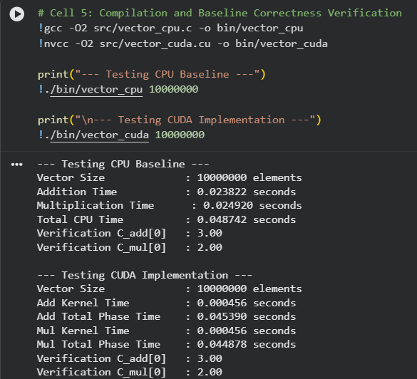
Correct at N = 10⁷: 3.00 and 2.00 on CPU and GPU
CHECKPOINT 2 · BUILD AND CORRECTNESS
Colab · Cell 5 · compile and verify (screenshot 02)
3.00 / 2.00 ✓
C_add[0] and C_mul[0] on both the CPU and the GPU — exactly the expected values for A = 1, B = 2.
0.456 ms vs 45.390 ms
Add kernel vs add phase. About 99 % of the phase is copying — our main finding is already visible in this first run.
No architecture warning
CUDA 13.0 compiles for sm_75 (Turing) by default, which matches the T4. CPU total at N = 10⁷: 48.742 ms.
Notes:
Correctness. Screenshot 02 is cell 5: both programs compiled with -O2 and run at ten million elements. Both print 3.00 and 2.00. Notice the CUDA timings: the add kernel takes 0.456 ms but the whole add phase takes 45.39 ms. That hundred-fold gap is the story of the rest of the analysis.

Slide 11
Five sizes, 250× apart, logged automatically to CSV
CHECKPOINT 3 · RUNS WITH DIFFERENT DATA SIZES
N = 100 K
N = 1 M
N = 5 M
N = 10 M
N = 25 M
1.14 MiB on GPU
11.44 MiB
57.22 MiB
114.44 MiB
286.10 MiB
N | CPU_Total | GPU_Add_Kernel | GPU_Add_Total | GPU_Mul_Kernel | GPU_Mul_Total
100,000 | 0.000517 | 0.000017 | 0.000629 | 0.000016 | 0.001775
1,000,000 | 0.004986 | 0.000048 | 0.004704 | 0.000052 | 0.004661
5,000,000 | 0.026466 | 0.000239 | 0.022191 | 0.000235 | 0.022584
10,000,000 | 0.048217 | 0.000462 | 0.044393 | 0.000465 | 0.044835
25,000,000 | 0.125050 | 0.001147 | 0.114269 | 0.001179 | 0.118446
run_benchmarks.sh
for each N in the 5 sizes:
run ./bin/vector_cpu N
run ./bin/vector_cuda N
grep + awk the timing lines
append one row to the CSV
results/timing_data.csv — seconds, exactly as written by scripts/run_benchmarks.sh
Repeatability check, N = 10⁷
Why these sizes: from 0.4 MB per vector (fits in cache, GPU barely filled) to 100 MB per vector (both processors fully streaming).
CPU 48.742 vs 48.217 ms (1.1 %)
Add kernel 0.456 vs 0.462 ms (1.3 %)
Screenshot 02 run vs benchmark run
Notes:
Checkpoint 3. Five sizes from one hundred thousand to twenty-five million elements, 250 times apart. The script runs both binaries for each size, extracts the timing lines with grep and awk, and appends a row to the CSV; this table is that file, unedited. The verification run and the benchmark run at ten million agree within about one percent.

Slide 12
The kernel wins by ~54×; end to end, the GPU never wins
CONSOLIDATED RESULTS
N | CPU (ms) | GPU kernel (ms) | GPU end-to-end (ms) | Kernel speedup | End-to-end speedup | Kernel BW (GB/s) | PCIe share
100,000 | 0.517 | 0.033 | 2.404 | 15.67× | 0.215× | 72.7 | 98.63 %
1,000,000 | 4.986 | 0.100 | 9.365 | 49.86× | 0.532× | 240.0 | 98.93 %
5,000,000 | 26.466 | 0.474 | 44.775 | 55.84× | 0.591× | 253.2 | 98.94 %
10,000,000 | 48.217 | 0.927 | 89.228 | 52.01× | 0.540× | 258.9 | 98.96 %
25,000,000 | 125.050 | 2.326 | 232.715 | 53.76× | 0.537× | 258.0 | 99.00 %
GPU times are add phase + mul phase. Correctness: 3.00 / 2.00 in the verification run; the same binaries were used for every size.
55.84×
0.215–0.591×
≈ 258 GB/s
98.6–99.0 %
peak kernel speedup (N = 5 M); 49.9–55.8× for N ≥ 10⁶
end-to-end speedup: the GPU is slower at every size
kernel bandwidth at N ≥ 10⁷: 80.6 % of the T4's 320 GB/s
share of GPU time spent copying over PCIe
Notes:
Consolidated results, from the CSV. Green column: kernel speedup, rising to about 54 and staying there. Orange column: end-to-end speedup, below one at every size. Bandwidth levels off near 258 GB/s and the PCIe share is almost exactly 99 percent everywhere. The next slides show these as graphs.

Slide 13
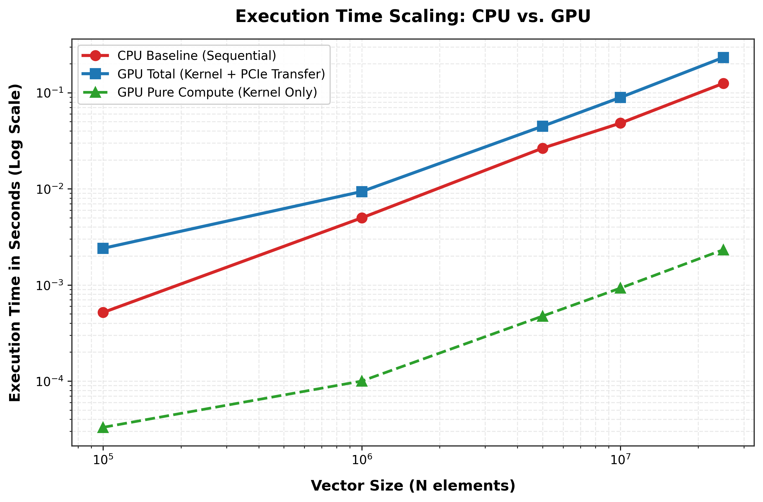
Execution time: no crossover in the measured range
CHECKPOINT 4 · PERFORMANCE ANALYSIS
1
CPU (red) has slope 1: 250× more data took 241.9× more time — linear, as expected.
2
GPU kernel (green) sits 1.2–1.7 orders of magnitude below the CPU. Below 10⁶ it is flatter: 391 blocks do not fill the GPU.
3
GPU end to end (blue) is above the CPU at every size: 4.6× slower at 10⁵, then 1.7–1.9× slower.
4
No crossover: both lines have slope 1 beyond 10⁶, so a larger N would not help.
Fig. 1 — Execution time vs vector size (log–log)
Notes:
Figure 1. Both axes are logarithmic, so slope one means time proportional to N. The CPU line is linear. The kernel line is far below it. But the end-to-end GPU line stays above the CPU at every size and runs parallel to it, so there is no crossover point and a bigger problem would not change the answer.

Slide 14
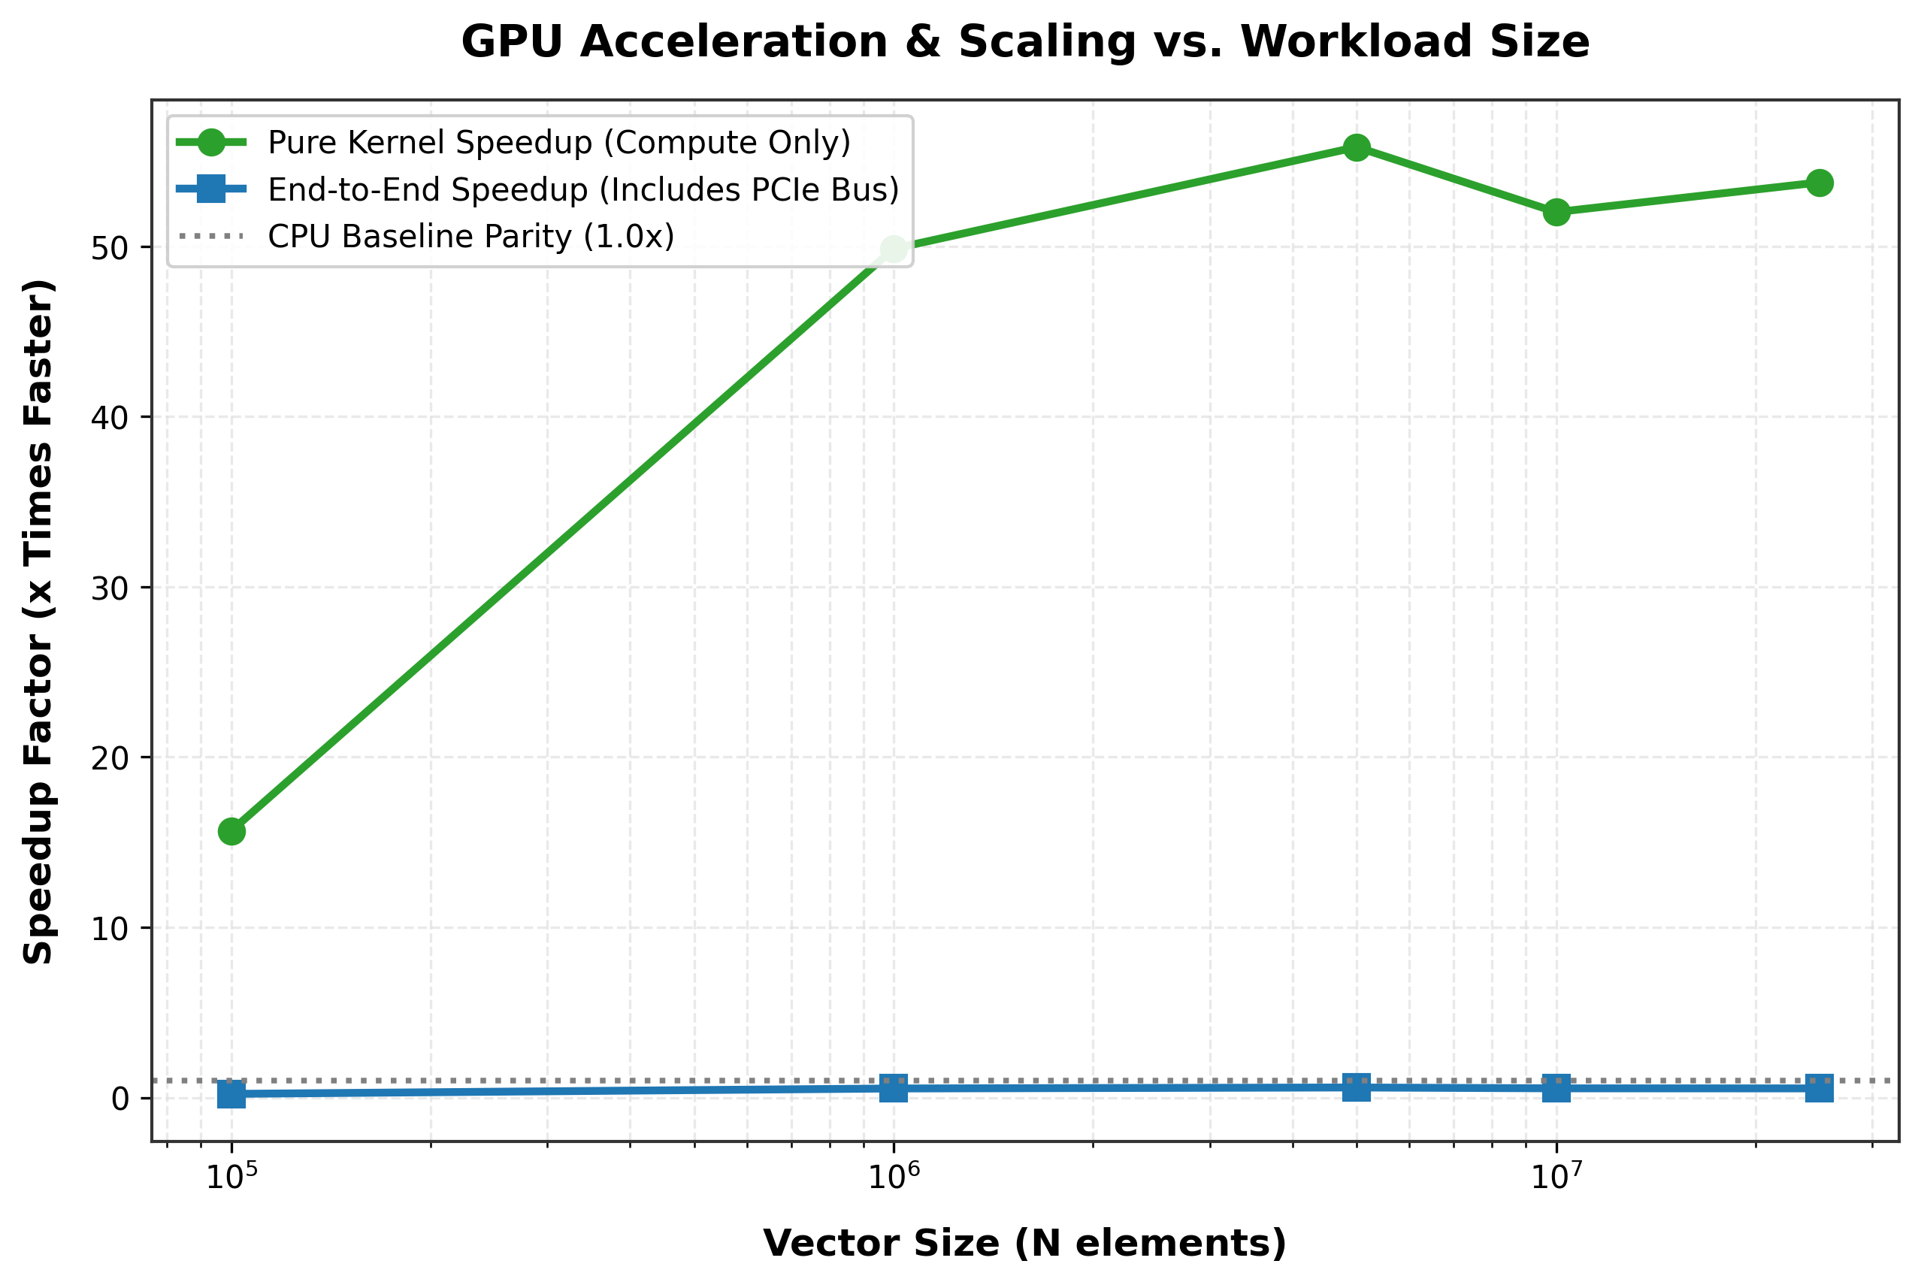
Speedup: 55.8× for the kernel, below 1× end to end
CHECKPOINT 4 · PERFORMANCE ANALYSIS
1
Kernel speedup rises 15.7× → 49.9× → 55.8× (5 M), then holds at 52–54×.
2
End-to-end speedup stays under the 1.0× line: 0.215× at 10⁵, then 0.53–0.59×.
258 ÷ 4.8 ≈ 54
The flat top is the signature of a memory-bound task: the kernel speedup equals the ratio of the two memory streaming rates — GPU ≈ 258 GB/s vs one CPU core ≈ 4.8 GB/s.
Fig. 2 — Kernel and end-to-end speedup vs vector size
Notes:
Figure 2. The kernel speedup climbs and then flattens at about 54. That plateau is not a coincidence: when both sides are limited by memory, the speedup is just the ratio of their memory bandwidths, 258 divided by 4.8. The end-to-end curve never reaches one.

Slide 15
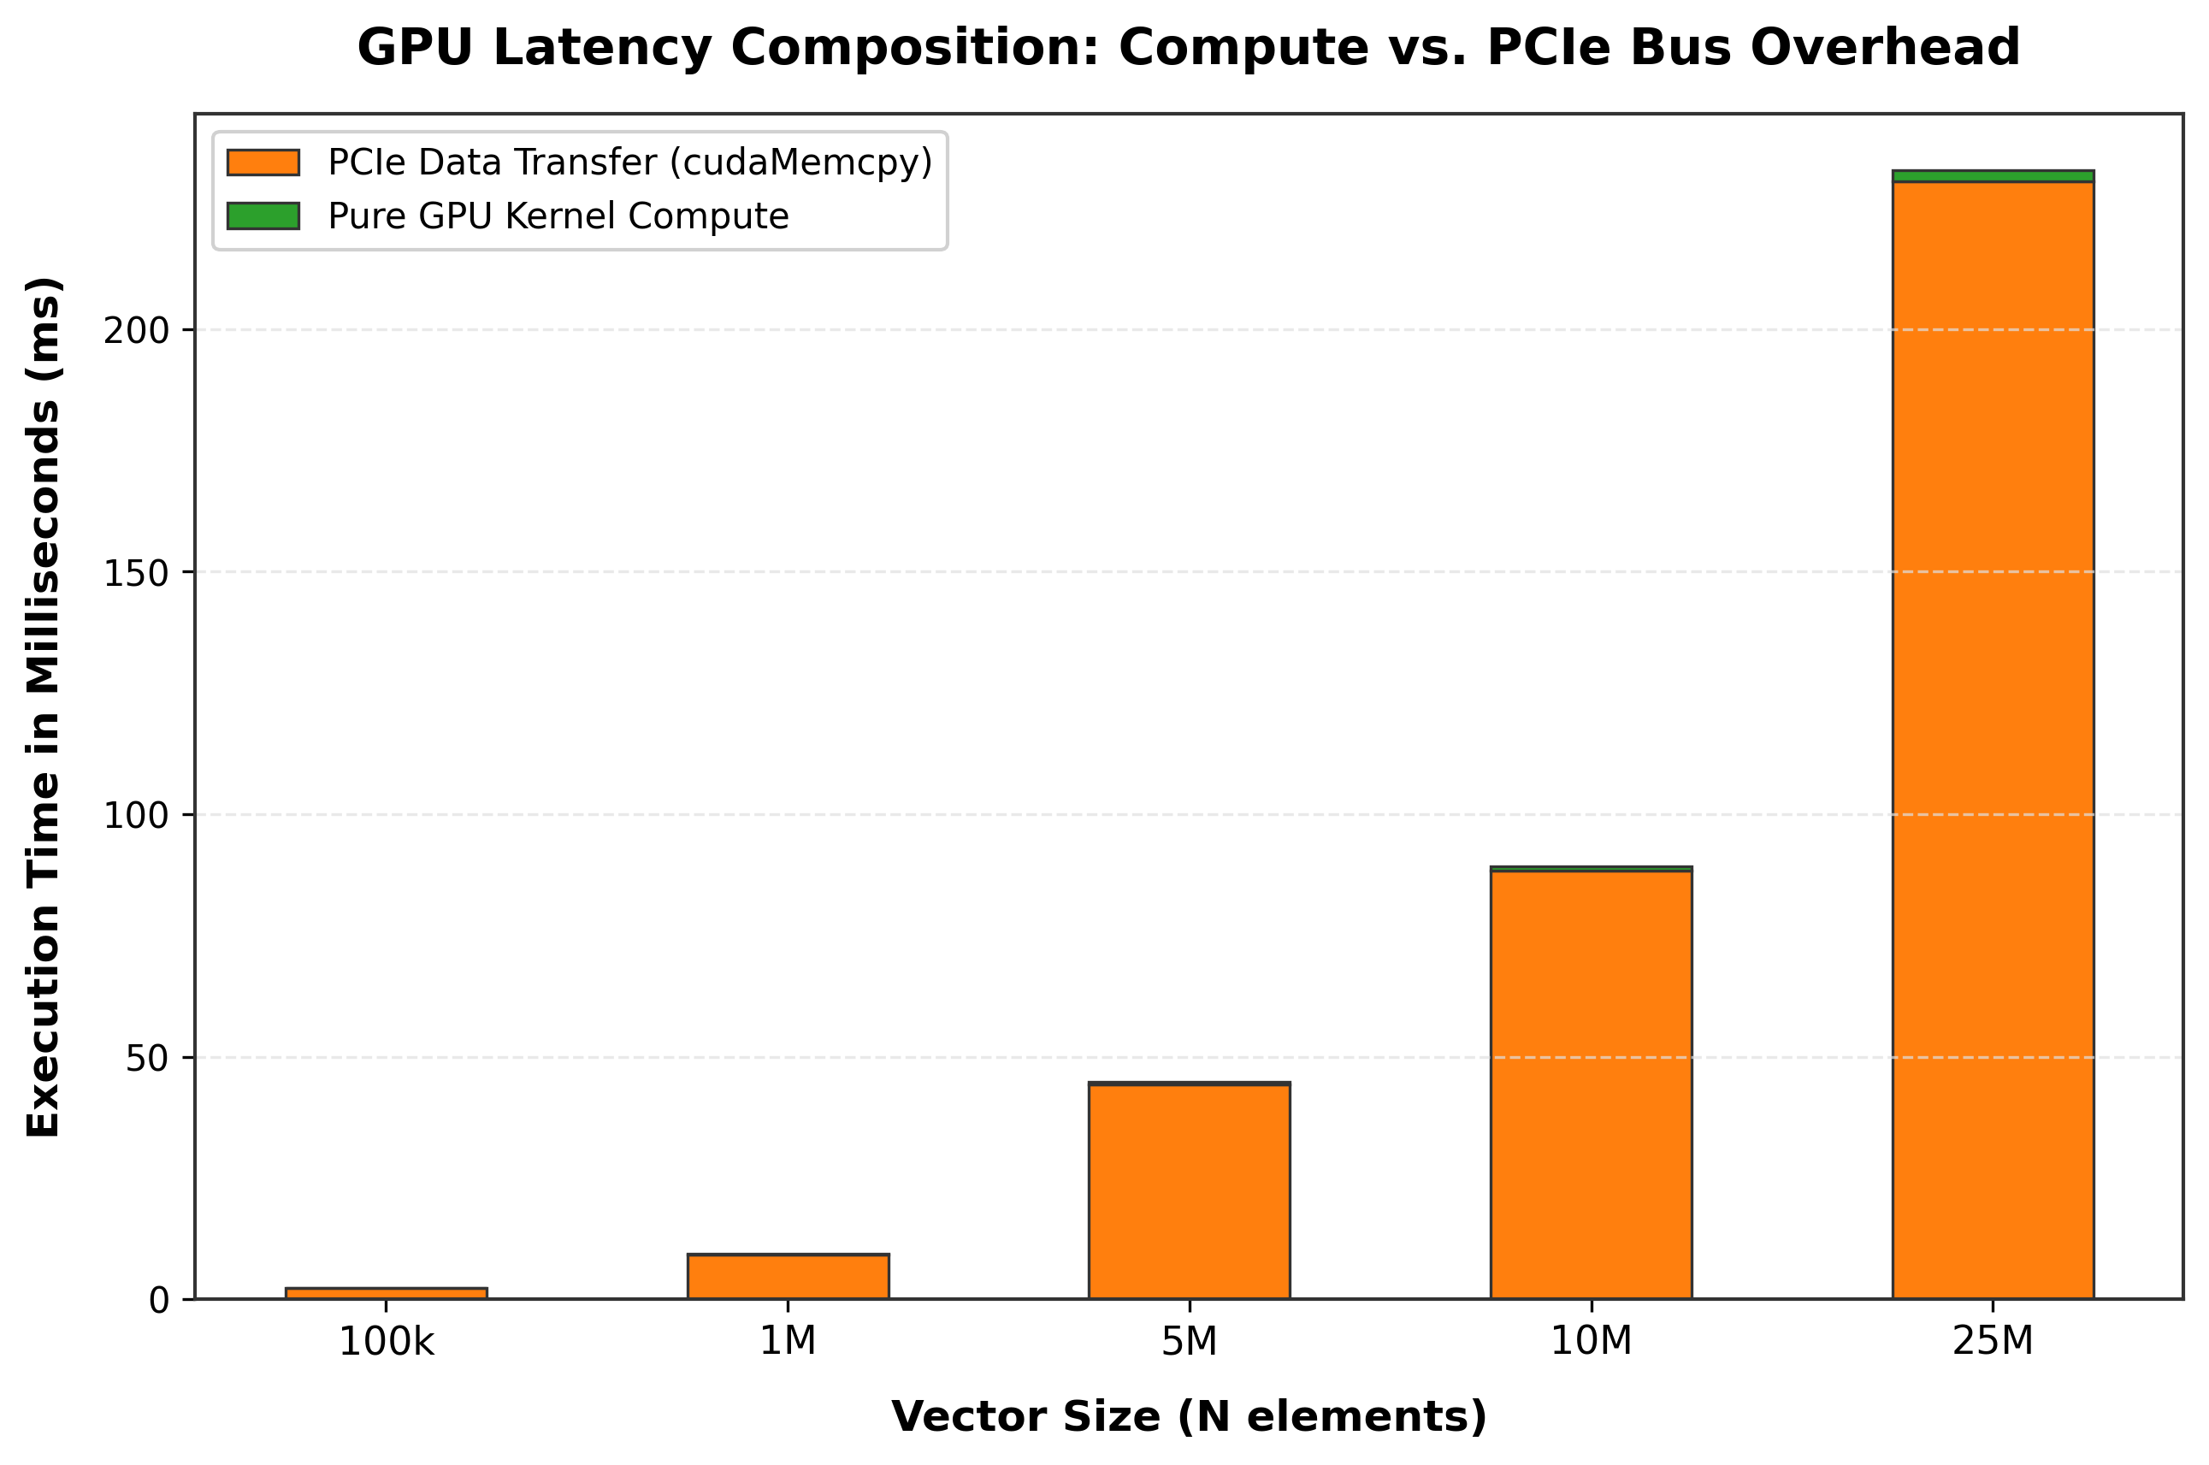
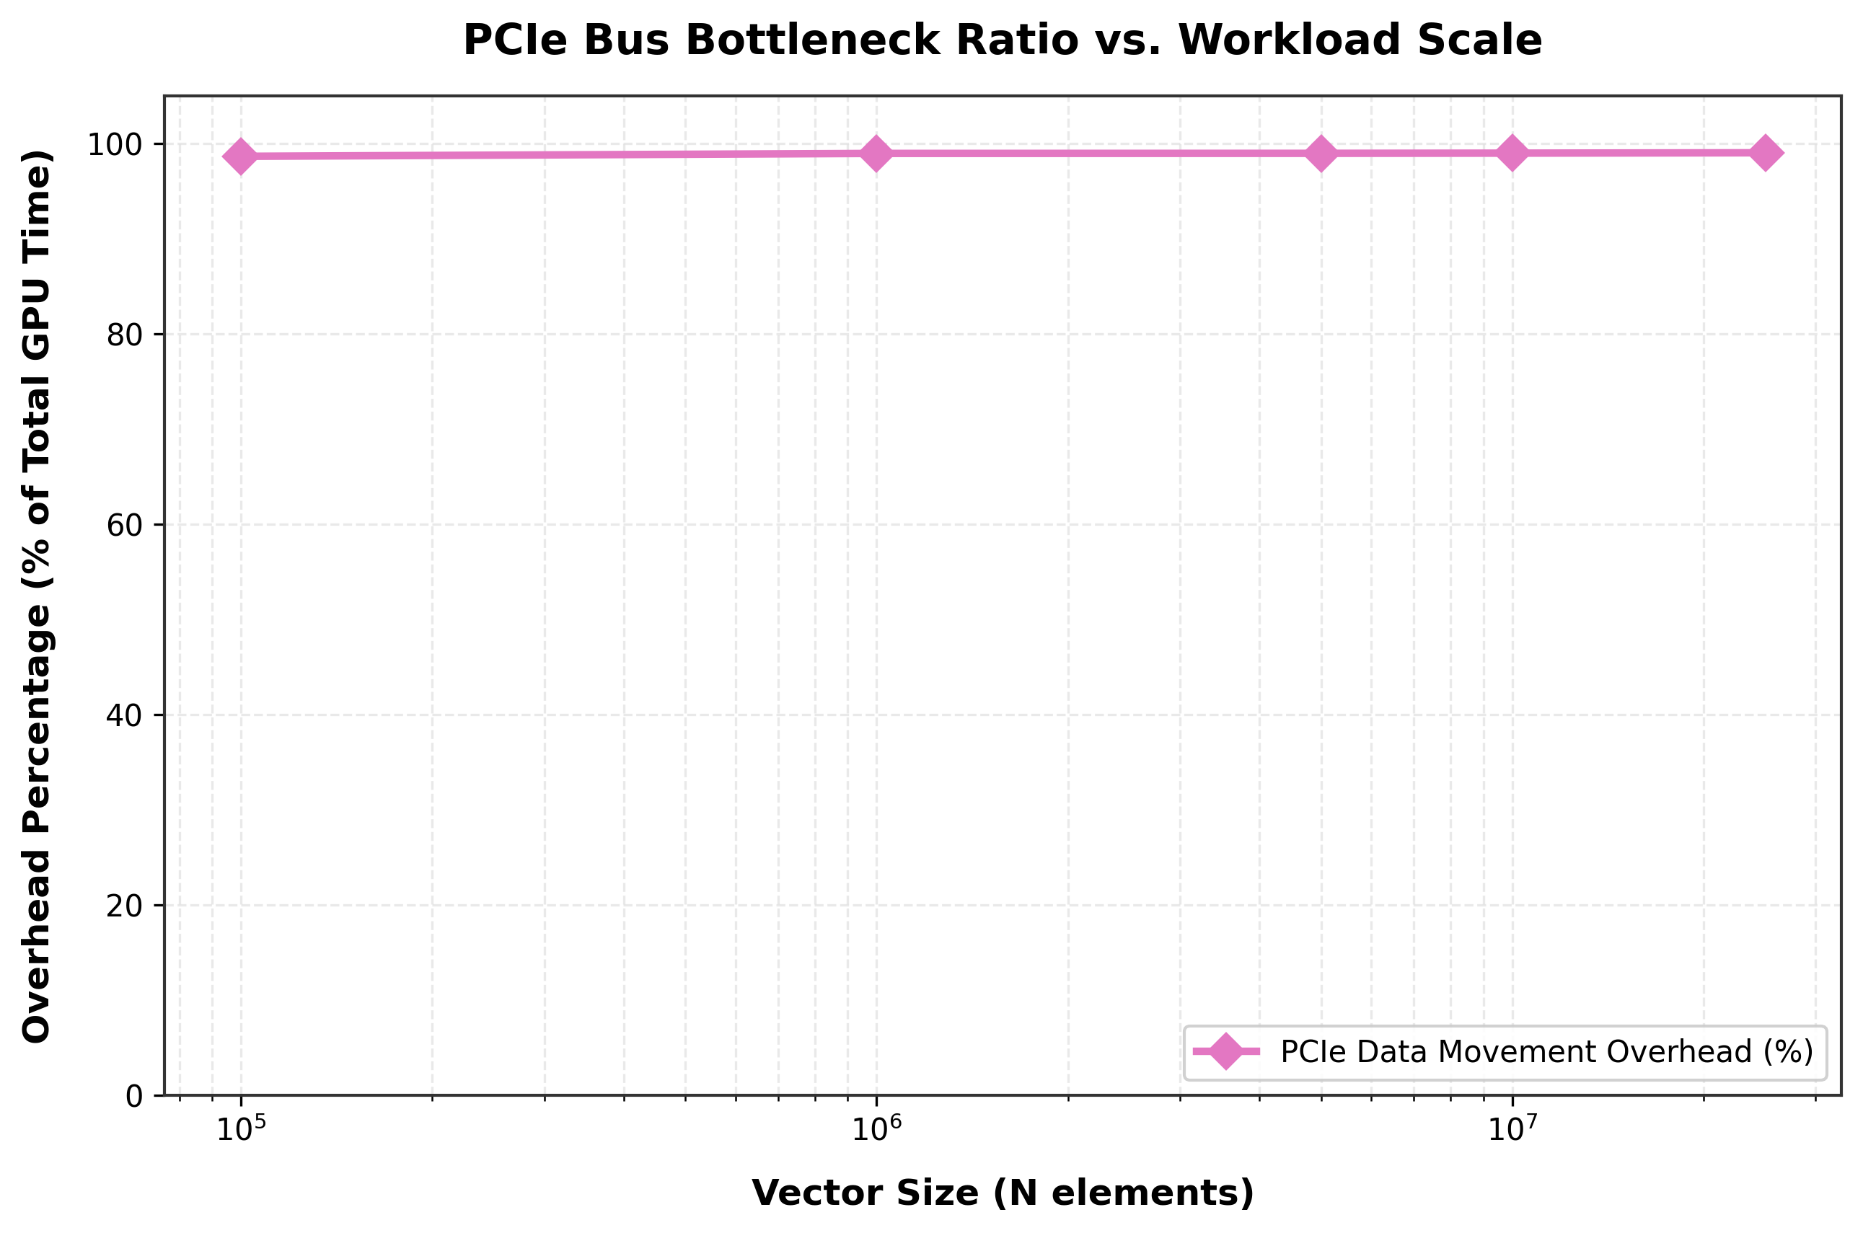
Transfer time, not compute, fills the GPU timeline
CHECKPOINT 4 · PCIe TRANSFER OVERHEAD
Fig. 4 — GPU time split: PCIe transfer vs kernel
Fig. 5 — PCIe overhead as a share of GPU time
Orange is transfer, the thin green cap is the kernel: 2.3 ms of compute on 230.4 ms of copying at 25 M. A zero-time kernel would shorten the bars by under 1.1 %.
Flat at 98.6–99.0 %: transfer and kernel time both grow with N, so N cancels. The overhead is set by the two bandwidths, not the size.
Notes:
Figures 4 and 5. In Figure 4 every bar is almost entirely orange, which is transfer. Figure 5 shows the share is flat at about 99 percent. Because both parts scale with N, N cancels out of the ratio; only the bandwidth of PCIe versus GPU memory matters.

Slide 16
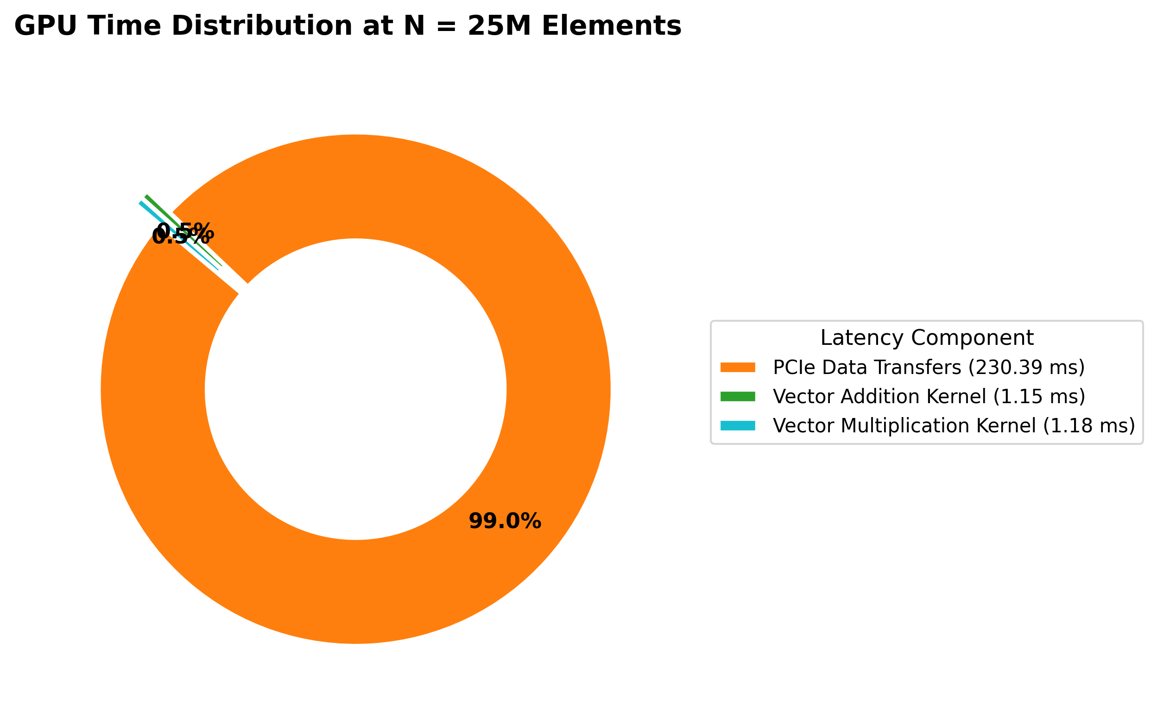
At N = 25 M, 99 % of GPU time is spent moving data
CHECKPOINT 4 · TIME DISTRIBUTION
99.0 %
of the GPU's time is PCIe transfer — in and out, both phases.
Part | Time (ms) | Share
PCIe transfers | 230.389 | 99.0 %
Addition kernel | 1.147 | 0.5 %
Multiplication kernel | 1.179 | 0.5 %
Fig. 7 — Where the 232.7 ms of GPU time goes (N = 25 M, 286 MiB)
Add and multiply cost the same: both move 12 bytes per element and are limited by memory, not by the arithmetic.
Notes:
Figure 7. At the largest size, 230 of the 233 milliseconds are transfer. The two kernels together are about one percent, and they take the same time as each other because both move the same twelve bytes per element.

Slide 17
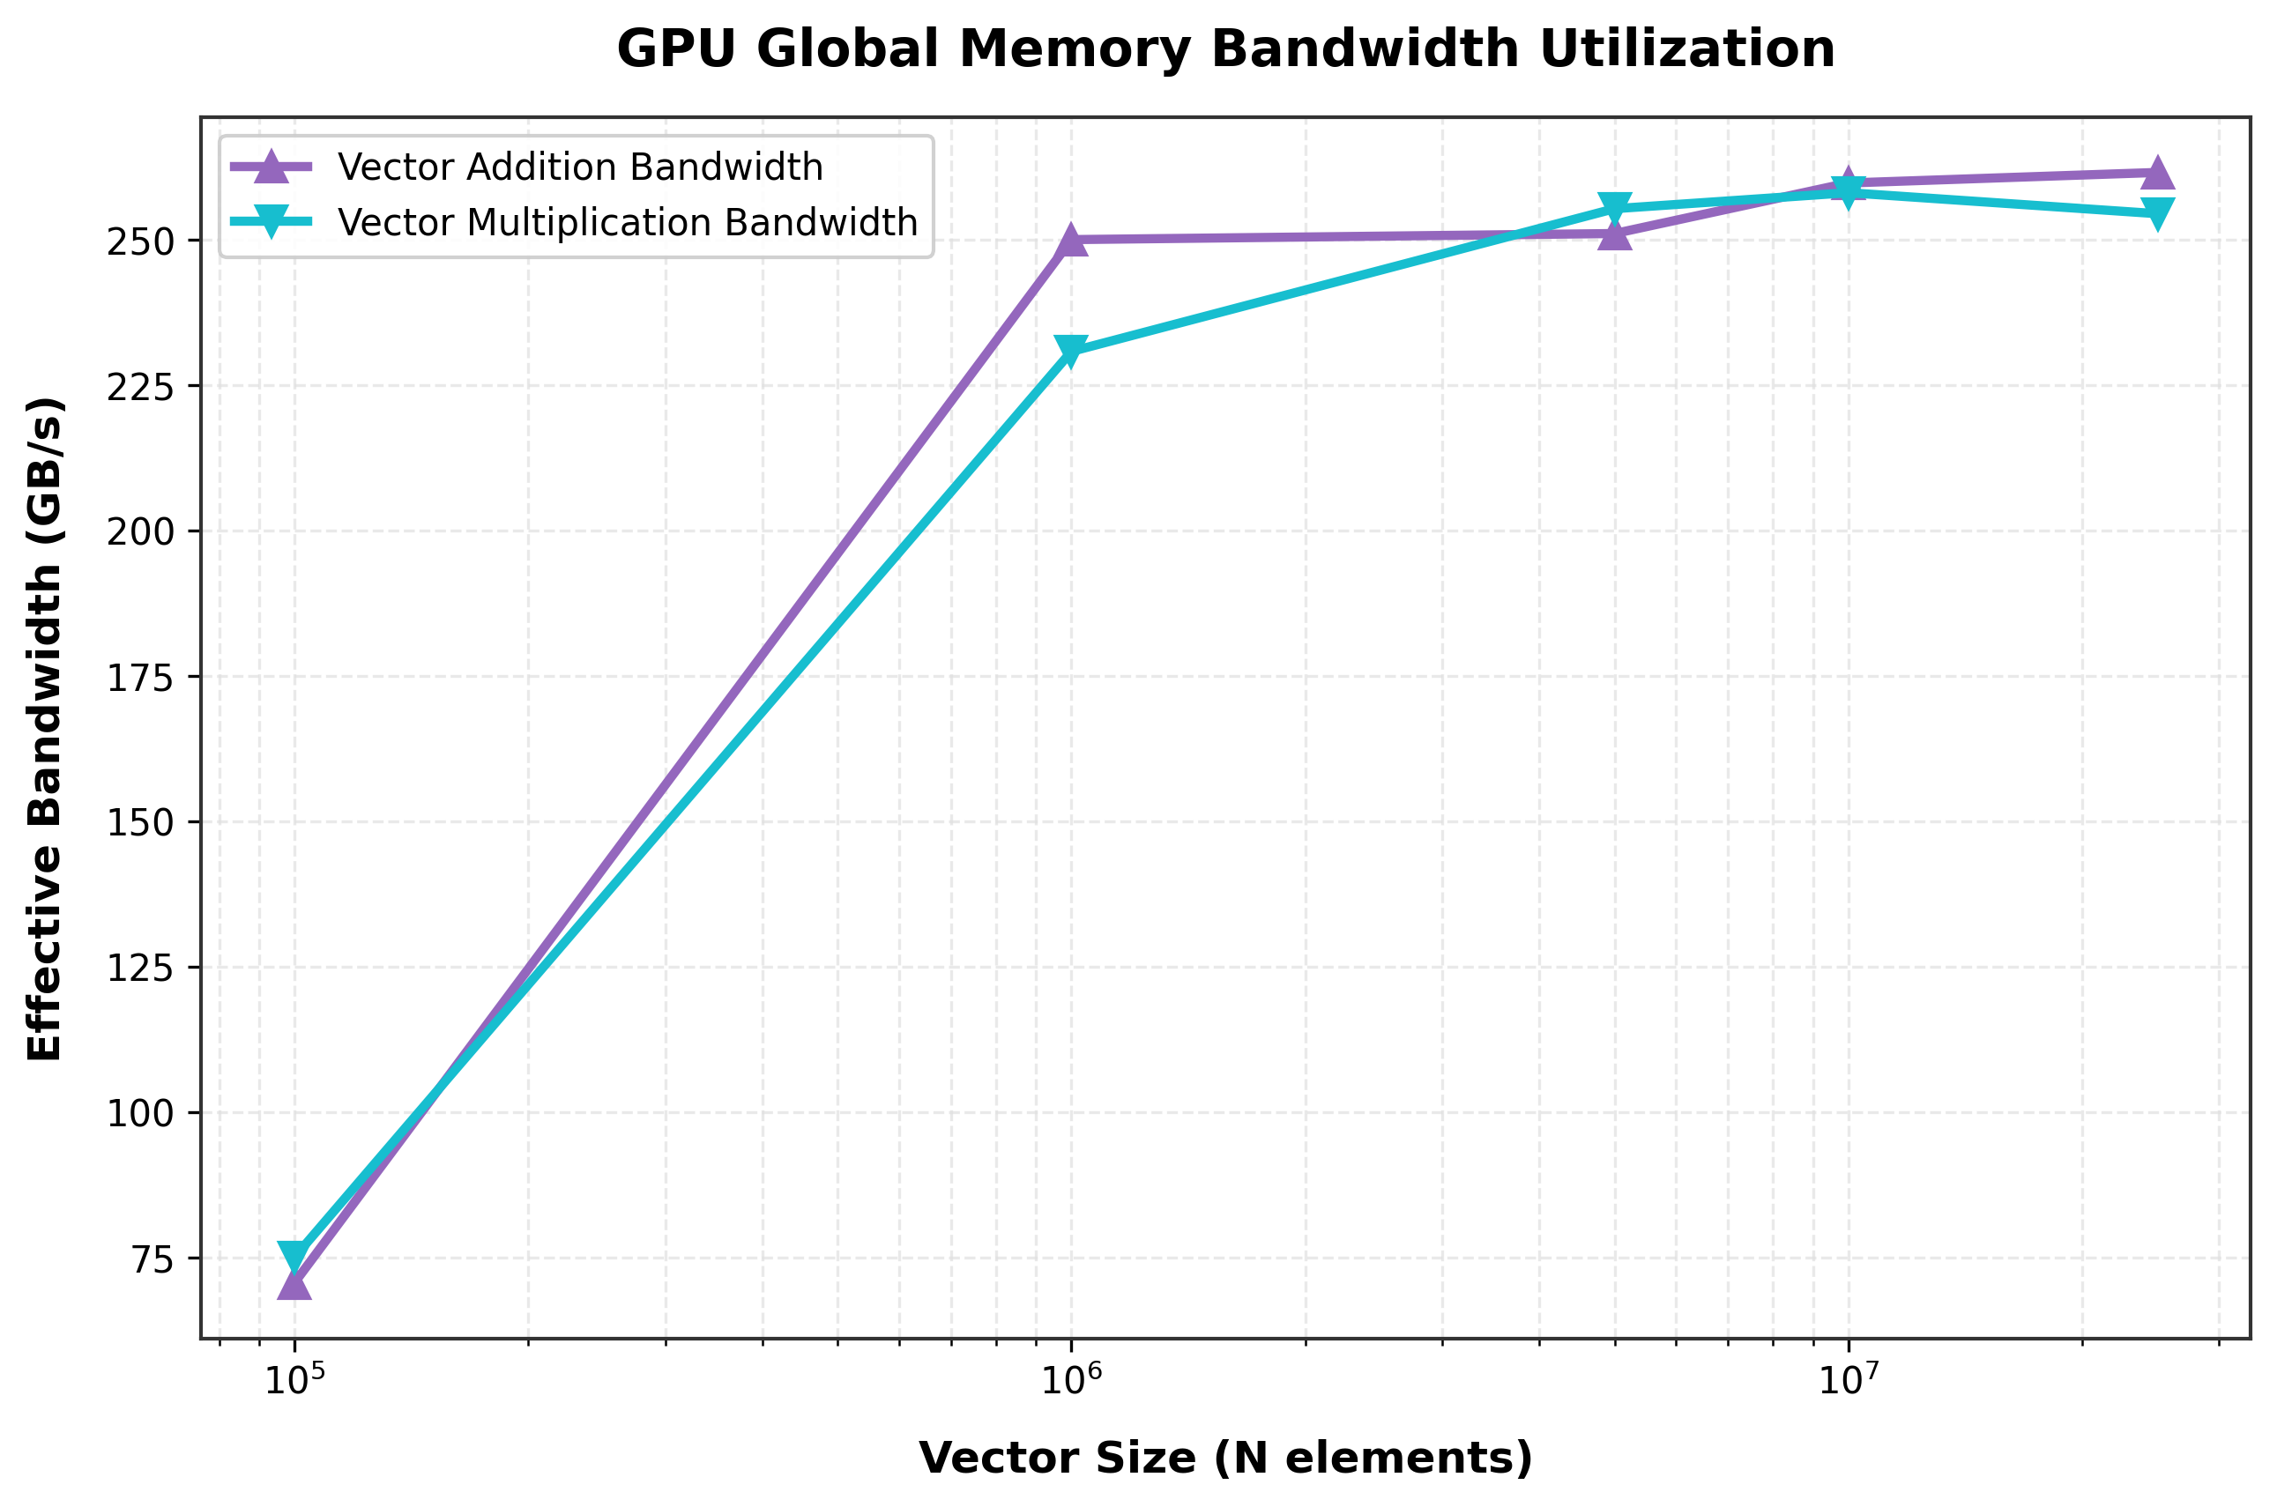
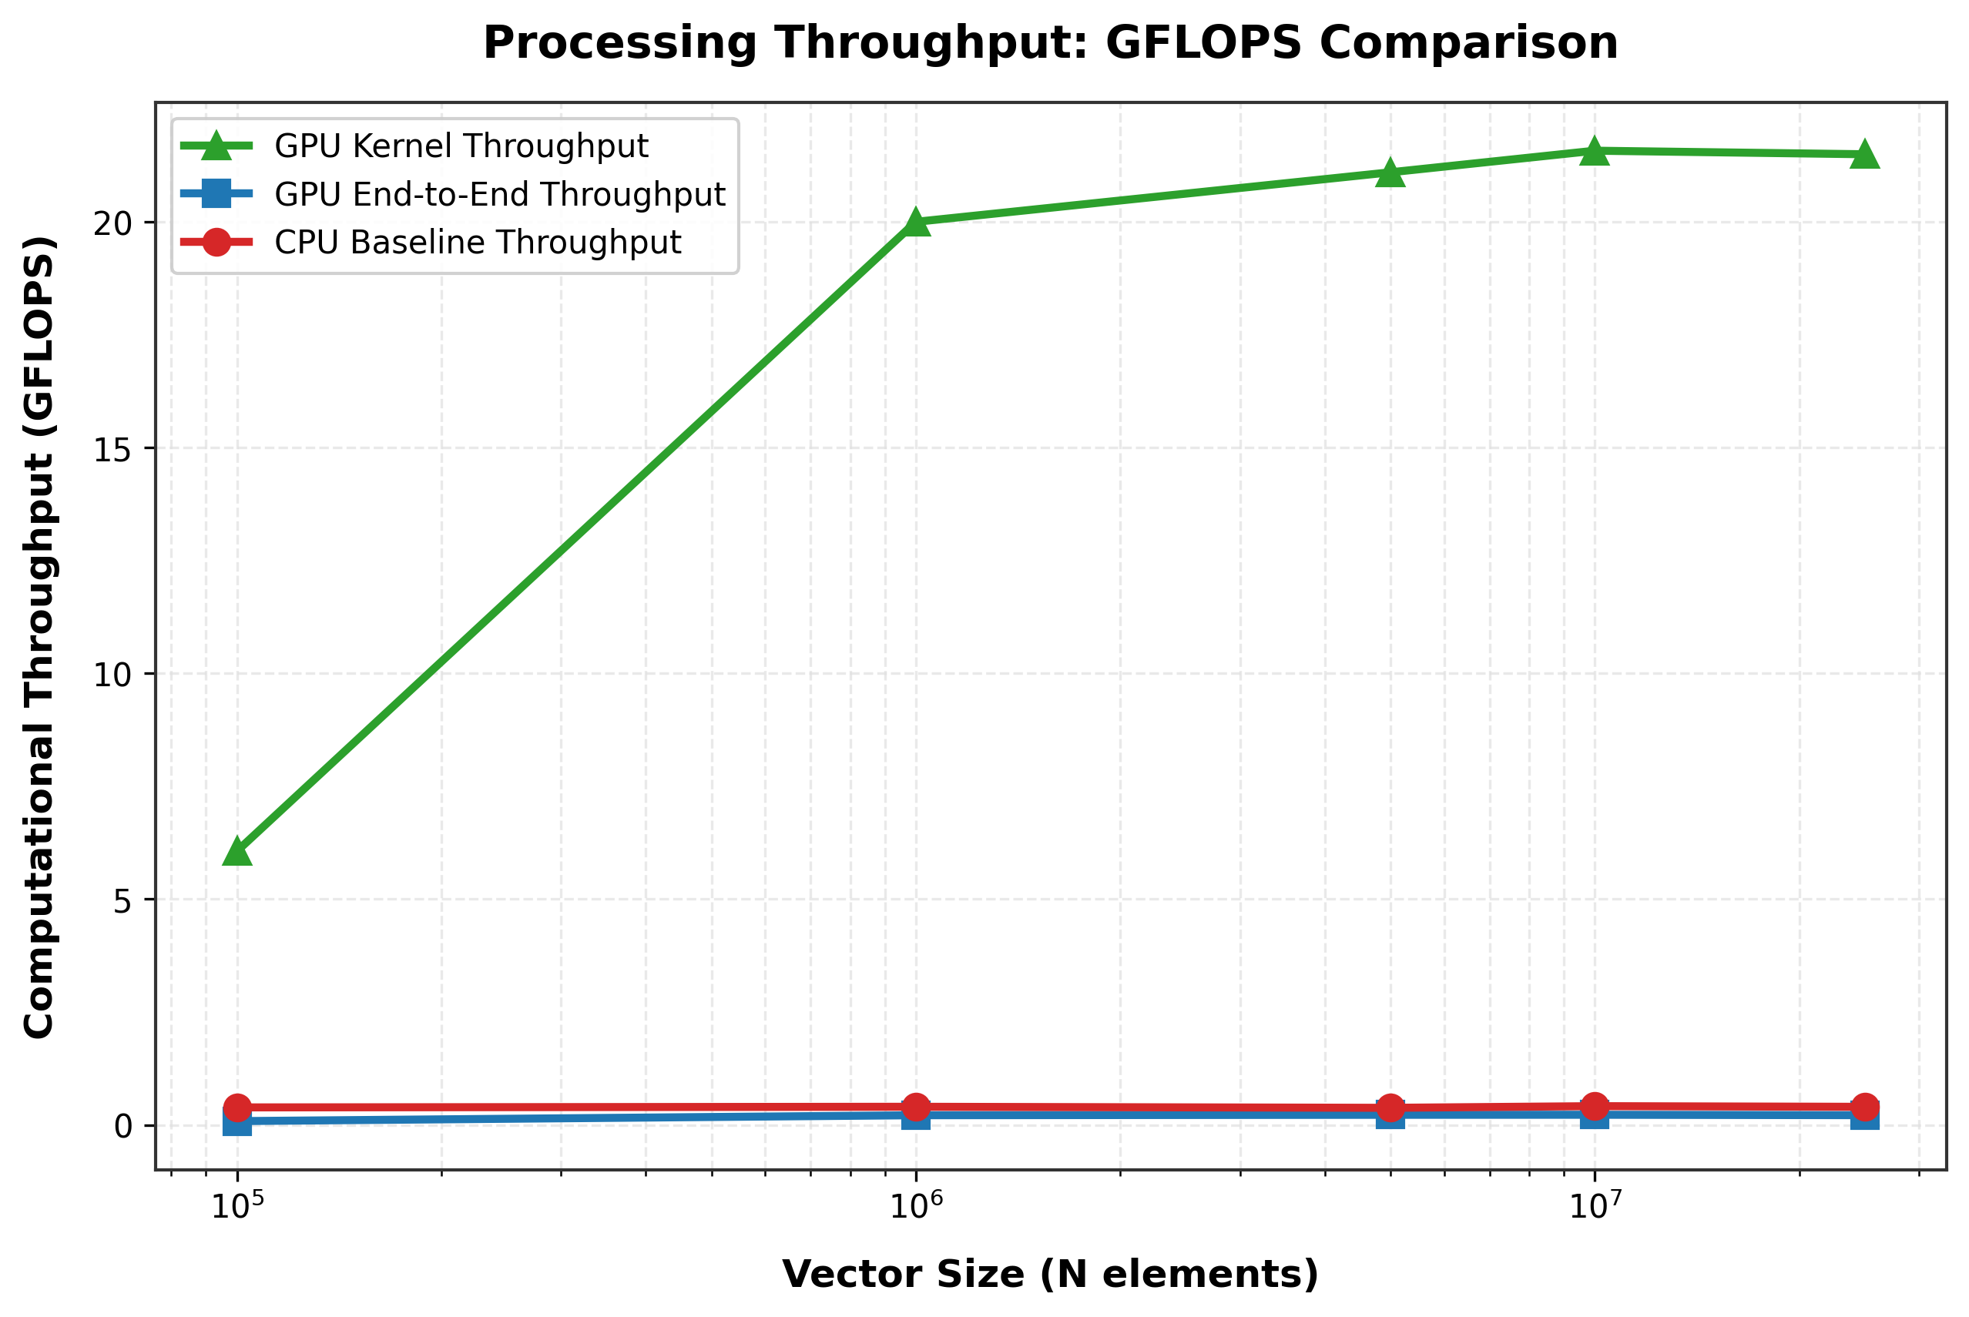
The memory bus is saturated at ≈ 258 GB/s
CHECKPOINT 4 · THROUGHPUT AND BANDWIDTH
Fig. 6 — Effective GPU memory bandwidth per operation
Fig. 3 — Computational throughput (GFLOPS)
71–75 GB/s at 10⁵, then a plateau at 251–262 GB/s: ≈ 80 % of 320 GB/s, the practical ceiling. More data cannot raise bytes per second.
21.5 GFLOPS is only 0.27 % of 8.1 TFLOPS, but it is 80.6 % of what 1 FLOP per 12 bytes allows (26.7 GFLOPS).
Notes:
Figures 6 and 3. Bandwidth jumps after one million elements and then levels off around 258 GB/s, about 80 percent of the datasheet peak, which is the realistic ceiling for a streaming kernel. In GFLOPS the kernel looks tiny compared to 8.1 TFLOPS, but that peak is unreachable for this operation; relative to its real limit, 26.7 GFLOPS, it achieves 80.6 percent.

Slide 18
The right yardstick: the kernel is 80.6 % efficient
CHECKPOINT 4 · EFFICIENCY AND THE ROOFLINE
2.10 %
80.6 %
80.6 %
Per-core efficiency: 53.76 ÷ 2,560 cores. Misleading here — the cores mostly wait for memory.
Bandwidth efficiency: 258.0 ÷ 320 GB/s. Real streaming kernels reach 80–90 %.
Roofline efficiency: 21.50 ÷ 26.67 GFLOPS, the best its memory traffic allows.
Why memory, not cores, sets the limit
GFLOPS (log)
compute roof 8.1 TFLOPS
1
Arithmetic intensity: 1 FLOP per 12 bytes (read A, read B, write C) = 0.083 FLOP/byte.
memory roof: AI × 320 GB/s
2
Ridge point of the T4: 8.1 TFLOPS ÷ 320 GB/s ≈ 25.3 FLOP/byte.
our kernel
0.083 FLOP/B · 21.5 GFLOPS
3
Our kernel is ≈ 304× below the ridge, so only moving fewer bytes could make it faster.
ridge 25.3
arithmetic intensity, FLOP/byte (log) — schematic
Notes:
Efficiency. Speedup divided by 2,560 cores gives 2.1 percent, but that measure assumes the cores are the limit. They are not: the kernel does one operation for every twelve bytes, 304 times below the T4's ridge point. The meaningful measures are bandwidth efficiency and roofline efficiency, both 80.6 percent. The sketch shows our kernel sitting just under the sloped memory roof, far from the flat compute roof.

Slide 19
Why the GPU loses end to end: PCIe and Amdahl's law
DISCUSSION
Amdahl's law at N = 25 M
S_max = T_CPU / T_X = 125.05 / 230.39 = 0.543×
Even an infinitely fast kernel could not beat the CPU. We measured 0.537×, within 1.1 % of this limit: copying alone took 1.84× longer than the whole CPU computation.
How the GPU could win end to end
1
Keep data on the GPU and run many operations per transfer.
Why PCIe reached only ≈ 2.6 GB/s (vs ≈ 12 GB/s possible)
Pageable malloc memory: the driver stages every copy through a hidden pinned buffer.
First-touch page faults on the output buffers during the timed copy.
Virtualised Colab host: extra address translation for DMA.
2
Pinned memory (cudaMallocHost): estimated ≈ 2.4× end to end — not measured.
3
Fuse add + mul into one kernel; overlap copies with streams.
Notes:
Discussion. The bar chart is the whole explanation: the GPU's own memory moves 258 GB/s, a CPU core about 4.8, and the PCIe link in our run only 2.6. By Amdahl's law, with the transfer as the part we cannot speed up, the best possible end-to-end speedup is 0.543, and we measured 0.537. The pinned-memory figure of about 2.4 times is an estimate from the datasheet rate, not a measurement.

Slide 20
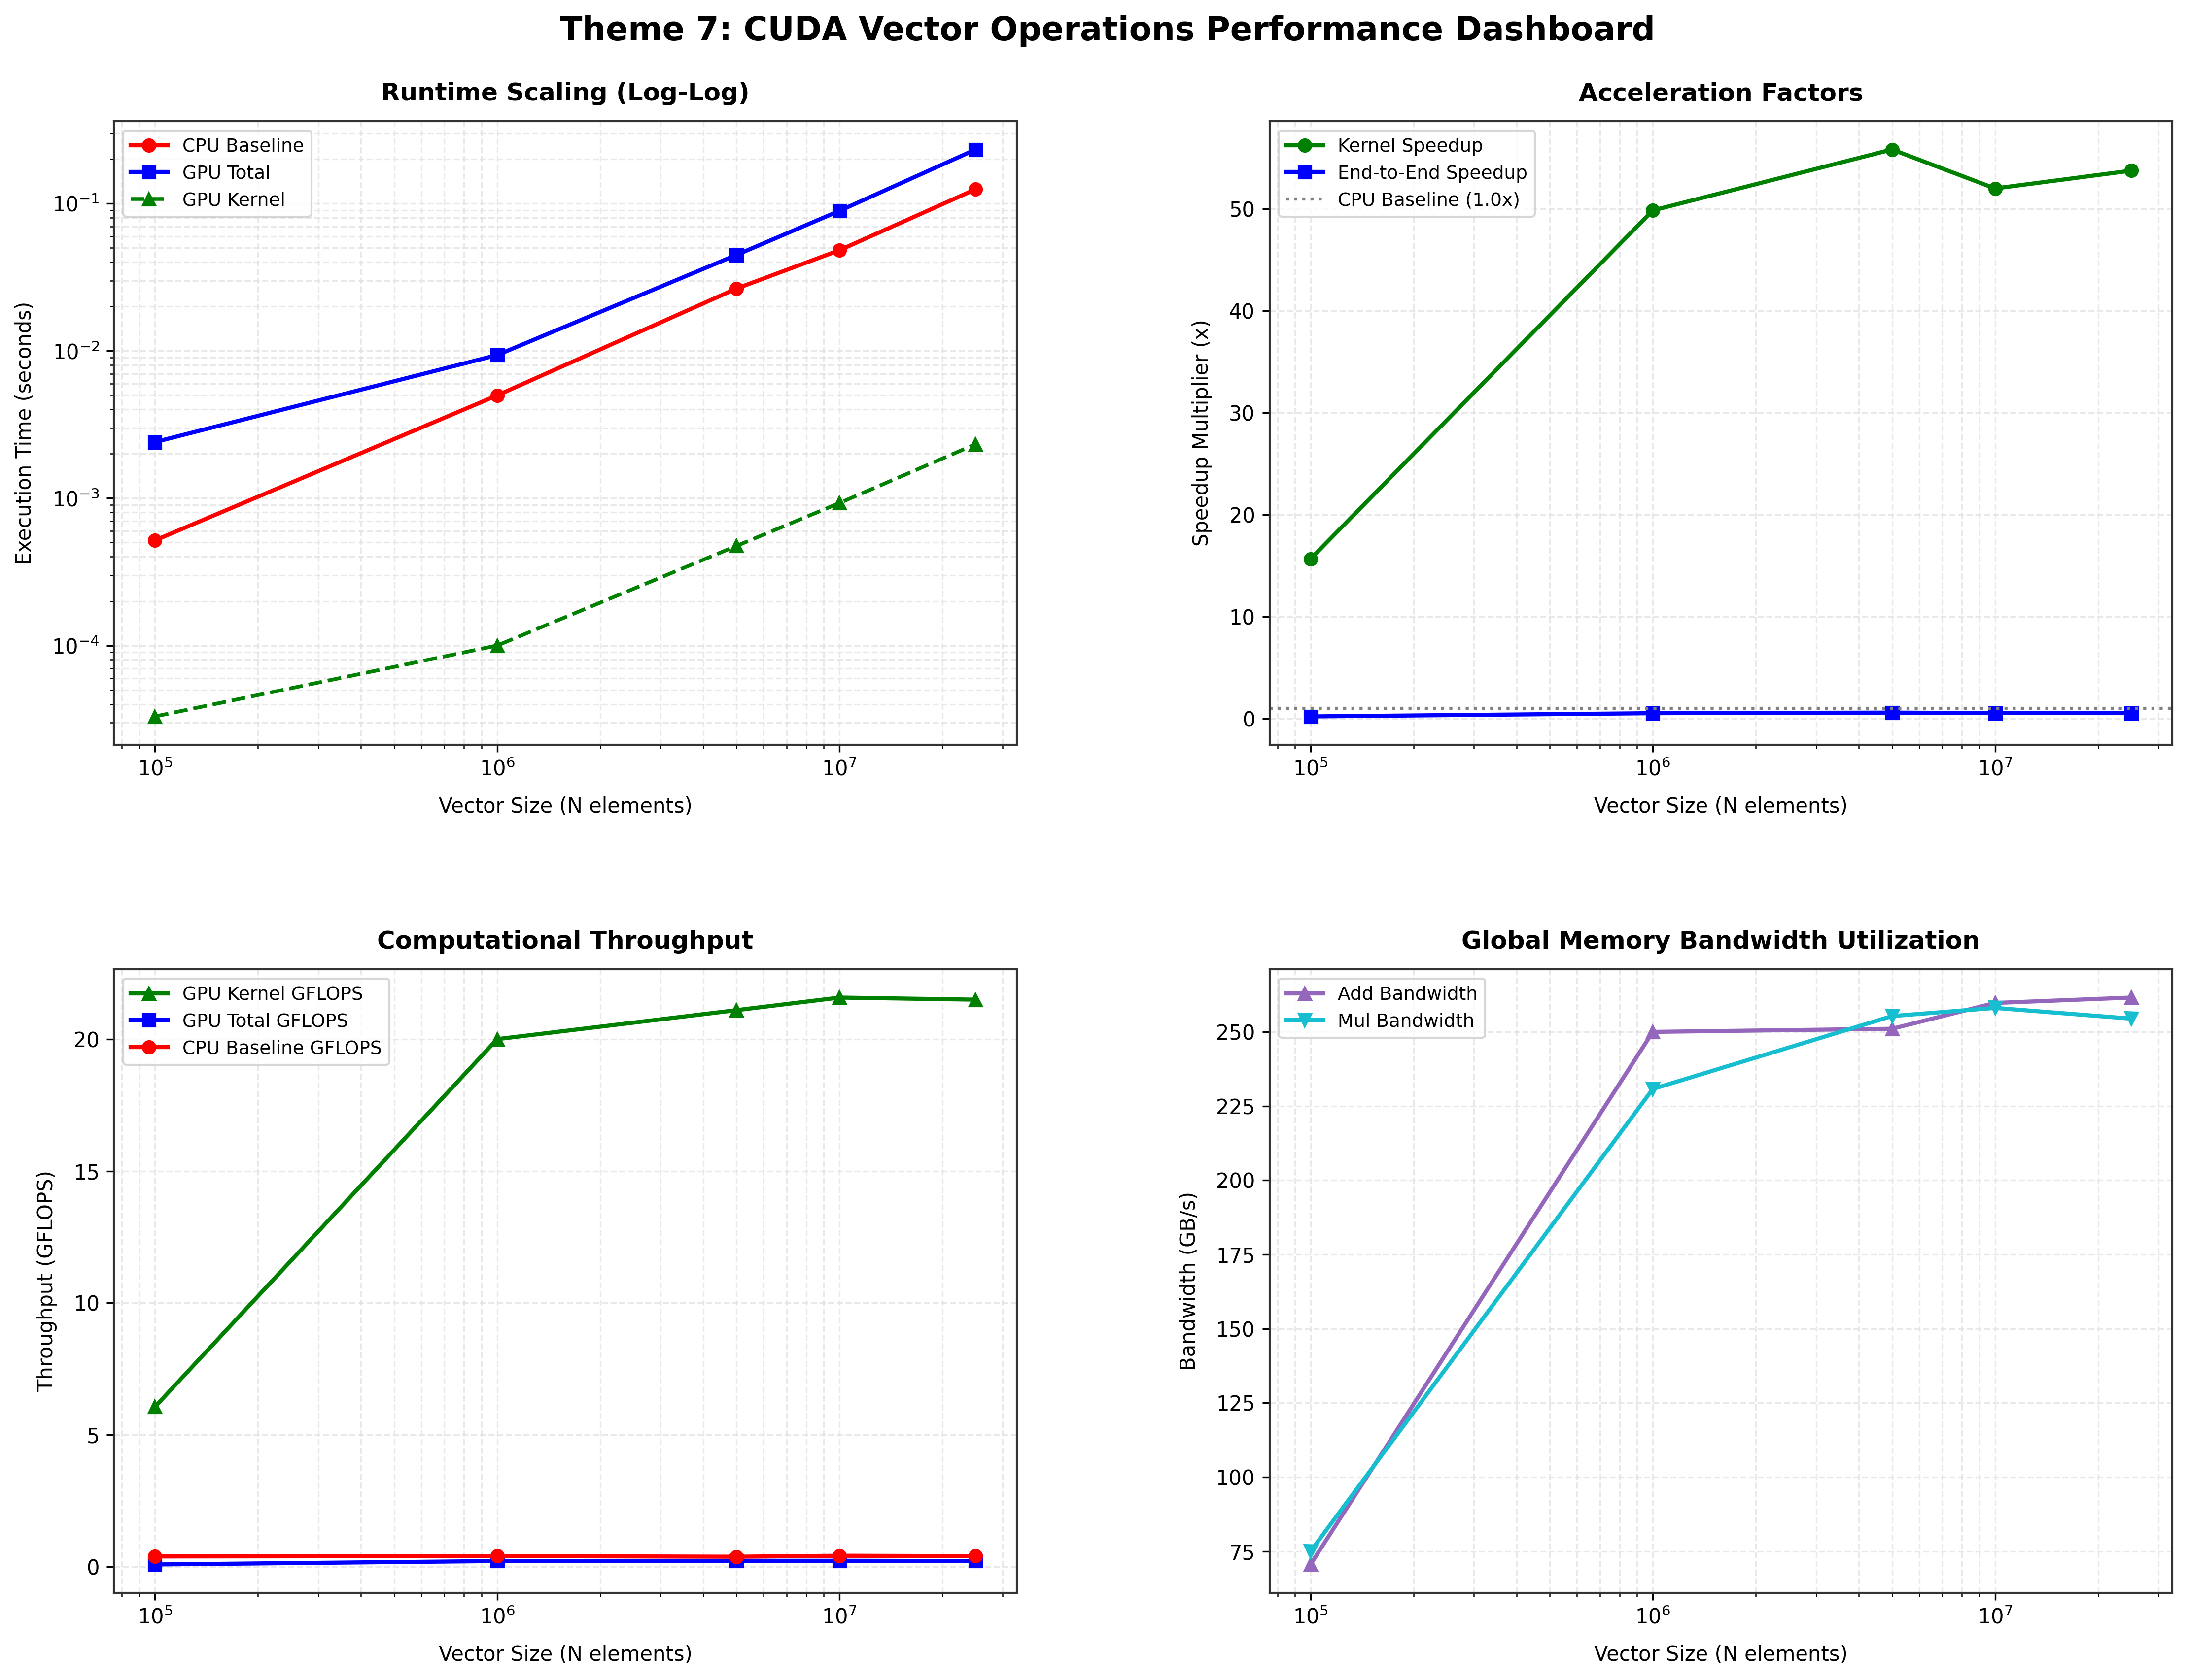
What we conclude
Correct
Both programs print 3.00 and 2.00; thread mapping, grid sizing and the boundary guard work.
Fast kernel
49.9–55.8× faster than one CPU core for N ≥ 10⁶, at 80.6 % of peak memory bandwidth.
Slow end to end
0.22–0.59× once PCIe copies are counted: ≈ 99 % of GPU time is data transfer.
Lesson
A GPU pays off when there is much compute per byte, or when data stays on the GPU.
Fig. 8 — the four views in one dashboard
Thank you
Questions are welcome
Notes:
Conclusion. Correct results; a kernel that runs at 80 percent of the memory bandwidth and is about 54 times faster than one core; but an end-to-end time that loses to the CPU because 99 percent of the GPU time is PCIe transfer. The lesson is about arithmetic intensity and data residency. Thank the evaluators and invite questions.

