Slide 1
Core Java

Slide 2
Java Tokens
A token is the smallest element of a program that is meaningful and is able to be identified by the compiler.
Java Language includes five types of tokens
Reserved Keywords
Identifiers
Literals
Operators
Separators

Slide 3
Identifiers
Identifiers are programmer designed tokens also called as Variables.
Variable value can change any number of time during execution and saved in an allocated memory location.
Name of classes, methods, variables, objects, labels, packages and interfaces in a program is called identifiers.
Whenever a variable is declared within a method it is a local variable
Whenever a variable is declared outside a method it is Global Variable/Member
If same variable is available in both global and local, local variable is given preference over global variable.

Slide 4
Naming Convention
Rules:
They can have alphabets, digits, underscore and dollar sign characters
Cannot begin with digits
Uppercase and Lowercase are distinct
Any length
All public methods and instance variables start with leading lower case letters
e.g., average, sum.
All private and local variables use only lower case letters combined with underscores
e.g., length, batch_strength
All classes and interfaces start with leading uppercase letter and subsequent word with uppercase letter.
e.g., Student, HelloWorld
When more than one word are used in a name, the second and subsequent word should start with uppercase letter.
e.g., todaysTemperature, studentName
Variables that represent constant values use uppercase letters and underscores
e.g., TOTAL, COUNT

Slide 5
Literals
Literals are a sequence of characters that represents a constant values to be stored in an variable.

Slide 6
Operators
An operator is a symbol that takes one or more arguments and operates on them to produce a result.
Types of operators:
Arithmetic Operators (+,-,*,/,%)
Relational Operators (<,<=,>,>=,==,!=)
Assignment Operators (=)
Logical operators (&&,!!,!)
Conditional Operators( exp1 ? exp2(true) : exp3(false))
Unary Operators (++, --)
Bitwise Operators (&,!, ^, ~, <<, >>, >>>)

Slide 7
Seperators
Seperators are used to divide, arrange or group code.
Paranthesis → ()
curly braces → {}
Brackets → []
comma → (,)
Semicolon → (;)
period →(.)

Slide 8
Reserved Keywords
Keywords have specific meaning to themselves and always in lowercase letters.
Since the possess specific meaning we cannot use them as identifier while naming.
But, one can use these keywords as identifiers by changing one or more characters in keyword to upperCase.
e.g., FLOAT, INT are not keywords. But its bad practise to use them as identifiers

Slide 9
Variable Declaration
String Constant Pool
Non Constant Pool
New operator saves data to non constant pool and normal initialization saves to String Constant pool.
Duplicates in string constant pool is not allowed, whereas allowed in non constant pool.

Slide 10
Datatypes in java
Datatype can be classified as
1)Primitive datatype-
byte,short,int,long,float,double
char,boolean
2)Derive Datatype
String

Slide 11
Default value of byte, short, int, long, float, double is 0(zero).
Default value of String is null.

Slide 12
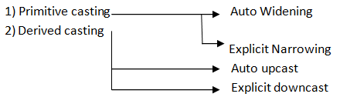
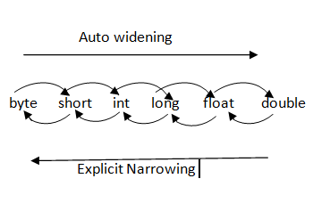
Type Casting in java
Casting is nothing but converting one data type to another type.

Slide 13
Keywords
public, private, protected, package, class, return, import, static, final, new, void
abstract , interface ,extends, implements
if, else, for, while, do, switch, case
break, goto, continue, default
boolean, byte, char, double, long, int, short, float
try, catch, finally, throw, throws
this, super
instanceof
volatile, transient, synchronized

Slide 14
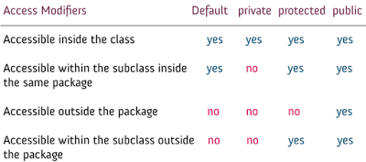
Access Specifiers

Slide 15
Static - Non Static difference
Static Member
A static member has only one copy of variables that share among all the objects of the class
A non-static member has its own copy of instance variable.
Static Block:
It is a block { code} with keyword static which gets executed before the main method and is used for initializing the static variables.
If there is static block, java first execute the static block then the main method
You can have multiple static blocks. Always it executes in top to bottom sequential order.

Slide 16
Constructor – new keyword
Why name – constructor.
Constructor is what constructs our objects.
e.g.,
SimpleClass simpleClassObj = new SimpleClass();
where new SimpleClass() basically constructs the object/reference/instance. When there is no constructor in class, compiler will write the constructor. The constructor created by java compiler is called default constructor.
Hint : run FlowOverview.java

Slide 17
Keywords
extends is the keyword used to inherit the properties of one class by another class
A class uses the implements keyword to implement an interface.
Note: When a class implements an interface, you can think of the class as signing a contract, agreeing to perform the specific behaviors of the interface. If a class does not perform all the behaviors of the interface, the class must declare itself as abstract.

Slide 18
Serialization
Serialization is the process of making the object’s state is persistent. That means the state of the object is converted into stream of bytes and stored in a file. In the same way we can use the de-serilization concept to bring back the object’s state from bytes.
The object’s which are needs to be transmitted through network has to be converted as bytes, for that purpose every class or interface must implement serialization interface
e.g,
class sample implements Serializable{
----------
------
}

Slide 19
Transient keyword
The keyword transient in Java used to indicate that the variable should not be serialized.
By default all the variables in the object is converted to persistent state.
In some cases, you may want to avoid persisting some variables because you don’t have the necessity to transfer across the network.
So, you can declare those variables as transient. If the variable is declared as transient, then it will not be persisted

