Slide 1
Predicting the “Telecom Customer Churn"
Kommera Jaideep Reddy
Batch 31
Student ID:1409

Slide 2
OVERVIEW
Problem Statement
Data
Pre- Processing
Model
Rule Mining
Conclusion

Slide 3
Problem Statement
To predict the telecom customers who are likely to exit the contract and also to generate patterns of Churn and non-churn to assist the management to take appropriate decisions to limit churn.
Beyond building a model to predict churn you will have to identify the patterns for churn and non-churn also which will help in-turn to the company to take action accordingly to limit churn.

Slide 4
Data
Independent Variables
Nominal Variables: Customer ID, Country, State, Retired, Haspartner, Has Dependents, Gender, Electronic Billing, Contract Type, Payment Method
Ordinal Variable: Education
Date Variables: DOC, DOC
Numeric Variables: Base Charges, Total Charges
Dependent Variable
Churn: factor of 2 levels (Yes, No)

Slide 5
Pre-Processing
‘Services opted’ dataset has been recasted to make all the datasets have same number of instances
All four data sets are merged using ‘merge()’ function
Making all the categorical to factors using ‘lapply’
Changing ‘’, MISSINGVAL and ? To NA
As the number of missing values are minimum, the instances with NA have been dropped on Train Data
Central Imputation has been used on test data
The level mismatch in ‘PaymentMethod’ attribute has been solved using ‘levels()’

Slide 6
Model
Models implemented
Logistic Regression
C5.0
Rpart
SVM
Boosting
KNN
The evaluation metric for our problem is ‘Recall’ as the telecom company wants to find customers who churn
The model giving the best recall was Logistic Regression

Slide 7
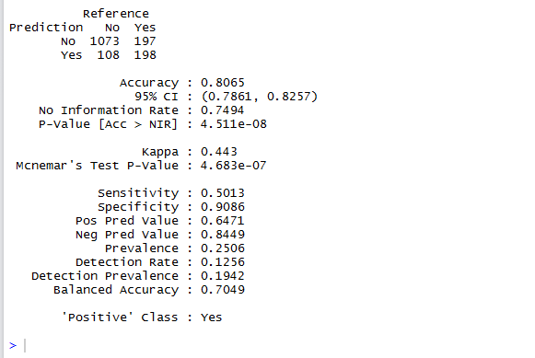
Logistic Model Summary (Threshold: 0.5)

Slide 8
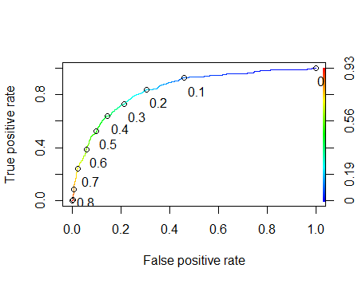
ROC Curve (Logistic Model)

Slide 9
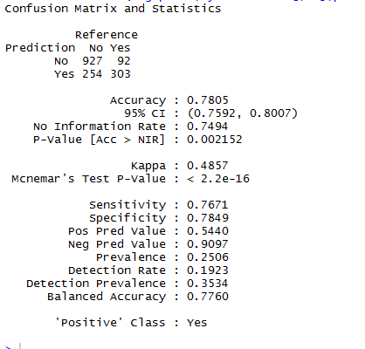
Logistic Model (Threshold:0.27)

Slide 10
Logistic Model Results
As we want better ‘True Positive Rate’
The chosen threshold is 0.27
Accuracy (on test) : 74%
Recall (on test): 84.88%

Slide 11
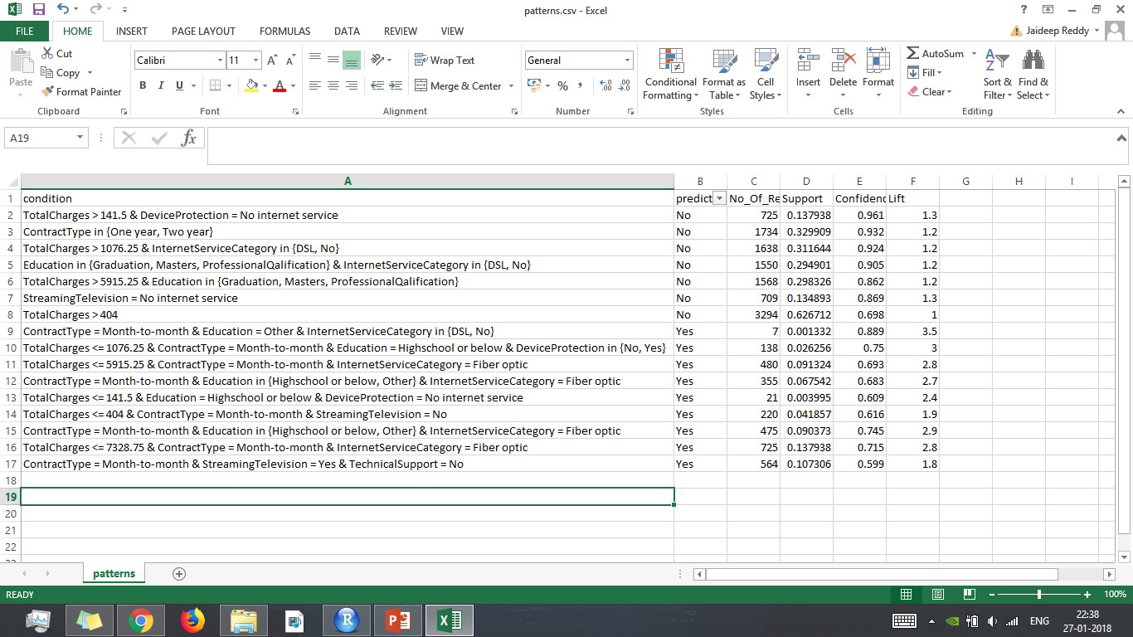
Rules (c5.0 Decision Tree)

Slide 12
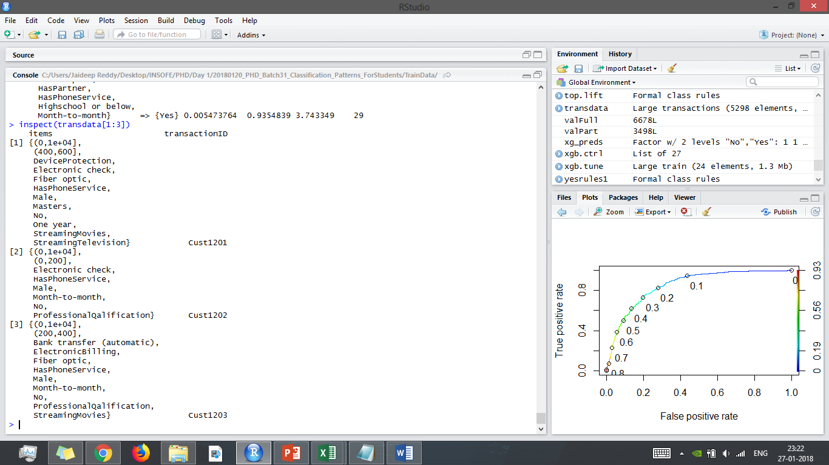
Association Rule Mining

Slide 13
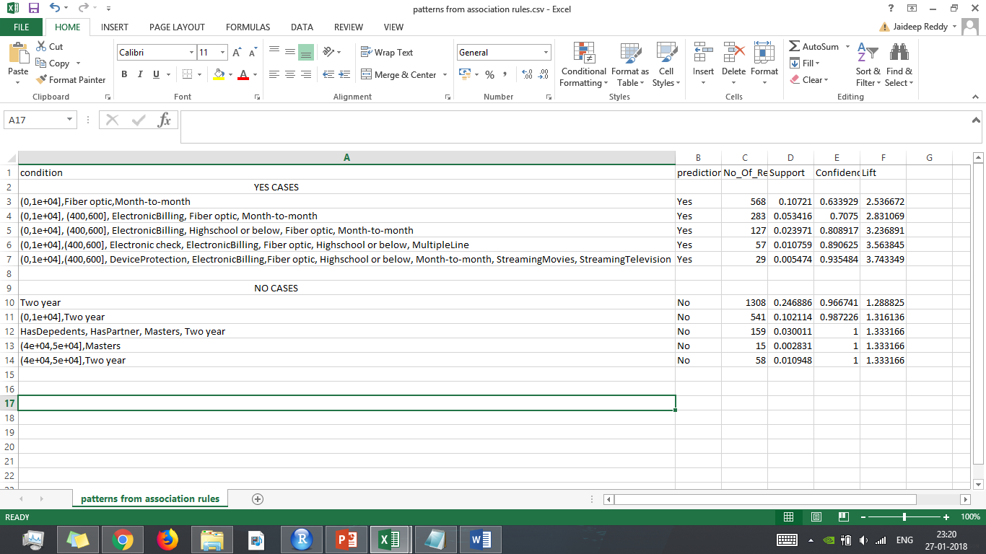
Rule Mining (apriori)

Slide 14
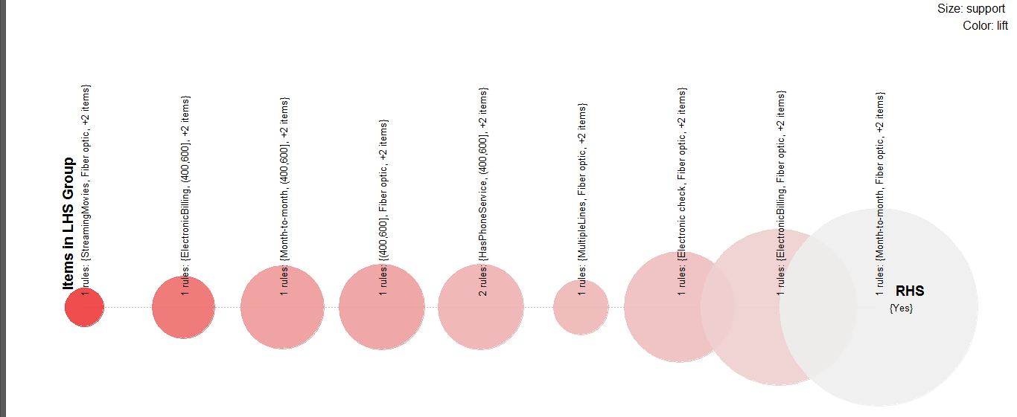
Rules Visualization (Churn=Yes)

Slide 15
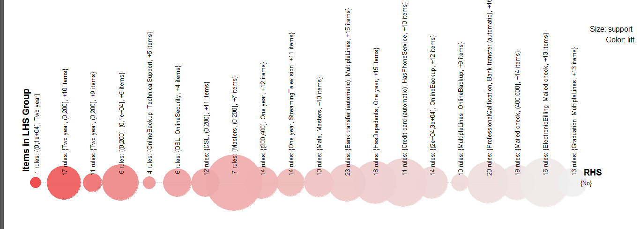
Rules Visualization (Churn=No)

Slide 16
Conclusions
Logistic Model gave the best recall
Association Rules provide great insights’
Fiber Optic customers churned more

