Slide 1
Design Patterns
By Jaideep

Slide 2
What is a Design pattern
A design pattern is a general reusable solution to a commonly occurring problem within a specific context in software design. It is not a finished design that can be transformed directly into code. Instead, it is a template for solving a particular problem
“Each pattern describes a problem which occurs over and over again in our environment, and then describes the core of the solution to that problem, in such a way that you can use this solution a million times over, without ever doing it the same way twice”.
Christopher Alexander, 1977

Slide 3
Why do we need Design Patterns
Simplify coding process, patterns give a design common vocabulary for software design:
Allows engineers to abstract a problem and talk about that abstraction in isolation from its implementation.
Enhance code maintainability and allow it to be communicated:
Design patterns support object-oriented reuse at a high level of abstraction
Makes it easier for other developers to understand a system.
Code Reuse : Design patterns provide a “framework” that guides and constrains object-oriented implementation

Slide 4
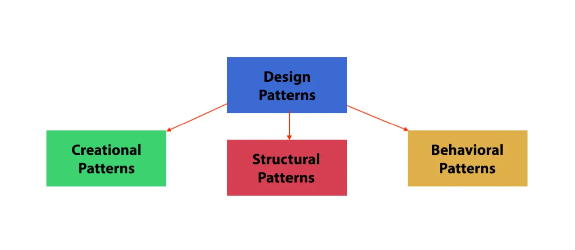
Creational Patterns: These patterns deal with object creation mechanisms, emphasizing the best ways to instantiate objects. Examples include the Singleton, Factory Method.
Structural Patterns: Structural patterns address the composition of classes and objects to form larger structures. They provide solutions to create relationships between different entities. Patterns such as Adapter and Facade fall into this category.
Behavioral Patterns: Behavioral patterns concentrate on communication and interaction between objects. They define the manner in which objects collaborate and distribute responsibilities. Behavioral patterns are Observer, Strategy, Template Method, Iterator patterns

Slide 5
Singleton (Creational Pattern)
The Singleton pattern ensures that only one instance of a class is created throughout the application. This pattern is particularly useful when there should be a single point of access to a resource, such as a database connection or a logging mechanism Example: For a bank account only 1 process should have access to deposit or withdraw money

Slide 6
Let’s see the implementation of singleton in Typescript
Is it same implementation in javascript ?
Why is Singleton called an anti pattern:
Testing Challenges: Singleton introduces challenges in unit testing. Since the Singleton instance is accessed globally, it can create dependencies that are difficult to isolate for testing purposes.
Inflexibility and Tight Coupling: This tight coupling can make it harder to replace the Singleton with a different implementation or to refactor the code.
Violates Single Responsibility Principle: The Singleton class often takes on the responsibility of both managing its instance and providing specific functionality.

Slide 7
Factory (Creational Pattern)
The Factory design pattern is a creational pattern that lets you create objects without exposing their specific creation logic. Instead of directly instantiating objects using their constructors, you delegate the creation process to a central "factory" class or method.
This pattern helps in creating an object while hiding the implementation details and the exact type of the object that will be created.
Example : If you have an application that converts documents to different formats (PDF, Word, HTML), a factory pattern can be used to create the appropriate converter based on the desired output format.

Slide 8
Factory Pattern and Abstract Factory Pattern
the key difference lies in the scope of creation. The Factory Pattern is concerned with creating individual objects, while the Abstract Factory Pattern is concerned with creating families of related or dependent objects. The Abstract Factory Pattern often involves multiple factory methods, each responsible for creating a different type of object within the family.
If you only need to create a few unrelated objects, a simple Factory might suffice. However, for managing families of related objects or scenarios with potential expansion, the greater flexibility of an Abstract Factory could be beneficial.

Slide 9
Facade (Structural Pattern)
A facade is a class that provides a simple interface to a complex subsystem which contains lots of moving parts. A facade might provide limited functionality in comparison to working with the subsystem directly. However, it includes only those features that clients really care about.

Slide 10
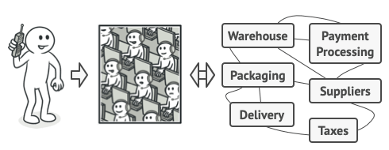
Facade Pattern
Real World Example: When you call a shop to place a phone order, an operator is your facade to all services and departments of the shop. The operator provides you with a simple voice interface to the ordering system, payment gateways, and various delivery services.

Slide 11
Façade vs Factory Pattern
Facade Pattern: The Facade pattern is a structural design pattern that provides a simplified interface to a complex subsystem. It doesn't encapsulate or hide the subsystem but provides a simpler or reduced interface to a more complex one, making it easier to use. The Facade pattern is typically used when you want to simplify a complex system, or when you want to decouple a client implementation from a complex subsystem.
Factory Pattern: The Factory pattern is a creational design pattern that provides an interface for creating objects in a superclass, but allows subclasses to alter the type of objects that will be created. The Factory pattern is typically used when a class can't anticipate the type of objects it needs to create, or when a class wants its subclasses to specify the objects it creates.

Slide 12
Strategy (Behavior Pattern)
Strategy pattern is a behavioral design pattern that allows you to dynamically choose an algorithm at runtime instead of having them directly embedded in the code. It provides a flexible way to encapsulate different strategies (algorithms) for performing a task and swap between them easily based on context or user preference.

Slide 13
Ex: Payment System
Imagine you're on an Online Store:
You've added items to your cart and are ready to pay.
Different Ways to Pay:
You can pay with a credit card, use PayPal, or even pay with cryptocurrency.
Each Payment Method is Like a Strategy:
Think of each way to pay as a different "strategy" for handling the payment.
Strategy Interface:
We have a common set of rules (interface) that all payment methods follow.
For example, each method must know how to process the payment amount.
Concrete Payment Methods:
We have specific ways to handle payments:
Credit Card Payment: Knows how to process credit card transactions.
PayPal Payment: Understands PayPal transactions.
Cryptocurrency Payment: Handles payments using digital currency.
Concrete Payment Methods:
We have specific ways to handle payments:
Credit Card Payment: Knows how to process credit card transactions.
PayPal Payment: Understands PayPal transactions.
Cryptocurrency Payment: Handles payments using digital currency.
Choosing a Payment Method:
You, as the customer, get to choose how you want to pay.
If you change your mind, you can switch your payment method easily.
How the System Works:
The store has a smart system (context) that knows how to talk to each payment method.
When you click "pay," the system uses the chosen payment method to handle the transaction.
Benefits of this Approach:
Easy Switching: You can change your mind about how to pay without any trouble.
Adding New Ways to Pay: The store can add new payment methods easily in the future.

Slide 14
End Result:
No matter which way you choose to pay, the system knows what to do, and your payment goes through smoothly!
Benefits:
Flexible: Easily switch between payment methods.
Extensible: Add new payment methods without modifying existing code.
Dynamically switches payment strategy.
Conclusion:

Slide 15
Observer (Behavior Pattern)
The Observer pattern offers a subscription model in which objects subscribe to an event and get notified when the event occurs. This pattern is the cornerstone of event driven programming, including JavaScript. The Observer pattern facilitates good object-oriented design and promotes loose coupling.

Slide 16
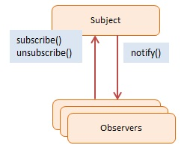
Example
Real-world example of the Observer Pattern can be found in the implementation of a stock market or financial trading system. In this scenario, multiple traders or financial instruments can observe changes in the stock prices and react accordingly we can sell or buy stocks based on the subscription notification received.

Slide 17
What pattern does Angular use
It uses a combination of
1. Observer pattern
2. MVVC pattern ( similar to MVVM )
MVVC (Model-View-View-Controller): This emphasizes the two-way data binding and component focus present in Angular.
MVVM-light: This is a lighter version of MVVM where components manage both view and logic while still utilizing data binding features.

Slide 18
Thank you
Questions/Discussions ?

