Slide 1
Hostel Accommodation & Student Services
Presentation-III: Final Demonstration
Name: [your name] Roll no.: [roll number]
Course: [course] Faculty: [faculty name] Year: [academic year]

Slide 2
Problem and Objectives
Paper registers cause duplicate records, lost fee data and slow complaint handling
Objective: one normalised MySQL database for staff, blocks, rooms, students, fees, complaints, mess and visitors
Web admin panel to insert, view and delete records in all 8 modules
SQL reports: room occupancy, unpaid fees, open complaints, mess revenue

Slide 3
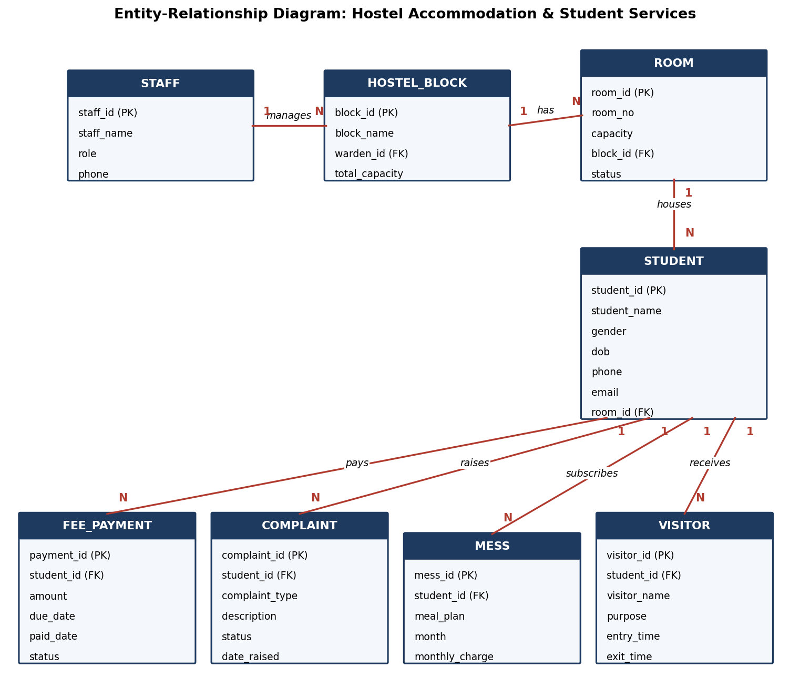
ER Diagram: 8 Related Tables
Staff 1:N Hostel_Block (warden)
Hostel_Block 1:N Room
Room 1:N Student
Student 1:N Fee_Payment, Complaint, Mess, Visitor
Schema is in 3NF; foreign keys keep data consistent

Slide 4
Technology and Implementation
Node.js v24.15.0, started with npm start (port 3000)
MySQL database; connection pool in config/db.js
HTML, CSS, JavaScript panel with sidebar for 8 modules
Parameterised queries (?) prevent SQL injection
Drop-downs filled from related tables enforce valid foreign keys

Slide 5
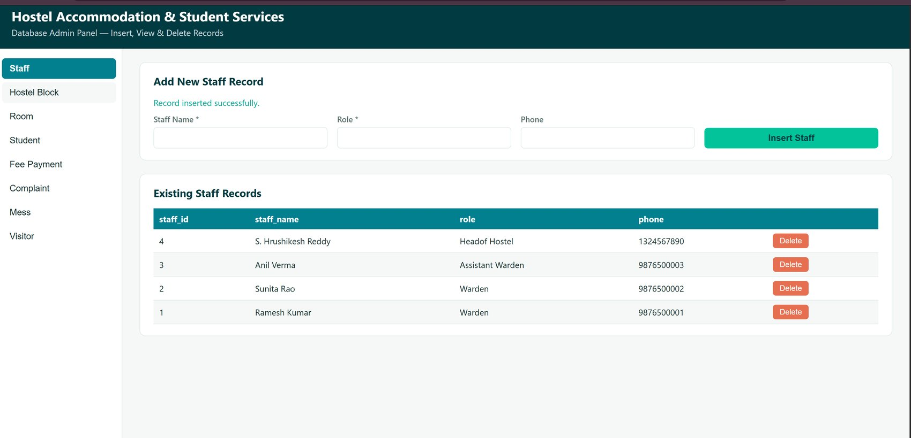
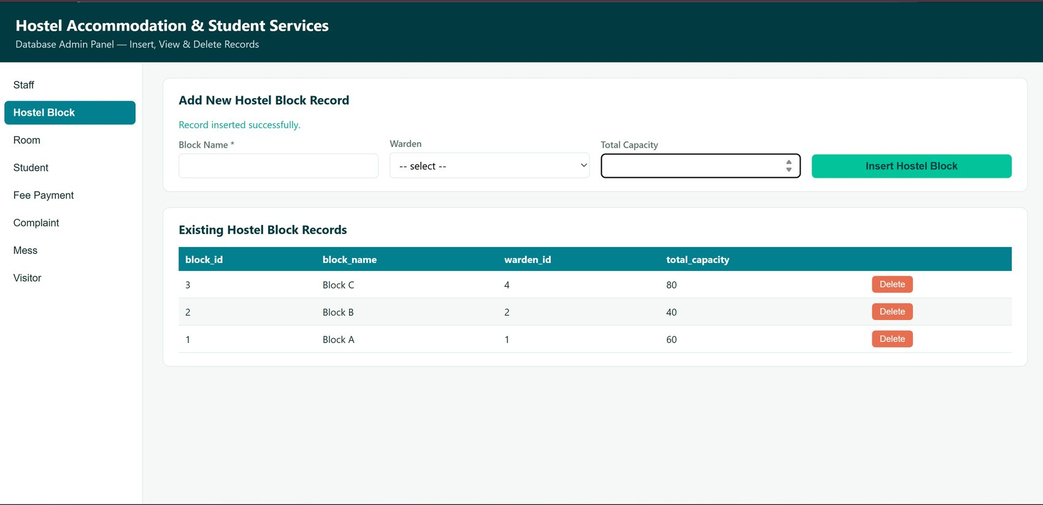
UI Screens: Staff and Hostel Block
Staff: view + insert success message
Hostel Block: view + warden drop-down

Slide 6
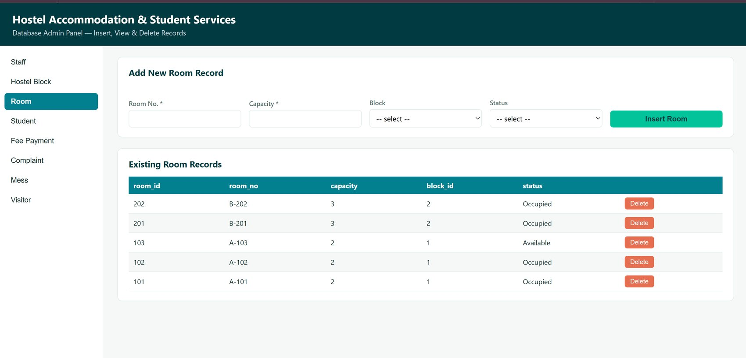
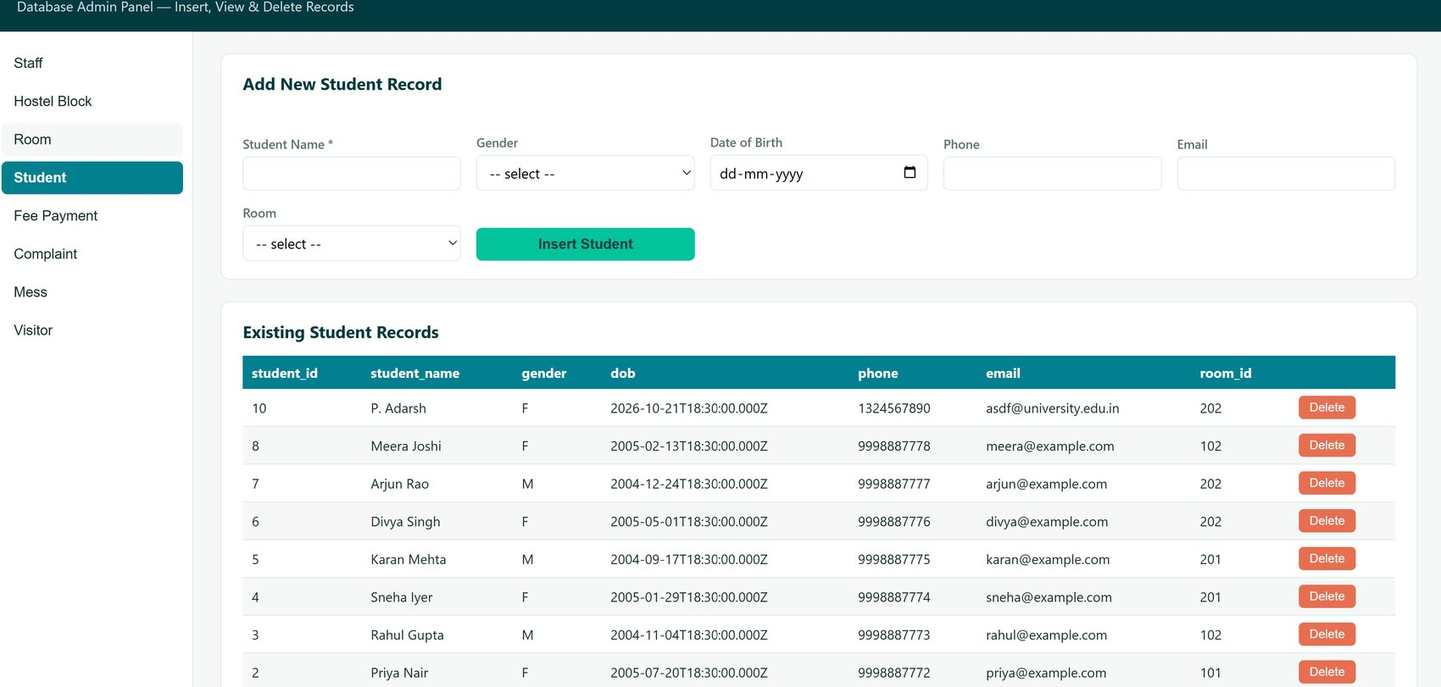
UI Screens: Room and Student
Room: view + block and status drop-downs
Student: view + room drop-down

Slide 7
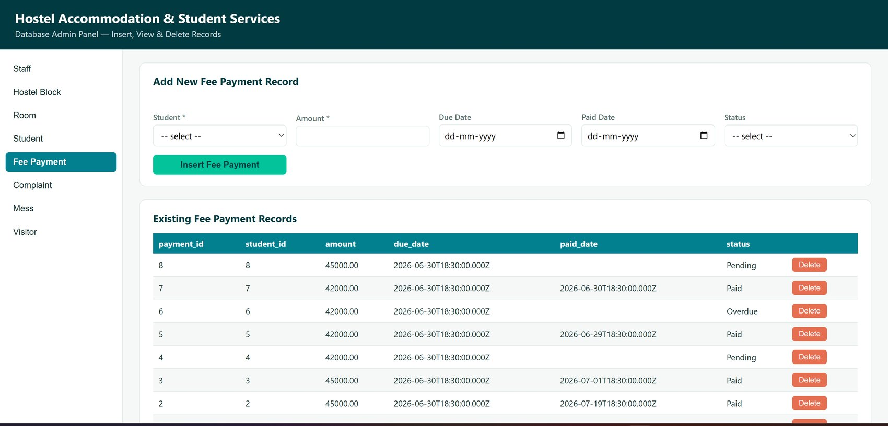
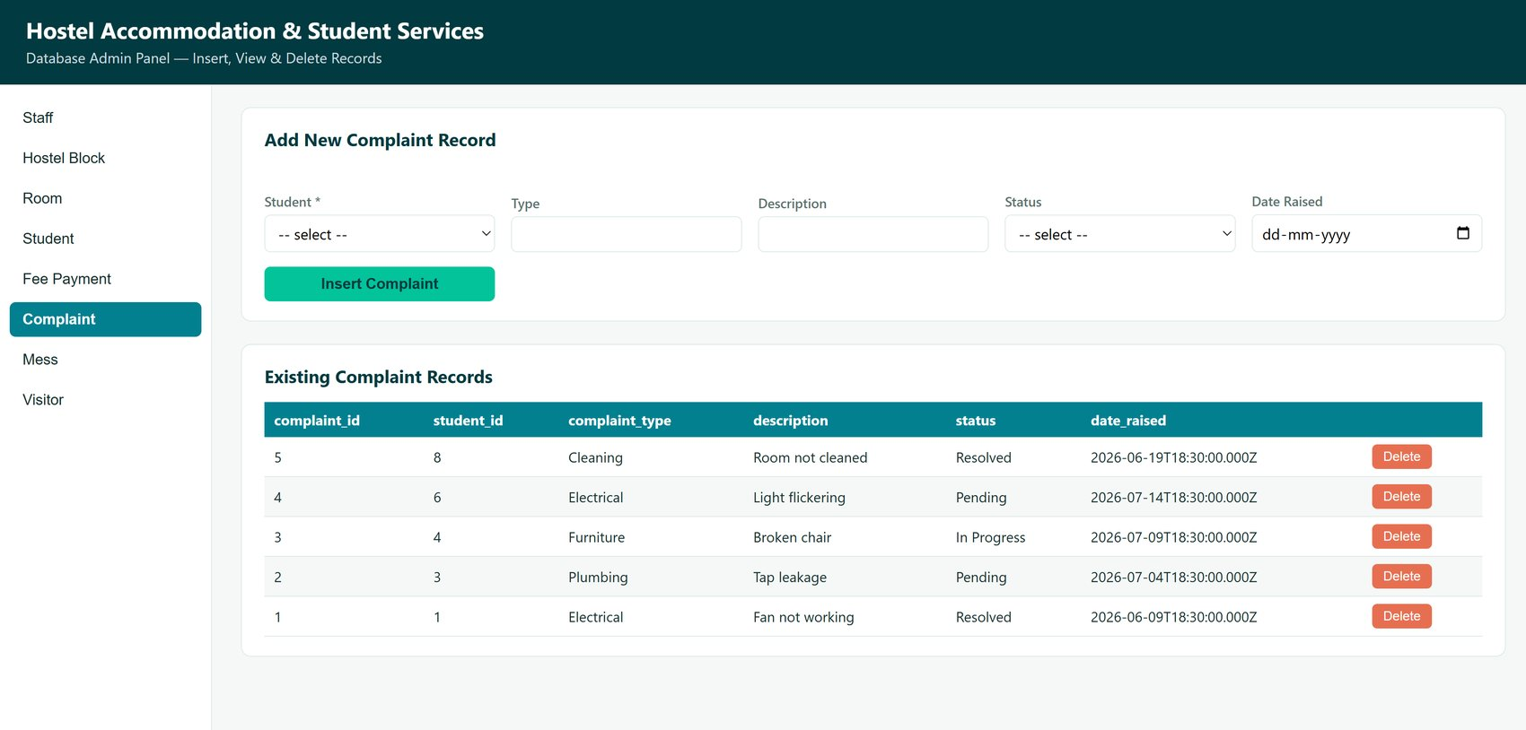
UI Screens: Fee Payment and Complaint
Fee Payment: view with status
Complaint: view with status

Slide 8
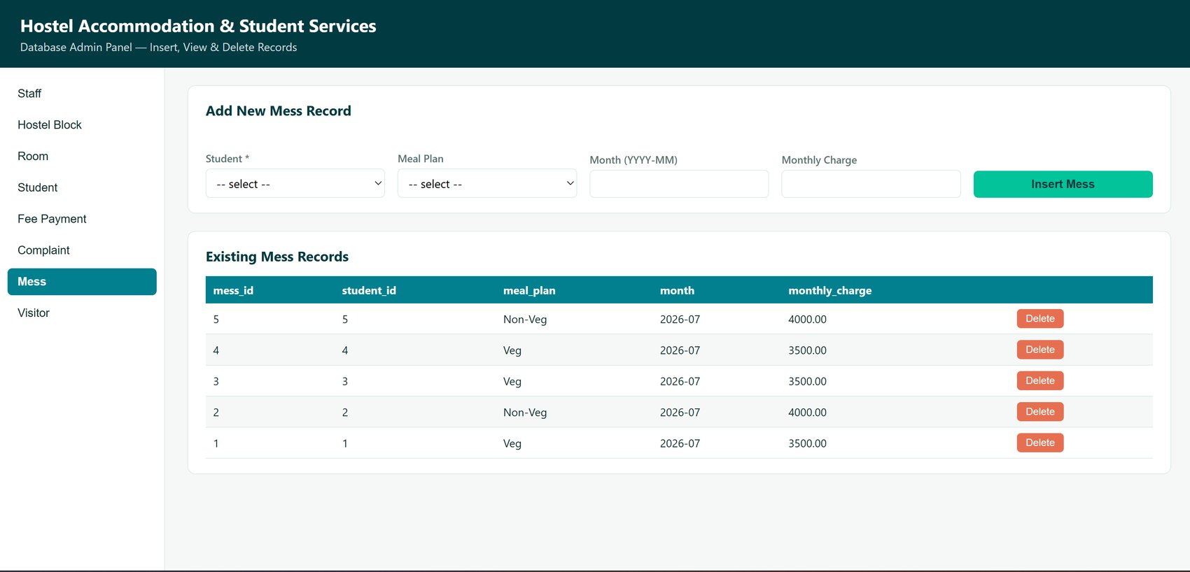
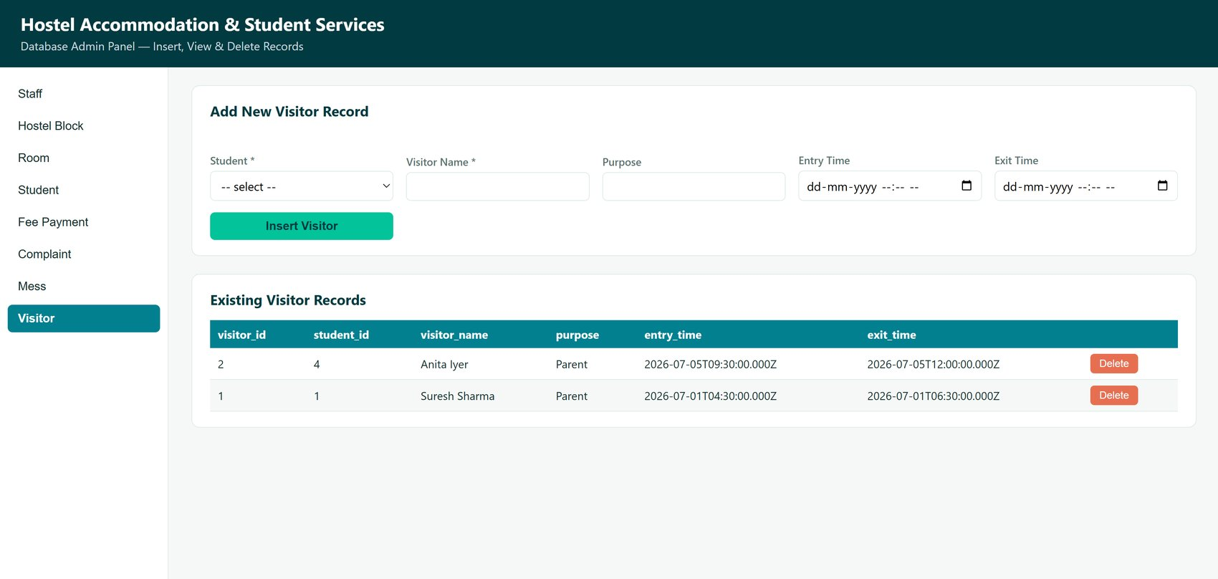
UI Screens: Mess and Visitor
Mess: view with meal plan
Visitor: view with entry/exit time

Slide 9
Insert Operation: Before and After
[Insert screenshot: form filled, BEFORE clicking Insert]
[Insert screenshot: AFTER insert, new row in table]
Example: Staff module shows 'Record inserted successfully.' and the new row (staff_id 4) in the table. Repeat for other modules.

Slide 10
Delete Operation: Before and After
[Insert screenshot: table BEFORE clicking Delete]
[Insert screenshot: table AFTER deleting the row]
Each row has a Delete button; the row disappears from the table and from MySQL.

Slide 11
Sample SQL Query Results
Unpaid fees (JOIN)
Fees by status (GROUP BY)
student_name | amount | status
Divya Singh | 42000.00 | Overdue
Meera Joshi | 45000.00 | Pending
Sneha Iyer | 42000.00 | Pending
status | payments | total_amount
Overdue | 1 | 42000.00
Paid | 5 | 219000.00
Pending | 2 | 87000.00
Presentation-II query: [paste query and output here]

Slide 12
Conclusion and Future Work
Normalised 8-table design with working insert, view and delete in every module
Future: edit option, form validation, DD-MM-YYYY dates, login roles, fee reminders, dashboard charts
Source code: [GitHub repository link]

