Slide 1
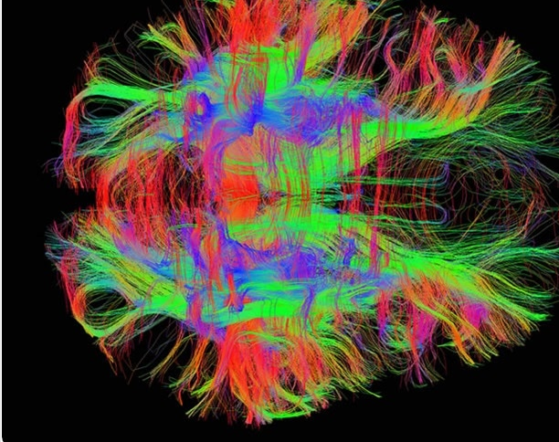
Fitting a Diffusion Tensor field from MRI data
Kurt Cook, Darius McLean, Zhenghong Shen, Jaiden Thomas

Slide 2
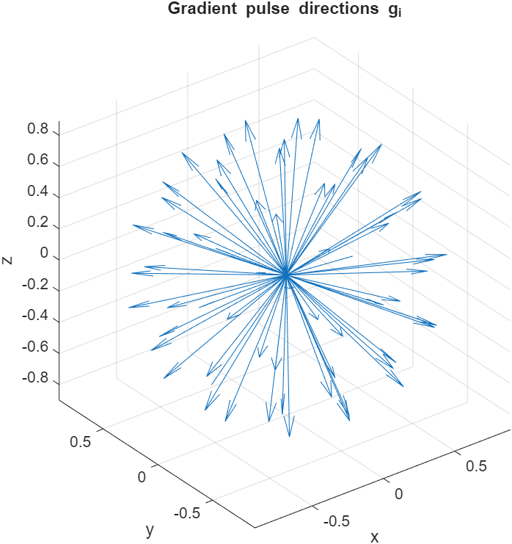

The Problem: Fitting the Diffusion Field
Mapping water diffusivity through a patient's brain is characterised by the equation
$S=S_{0}exp\left(−b{\vec{g}}^{T}D\vec{g}\right)$
Since this process is anisotropic D is a rank(2,0) tensor or an SPD(3) matrix.
The signals, gradient directions, and diffusion weighting parameter are experimentally determined.
We seek to reconstruct the diffusion tensor field both voxel-wise and as an analytic function.

Slide 3
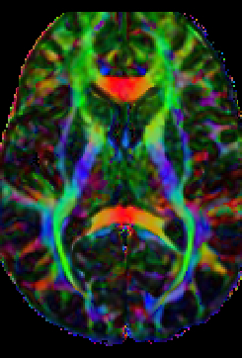

Determining the Diffusion tensor
The diffusion equation can be converted to a linear equation
$ln\left(\frac{S}{S_{0}}\right)=−$ $b{\vec{g}}^{T}D\vec{g} ⟹ A\tilde{D}=B$
Where,
$B = −\frac{1}{b}ln\left(\frac{S}{S_{0}}\right)$
$\tilde{D} ={[D_{xx}, D_{yy},D_{zz},D_{xy}, D_{xz},D_{yz}] }^{T}$
$A_{n} = [{\left(g_{x}^{n}\right)}^{2}$, ${\left(g_{y}^{n}\right)}^{2},{\left(g_{z}^{n}\right)}^{2}, 2g_{x}^{n}g_{y}^{n},2g_{x}^{n}g_{z}^{n},2g_{y}^{n}g_{z}^{n}]$

Slide 4
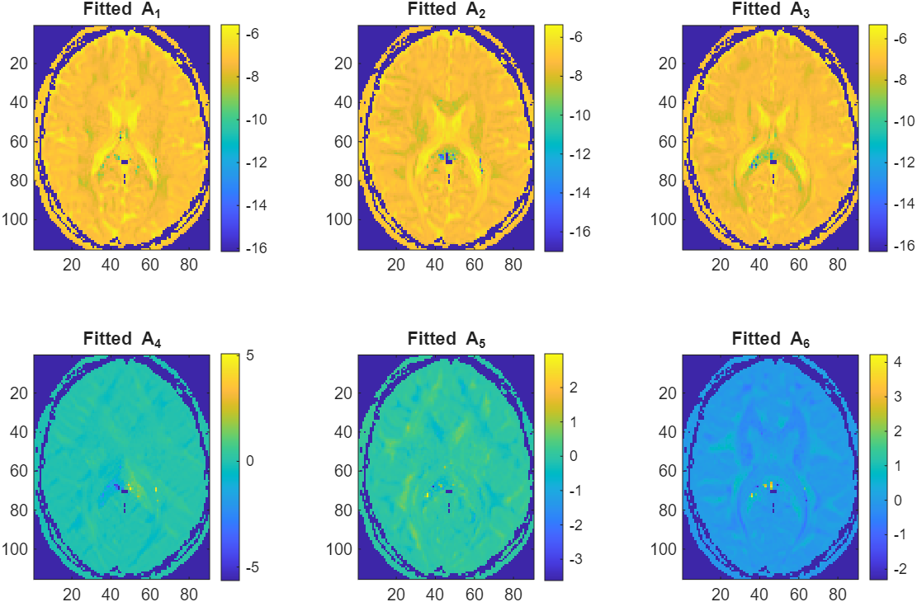
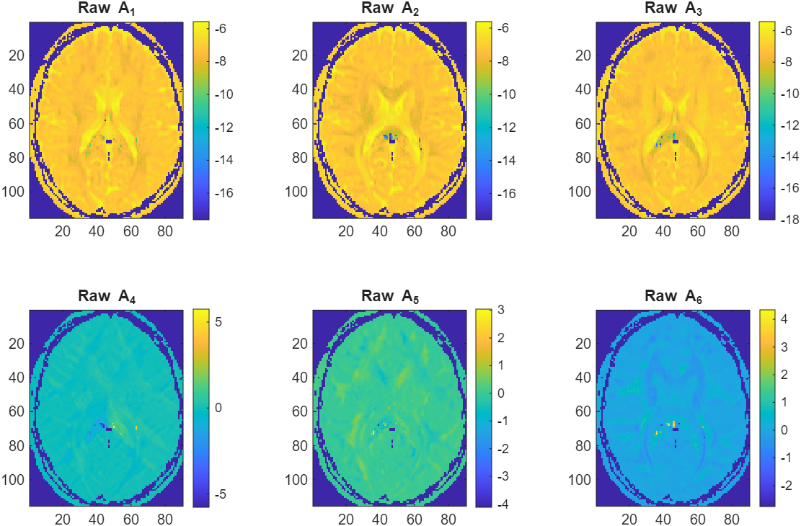

Finding a continuous Diffusion Field
Fitted results
We seek to determine a continuous function for each diffusion component $D_{ij}$.
To this end we used Gaussian RBF’s to model each component.
$$lnD_{ij}\left(x\right)=\sum_{n=1}^{N_{vox}}{C_{ij}^{n}exp\left(−ε^{2}{\left\|x − x_{n}\right\|}^{2}\right)}$$
To ensure we don’t overfit noise a parameter $ρ$ was introduced and the minimum gcv-score for $ε$ and $ρ$ was calculated.
Raw results

Slide 5
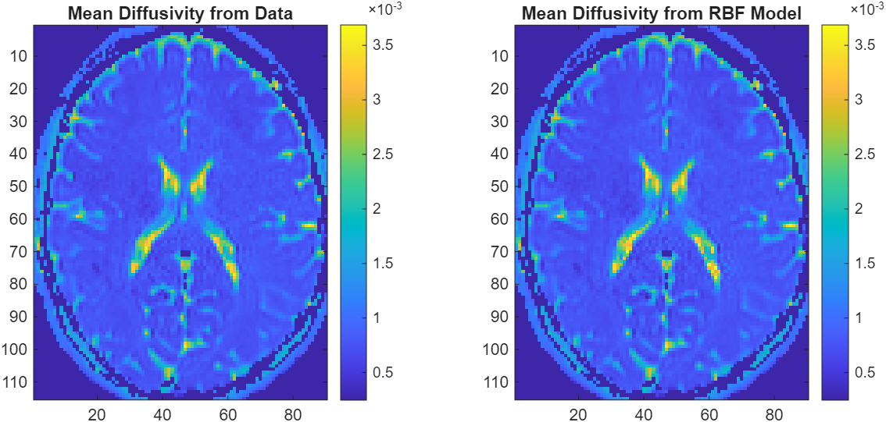

Results: Mean Diffusivity Maps
Mean diffusivity from Data and Model
The diffusion tensor at each voxel has 3 principal directions with accompanying ‘weights’ telling us the strength of diffusion for each of these directions
These ‘weights’ are called eigenvalues and their average gives mean diffusivity
$MD = \frac{λ_{1}+ λ_{2}+λ_{3}}{3}$
This tells us which regions of the brain have the most diffusion and how diffusivity is distributed across the brain

Slide 6
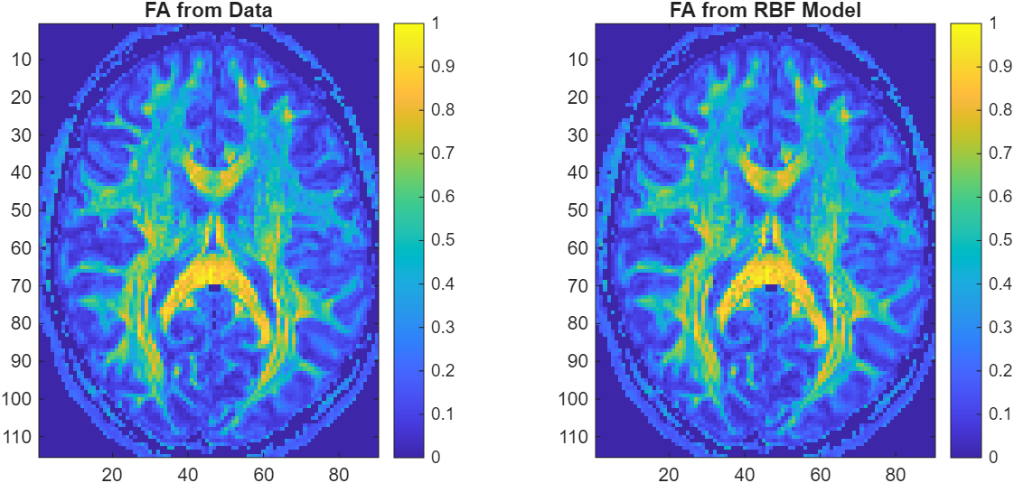

Results: Fractional Anisotropy Maps
Fractional Anisotropy for Data and Model
Fractional Anisotropy lets us quantify how direction dependent different regions of the brain are.
That is to say how isotropic or anisotropic different brain regions are.
Fractional anisotropy is given by
$FA=\sqrt{\frac{{\left(λ_{1}−λ_{2}\right)}^{2}+{\left(λ_{2}−λ_{3}\right)}^{2}+{\left(λ_{3}−λ_{1}\right)}^{2}}{2\left(λ_{1}^{2}+λ_{2}^{2}+λ_{3}^{2}\right)}}$

Slide 7
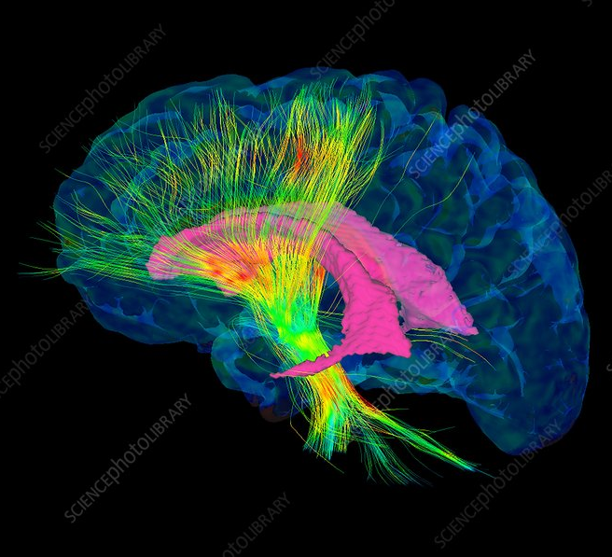
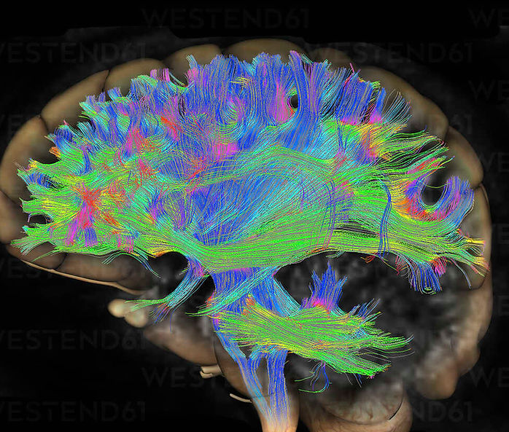
Further Extensions:
With an analytic form for the diffusion tensor differential geometry methods can then be applied.
The brain can be treated as a 3-dim manifold and diffusion field as a section of a tangent bundle.
This allows a metric to be induced from D allowing for the computation of geodesics, curvature, and holonomy groups.
From these results a robust framework can be designed to allow for a precise and thorough comparison between healthy and unhealthy brains.

Slide 8
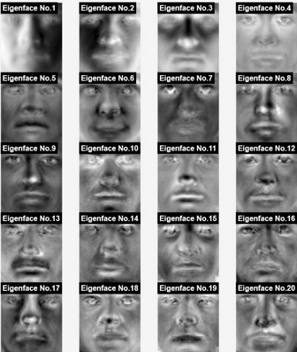
Eigenface Feature Detection : Developing a Rudimentary Moustache Detector
Kurt Cook, Darius McLean, Zhenghong Shen, Jaiden Thomas

Slide 9
Mathematical concepts
PCA (Principal component analysis) and Eigenfaces (EF) were used to detect the moustache from a large data set.
Code on MATLAB was written for detection of the faces, the process:
1
2
3
Upload Face Image
Mean Centre
Composed into SVD
Projection Score
Take Eigenface vector (Column vector of U)
Classification
6
5
4

Slide 10





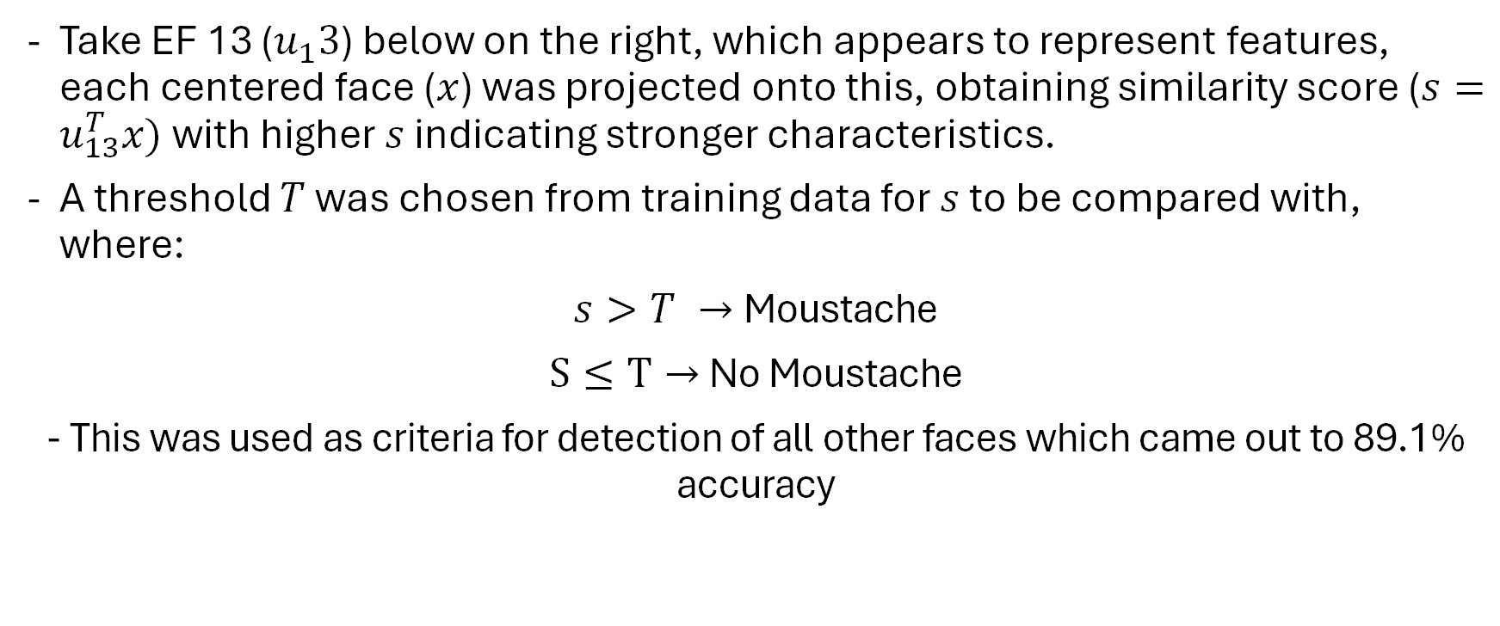
Moustache Detection
Take EF 13 ($u_{1}3$) below on the right, which appears to represent features, each centered face ($x$) was projected onto this, obtaining similarity score ($s=u_{13}^{T}x)$ with higher $s$ indicating stronger characteristics.
A threshold $T$ was chosen from training data for $s$ to be compared with, where:
$s>T →$Moustache
$S≤T→$ No Moustache
- This was used as criteria for detection of all other faces which came out to 89.1% accuracy

Slide 11
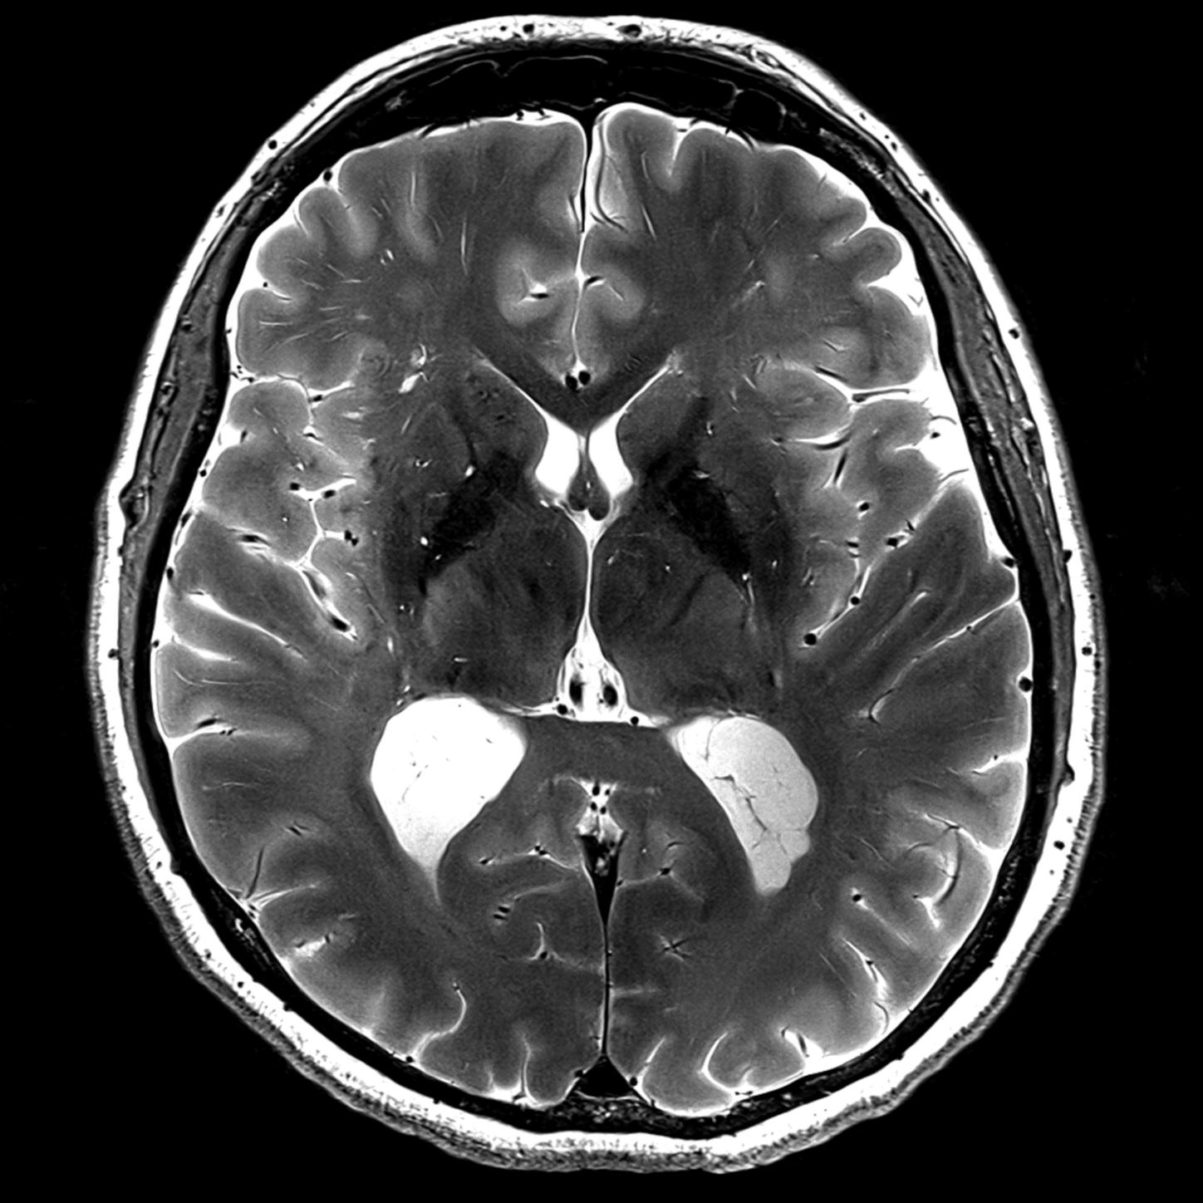
Adapting to Use MRI Data
Notes:
Script: Thanks to the mathematical precision in MRI brain scans and consistency. We can easily apply the same feature extraction methodology, with near optimal input data, making it then possible to detect and classify various abnormalities, be it a tumor, lesion within MRI brain scans. This can be a rigorous and rapid tool to aid in doctors identifying possibly life threatening illnesses.

