Slide 1
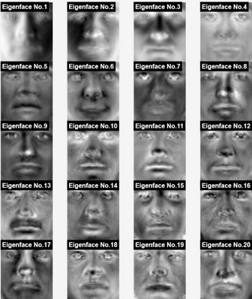
Eigenface Feature Detection : Developing a Rudimentary Moustache Detector
Kurt Cook, Darius McLean, Zhenghong Shen, Jaiden Thomas

Slide 2
Mathematical concepts
PCA (Principal component analysis) and Eigenfaces (EF) were used to detect the moustache from a large data set.
Code on MATLAB was written for detection of the faces, the process:
1
2
3
Upload Face Image
Mean Centre
Composed into SVD
Projection Score
Take Eigenface vector (Column vector of U)
Classification
6
5
4

Slide 3





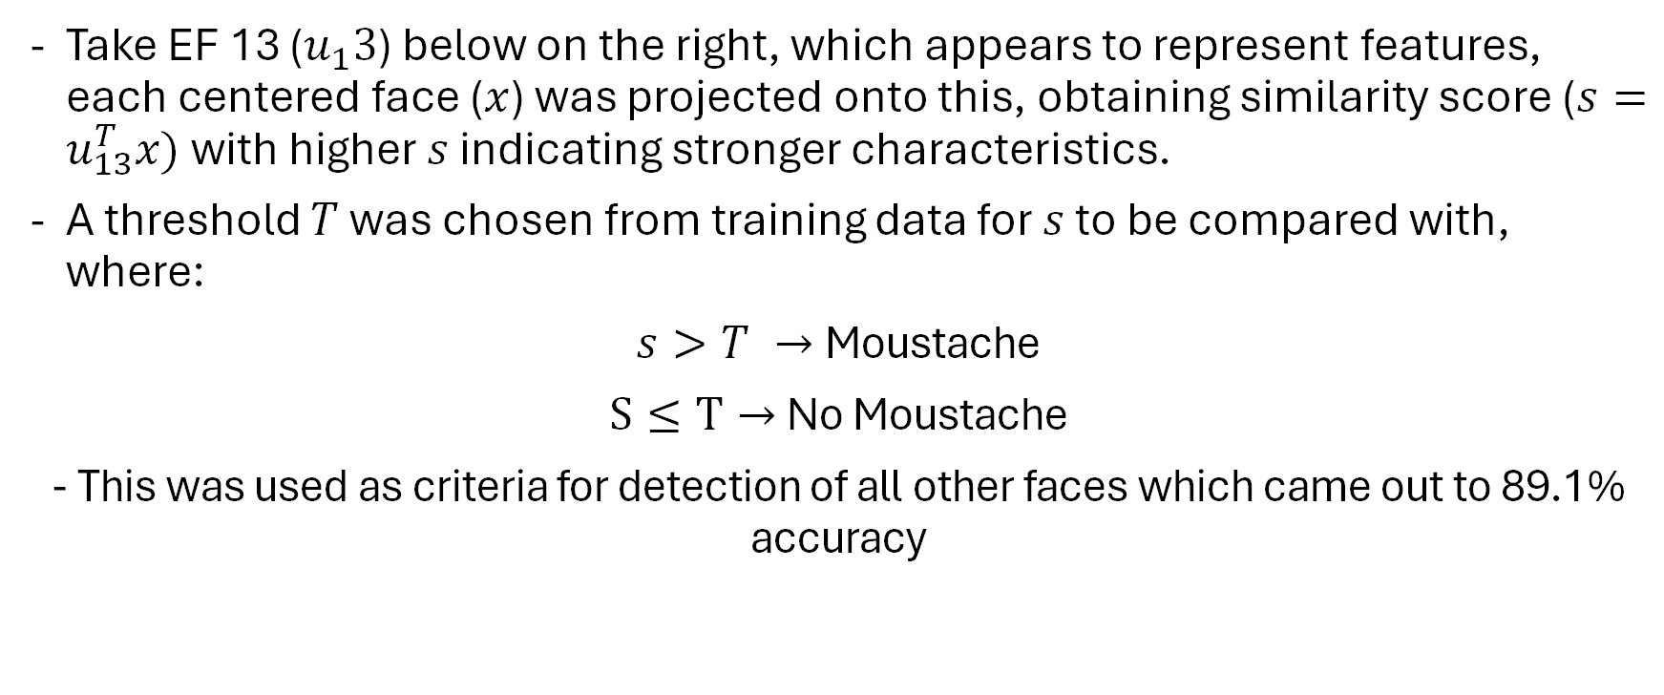
Moustache Detection
Take EF 13 ($u_{1}3$) below on the right, which appears to represent features, each centered face ($x$) was projected onto this, obtaining similarity score ($s=u_{13}^{T}x)$ with higher $s$ indicating stronger characteristics.
A threshold $T$ was chosen from training data for $s$ to be compared with, where:
$s>T →$Moustache
$S≤T→$ No Moustache
- This was used as criteria for detection of all other faces which came out to 89.1% accuracy

Slide 4
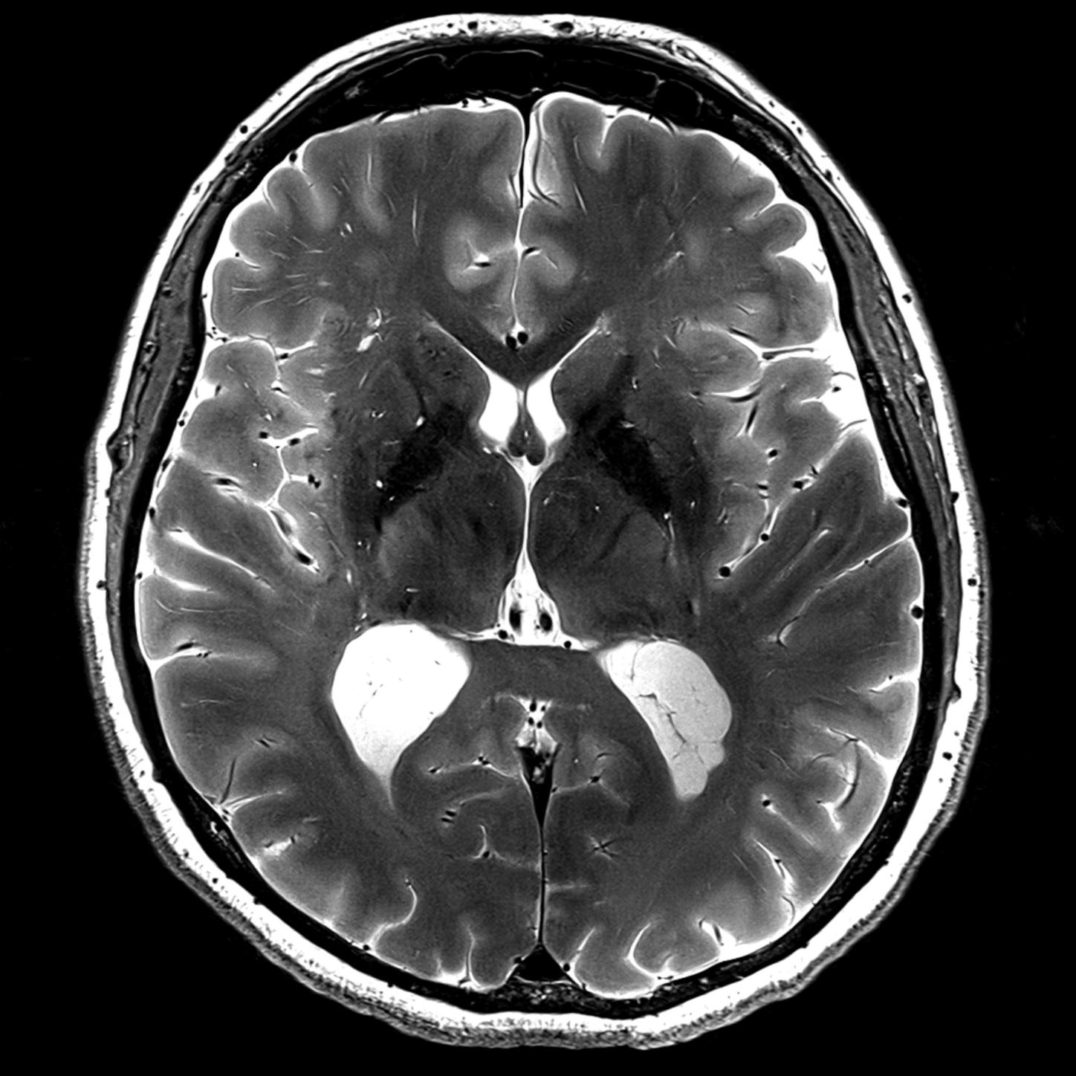
Adapting to Use MRI Data
Notes:
Script: Thanks to the mathematical precision in MRI brain scans and consistency. We can easily apply the same feature extraction methodology, with near optimal input data, making it then possible to detect and classify various abnormalities, be it a tumor, lesion within MRI brain scans. This can be a rigorous and rapid tool to aid in doctors identifying possibly life threatening illnesses.

