Slide 1
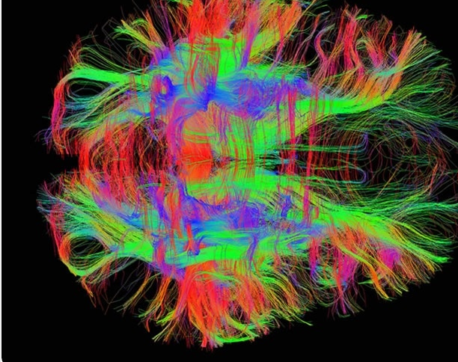
Fitting a Diffusion Tensor field from MRI data
Kurt Cook, Darius McLean, Zhenghong Shen, Jaiden Thomas

Slide 2
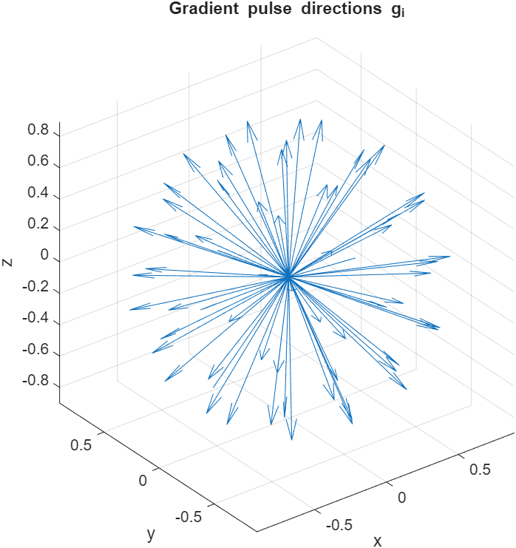

The Problem: Fitting the Diffusion Field
Mapping water diffusivity through a patient's brain is characterised by the equation
$S=S_{0}exp\left(−b{\vec{g}}^{T}D\vec{g}\right)$
Since this process is anisotropic D is a rank(2,0) tensor or an SPD(3) matrix.
The signals, gradient directions, and diffusion weighting parameter are experimentally determined.
We seek to reconstruct the diffusion tensor field both voxel-wise and as an analytic function.

Slide 3
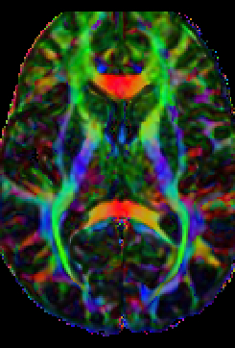

Determining the Diffusion tensor
The diffusion equation can be converted to a linear equation
$ln\left(\frac{S}{S_{0}}\right)=−$ $b{\vec{g}}^{T}D\vec{g} ⟹ A\tilde{D}=B$
Where,
$B = −\frac{1}{b}ln\left(\frac{S}{S_{0}}\right)$
$\tilde{D} ={[D_{xx}, D_{yy},D_{zz},D_{xy}, D_{xz},D_{yz}] }^{T}$
$A_{n} = [{\left(g_{x}^{n}\right)}^{2}$, ${\left(g_{y}^{n}\right)}^{2},{\left(g_{z}^{n}\right)}^{2}, 2g_{x}^{n}g_{y}^{n},2g_{x}^{n}g_{z}^{n},2g_{y}^{n}g_{z}^{n}]$

Slide 4
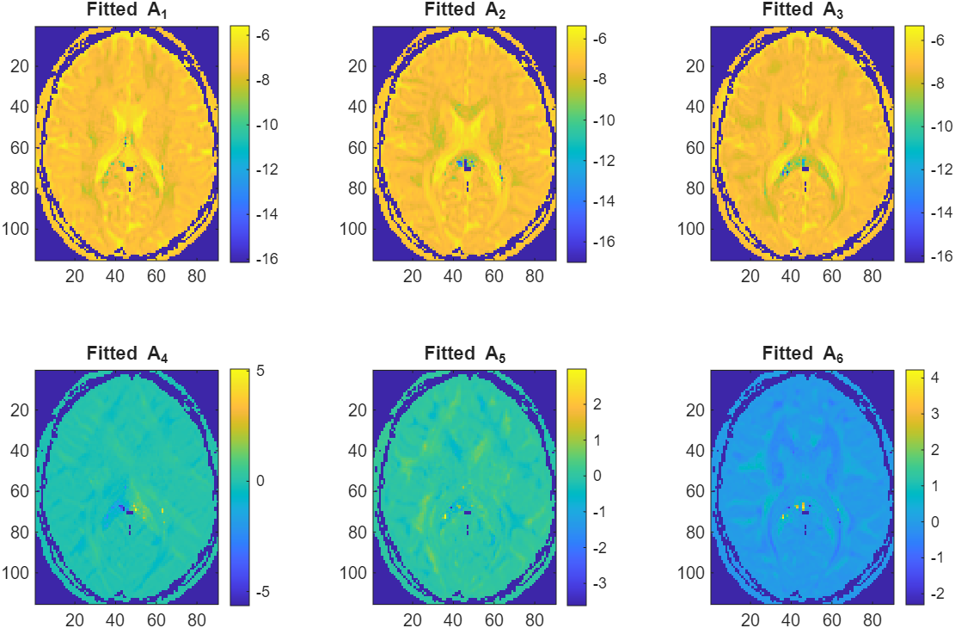
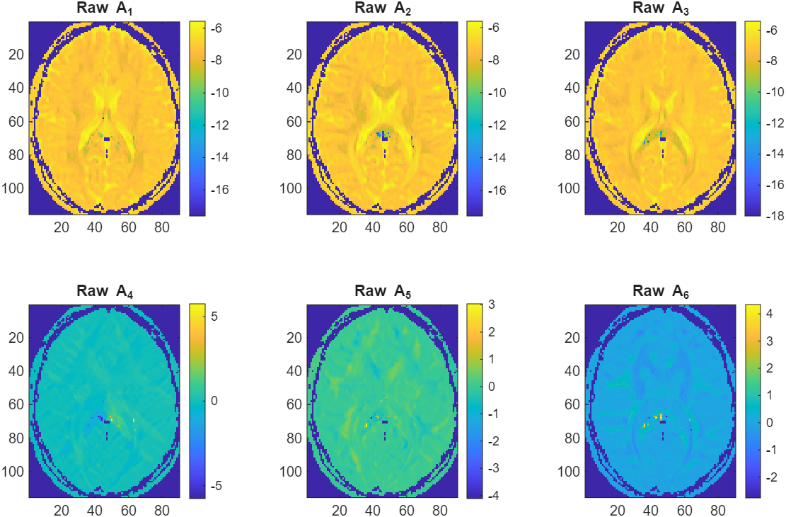

Finding a continuous Diffusion Field
Fitted results
We seek to determine a continuous function for each diffusion component $D_{ij}$.
To this end we used Gaussian RBF’s to model each component.
$$lnD_{ij}\left(x\right)=\sum_{n=1}^{N_{vox}}{C_{ij}^{n}exp\left(−ε^{2}{\left\|x − x_{n}\right\|}^{2}\right)}$$
To ensure we don’t overfit noise a parameter $ρ$ was introduced and the minimum gcv-score for $ε$ and $ρ$ was calculated.
Raw results

Slide 5
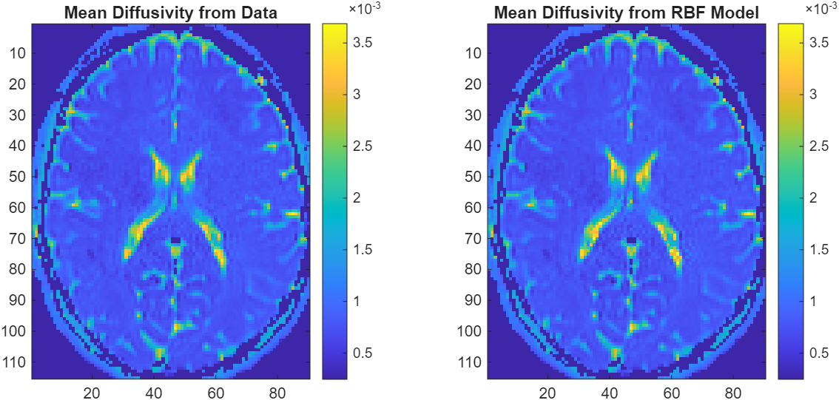

Results: Mean Diffusivity Maps
Mean diffusivity from Data and Model
The diffusion tensor at each voxel has 3 principal directions with accompanying ‘weights’ telling us the strength of diffusion for each of these directions
These ‘weights’ are called eigenvalues and their average gives mean diffusivity
$MD = \frac{λ_{1}+ λ_{2}+λ_{3}}{3}$
This tells us which regions of the brain have the most diffusion and how diffusivity is distributed across the brain

Slide 6
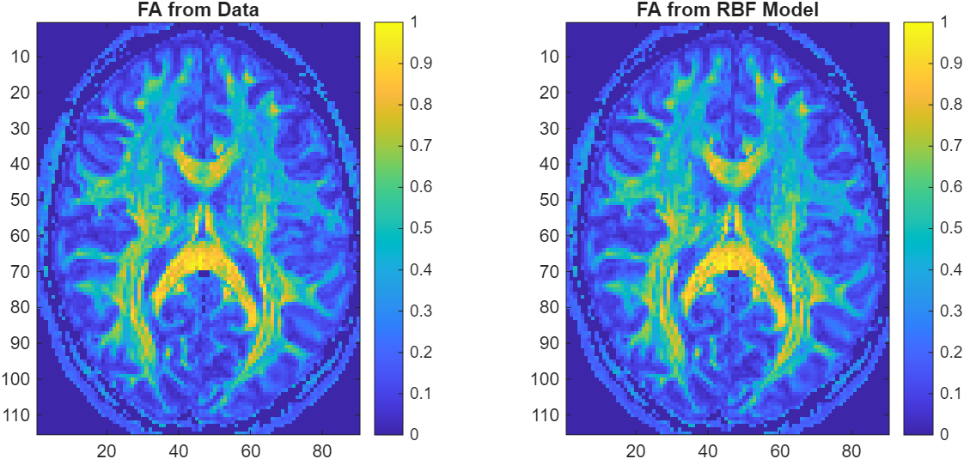

Results: Fractional Anisotropy Maps
Fractional Anisotropy for Data and Model
Fractional Anisotropy lets us quantify how direction dependent different regions of the brain are.
That is to say how isotropic or anisotropic different brain regions are.
Fractional anisotropy is given by
$FA=\sqrt{\frac{{\left(λ_{1}−λ_{2}\right)}^{2}+{\left(λ_{2}−λ_{3}\right)}^{2}+{\left(λ_{3}−λ_{1}\right)}^{2}}{2\left(λ_{1}^{2}+λ_{2}^{2}+λ_{3}^{2}\right)}}$

Slide 7
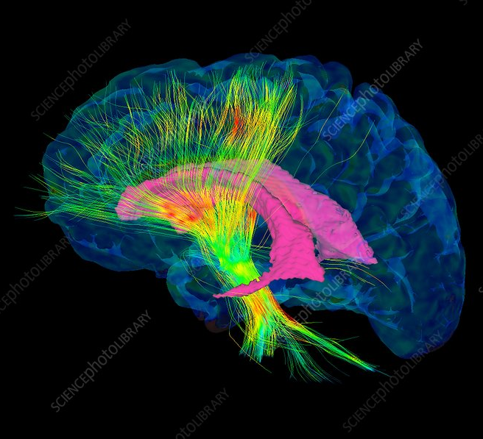
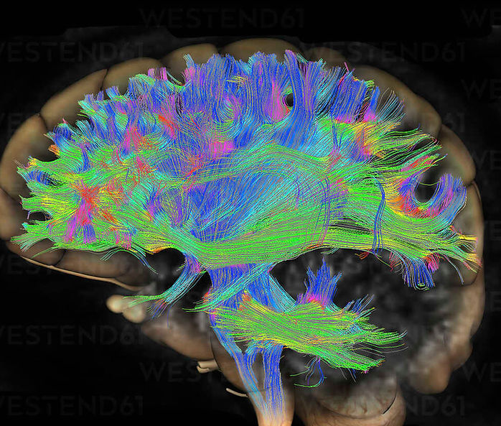
Further Extensions:
With an analytic form for the diffusion tensor differential geometry methods can then be applied.
The brain can be treated as a 3-dim manifold and diffusion field as a section of a tangent bundle.
This allows a metric to be induced from D allowing for the computation of geodesics, curvature, and holonomy groups.
From these results a robust framework can be designed to allow for a precise and thorough comparison between healthy and unhealthy brains.

