Slide 1
Cryptography and Steganography
Team: What It Does?
Jason Devlin, Jaiden Gerig, Cody Taylor, Brennen Taylor, George Gaytan, Andrew Schlotzhauer

Slide 2
LSB Embedding
Turn message into 8 bit binary characters.
First value embedded is a twelve bit binary number that represents the number of characters in the message
Each number of the 8 bit binary characters is embedded into LSBs of image.
Embedded picture saved to “NothingToSeeHere.bmp”
Command line argument:
- ./toto –lsbem filename.bmp

Slide 3
LSB Extracting
First value extracted is the number of characters in the message
Once size is known, message is extracted in binary format, converted to characters and displayed in the terminal
Command line argument:
./toto –lsbex filename.bmp

Slide 4
Randomization Attack
Randomly selects 0 or 1
If the current LSB does not match the randomly selected value, it is changed
Command line argument:
./toto –osfa fileName.bmp

Slide 5
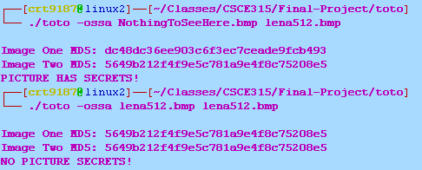
Detection Attack
Command line argument:
./toto –ossa filename1.bmp filename2.bmp
or ./toto –ossa MD5val filename2.bmp

Slide 6
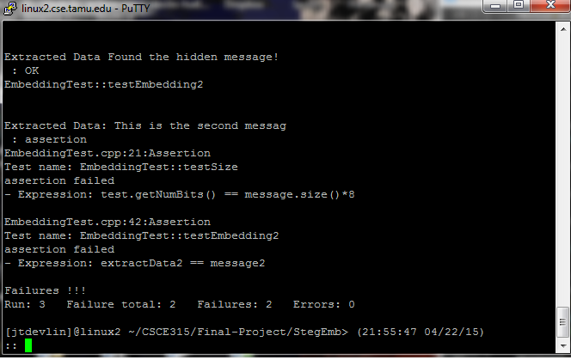
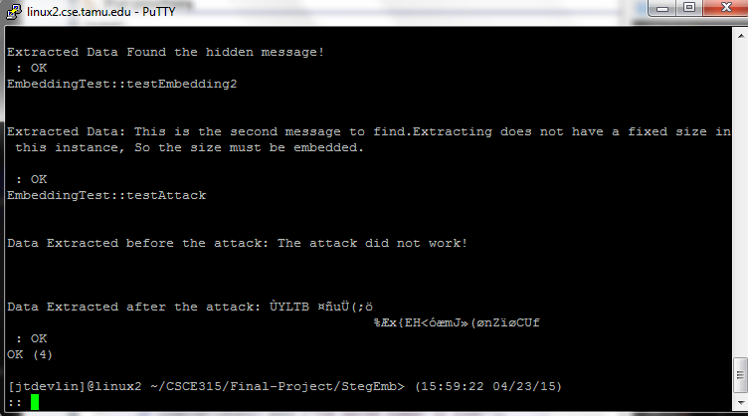
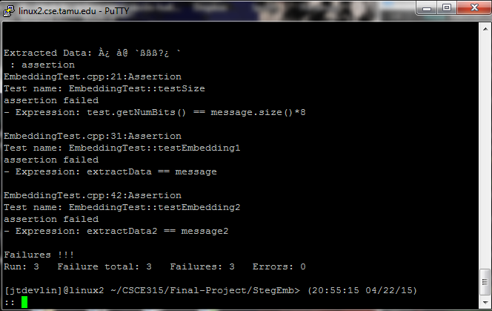
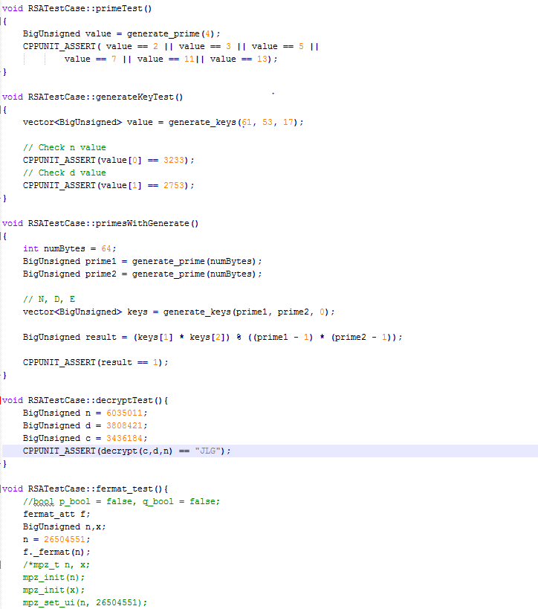
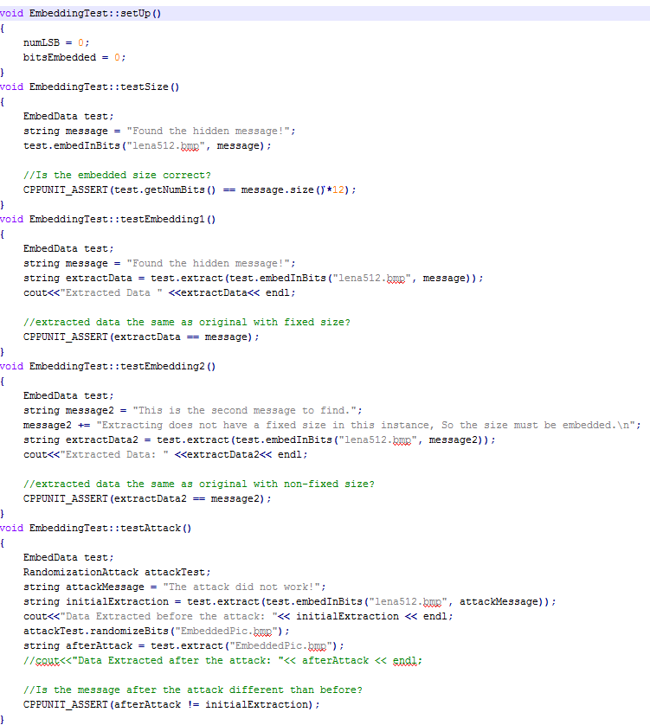
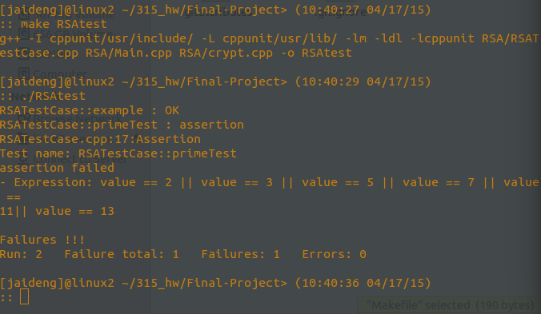
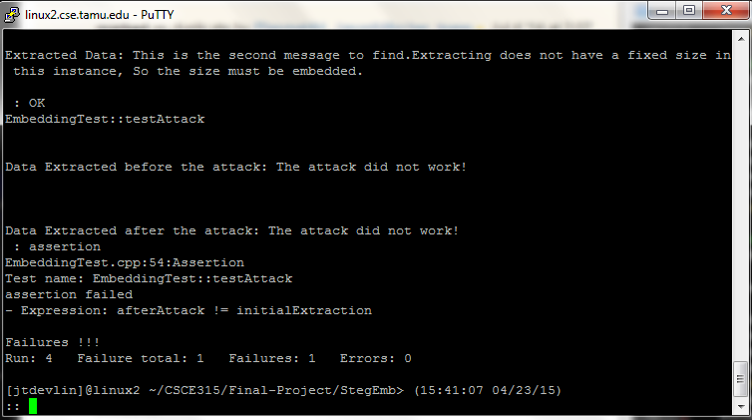
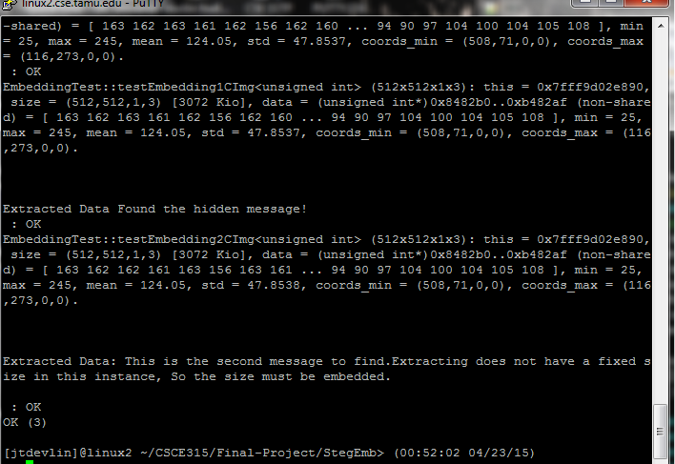
Test Driven Design

Slide 7
RSA- Generating Primes and Keys

Slide 8
RSA- Encryption and Decryption

Slide 9
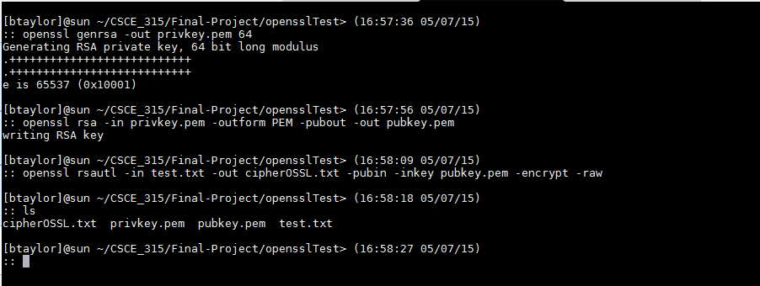
RSA- Verifying with openssl
To verify with openssl, we first generated keys.
In this case, we will use 64 bit keys and encrypt the message, “Message” contained in text.txt.

Slide 10
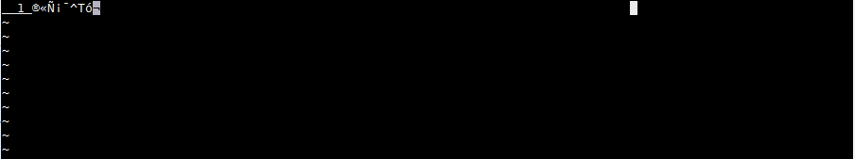
RSA- Verifying with openssl
Below, we also show the generated cipher text.

Slide 11
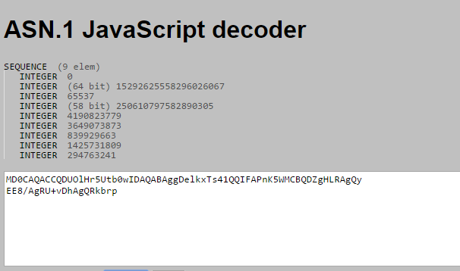
RSA- Verifying with openssl
Next, we extracted the generated p and q and e from the private key.

Slide 12
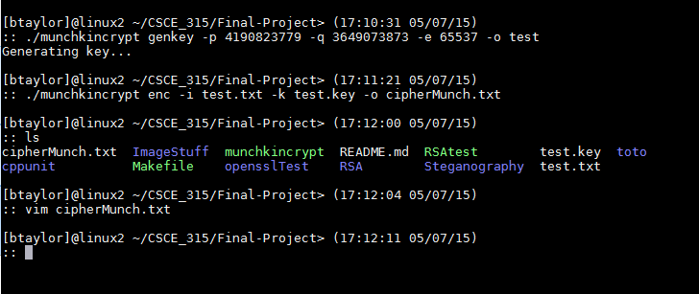
RSA- Verifying with openssl
After this, we generated a our key file from these primes and encrypted the message with munchkincrypt.

Slide 13

RSA- Verifying with openssl
We show our cipher text
We also show OpenSSL cipher text again

Slide 14
RSA- Verifying with openssl
The reason that the two do not match has to do with how the values are stored.
Our program breaks the message into blocks and writes these blocks to the file in decimal form.
It also stores the message in reverse. It starts by encoding the last character and works back from there.
On the other hand, OpenSSL wrote the modified binary data directly to a file, thus we could not directly compare the two.
The implementation is still shown to be correct when they decrypt to the same value.

Slide 15
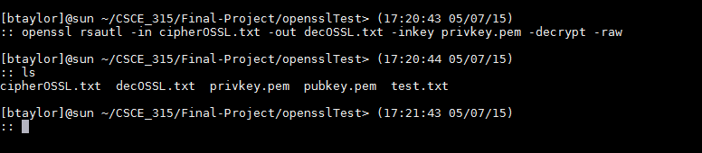
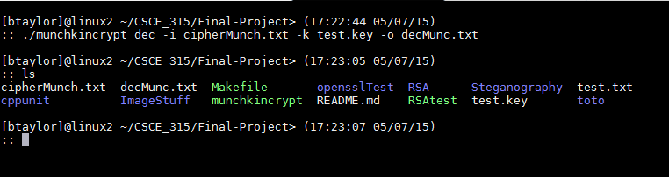
RSA- Verifying with openssl
Next we decrypt both of the cipher texts with their respective programs.
OpenSSL
Munchkincrypt

Slide 16
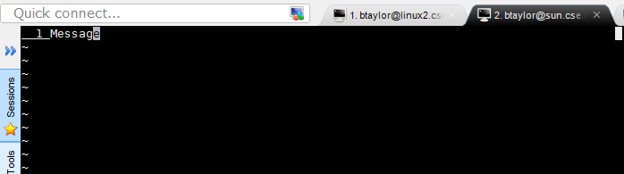
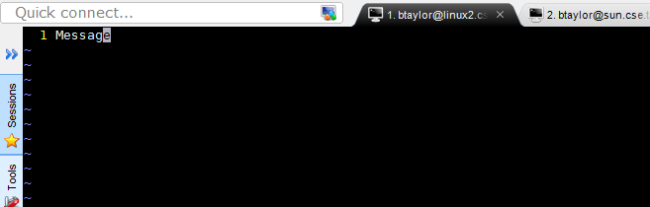
RSA- Verifying with openssl
The decrypted version of each file is shown below.
OpenSSL
Munchkincrypt

Slide 17
RSA- Verifying with openssl
In this case, both of the decrypted files indeed match.
This is because both programs decrypt the message into its original, plaintext state and write this directly to the decrypted file.
Because of this, OpenSSL verifies that our munchkincrypt program works correctly.

Slide 18
RSA- Attacks
Brute Force: Guessing p or q by iterating through all primes up to n.
Handy for any n that is not overly large (512 bits plus)
Fermat: Factors p and q by checking for perfect squares associated with n.
Handy for when p and q are near each other
Pollards p-1: Factors p by checking when it has a gcd with n, accelerated with the use of a quickly expanding modexp.
Handy for when p is not overly large

Slide 19
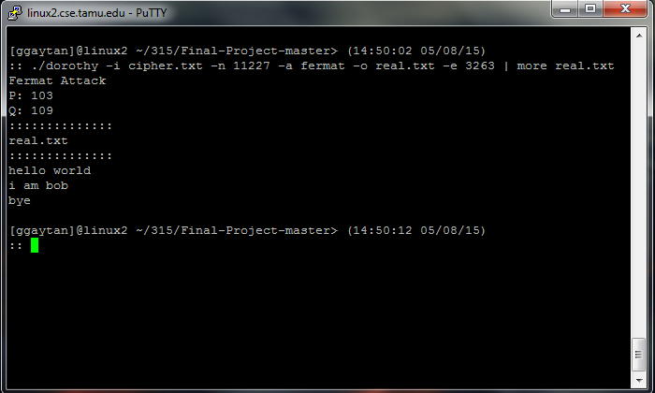
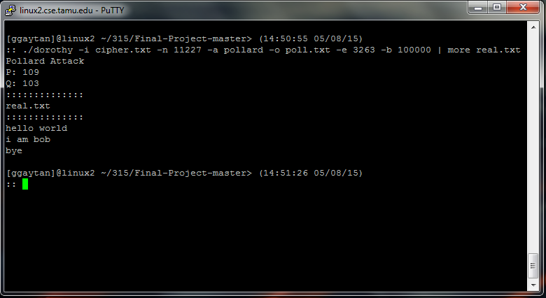
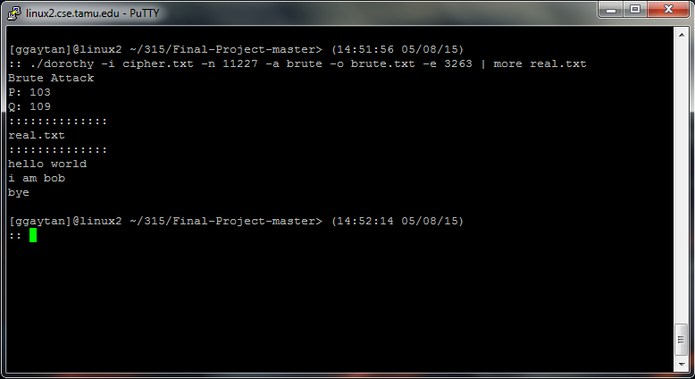
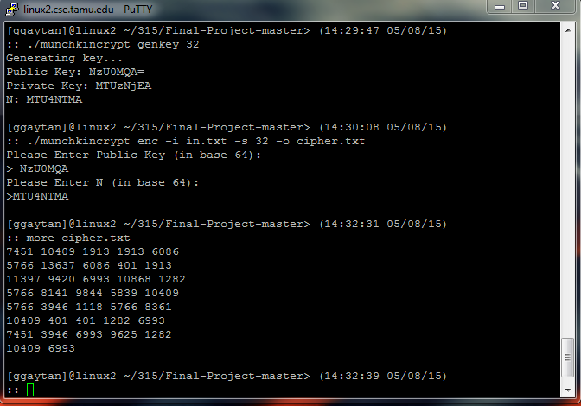
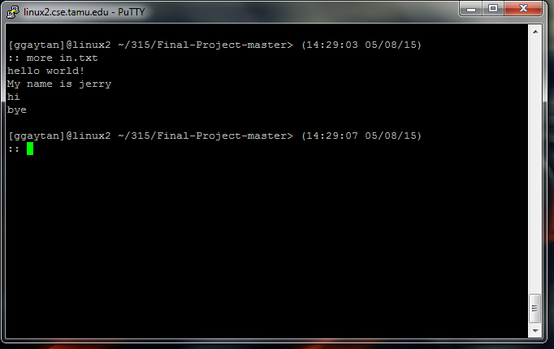
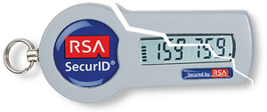
RSA- Attacks

Slide 20
RSA Tests

Slide 21
RSA Attack Tests
Fermat_test: Test if Fermat attack is working
Pollards_test: Test if Pollards attack is working
Brute_force_test: Test if the brute force attack is working correctly

Slide 22
References to libraries/papers
Libraries
https://mattmccutchen.net/bigint/
RSA
https://www.cs.purdue.edu/homes/ssw/cs555/2009f.pdf
http://www.ams.org/notices/199902/boneh.pdf
http://www.cs.rit.edu/~ib/Classes/CS482-705_Winter10-11/Slides/crypto_6d.pdf

