Slide 1
Cryptography and Steganography Team: What It Does?
Jason Devlin, Jaiden Gerig, Cody Taylor, Brennen Taylor, George Gaytan, Andrew Schlotzhauer

Slide 2
LSB Embedding
Turn message into 8 bit binary characters.
First value embedded is a twelve bit binary number that represents the number of characters in the message
Each number of the 8 bit binary characters is embedded into LSBs of image.
Embedded picture saved to “NothingToSeeHere.bmp”
Command line argument:
- ./toto –lsbem filename.bmp

Slide 3
LSB Extracting
First value extracted is the number of characters in the message
Once size is known, message is extracted in binary format, converted to characters and displayed in the terminal
Command line argument:
./toto –lsbex filename.bmp

Slide 4
Randomization Attack
Randomly selects 0 or 1
If the current LSB does not match the randomly selected value, it is changed
Command line argument:
./toto –osfa fileName.bmp

Slide 5
Detection Attack
Command line argument:
./toto –ossa filename1.bmp filename2.bmp
or ./toto –ossa MD5val filename2.bmp

Slide 6
Tests
Test 1: Message embedded and extracted correctly with fixed size?
Test2: Size embedded correctly?
Test3: Message embedded and extracted correctly using size embedded?
Test4: Message is not the same as before the attack?

Slide 7
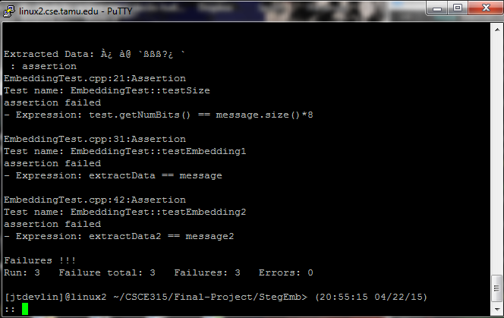
Initial Failures

Slide 8
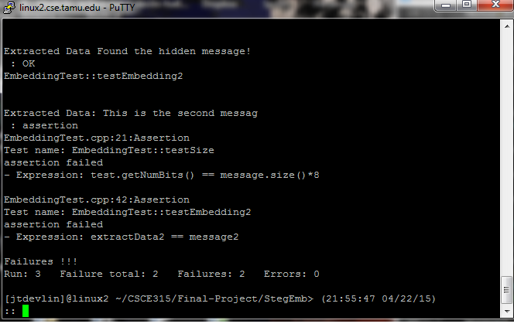
Test 1 success

Slide 9
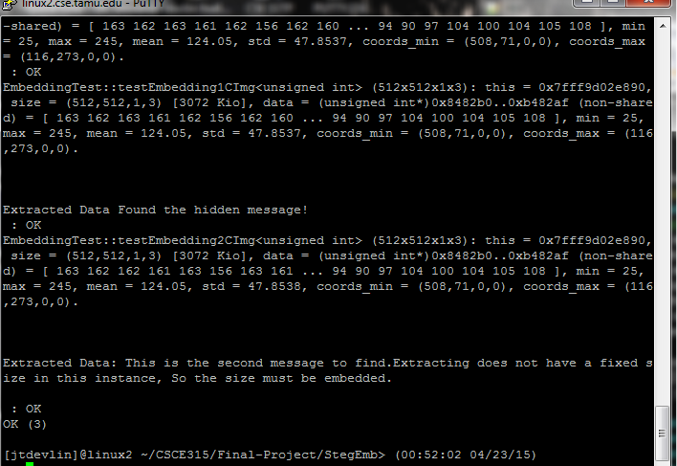
Test 2 and 3 success

Slide 10
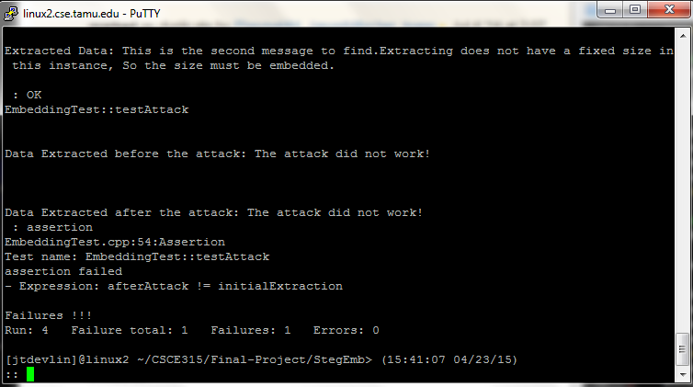
Test attack 1 failure

Slide 11
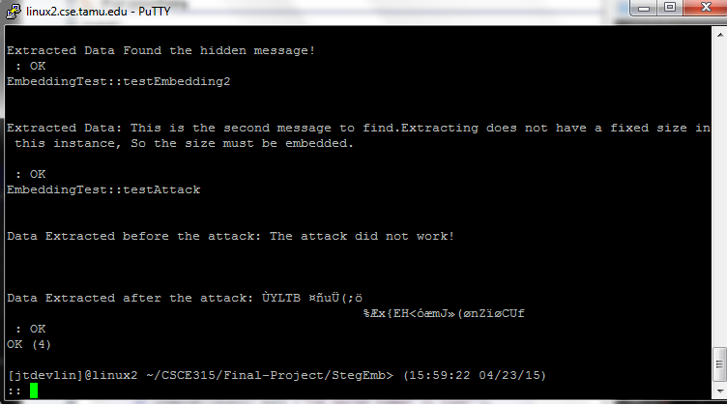
Test attack 1 success
Notes:
<number>

Slide 12
RSA- Generating Primes and Keys

Slide 13
RSA- Encryption and Decryption

Slide 14
RSA- Verifying with openssl

Slide 15
RSA- Attacks
Brute Force: Guessing p or q by iterating through all primes up to n.
Handy for any n that is not overly large (512 bits plus)
Fermat: Factors p and q by checking for perfect squares associated with n.
Handy for when p and q are near each other
Pollards p-1: Factors p by checking when it has a gcd with n, accelerated with the use of a quickly expanding modexp.
Handy for when p is not overly large

Slide 16
References to libraries/papers
Libraries
https://mattmccutchen.net/bigint/
RSA
https://www.cs.purdue.edu/homes/ssw/cs555/2009f.pdf
http://www.ams.org/notices/199902/boneh.pdf
http://www.cs.rit.edu/~ib/Classes/CS482-705_Winter10-11/Slides/crypto_6d.pdf

