Slide 1
Music database system
Jaiditya beeraka (21csb0b23)
Jaswanth yerramsetti (21csb0b68)

Slide 2
CONTENTS
PROBLEM STATEMENT
ER DIAGRAM
RELATIONAL SCHEMA
ASSUMPTIONS
ENTITIES AND RELATIONSHIPS
NORMALIZATION
TABLES
QUERIES

Slide 3
PROBLEM STATEMENT
Music plays an important role in this era of busy society. So, we choose to make a Database management project on Music.
A Music Database contains information about music albums and songs played by the users. This includes information about Songs and albums i.e, which album it is from, Singers and composers, Genres of the songs and Release date. This Database also includes data about Most played songs. We would also like to classify songs according to their release times as old and new songs. This kind of classification in database helps users to find their favorite songs in less time.

Slide 4
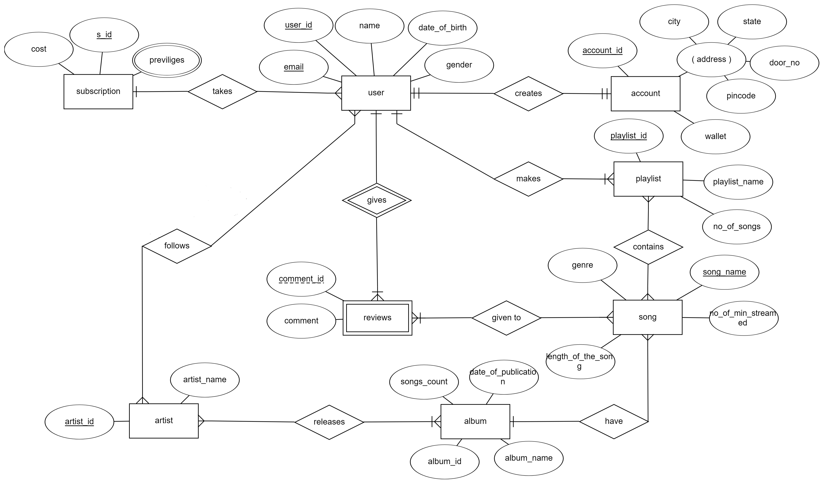
Er - diagram

Slide 5
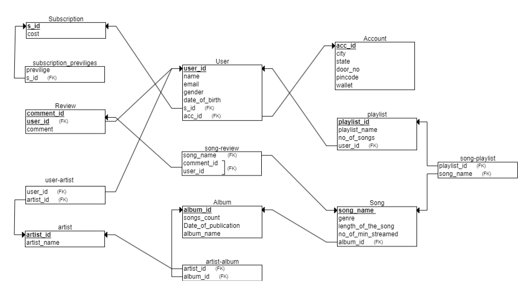
RELATIONAL SCHEMA

Slide 6
ASSUMPTIONS
We assumed that one user has one account.
We assumed that one user can have only one subscription but one subscription can be taken by many users.
We assumed that one user can give any number of comments to a song but one comment can be given by single user.
We assumed that one user can follow any number of artists and an artist can have any number of followers(users).
We assumed that any number of reviews can be given to any number of songs.
We assumed that a song can be in any number of playlists created by user and a playlist can have any number of songs.
We assumed that a user can create any number of playlists but a playlist must be created by a single user.
We assumed that an album can have any number of songs but a song must belong to single album.
We assumed that an album can be sung by any number of artists and an artist can sing in many albums.

Slide 7
Entities and relationships
User :
This entity represents a user who was browsing the database
This entity has user_id, name, date_of_birth, gender, email attributes.
user_id is the primary key.
Account :
Users creates an account to buy a subscription.
This entity has account_id, wallet, address(composite attribute) attributes.
account_id is the primary key.
It is in ‘creates’ relationship with User entity.

Slide 8
Entities and relationships
Subscription:
This entity specifies about the subscription bought by user using account.
This entity has cost, s_id, previliges attributes.
s_id is the primary key.
It is in ‘takes’ relationship with User.
Reviews:
This entity stores information about a review given by a user to a song.
It is a weak entity with comment_id and comment as attributes.
It is in ‘gives’ relationship with strong entity User to form primary key (user_id,comment_id).

Slide 9
Entities and relationships
Playlist:
This entity stores information of playlist created by a user.
It has playlist_id, playlist_name and no_of_songs as attributes.
Playlist_id is the primary key.
It is in ‘makes’ relationship with user.
Song:
This entity stores information of a song.
It has song_name, genre and no_of_min_streamed as attributes.
song_name is the primary key.
It is in ‘contains’ relationship with playlist and ‘given to’ relationship with review.

Slide 10
Entities and relationships
Album:
This entity stores information of song albums and songs in them.
It has songs_count, date_of_publication, album_name, album_id attributes.
album_id is the primary key.
It is in ‘have’ relationship with song.
Artist:
This entity stores information of the artist.
It has artist_name and artist_id attributes.
artist_id is the primary key.
It is in ‘releases’ relationship with album and ‘follows’ relationship with User.

Slide 11
NORMALIZATION
In our database model, All relations are in BCNF normal form. So, no normalization is required.

Slide 12
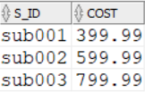
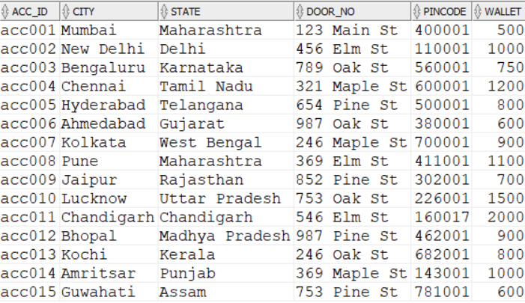
TABLES
SUBSCRIPTION
ACCOUNT

Slide 13
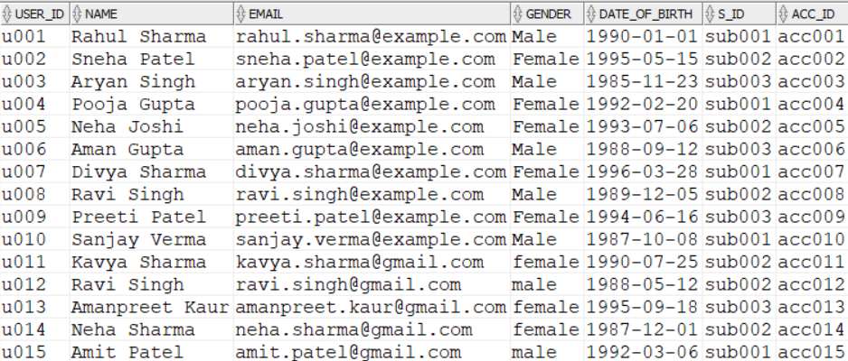
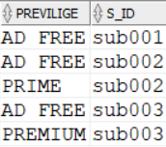
USER
SUBSCRIPTION-PREVILIGES

Slide 14
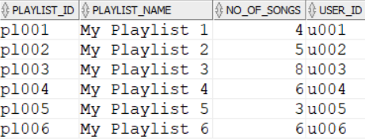
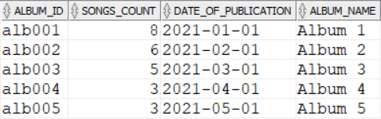
PLAYLIST
ALBUM

Slide 15
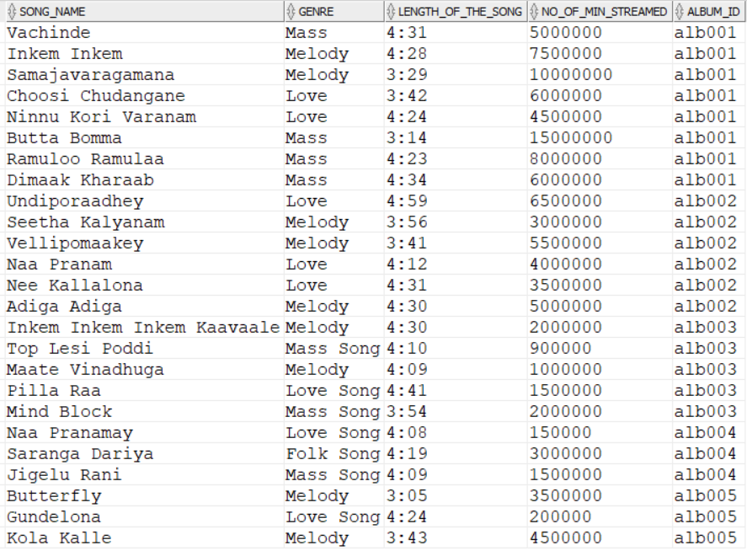
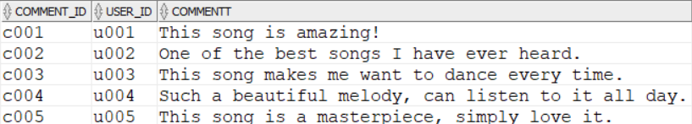
SONG
REVIEW

Slide 16
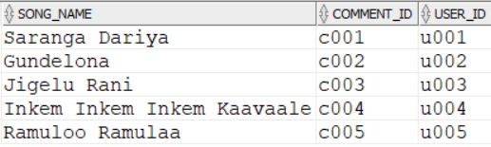
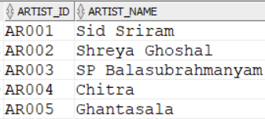
SONG-REVIEW
ARTIST

Slide 17
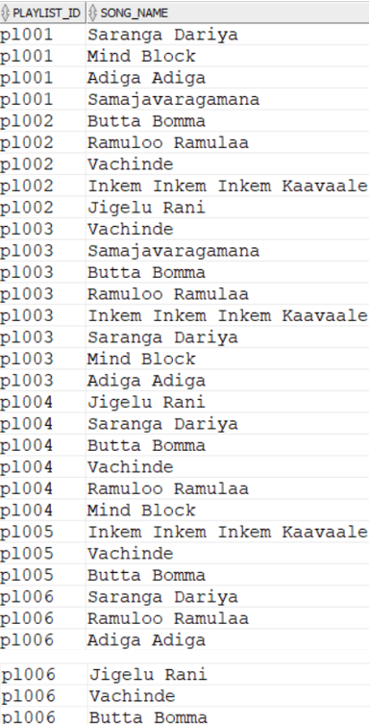
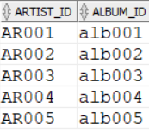
ARTIST-ALBUM
SONG-PLAYLIST

Slide 18
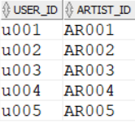
USER-ARTIST

Slide 19
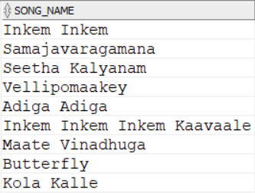
queries
Write an SQL query for finding all the songs of the genre MELODY.
QUERY :
SELECT SONG_NAME FROM SONG WHERE GENRE='Melody';

Slide 20
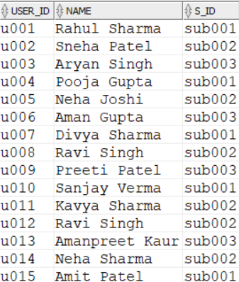
2. Write an SQL query for finding which user took what subscription.
QUERY :
SELECT USERR.USER_ID,USERR.NAME,SUBSCRIPTION.S_ID FROM
USERR JOIN SUBSCRIPTION ON USERR.S_ID=SUBSCRIPTION.S_ID;

Slide 21
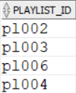
3. Write an SQL query for finding which playlists contains the song RAMULO RAMULA.
QUERY:
SELECT PLAYLIST_ID FROM SONG_PLAYLIST
WHERE SONG_NAME='Ramuloo Ramulaa'
GROUP BY PLAYLIST_ID HAVING COUNT(*)>=1;

Slide 22
4. Write an SQL query to find which users have written comments on the song INKEM INKEM INKEM KAVALI.
QUERY:
SELECT USERR.NAME,REVIEW.COMMENTT FROM SONG_REVIEW
JOIN REVIEW ON SONG_REVIEW.COMMENT_ID=REVIEW.COMMENT_ID
JOIN USERR ON REVIEW.USER_ID=USERR.USER_ID
WHERE SONG_NAME='Inkem Inkem Inkem Kaavaale';

Slide 23

5. Write an SQL query for finding the playlist with max no songs.
QUERY:
SELECT NO_OF_SONGS,PLAYLIST_NAME FROM PLAYLIST
ORDER BY NO_OF_SONGS DESC
OFFSET 0 ROWS FETCH NEXT 1 ROW ONLY;

Slide 24


