Slide 1
Digital Portfolio
STUDENT NAME: JAIGANESH P
REGISTER NO AND NMID: 20924Uu9073,astvu20924u09073
DEPARTMENT: BCA
COLLEGE: COLLEGE/ UNIVERSITY. Shanmuga industries arst & science college/Thiruvalluvar University

Slide 2
PROJECT TITLE
Digital portfolio for IT employe using html,css and javascript

Slide 3


AGENDA
Problem Statement
Project Overview
End Users
Tools and Technologies
Portfolio design and Layout
Features and Functionality
Results and Screenshots
Conclusion
Github Link
3/21/2024 Annual Review

Slide 4

PROBLEM STATEMENT
Current process is inefficient and time-consuming.
Lack of automation leads to errors and delays.
There is a need for a streamlined solution to improve accuracy and productivity.

Slide 5

PROJECT OVERVIEW
To develop an efficient and user-friendly solution.
To reduce manual effort and improve accuracy.
To enhance productivity through streamlined processes.

Slide 6

WHO ARE THE END USERS?
Employees who perform daily operational tasks.
Managers requiring accurate insights for decision-making.
Customers who benefit from improved service delivery.

Slide 7

TOOLS AND TECHNIQUES
Utilization of modern software platforms and frameworks.
Application of automation and data analysis methods.
Implementation of testing, monitoring, and feedback mechanisms.

Slide 8
POTFOLIO DESIGN AND LAYOUT
Clean, modern interface with consistent theme and colors.
Structured sections for About, Projects, and Contact.
Responsive layout optimized for both desktop and mobile.
8

Slide 9
FEATURES AND FUNCTIONALITY
Interactive navigation for seamless user experience.
Dynamic project showcase with visuals and descriptions.
Integrated contact options for quick communication.

Slide 10

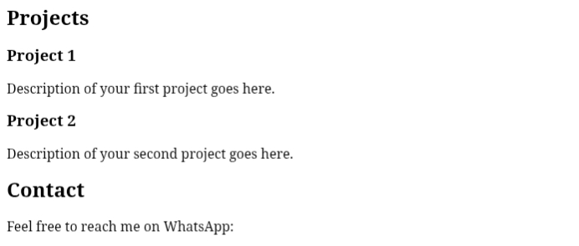
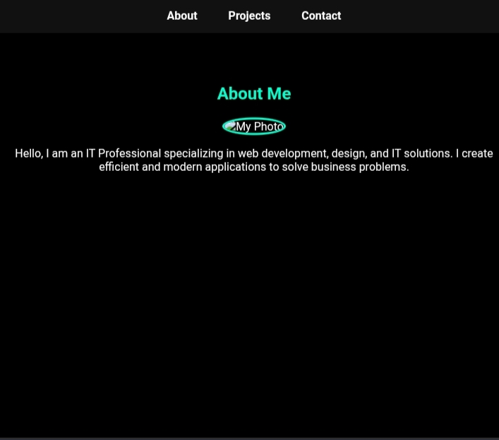
RESULTS AND SCREENSHOTS
Screenshot of each section.
Before VS After (plain HTML ->with css and javascript.
3/21/2024 Annual Review
10

Slide 11
CONCLUSION
Digital portfolio program halps users showcase their skills andProjects easily.
It improves career opportunities by providing a professional digital portfolio.
11

