Slide 1
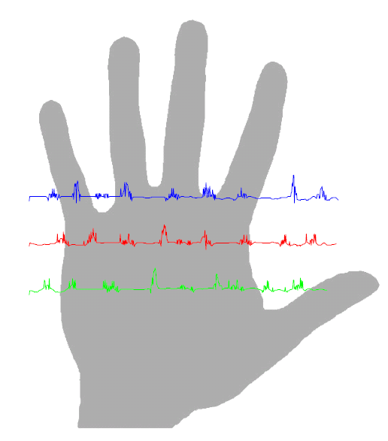
PalmPrint Identification System

Slide 2
CONTENTS
Biometrics
Which Biometric is the Best?
Recognition Flow Chart
Feature Extraction
Experiment & Results
Conclusion

Slide 3
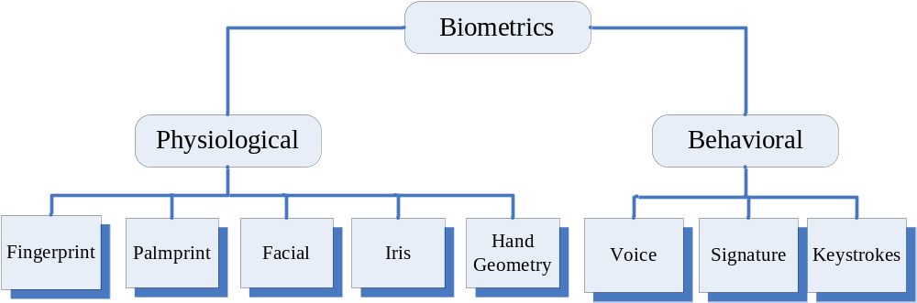
Biometric Recognition System
Biometrics :is the automated use of physiological or behavioral characteristics to determine or verify and identity a person
to determine or verify an identity

Slide 4
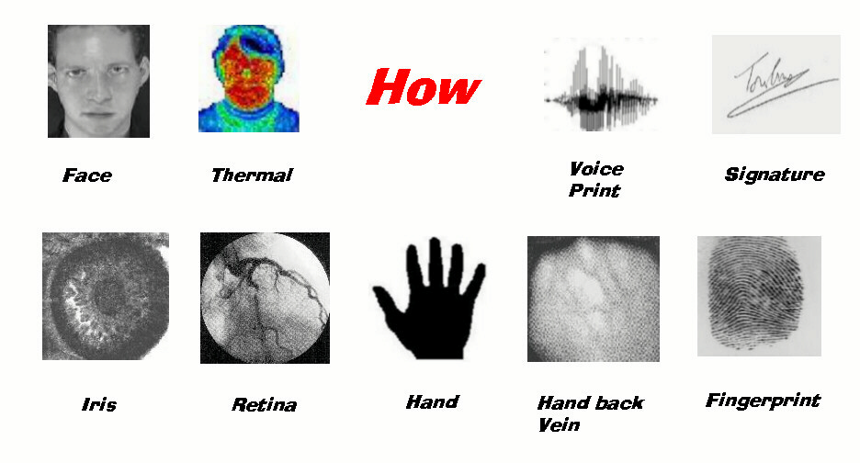
Biometrics Examples

Slide 5
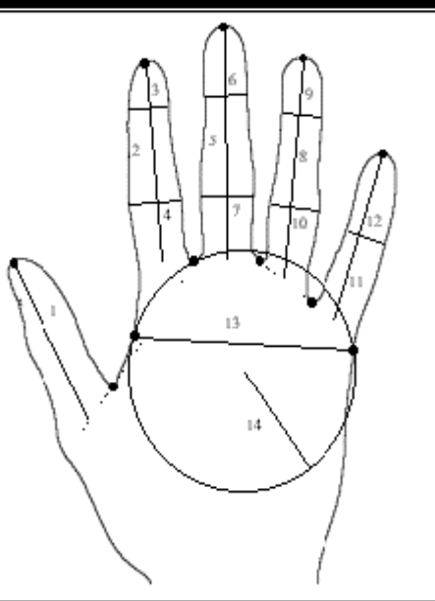
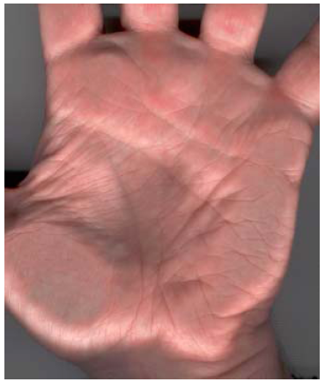
Hand and Palm Recognition
Features: dimensions and shape of the hand, fingers, (size and length)
Features: Palmprint focuses on the inner surface of a hand, its pattern of lines and the shape of its surface.

Slide 6
Which Biometric is the Best?
Why PalmPrint?
High Distinctiveness
High Permanence (duration)
High Performance
Medium Collectabillity
Medium Acceptability
Medium Universality
Medium Circumvention (fooling)

Slide 7
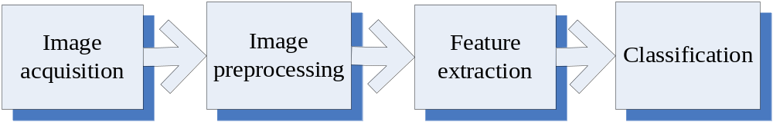
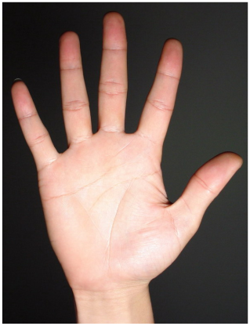
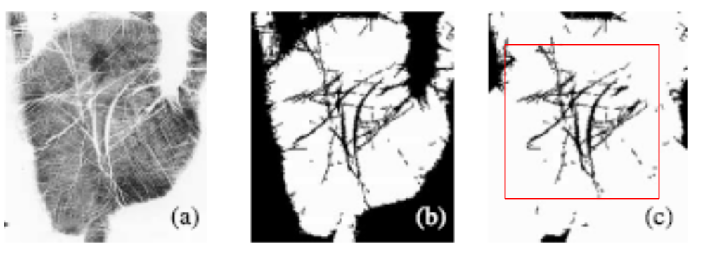
Palmprint Recognition Flowchart

Slide 8

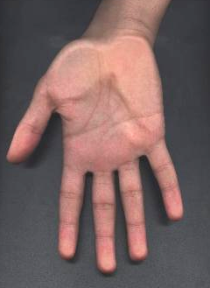
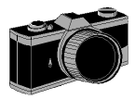
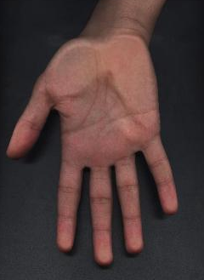
Image Acquisition
A scanner with high resolution
Degraded image
Original image

Slide 9
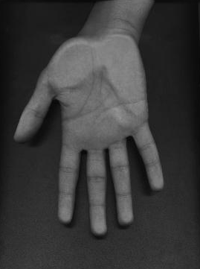
Preprocessing
Transforming image from RGB to Gray
Cut only the palm from the hand

Slide 10
Feature Extraction
EignPalm-based approach to extract the features of palmprint.
Find the eign-vectors that best account for the distribution of the palmprint image.
Eignvectors of the covariance matrix palmprint like in appearance, we refer to them as “EignPalms”.

Slide 11
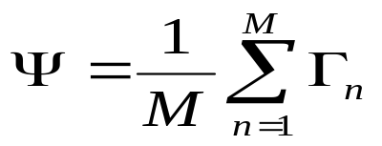
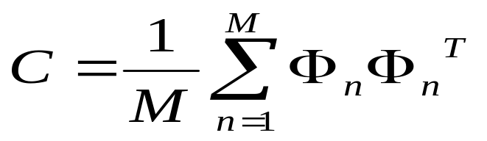

Feature Extraction
Mathematical Calculations:
Mean of training palmprints
Covariance matrix
Eigenvectors and eigenvalues

Slide 12
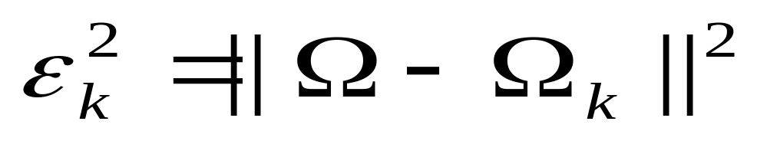

PalmPrint Matching
The Euclidian distance
Chosen threshold (Experimentally) :
Below : palmprint ‘classified’
otherwise :palmprint ‘unknown’
In Our Project : = 0.8

Slide 13
Experiment and Results
Steps:
1- a set of palm images of known persons
(5 images for each persons).
2- following the stages as in previous flow chart ( acquisition + pre-processing+ feature extraction)
3- using the matlab program developed of algebraic equations (EigenPalm method)
4- Testing

Slide 14
Testing The Program
Demo Show
Comments:
Threshold of 0.75 experminetlly
Recognition rate up to 90%
Good rate in recognition world !!

Slide 15
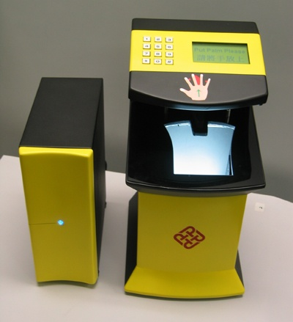
Commercial Application
Palmprint Identification System
( Polytechnic University)

Slide 16
CONCLUSION
Biometrics system
Different between PalmPrint &Hand
PalmPrint Recognition Flow Chart
Feature Extraction
Experiment & Results
Commercial Application

Slide 17
REFERENCES
[1] A. K. Jain, R. Bolle, and S. Pankanti, Biometrics: Personal Identification in Networked Society, Kulwer Academic, 1999.
[2]M.-H. Yang, D. J. Kriegman, and N. Ahuja, “Detecting faces in images: A Survey,” IEEE Trans. Patt. Anal. Machine Intell., vol. 24, pp. 34-58, Jan. 2002..
[6] J. You, W. Li, and D. Zhang, "Hierarchical palmprint identification via multiple feature extraction," Pattern Recognition., vol. 35, pp. 847-859, 2002.
[7] X. Wu, K. Wang, and D. Zhang, "Fuzzy directional energy element based palmprintidentification," Proc. ICPR-2002, Quebec City (Canada).
[8] W. Shu and D. Zhang, “Automated personal identification by palmprint,” Opt. Eng., vol. 37, no. 8, pp. 2359-2362, Aug. 1998.
[9]D. Zhang and W. Shu, “Two novel characteristics in palmprint verification: datum point invariance and line feature matching,” Pattern Recognition, vol. 32, no. 4, pp. 691-702, Apr. 1999.
[10] N. Duta, A. K. Jain, and Kanti V. Mardia, “Matching of palmprint,” Pattern Recognition. Lett., vol. 23, no. 4, pp. 477-485, Feb. 2002.

Slide 18

Thanks

