Slide 1
DATABASE MANAGEMENT SYSTEMS • PROJECT REVIEW 2
DESIGN AND IMPLEMENTATION OF A DATABASE MANAGEMENT SYSTEM FOR LIBRARY CIRCULATION AND DIGITAL RESOURCE MANAGEMENT
Focus: Conceptual E-R Modeling, Relational Schema Conversion, Normalization (1NF–3NF), Integrity Constraints & Schema DDL
Student: Jai Havish Sannapareddy | Roll No: 25WU0102103 | Program: AI/ML | Section: AI/ML RHINOS | Faculty: Miss Sahiti | 15/10/2026

Slide 2
DBMS PBL REVIEW
Project Evolution: Progress from Review 1 to Review 2
Review 1 Scope & Problem Definition• Problem Statement: Manual registers and isolated spreadsheets cause duplicate data, untracked book copies, lost fines, and zero visibility into queue waiting lists.
• Objectives Set: Design an integrated, centralized relational database to manage print books, digital resources, patrons, circulation, and fines.
• User Roles Identified: Librarians (daily operations), Admins (policies & reports), and Members (students, faculty, public).
• Initial Scope: High-level requirements gathering and initial feature specification.
Review 2 Deliverables Achieved• Comprehensive E-R Model: Identified 15 distinct entities, cardinalities, associative entities, and relationship attributes.
• 3-Tier Catalog Architecture: Split Book (title work), Edition (ISBN publication), and Copy (physical barcode/shelf item).
• Relational Mapping: Transformed conceptual ER model into normalized relational schemas with full foreign key constraints.
• Formal Normalization Proof: Verified progression through 1NF, 2NF, and 3NF/BCNF to prevent update, insertion, and deletion anomalies.
• MySQL 8.0 DDL Scripts: Implemented 01_schema.sql with primary keys, checks, enums, cascades, and indexes.
Library Circulation & Digital Resource Management System | DBMS PBL | REVIEW 2

Slide 3
DBMS PBL REVIEW
System Requirements & Circulation Rules Specification
1. Functional Scope• Catalog Control: Manage books, editions, authors, publishers, and categories.
• Copy Tracking: Unique accession numbers per physical copy with real-time status.
• Circulation: Issue, return, and loan renewal operations.
• Hold Queue: Ordered waitlist reservations for out-of-stock titles.
• Fines & Audits: Overdue fee calculation and payment tracking.
• Digital Assets: E-books, journals, and patron access duration logging.
2. Tiered Policy Table• Student Policy: Max 3 books concurrently | 14-day loan period | ₹2.00 / late day fine.
• Faculty Policy: Max 6 books concurrently | 30-day loan period | ₹1.00 / late day fine.
• Public Policy: Max 2 books concurrently | 7-day loan period | ₹5.00 / late day fine.
• Separation Rationale: Rules live in `member_policy` table so admins adjust loan rules dynamically without modifying codebase.
3. Integrity Constraints• ₹50 Fine Lock Rule: A patron with > ₹50 in unpaid fines cannot borrow any new books.
• 1 Active Issue / Copy: A physical copy cannot be issued if status is already ISSUED or ON_HOLD.
• Reservation Trigger: A reservation can only be placed when 100% of physical copies are checked out.
• FIFO Hold Transition: Returned books automatically assign to next WAITING reservation and shift to READY.
Library Circulation & Digital Resource Management System | DBMS PBL | REVIEW 2

Slide 4
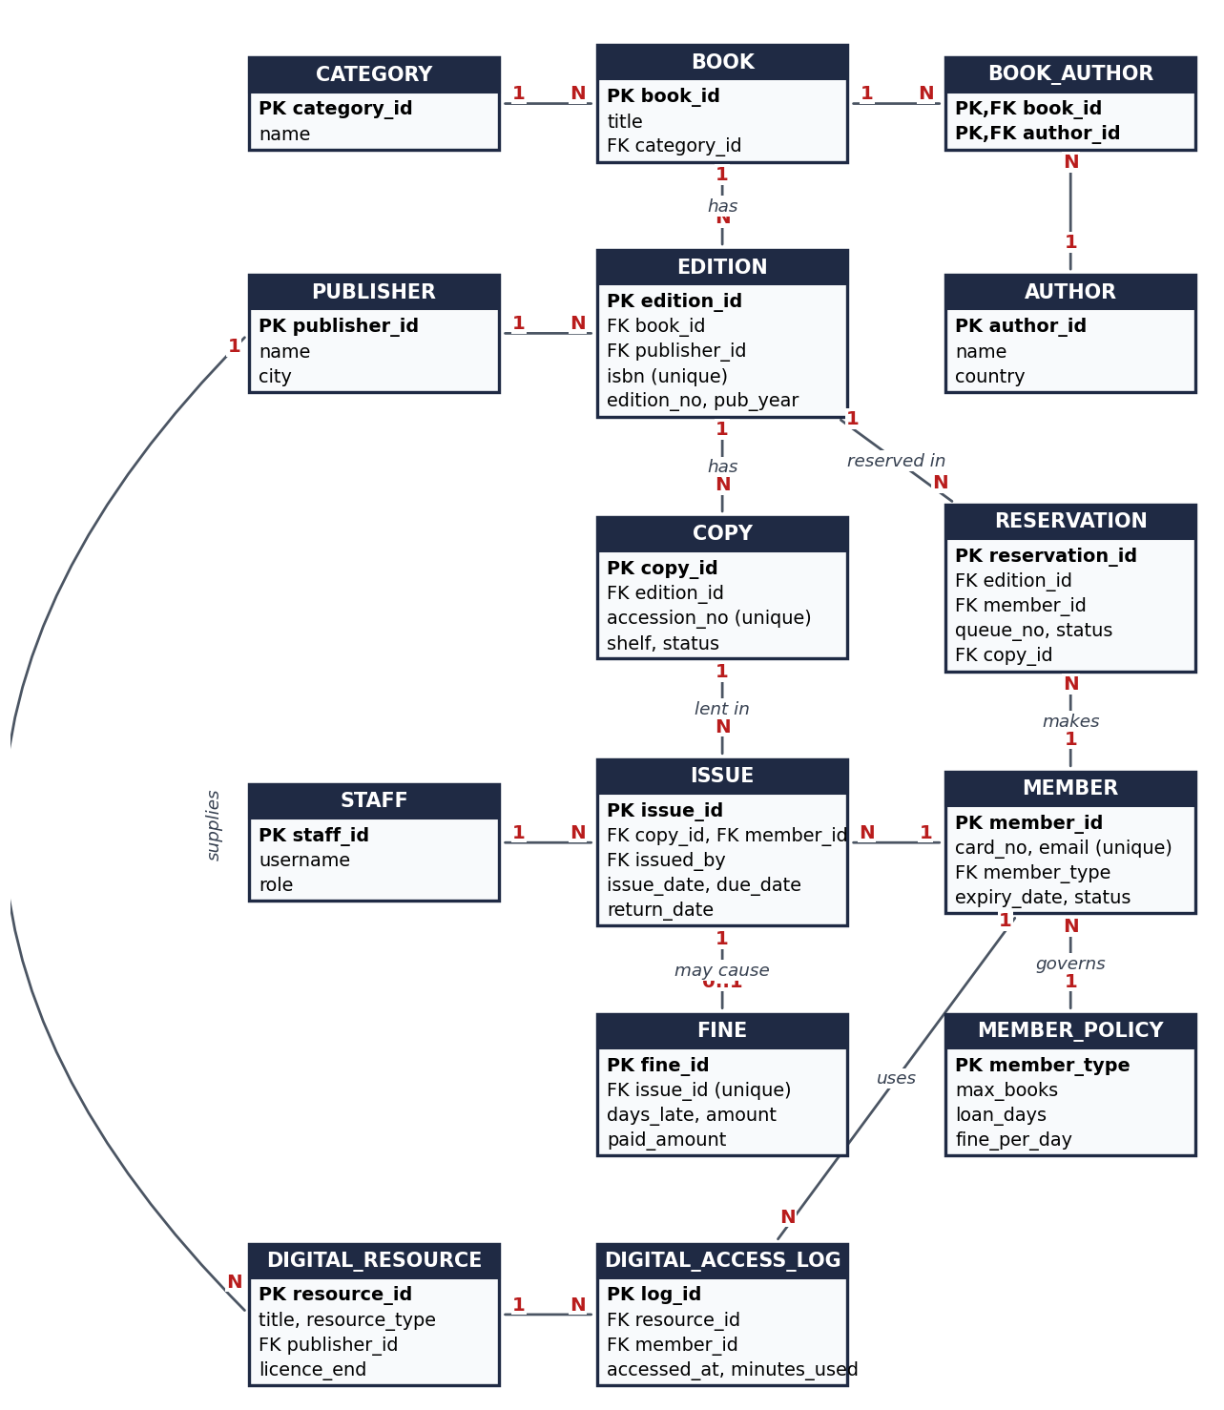
DBMS PBL REVIEW
Conceptual Design: Entity-Relationship (ER) Architecture
Core Entities & Relationship Mappings• Publisher (1) ──< (N) Edition: A publisher produces many published book editions.
• Book (N) >──< (M) Author: Many-to-many relationship resolved using `book_author` bridge table.
• Book (1) ──< (N) Edition: One master title work has multiple physical published editions.
• Edition (1) ──< (N) Copy: One edition has multiple physical inventory copies on library shelves.
• Copy (1) ──< (N) Issue: A copy appears in loan history; only one active issue at a time.
• Member (1) ──< (N) Issue: Patrons borrow books governed by their linked `member_policy`.
• Issue (1) ──< (0..1) Fine: Late returned books generate at most one fine record.
• Edition (1) ──< (N) Reservation: Waitlist entries queue members for checked-out editions.
Library Circulation & Digital Resource Management System | DBMS PBL | REVIEW 2

Slide 5
DBMS PBL REVIEW
Key Structural Decision: The 3-Tier Catalog Model
Tier 1: BOOK (The Work)• Concept: Represents the intellectual literary work regardless of publication format.
• Attributes: `book_id` (PK), `title`, `category_id` (FK).
• Example: 'Database System Concepts'
• Advantage: Title name, authors, and classification are defined exactly once. No duplication when multiple editions are purchased.
Tier 2: EDITION (Publication)• Concept: Represents a specific release from a publisher with page count and year.
• Attributes: `edition_id` (PK), `book_id` (FK), `publisher_id` (FK), `isbn` (UNIQUE 13-digit), `edition_no`, `pub_year`, `pages`.
• Example: 7th Edition, McGraw-Hill, 2019, ISBN: 9780078022159.
• Advantage: Strictly separates publication metadata from physical items.
Tier 3: COPY (Inventory)• Concept: Represents a specific physical book sitting on the library shelf.
• Attributes: `copy_id` (PK), `edition_id` (FK), `accession_no` (UNIQUE barcode), `shelf`, `status` (AVAILABLE, ISSUED, ON_HOLD, WITHDRAWN).
• Example: Barcode `ACC-CS-001` on shelf `CS-A1-01`.
• Advantage: Enables accurate per-item circulation history and real-time availability tracking.
Library Circulation & Digital Resource Management System | DBMS PBL | REVIEW 2

Slide 6
DBMS PBL REVIEW
Database Normalization: 1NF to 3NF / BCNF Analysis
Step-by-Step Normalization Breakdown• First Normal Form (1NF) Compliance: All attributes contain atomic values. Multi-valued fields (e.g. multiple authors for a book) are eliminated by introducing the associative table `book_author(book_id, author_id)`. ISBNs, phone numbers, and dates are stored in singular standardized columns.
• Second Normal Form (2NF) Compliance: All non-prime attributes are fully functionally dependent on the primary key. In composite primary key tables (like `book_author`), no non-key attribute depends on just a subset of the primary key. Author details live in `author`, title details live in `book`.
• Third Normal Form (3NF) Compliance: Elimination of transitive functional dependencies ($X \rightarrow Y, Y \rightarrow Z$). Example: A member's borrow limit and daily fine rate depend strictly on `member_type`, not `member_id`. Moving `(member_type, max_books, loan_days, fine_per_day)` into `member_policy` ensures that policy changes do not cause update anomalies across thousands of member rows.
• Boyce-Codd Normal Form (BCNF): Every determinant in every relation is a candidate key. All functional dependencies $X \rightarrow Y$ satisfy the condition that $X$ is a superkey.
Library Circulation & Digital Resource Management System | DBMS PBL | REVIEW 2

Slide 7
DBMS PBL REVIEW
Relational Schema Specification & Integrity Constraints
Relational Table Catalog (15 Tables)• Master Entities: `publisher`, `author`, `category`, `staff`, `member_policy`
• Catalog Schema: `book`, `book_author`, `edition`, `copy`
• Circulation Schema: `member`, `issue`, `fine`, `reservation`
• Digital Resource Schema: `digital_resource`, `digital_access_log`
• Primary Key Policy: Auto-increment synthetic integers for internal joins; natural UNIQUE candidate keys for domain identifiers (`isbn`, `accession_no`, `card_no`).
Enforced Database Constraints• Domain Constraints: CHECK (`max_books` > 0), CHECK (`loan_days` > 0), CHECK (`fine_per_day` >= 0), CHECK (`days_late` >= 0).
• Enum Constraints: `role` ENUM('LIBRARIAN', 'ADMIN'); `status` ENUM('AVAILABLE', 'ISSUED', 'ON_HOLD', 'LOST', 'WITHDRAWN'); `member_type` ENUM('STUDENT', 'FACULTY', 'PUBLIC').
• Referential Integrity: Foreign key cascades on book deletion (`ON DELETE CASCADE`), while restricting deletion of copies currently out on loan (`RESTRICT`).
• Uniqueness: Enforced unique ISBN-13, barcode accession numbers, member card numbers, and staff usernames.
Library Circulation & Digital Resource Management System | DBMS PBL | REVIEW 2

Slide 8
DBMS PBL REVIEW
Database Implementation: Schema DDL (`01_schema.sql`)
DDL Implementation Highlights in MySQL 8.0• Engine & Character Set: Configured all tables using MySQL `InnoDB` engine for robust ACID transaction support, foreign key constraints, and crash recovery. Default charset `utf8mb4` with `utf8mb4_unicode_ci` collation.
• CHECK Constraint Enforcement: Leveraged MySQL 8.0.16+ native CHECK constraint enforcement to ensure monetary fine amounts, days overdue, and book allocations never accept negative or invalid values.
• Temporal Tracking: `issue_date`, `due_date`, `return_date`, and `assessed_on` typed as DATE/DATETIME with DEFAULT `CURRENT_TIMESTAMP` for reliable circulation auditing.
• Indexing Strategy: Primary keys indexed automatically; added secondary indexes on `member.card_no`, `copy.accession_no`, `edition.isbn`, and `issue.return_date` to accelerate high-frequency circulation queries.
Library Circulation & Digital Resource Management System | DBMS PBL | REVIEW 2

Slide 9
DBMS PBL REVIEW
Summary of Review 2 & Roadmap to Final Review 3
Review 2 Deliverables Complete• Conceptual ER Model: Complete entity identification & relationship cardinality defined.
• 3-Tier Normalization: Separated Book, Edition, Copy; normalized to 3NF/BCNF.
• Relational Schema: Full 15-table relational design with primary and foreign keys.
• Integrity Architecture: CHECK constraints, ENUM validations, and uniqueness rules.
• MySQL DDL Generation: `01_schema.sql` scripted, verified, and executed in MySQL 8.0.
Target Roadmap for Review 3• Data Seeding: Populate database with comprehensive realistic test data (`02_sample_data.sql`).
• SQL Views & Queries: Create operational views and analytical queries (joins, aggregations, window functions).
• Transaction Management: Implement atomic transaction engine with pessimistic locking in Python (`library.py`).
• Dual User Interface: Build full desktop GUI (Tkinter) and modern Web Application (Flask + Tailwind).
• Systematic Testing: Complete unit and integration test suite (`test_library.py`).
Library Circulation & Digital Resource Management System | DBMS PBL | REVIEW 2

