Slide 1
DATABASE MANAGEMENT SYSTEMS • FINAL PROJECT REVIEW 3
DESIGN AND IMPLEMENTATION OF A DATABASE MANAGEMENT SYSTEM FOR LIBRARY CIRCULATION AND DIGITAL RESOURCE MANAGEMENT
Final Phase: Advanced SQL Queries, Analytical Views, ACID Transactions, Dual Front-End (Web & Desktop), Systematic Testing & Deployment
Student: Jai Havish Sannapareddy | Roll No: 25WU0102103 | Program: AI/ML | Section: AI/ML RHINOS | Faculty: Miss Sahiti | 15/10/2026

Slide 2
DBMS PBL REVIEW 3
Implementation Journey: Progress from Review 2 to Review 3
State at Review 2 (Design Phase)• Conceptual ER Model: Entity-Relationship diagram completed with relationships and cardinalities.
• Normalized Relational Schema: 15 tables normalized up to 3NF/BCNF.
• DDL Scripts Created: `01_schema.sql` written with primary, foreign keys and check constraints.
• Limitation: Database was empty; no circulation queries, views, transactions, or user applications existed yet.
Implemented in Review 3 (Final Phase)• Comprehensive Data Population: `02_sample_data.sql` with realistic books, members, issues, fines, and digital logs.
• Pre-compiled SQL Views: 6 operational views created (`03_views.sql`) including window functions.
• Complex SQL Queries: 10 benchmark queries (`04_queries.sql`) covering multi-joins, aggregates, and subqueries.
• ACID Transaction Engine: Python business layer (`library.py`) with atomic transactions and pessimistic locking.
• Dual Interface Applications: Built both a desktop GUI (`app.py`) and a modern web application (`web_app.py`).
• Systematic Unit Testing: Automated test suite (`test_library.py`) verifying all business rules.
Library Circulation & Digital Resource Management System | DBMS PBL | REVIEW 3

Slide 3
DBMS PBL REVIEW 3
Database Population & Realism (`02_sample_data.sql`)
Realistic Seed Dataset Overview• Diverse Book Catalogue: Populated with real-world computer science, mathematics, physics, and literature textbooks (e.g. Silberschatz Database Concepts, Cormen Algorithms, Rosen Discrete Mathematics) across diverse publishers (MIT Press, McGraw-Hill, Wiley, Prentice Hall).
• Multi-Tier Member Base: Registered Student, Faculty, and Public patrons with valid card numbers, emails, and phone numbers.
• Varied Circulation States: Created active loans on shelf copies, on-time returned books, and realistic overdue loans to evaluate penalty calculations.
• Fine Accrual Records: Populated both settled and outstanding fine records with exact days overdue and fine assessments.
• Hold Reservation Queues: Simulated high-demand titles with patrons waiting in ordered queue positions (`WAITING` and `READY`).
• Digital Resource Logs: Recorded patron access sessions on online learning platforms (ACM Digital Library, O'Reilly, MIT OCW).
Library Circulation & Digital Resource Management System | DBMS PBL | REVIEW 3

Slide 4
DBMS PBL REVIEW 3
Advanced SQL Query Implementation (`04_queries.sql`)
Joins & Aggregate Evaluations• Multi-Table Relational Joins: 5-table join combining `book`, `edition`, `publisher`, `book_author`, and `author` with `GROUP_CONCAT` to aggregate multi-author names.
• Aggregations with GROUP BY & HAVING: Query Q8 groups issues by member and uses `HAVING COUNT(*) >= 3` to isolate frequent borrowers.
• Category Volume Aggregates: Query Q9 groups categories with `LEFT JOIN` and computes distinct titles and total physical copies.
Nested Queries & Subqueries• Nested NOT IN Subquery: Query Q10 isolates dead inventory—books that have never been issued—by nesting a subquery selecting issued copy IDs.
• Dynamic Search Subquery: Query Q3 powers catalog search matching titles, author names, categories, or ISBNs simultaneously.
• Fine Accrual Calculations: Calculates live fines by combining `DATEDIFF(CURDATE(), i.due_date)` with dynamic member policy rates.
Library Circulation & Digital Resource Management System | DBMS PBL | REVIEW 3

Slide 5
DBMS PBL REVIEW 3
Analytical Database Views (`03_views.sql`)
Pre-Compiled Views for Data Abstraction & Real-Time Reporting• v_available_titles: Real-time list of titles with at least one physical copy on the shelf (`status = 'AVAILABLE'`), with distinct authors concatenated.
• v_overdue_copies: Joins `issue`, `copy`, and `member` with `DATEDIFF` to compute exact overdue days and accrued fines per borrower.
• v_member_history: Complete historical loan audit per member showing issue date, due date, return date, loan status, and paid fines.
• v_popular_books: Aggregates circulation counts by book to highlight high-demand textbooks and reading materials.
• v_reservation_queue: Uses the SQL Window Function `ROW_NUMBER() OVER (PARTITION BY edition_id ORDER BY queue_no)` to present live queue positions.
• v_fine_summary: Monthly revenue reporting aggregating fines assessed, total collected, and still pending.
Library Circulation & Digital Resource Management System | DBMS PBL | REVIEW 3

Slide 6
DBMS PBL REVIEW 3
Transaction Management & Concurrency Control
ACID Properties Implementation• Atomicity: All multi-table mutations (e.g. issuing a book updates `copy.status`, inserts `issue`, and updates `reservation`) run inside a Python transaction context manager (`tx()`). If any step errors, the entire block rolls back.
• Consistency: Foreign keys and CHECK constraints prevent corrupt states; borrow limit and fine lock validations precede any write.
• Isolation: Transactions prevent dirty and non-repeatable reads using MySQL InnoDB default REPEATABLE READ isolation.
• Durability: Committed transactions persist to disk via MySQL write-ahead redo logs.
Pessimistic Concurrency Locking• SELECT ... FOR UPDATE: Used during issue, return, and reservation operations. Locks the target `copy` and `member` rows to prevent race conditions when two librarians attempt to issue the same book simultaneously.
• Queue Number Serialization: Locks the edition reservation rows to guarantee sequential, un-duplicated `queue_no` assignment during concurrent reservation requests.
• Automatic Rollbacks: Handles integrity errors and custom `LibraryError` exceptions gracefully, reporting clean feedback to users.
Library Circulation & Digital Resource Management System | DBMS PBL | REVIEW 3

Slide 7
DBMS PBL REVIEW 3
Business Logic & Circulation Engine (`library.py`)
Python Business Layer Architecture• Shared Codebase: `app/library.py` contains all circulation logic, shared identically across the desktop GUI (`app.py`), the web app (`web_app.py`), and the automated test suite (`tests/test_library.py`).
• Input Validation Engine: Custom regex sanitization: `check_isbn` verifies strict 13-digit format; `check_email` verifies valid email syntax; `check_phone` enforces 10 digits.
• ₹50 Fine Lock Enforcement: Queries outstanding unpaid fines for the borrower; blocks book checkouts if debt exceeds ₹50.00.
• Book Return & Dynamic Fine Calculation: Computes `(today - due_date)` in days and multiplies by `fine_per_day` for that borrower's tier; inserts a `fine` record only if overdue.
• FIFO Hold Queue Transition: When a book is returned, `_free_copy()` checks for WAITING reservations. If found, the copy is reserved as `ON_HOLD` and reservation status becomes `READY`.
Library Circulation & Digital Resource Management System | DBMS PBL | REVIEW 3

Slide 8
DBMS PBL REVIEW 3
Front-End Applications: Desktop GUI & Web Interface
1. Desktop GUI (`app/app.py`)• Framework: Python Tkinter with custom `ttk` styling (`clam` engine).
• Design System: Deep navy header, card-based layout, Segoe UI typography.
• Key Screens: Dashboard overview, Catalogue search & copy adder, Circulation issue/return, Member directory, Reservations queue, Fines ledger, Reports exporter.
• Best For: Librarian desktop workstations with local peripheral barcode scanners.
2. Modern Web App (`web_app.py`)• Stack: Python Flask REST API + HTML5 / Tailwind CSS + Chart.js.
• Design System: Modern SaaS responsive layout with real-time donut and bar charts.
• Interactive Features: Instant live search, animated toast alerts, interactive issue/return dropdowns, member history drawer, 1-click fine payments, and CSV export.
• Zero-Friction Fallback: Includes live MySQL connection modal AND zero-setup in-memory fallback demo mode.
Library Circulation & Digital Resource Management System | DBMS PBL | REVIEW 3

Slide 9
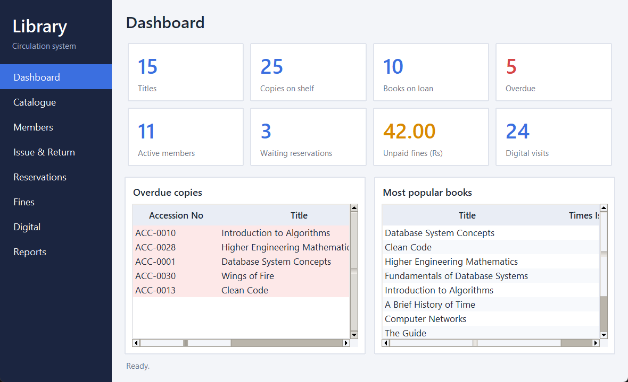
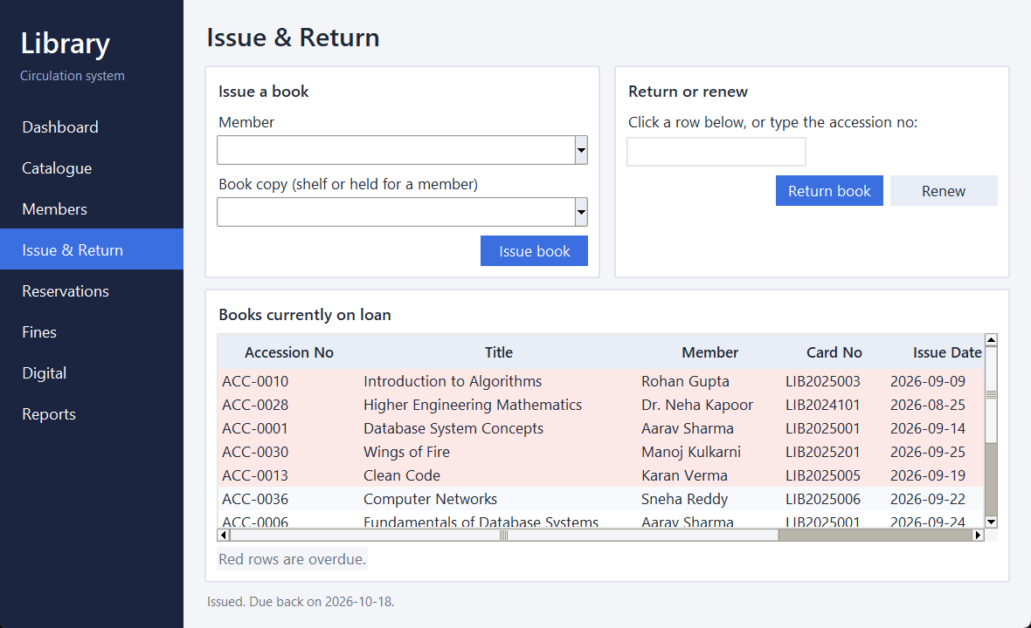
DBMS PBL REVIEW 3
Application Demonstration: Core Operational Screens
Executive Dashboard & Overdue Board
Circulation Desk (Book Issue & Return)
Library Circulation & Digital Resource Management System | DBMS PBL | REVIEW 3

Slide 10
DBMS PBL REVIEW 3
Systematic Testing & Rule Verification (`tests/test_library.py`)
Automated Test Suite Methodology & Test Scenarios• Isolated Test Harness: Each test run drops and rebuilds `library_db` from `01_schema.sql`, `02_sample_data.sql`, and `03_views.sql` to guarantee repeatability.
• Borrow Limit Enforcement Tests: Verifies that student patrons holding 3 books are strictly blocked upon attempting to check out a 4th book.
• Fine Lock Verification Tests: Verifies that an unpaid fine exceeding ₹50.00 blocks borrowing, while a partial payment bringing debt below ₹50 restores borrowing rights.
• Overdue Math Validation Tests: Simulates overdue dates and asserts that calculated fines exactly equal `(days_late * fine_per_day)` according to member tier.
• Reservation Queue Fulfillment Tests: Tests that returning a reserved book puts the copy into `ON_HOLD`, advances the reservation to `READY`, and prevents other patrons from taking it.
• Transaction Rollback Tests: Forces database errors and verifies that partial writes leave zero residual records in `copy` or `issue`.
Library Circulation & Digital Resource Management System | DBMS PBL | REVIEW 3

Slide 11
DBMS PBL REVIEW 3
Technical Achievements & Project Outcomes
1. Data Integrity• Normalized 3NF: Zero data redundancy across titles, authors, editions, and copies.
• Integrity Constraints: Strict CHECK and foreign key rules prevent invalid entries at the database engine level.
• ACID Guarantees: Atomic transactions protect multi-table updates from corruption.
2. Operational Performance• Pre-Compiled Views: Eliminates repetitive complex join queries for common circulation screens.
• Indexing Architecture: Primary and secondary B-Tree indexes speed up lookups on barcodes and ISBNs.
• Pessimistic Locking: Prevents concurrency collisions during peak circulation periods.
3. Usability & Deliverables• Dual Interface: Provides both desktop GUI and responsive browser web interface.
• Automated Tests: Comprehensive test suite verifying business logic.
• Complete Documentation: Formal project reports in Markdown, Word, PDF, and PPTX.
Library Circulation & Digital Resource Management System | DBMS PBL | REVIEW 3

Slide 12
DBMS PBL REVIEW 3
Conclusion & Future Enhancements
Project Summary• Complete Lifecycle: Successfully executed the entire database development lifecycle from requirement analysis, conceptual modeling, normalization, physical implementation, to full-stack application deployment.
• Objective Achieved: Replaced uncoordinated registers with an integrated, reliable DBMS enforcing circulation rules, queue order, fine settlement, and digital usage tracking.
• Ready for Production: Equipped with dual user interfaces, comprehensive test suite, and database views.
Future Enhancements• Hardware Integration: Direct integration with handheld Barcode / QR / RFID scanners for automated shelf audits.
• Automated Notifications: Automated email / SMS webhooks notifying patrons 2 days before due dates and alerting reservation holders when books become READY.
• Online Student Portal: Self-service mobile web portal allowing students to view active loans and renew books remotely.
Library Circulation & Digital Resource Management System | DBMS PBL | REVIEW 3

