Slide 1
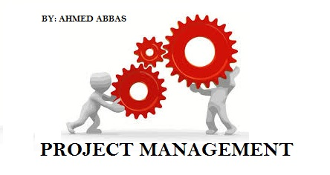
Project TIME Management

Slide 2
Project Time Management
Monitoring &
Controlling Processes
Planning
Processes
Enter phase/
Start project
Initiating
Processes
Closing
Processes
Exit phase/
End project
Executing
Processes
Knowledge Area | Process
 | Initiating | Planning | Executing | Monitoring & Control | Closing
Time |  | Plan Schedule Management Activity Definition Activity Sequencing Activity Resource Estimating Activity Duration Estimating Schedule Development |  | Schedule Control

Slide 3
Project Time Management
The process required to manage timely completion of the project
Project time management start with planning by the project management team (not shown as a discrete process)
In small project, defining & sequencing activities, estimating activity resource & duration, developing schedule are viewed as a single process.

Slide 4
6.2 Define Activities
The process of identifying the specific actions to be performed produce the project deliverables.
Work package decomposed into activities (schedule activities)
Inputs
Schedule Management Plan Scope baseline Enterprise environmental factors Organizational process assets
Tools & Techniques
Decompositions Rolling wave planning Templates Expert judgment
Outputs
Activity list Activity attributes Milestone list
In the real word sometime we skip define activities since we take WBS down to the activity level. This is not a wrong practice but not a PMBOK practice.

Slide 5
Define Activities (Tools & Techniques)
Rolling Wave Planning: progressive elaboration planning where you do not to plan activities until you start the project management process for that phase is in the project life cycle
Activity Attributes:
Use for schedule development, selecting, ordering, sorting the planned schedule activities
Used to identify e.g. responsible person, place, level of effort (LOE), apportioned effort (AE)
Milestone: a significant point or event in the project.
Not a work activity
Checkpoint to help control the project
Additional milestone can be add in Sequence Activities & Develop Schedule process
The list can indicates the level of milestone (mandatory, optional, etc)

Slide 6
6.2 Sequence Activities
Process of identifying and documenting relationship among the project activities
Inputs
Activity list Activity attributes Milestone list Project scope statement Organizational process assets
Tools & Techniques
Precedence diagramming method (PDM) Dependency determination Applying leads and lags Schedule network templates
Outputs
Project schedule network diagram Project document updates

Slide 7
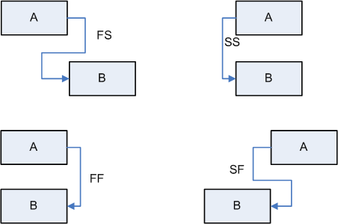
Precedence Diagramming Method (PDM)
Precedence Diagramming Method (PDM) or Activity-on-Node (AON)
Method used in Critical Path Methodology(CPM)
No dummy activities
Logical relationship:
Finish-to-Start (FS)
Finish-to-Finish (FF)
Start-to-Start (SS)
Start-to-Finish (SF)

Slide 8
Applying Leads & Lags
Use leads and lags to support realistic and achievable project schedule.
Each activity is connected at least to one predecessor and one successor except the start and the end.
Leads.
May be added to start an activity
before the predecessor activity is complete.
Lags
Inserted waiting time between activities
A
B
C
predecessor
Successor
A
B
A
B

Slide 9
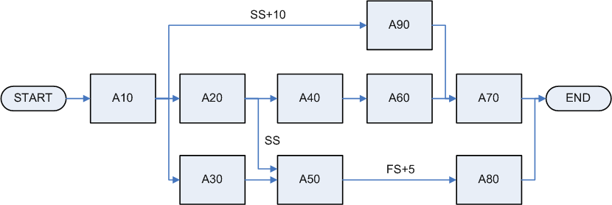
Precedence Diagramming Method (PDM)
Example of PDM which showing logical relationship and leads or lags
Other method to draw network diagram:
Arrow Diagramming Method (ADM)
GERT: allows loops between activities

Slide 10

Dependency Determination
To define sequence among activity, these type of dependency are used:
Mandatory (hard logic)
Inherent in the nature of work being done or required by the contract
E.g. You must design before you can develop
Discretionary (preferred, preferential, or soft logic)
Define base on knowledge
Can be changed if needed
Important when how to shorten or re-sequence the project
External
Based on the need t of the party outside the project
Network diagram
≠ PERT chart
Shows just dependencies (logical relationship)
Could show the critical path if activity duration estimates added
PERT »

Slide 11
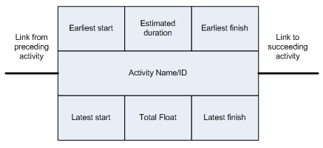
PMD
ES = Early Start
LS = Latest Start
EF = Early Finish
LF = Late Finish
EF = ES + D -1
LS = LF – D +1
Float (F) = LS – ES = LF – EF

Slide 12
6.3 Estimate Activity Resources
Process of estimating the type and quantities of material, people, equipment or supplies required to perform each activity.
Inputs
Activity list Activity attributes Resource Calendars Enterprise environmental factors Organizational process assets
Tools & Techniques
Expert judgment Alternatives analysis Published estimating data Bottom-up estimating Project management software
Outputs
Activity resource requirements Resource breakdown structure Project document updates

Slide 13
Estimate Activity Resource (Tools & Techniques)
Resource Calendar:
Information (skill, location, etc) in which resource (people, equipment, material, etc) are potentially available.
Published estimating data:
Use company’s rates
Bottom up estimating:
Activity is decomposed to be more confidence in estimating

Slide 14
6.4 Estimate Activity Durations
Process of approximating the number of work periods to complete individual activities with estimated resources.
Schedule shall be as believable and realistic as possible (do not allow padding)
Inputs
Activity list Activity attributes Activity resource requirements Resource Calendars Project scope statement Enterprise environmental factors Organizational process assets
Tools & Techniques
Expert judgment Analogous estimating Parametric estimating Three-point estimates Reserve analysis
Outputs
Activity duration estimates Project document updates

Slide 15
Estimate Activity Durations (Tools & Techniques)
Analogous Estimating (Top down):
use actual duration of previous activity (historical) that has similarity
Parametric Estimating:
use statistical relationship between historical data and other variables (e.g. learning curve)
The result can become heuristics (experience based technique/rule of thumb)
Reserve analysis (buffer): includes contingency reserves
“A Buffer Isn’t Padding. Padding is extra time added to a schedule that you don’t really think you need but that you add just to feel confident in the estimate. Padding is when I take a conventional approach to building a Gantt chart, come up with three months, but tell my boss four months.”
Mike Cohn – Agile Software Development

Slide 16
3-Points Estimate (PERT)
Also called Program Evaluation and Review technique (PERT)
Use for time and cost estimation
Expected calculated from Most-likely, Optimistic, Pessimistic
Range of estimate = EAD (Expected Activity Duration) +/- SD (Standard Deviation)
Standard deviation cannot be sum.
Variance used to calculate total SD of the project
Expected
Standard
Deviation
Variance

Slide 17
Exercise: Tree-point estimates (PERT)
Activity | Duration |  |  | Expected Duration (PERT) | Activity Standard Deviation | Variance range | Range of the estimate
 | P | M | O
A | 3 | 5 | 1
B | 8 | 4 | 2
C | 15 | 8 | 5
D | 20 | 10 | 5
Project (Total) | -

Slide 18
Exercise: PERT - Most tricky question
Together with your team, you applied three-point estimation on a Critical path which consists of two activities. The following duration uncertainties are all calculated assuming a ±3 sigma Confidence interval.
The duration uncertainty—defined as pessimistic minus optimistic estimate—of the first activity is 18 days; the second estimate has an uncertainty of 24 days. Applying the PERT formula for paths, what is the duration uncertainty of the entire path?
21 days
30 days
42 days
No statement is possible from the information given.

Slide 19
Exercise: PERT - Most tricky question (Answer)
See that the question says that Duration Uncertainty is Pessimistic minus Optimistic in other words P-O. We know that SD is (P-O ) / 6 , thus SD is "duration Certainty " / 6 Thus For Path 1 : SD = 18/6 = 3 Variance = 3*3 = 9 For path 2 : SD = 24 /6 = 4 Variance = 4*4 = 16 Total Path Variance = 16 + 9 = 25 Sqrt (25) = 5 Meaning (P-O) / 6 = 5 (p-O) = 5 * 6 DURATION UNCERTAINTY = 30

Slide 20
6.5 Develop Schedule
Process of analyzing activity sequences, durations, resource requirements, and schedule constraints to create the project schedule.
Inputs
Activity list Activity attributes Project schedule network diagram Activity resource requirements Resource Calendars Activity duration estimates Project scope statement Enterprise environmental factors Organizational process assets
Tools & Techniques
Schedule network analysis Critical path method Critical chain method Resource leveling What-if scenario analysis Applying leads and lags Schedule compression Scheduling tool
Outputs
Project schedule Schedule baseline Schedule data Project document updates

Slide 21
Critical Path
Critical Path is the longest duration path
Identify the shortest time needed to complete a project
There can be more than one critical path
We don’t want critical path, it increase risk
Don’t leave a project with a negative float, you would compress the schedule
Near-critical path is the path that has close in duration to critical path
Float (Slack)
Total float: the amount of time an activity can be delayed without delaying the project end date or intermediary milestone.
Free float: the amount of time an activity can be delayed without delaying the early start date of its successor(s).
Project float: the amount of time an activity can be delayed without delaying the externally imposed project completion date required by customer/management.

Slide 22
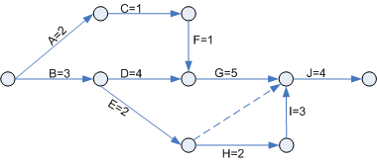
Critical Path Method Basic
Activity | Precedence | Duration
A |  | 2
B |  | 3
C | A | 1
D | B | 4
E | B | 2
F | C | 1
G | D,F | 5
H | E | 2
I | H | 2
J | G,I | 0
K
Dummy activity = 0 resource & 0 duration
Critical activities
all activities in the critical path
Delay in the completion of these activities will lengthen the project timescale
Has float = 0

Slide 23
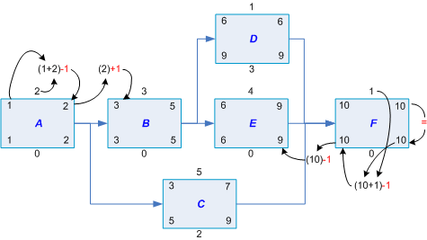

Critical Path using PDM
Forward Pass
Backward Pass
Calculation
Forward Pass:
ES + D = ES(successor)
use highest value on join
Backward Pass:
LS – D (predecessor) = LS (predecessor)
Use lowest value on join

Slide 24
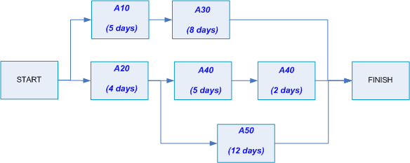
Exercise
Questions:
What is the critical path?
What is critical path duration?
What is float (slack) duration of activity A30?
Answers:
-
-
-

Slide 25
Critical Chain (Buffer Management) Method
The longest duration path through the project considering both activity dependencies and resource constraints.
Network diagram and critical path are identified first
Type of buffers
Project buffer
Feeding buffer
Resource buffer
Notes:
Revise this slide!

Slide 26
What-if Scenario Analysis
Analysis on effect of changes on a particular thing (assumption) on the project which make activity duration change.
Monte Carlo Simulation
Used when there is possibility that the critical path will be different for a given set of project conditions.
Using probability distribution for each activity or group of activities
Using computer software
Using three-point estimates and network diagram
Help deal with “path convergence”
Multiple paths converge into one or more activities (but adding risk)
Notes:
Revise this slide!

Slide 27
Schedule Compression
Fast Tracking
Performing critical path activities in parallel.
Usually increase risk and requires more attention to communication.
May need a rework.
E.g. Design is half finished and start coding.
Crashing
Analyze cost and schedule trade-offs.
Determine most compression for least cost.
Crash the tasks that cost the least first, focusing on minimizing project cost.
Always results in increased cost.
Notes:
Revise this slide!

Slide 28
Project Schedule
Schedule can be shown with or without dependencies (logical relationship).
Presented as
Summary form e.g. Master Schedule, Milestone schedule
Detailed form
Format:
Network diagram
Milestone chart
Bar chart (Gantt chart)

Slide 29
Schedule Data
Includes at least:
Schedule milestone
Schedule activities
Activity attributes
Assumptions & Constraints
Additional information can be added, such as
Resource histograms
Cash-flow projections
Order & delivery schedules
Alternative schedules

Slide 30
6.6 Control Schedule
Process of analyzing activity sequences, durations, resource requirements, and schedule constraints to create the project schedule.
Inputs
Project Management Plan Project Schedule Work performance information Organizational process assets
Tools & Techniques
Performance reviews Variance Analysis Project Management Software Resource leveling What-if scenario analysis Adjusting leads & lags Schedule compression Schedule tooling
Outputs
Work performance measurements Organizational process assets updates Change requests Project management plan updates Project document updates

Slide 31
Next topic: Project Cost Management
Thank You

