Slide 1
ModSpec: Introduction and Tutorial updated 2012/11/06
Jaijeet Roychowdhury
Notes:
Notes here

Slide 2
ModSpec: Motivation and Goals
Verilog-A CME is lacking in several respects
  too EE (semiconductor device) centric; weird un-aesthetic syntax
    does not expose DAE API of devices transparently
  VA-CME “standard” fragmentation? turf wars between companies?
    want something GPL'd: no patents!
  VA-CME has no support for bias-dependent noise, initialization hooks (?), limiting hooks, convergence criterion hooks, scaling, etc.
  no support for parsing/netlist syntax info, time-dependence?
VA-CME has inadequate open-source toolchain
  ADMS: horrible structuring → limping for a decade
    lacks support for internal current variables (Tom R. added this?)
  is it really open-source? Laurent LeMaitre is now a company?
Don't want device limited to specific network eqn. formulation (eg, MNA) – should support any network formulation
Want genuinely domain-agnostic core device specification format (ie, should work for EE, reactions, etc.)
  and should be able to “naturally” define elements spanning different domains
Notes:
username: 219Afall2011
password: 1Matlab0C++

Slide 3
Outline
ModSpec illustrated using:
  electrical networks and devices
  bio-chemical reaction networks and devices
YET TO DO:
  Reaction-electrical interface devices
    eg, biosensors
  Signal flow networks and devices
  Mechanical networks and devices
    SUGAR netlist concepts: good enough?
  Fluidic networks and devices
    eg, for chemical energy networks
  Optical networks and devices

Slide 4
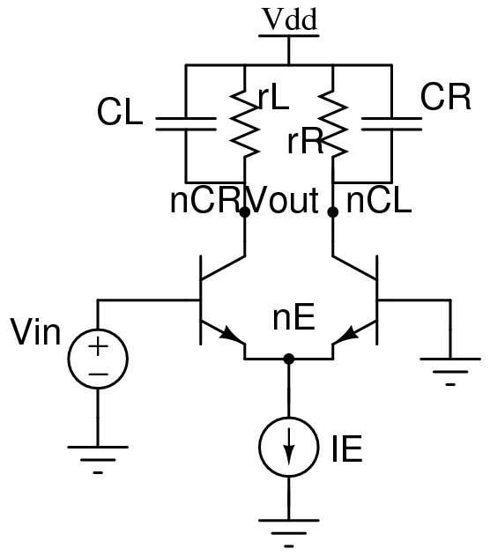
EE Networks: A Quick Recap
EE Network Layer
  nodes
    there is a special node called ground
  devices connect to nodes using branches
  network-level unknowns
    each non-ground node contributes one node voltage unknown
    each branch contributes (in principle):
      one branch current unknown
      one branch voltage unknown
        directions indicate current direction and branch voltage polarity
  network-level equations
    each non-ground nodes contributes one KCL equation
      eg, KCLN:
    each branch contributes one KVL equation:
      (each branch also contributes one BCR equation – from the device layer)
EE device layer
  each can contribute several branches (connected to network-level nodes)
    devices have access to network-level branch quantities ONLY
  each device contributes one BCR equation for each of its branches:

Slide 5
A Generic Device (not limited to EE)
Device's Network Interface Layer
(interfaces device to network level)
Core Device
(eg, only branch
quantities and
int. quantities)
Network
Level
n3
n1
n2
Network interface layer interfaces “network quantities” (eg, node voltages, node KCL current contribs) with “device quantities” (eg, branch voltages and currents)

Slide 6


Core vs NIL vs Network Level
Core device
  relates (its own) branch voltages and currents (I/Os)
    ie, supplies equations relating branch voltages/currents
  may also contribute internal unknowns
    these don't interact with network level quantities
    for each internal unknown, device supplies one equation
Network Level
  contributes node voltage unknowns
  sets up KCL equations for each node
    using each device's Network Interface Layer
Network Interface Layer
  relates core device's I/Os (branch voltages/currents) to network level quantities (node voltages, node KCL contribs)
  does not access core device's internal unknowns
n1
Network Level
3 nodes/KCL eqns
2 KVL eqns
n2
4 I/Os
Core
2 branches
2 eqns
3 device I/O to network KCL contrib. eqns
Network Interface
Layer
3 node KCL contribs.
3 node voltages
n3

Slide 7
Core Device: Basic Notions
Each device:
  has several inputs/outputs; some outputs provided explicitly, others implicit
  contributes several internal unknowns
  contributes several equations
IOs: these are the Inputs/Outputs
  2n of them. (What is n? # of “core I/O eqns”; eg, # branches)
    l of these can be designated ExplicitOutputs
      stored in
    the remaining 2n-l are called OtherIOs
      stored in
There can also be m InternalUnknowns (stored in )
Equations: total of n+m equations supplied by device
    l of these provide the ExplicitOutputs explicitly:
      l equations: : qe(), fe()
    the remaining n+m-l equations can be fully implicit:
      n+m-l equations: : qi(), fi()
    is a vector of time-varying functions, of length

Slide 8
Example: Resistor
Explicit current output formulation
  n=1; 2n = nIOs = 2
  l=1 (ib is an explicit output) → ,
  m=0 (no internal unknowns)
  only 1 (explicit-output) equation:
Implicit current formulation
  n=1; 2n = nIOs = 2
  l=0 (ib is implicit) →
  m=0 (no internal unknowns)
  only 1 (implicit) equation:
EE Network Interface Layer
  nn = n+1 = 2 nodes

Slide 9
Example: Capacitor (charge formulation)
Charge formulation, explicit output
  n=1; 2n = nIOs = 2
  l=1 (qb is an explicit output) → ,
  m=0 (no internal unknowns)
  only l=1 (explicit) equation:
Charge formulation, implicit
  n=1; 2n = nIOs = 2
  l=0 (no explicit output) →
  m=0 (no internal unknowns)
  only n+m-l=1 (implicit) equations:
EE Network Interface Layer
  nn = n+1 = 2 nodes
  2nn=4 NIF unknowns: nn=2 node voltages, nn=2 node currents:
  n + nn= 3 equations:

Slide 10
Example: Capacitor (current formulation)
Current formulation, explicit output
  n=1; 2n = nIOs = 2
  l=1 (qb is an explicit output) → ,
  m=0 (no internal unknowns)
  only l=1 (explicit) equation:
Current formulation, implicit
  n=1; 2n = nIOs = 2
  l=0 (no explicit output) →
  m=0 (no internal unknowns)
  only n+m-l=1 (implicit) equations:
EE Network Interface Layer
  nn = n+1 = 2 nodes
  2nn=4 NIF unknowns: nn=2 node voltages, nn=2 node currents:
  n + nn= 3 equations:

Slide 11
Example: Inductor (flux formulation)
Flux formulation, explicit output
  n=1; 2n = nIOs = 2
  l=1 (φb is an explicit output) → ,
  m=0 (no internal unknowns)
  only l=1 (explicit) equation:
Flux formulation, implicit
  n=1; 2n = nIOs = 2
  l=0 (no explicit output) →
  m=0 (no internal unknowns)
  only n+m-l=1 (implicit) equations:
EE Network Interface Layer
  nn = n+1 = 2 nodes
  2nn=4 NIF unknowns: nn=2 node voltages, nn=2 node currents:
  n + nn= 3 equations:

Slide 12
Example: Inductor (voltage formulation)
Voltage formulation, explicit output
  n=1; 2n = nIOs = 2
  l=1 (vb is an explicit output) → ,
  m=0 (no internal unknowns)
  only l=1 (explicit) equation:
Voltage formulation, implicit
  n=1; 2n = nIOs = 2
  l=0 (no explicit output) →
  m=0 (no internal unknowns)
  only 1=n+m-l (implicit) equations:
EE Network Interface Layer
  nn = n+1 = 2 nodes
  2nn=4 NIF unknowns: nn=2 node voltages, nn=2 node currents:
  n + nn= 3 equations:

Slide 13
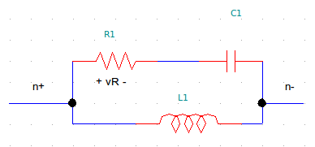
Example: 2-terminal RCL block
One way to do it
  n=1; 2n = nIOs = 2
  l=1 (1 explicit outputs) → ,
  m=3 (3 internal unknowns):
  l=1 explicit equations:
  n+m-l=3 other (implicit) equations:
EE Network Interface Layer
  nn = n+1 = 2 nodes
  2nn=4 NIF unknowns: nn=2 node voltages, nn=2 node currents:
  n + nn= 3 equations:

Slide 14
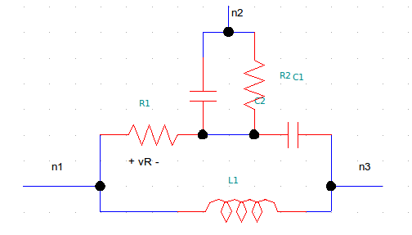
Example: 3-terminal RCLRC block
One way to do it
  n=2; 2n = nIOs = 4
  l=2 (2 explicit outputs) → ,
  m=2 (2 internal unknowns):
  l=2 explicit equations:
  n+m-l=2 other (implicit) equations:
EE Network Interface Layer
  nn = n+1 = 3 nodes
  2nn=6 NIF unknowns: nn=3 node voltages, nn=3 node currents:
  n + nn= 5 equations:

Slide 15
Biochemical Reaction Networks and Devices
“Nodes” == species (eg, A, B). Node vars: concs. ([A], [B])
“Devices” == reactions
“Branches” == which “nodes” involved in each reaction
  arrow into reaction means:
    conc. of “node” is used by reaction
  arrow into node means:
    reaction contributes term to “node's” dynamics
  bidirectional (or no arrows) means both - this is typical
“Devices” can have “internal nodes”
  ie, private species that are not shared by other reactions
A
C
F
B
reaction 3
reaction 2
reaction 4
reaction 1
I
E
D

Slide 16
Example: Enzyme-Catalyzed Reaction “Device”
I/O
: converts A (substrate) to D (product)
  B is the enzyme/catalyst; C is the intermediate
Rate equations:
  n=2; 2n = nIOs = 4
    : _d suffix for “device”
      same idea as branch quantities (as opposed to node quantities)
  l=2 (2 explicit outputs) → ,
  m=2 (2 internal unknowns):
  l=2 explicit equations:
  n+m-l=2 other (implicit) equations:
[A]d
ECR
dAdtd
[D]d
B
C
dDdtd

Slide 17
ECR: Network Interface
Reaction Network Interface Layer
  relates “node/network quantities” and “branch/device quantities”
  nn = n = 2 “nodes”: A, D
  2nn=4 NIL unknowns: nn=2 species ([A], [D]), nn=2 ddt terms: dAdt, dDdt
  2nn= 4 equations:
    2 “KCL contribs”:
    2 “KVL eqns”:
Network level equations
  at each “node” N (ie, for each species)
  write 1 “KCL” equation:
    1 term for each “branch” connecting to “node”
  “KVL”? Already taken care of at NIL level
F
dDdt2
dDdt1
D
dDdt3

Slide 18
Example: Michaelis-Menten-ECR “Device”
I/O
: converts A (substrate) to D (product)
  B is the enzyme/catalyst; C is the intermediate
Michaelis-Menten approximation:
    [B](0) == initial. conc. of the enzyme/catalyst
      we will treat [B] as a (slowly-varying) species in the network
  n=3; 2n = nIOs = 6
    ; but and [D]d is not used
  l=3 (3 explicit outputs) → ,
  m=0 (no internal unknowns)
  l=3 explicit equations:
  n+m-l=0: no other equations
Network Interface Layer
  n=3 “KCL contribs”:
  n=3 “KVL eqns”:
[B]d
[A]d
MM-ECR
dAdtd
[D]d
dDdtd

Slide 19
Example: “Species Source” Device
A
source
dAdtd
: provides A
  n=1; 2n = nIOs = 2
    ; but [A]d is not used
  l=1 (1 explicit output) → ,
  m=0 (no internal unknowns)
  l=1 explicit equation:
  n+m-l=0: no other equations
Network Interface Layer
  n=1 “KCL contribs”:
  n=1 “KVL eqns”:

Slide 20
Example: System “KCL” Equations for Two
Chained Enzyme-Catalyzed Reactions
dB2dtB2src
B2
B2
source
dAdtAsrc
A
ECR
MM-ECR
A
source
D
E
dAdtECR
B1
C
dDdtMM-ECR
dEdtMM-ECR
dDdtECR
A source supplies A (via rate of creation uA(t))
ECR converts A to D
  using “internal” species B1 (catalyst) and C (catalyst)
MM-ECR converts D to E
  using catalyst B2, supplied by B2 source
Network-level “KCLs”:
  A “KCL”:
  D “KCL”:
  B2 “KCL”:
  E “KCL”:

Slide 21
Chained ECR System: Unknown/Equation Counts
dB2dtB2src
B2
B2
source
dAdtAsrc
A
ECR
MM-ECR
A
source
D
E
dAdtECR
B1
C
dDdtMM-ECR
dEdtMM-ECR
dDdtECR
“MNA” formulation (eliminate “branch” quantities): size 6 system
  unknowns: total 6
    4 network species: [A], [B2], [D], [E]
    2 internal species from ECR: [B1], [C]
  equations: total 6
    4 network-level “KCL” equations (previous slide)
    2 internal equations from ECR (rate eqns. for [B1] and [C])
Tableau formulation (keep all “branch” and “node” quantities)
  unknowns: total 20
    4 “node” quantities == network species: [A], [B2], [D], [E]
    Asrc: n=1 “branch” → 2n=2 unknowns (NIL's [A] and dAdt)
    ECR: n=2 → 2n=4 unknowns (NIL's [A],[D],dAdt,dDdt)
      plus: m=2 internal unknowns ([B1], [C])
    B2src: n=1 “branch” → 2n=2 unknowns (NIL's [B2] and dB2dt)
    MM-ECR: n=3 → 2n=6 unknowns (NIL's [A],[D],[B2],dAdt,dDdt,dB2dt)
  equations: total 20
    4 “node KCLs” (previous slide)
    Asrc: n=1 “branch” → 2n=2 equations (NIL's “KCL contrib” and “KVL” equations)
    ECR: n=2 → 2n=4 equations (NIL's “KCL contrib” and “KVL” equations)
      plus: m=2 internal equations (rate equations for [B1], [C])
    B2src: n=1 “branch” → 2n=2 equations (NIL's “KCL contrib” and “KVL” equations)
    MM-ECR: n=3 → 2n=6 equations (NIL's “KCL contrib” and “KVL” equations)

Slide 22
Summary
ModSpec: seed of a genuinely multi-domain simulator?
  Xyce2?

Slide 23
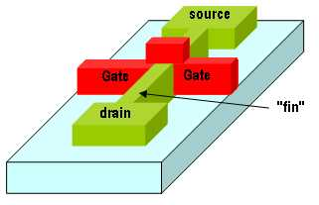
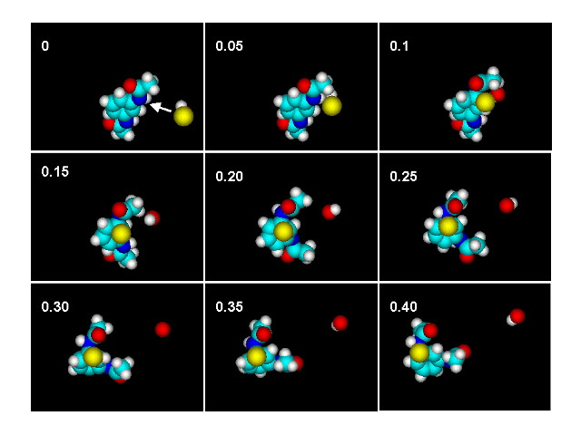

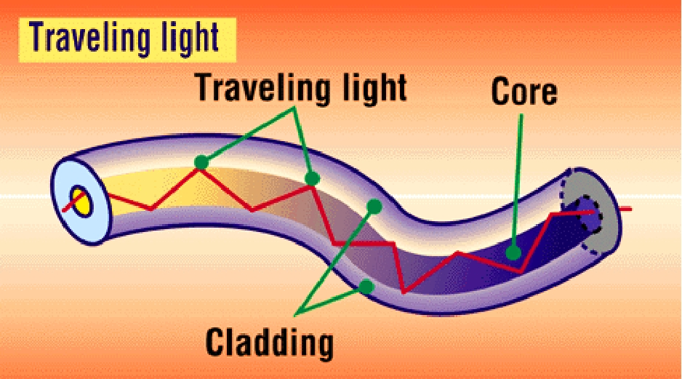



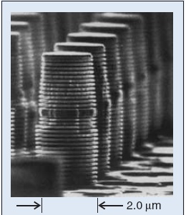
eg, chemical
sensors, “energy”
nano-mechanical
structures
optical
interconnect
transistor-like
nano-resonators
Verilog A CME
SBML
SUGAR
lasers
translator
translator
translator
ModSpec MSL (Model Specification Language)
ModSpec
Octave/MATLAB API
ModSpec
C++ API
DAEAPI + Algorithms
Xyce
Simulation Outputs
(text+ GUI)
Commercial
& Industrial
Simulators
Teaching
SPICE-compatible
Simulation Directives
SPICE-compatible
Netlists
Other
Open-Source
Simulators

Slide 24
eg, chemical
sensors, “energy”
nano-mechanical
structures
optical
interconnect
transistor-like
nano-resonators
Verilog A CME
SBML
SUGAR
lasers
translator
translator
translator
Internal Parse Tree (fully general)
“Verilog-A Parser
to ModSpec”
translation, optimization,
derivative code generation, etc.
Xyce
Internal Data Structure for Model Eqns (f/q/etc.)
output translator
output translator
SimKit
C?
ModSpec
C++
ModSpec MATLAB
MDE

Slide 25
Multi-physics support in Xyce through ModSpec
eg, chemical
sensors, “energy”
nano-mechanical
structures
optical
interconnect
transistor-like
nano-resonators
Verilog A CME
SBML
SUGAR
lasers
translator
translator
translator
ModSpec C++ and .so files
Xyce

Slide 26
Using ModSpec Devices in Xyce updated 2012/11/06
Notes:
Notes here

