Slide 1

Resistor
-
name:
+
2 terminals:
branch:
I/Os:
model equation:
explicit output:
parameter:
>> model_starter;
Notes:
username: 290Aspring2013
password: 0C++1Matlab

Slide 2
Resistor
1 function MOD = myR()
2 MOD = ee_model();
3 MOD = add_to_ee_model(MOD, 'name', 'myR');
4 MOD = add_to_ee_model(MOD, 'terminals', {'p', 'n'});
5 MOD = add_to_ee_model(MOD, 'explicit_outs', {'ipn'});
6
7 MOD = add_to_ee_model(MOD, 'parms', {'R', 1000.0});
8
9 MOD = add_to_ee_model(MOD, 'fe', @fe);
10 MOD = add_to_ee_model(MOD, 'qe', @qe);
11
12 MOD = finish_ee_model(MOD);
13 end % myR
14
15 function out = fe(S)
16 v2struct(S);
17
18 ipn_fe = vpn/R;
19
20 out(1, 1) = ipn_fe;
21 end % fe
22
23 function out = qe(S)
24 v2struct(S);
25
26 ipn_qe = 0;
27
28 out(1, 1) = ipn_qe;
29 end % qe
1
define parameter
2
fill in functions
Notes:
username: 290Aspring2013
password: 0C++1Matlab

Slide 3

Capacitor
-
name:
+
2 terminals:
branch:
I/Os:
model equation:
explicit output:
parameter:
Notes:
username: 290Aspring2013
password: 0C++1Matlab

Slide 4
Capacitor
1 function MOD = myC()
2 MOD = ee_model();
3 MOD = add_to_ee_model(MOD, 'name', 'myC');
4 MOD = add_to_ee_model(MOD, 'terminals', {'p', 'n'});
5 MOD = add_to_ee_model(MOD, 'explicit_outs', {'ipn'});
6
7 MOD = add_to_ee_model(MOD, 'parms', {'C', 1e-6});
8
9 MOD = add_to_ee_model(MOD, 'fe', @fe);
10 MOD = add_to_ee_model(MOD, 'qe', @qe);
11
12 MOD = finish_ee_model(MOD);
13 end % myC
14
15 function out = fe(S)
16 v2struct(S);
17
18 ipn_fe = 0;
19
20 out(1, 1) = ipn_fe;
21 end % fe
22
23 function out = qe(S)
24 v2struct(S);
25
26 ipn_qe = C*vpn;
27
28 out(1, 1) = ipn_qe;
29 end % qe
1
define parameter
2
fill in functions
Notes:
username: 290Aspring2013
password: 0C++1Matlab

Slide 5
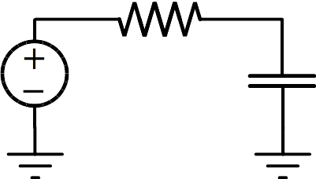

RC circuit
1 function cktnetlist = myRC_ckt()
2 cktnetlist.cktname = 'myRC_ckt';
3 cktnetlist.nodenames = {'1', '2'}; % non-ground nodes
4 cktnetlist.groundnodename = 'gnd';
5
6 cktnetlist = add_element(cktnetlist, myR(), 'R1', {'1', '2'}, {{'R', 1000}});
7 cktnetlist = add_element(cktnetlist, myC(), 'C1', {'2', 'gnd'}, 1e-6);
8
9 mysinfunc = @(t, args) sin(2*pi*1000*t);
10
11 cktnetlist = add_element(cktnetlist, vsrcModSpec(), 'V1', ...
12 {'1', 'gnd'}, {}, {{'DC', 1}, {'AC', 1}, {'TRAN', mysinfunc, []}});
13 end % myRC_ckt
Notes:
username: 290Aspring2013
password: 0C++1Matlab

Slide 6
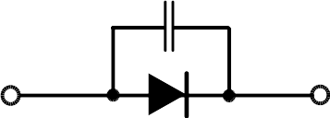
Diode
+
-
name:
2 terminals:
branch:
I/Os:
model equation:
explicit output:
parameters:
Notes:
username: 290Aspring2013
password: 0C++1Matlab

Slide 7
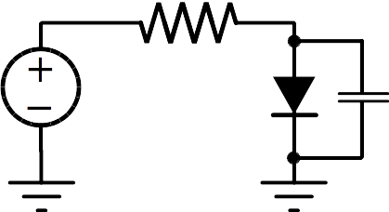
Vsrc-R-diode circuit
1 function cktnetlist = myR_diodeC_ckt()
2 cktnetlist.cktname = 'myR_diodeC_ckt';
3 cktnetlist.nodenames = {'1', '2'}; % non-ground nodes
4 cktnetlist.groundnodename = 'gnd';
5
6 cktnetlist = add_element(cktnetlist, vsrcModSpec(), 'V1', ...
7 {'1', 'gnd'}, {}, {{'DC', 1}});
8 cktnetlist = add_element(cktnetlist, myR(), 'R1', {'1', '2'}, {{'R', 1}});
9 cktnetlist = add_element(cktnetlist, diodeC(), 'D1', {'2', 'gnd'});
10 end % myR_diodeC_ckt
Notes:
username: 290Aspring2013
password: 0C++1Matlab

Slide 8
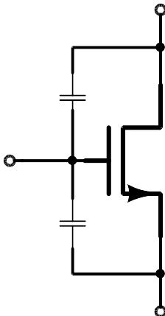
Schichman-Hodges MOS Model
name:
+
3 terminals:
Cgd
branchs:
+
Cgs
-
-
model equation:
explicit output:
parameters:
Notes:
username: 290Aspring2013
password: 0C++1Matlab

Slide 9
Schichman-Hodges MOS Model
d
g
+
+
-
-
DAEs
s
IOs:
explicit
outputs:
other IOs
internal unkowns
explicit
outputs
other IOs:
(part of IOs)
internal
unkowns:

Slide 10
Schichman-Hodges MOS Model
IOs:
explicit
outputs:
other IOs:
internal
unkowns:

