Slide 1

What is a “device”: version 0
Something you give inputs to, to get outputs
  n inputs n outputs
Examples
  resistor: n=1. or
  capacitor/inductor: n=1. ,
  : n=2.
input
output
+
+
outputs
inputs
-
Notes:
- Tianshi: 1) put anotther cap in parallel with resistor or better, 2) go straight to a SH model here.
- then run SH in model exerciser

Slide 2
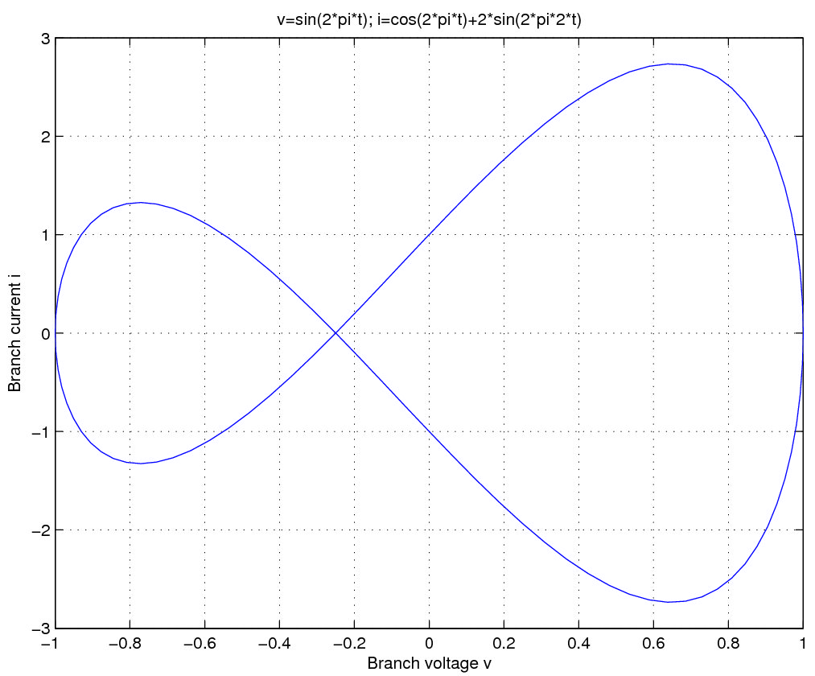
What is a “device”: vers. 0 (contd.)
In general:
  n inputs:
  n outputs:
  n differential equations providing the outputs:
But this cannot handle implicit formulations
  ie, i-v relationships like this:
    input/output distinction unclear
Notes:
- can access in model exerciser: MOD.qe, MOD.fe
- diode-connected FEFET? Yes – use Gokcen's homotopy plot
- hands on: just repeat last time's – doesn't have to be hands on, either, just a demo

Slide 3


What is a “device”: version 1
Lump inputs/outputs together: “IOs”
  2n IOs:
  n implicit equations:
  Key feature
    if you specify n of the IOs, the other n can be solved for
      more generally: if you supply n more equations in
Example
  n=1: , ,
But then how do you express:
  need internal unknowns
note abuse of notation: should be
Notes:
- examples are from a ckts background; better to update to parasitics on a device

Slide 4
What is a “device”: version 2
Augment IOs with internal unknowns
  2n IOs:
  add m internal unknowns:
To retain key property, need m more equations
  we already had n equations in the IOs
    generalize: make them depend on both and
  add m more equations (1 per internal unk.)
Notes:
- explain this using an RRAM template
- ipn = f1(vpn, s)
- ds/dt = f2(vpn, s), eg, cubic
- this will make it easier to get to the RRAM later

Slide 5
What is a “device”: version 2 (cont.)
Example:
  n=2; 2n IOs =
  Internal unks.: branch voltage and current of L
    m=2; m int. unks. =
  Equations
    n=2 eqns. for IOs:
    m=2 eqns. for int. unks.:
+
+
+
-
-

Slide 6
What is a “device”: version 3
Support for “explicit outputs”
  eventually, will want to set up KCL network eqns.
  if (e.g.) currents are available explicitly, MNA does not need them as system unknowns
    want a way to specify outputs that are available explicitly
Previous example: n=2, m=2
    equations are all implicit
    note: IOs i₁ and i2 are available explicitly
+
+
+
-
-

Slide 7
What is a “device”: version 3 (contd.)
Re-write previous example (n=m=2)
  2n IOs = v₁, v₂, i₁, i2
    denote i₁, i2 as explicit outputs:
    denote remaining IOs as “otherIOs”:
  Write equations for the explicit outputs
  Write remaining eqns. (don't use explicit outputs)
+
+
+
-
-
Notes:
- Juan-Pablo: why not make w() a function of z as well? Seems no flip side, and can make equation writing more compact and less error prone.

Slide 8
What is a “device”: version 3 (contd.)
Explicit output support: the general case
  2n IOs, split into:
    l explicit outputs (0 <= l <= n):
    2n-l “otherIOs”:
  m internal unknowns:
  l equations for the explicit outputs
  n+m-l remaining (implicit) equations
Notes:
- example: just continue with the RRAM pattern, no need to have explicit outputs; they have already seen that.
- have a small exercise for the MVS model – count number of equations and unknowns.

Slide 9
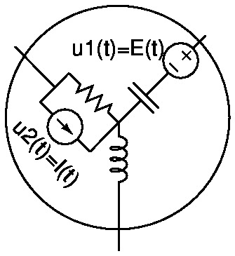
What is a “device”: version 4
Support for independent sources
Previous example w/ 2 indep. sources
  voltage source
  current source
Equations now involve :
+
+
+
-
-
Notes:
- motivate using not only vsrc/isrc, but also RRAM, which can, eg, have a noise voltage source – but it should be declared as a voltage source, then noise part (Monte-Carlo sample) should be attached in the simulator.
- so continue with the RRAM pattern.
- NEVER include any random number generation inside your model (that should be done at the simulator level)
- NEVER even attach deterministic time domain sources – also at the simulator level.

Slide 10
What is a “device”: finally
2n IOs, split into:
  l explicit outputs (0 <= l <= n):
  2n-l “otherIOs”:
m internal unknowns:
independent sources:
l equations for the explicit outputs
n+m-l remaining (implicit) equations

Slide 11
Describing a device: ModSpec
Look through, eg, resModSpec.m
  pulls in ModSpec_common_skeleton, which pulls in:
    ModSpec_skeleton_core (defines API - field names)
      uniqID, name, ModelName, description, ...
      parmnames, parmdefaults
      IOnames
      ExplicitOutputNames: (“vecZ”)
      InternalUnknames: (“vecY”)
      ImplicitEquationNames: (“vecW”)
      uNames: (“vecU”)
      otherIOnames: (“vecX”)
      fe, fi, qe, qi: functions
        note: dependence of on not supported yet
      NIL (Network Interface Layer): to be discussed later
    ModSpec_common_add_ons, ModSpec_derivative_add_ons
      these set up default values for data, define utility functions, set up functions to perform automatic differentiation (AD) using vecvalder
        AD used for obtaining Jacobians of
Notes:
- next time: some slides on vecvalder?

Slide 12
Describing a ModSpec device (contd.)
Network Interface Layer (NIL)
  list of nodes (NIL.node_names)
    eg, {'n1', 'n2'}
    reference node (NIL.refnode_name) - eg, 'n3'
  IOs are defined from these
    v/i branches from each
    node to refnode
    syntax:
      v<node><refnode>,
      i<node><refnode>
        all voltages first,
        then all currents
      eg.: {'vn1n3',
      'vn2n3', 'in1n3',
      'in2n3'}
  explicit outputs are
  a subset of these
    eg: {'in1n3', 'vn2n3'}
Network
Level
Network Interface Layer
(domain-specific: eg, EE-NIL has nodes)
n2
Core Device
generic, not just EE
n1
n3
refnode

Slide 13
Describing a ModSpec device (contd.)
resModSpec.m (contd.)
  set up data (API functions use these):
    model_name, spice_key, model_description
    parm_names (“R”), parm_defaultvals, parm_types (double/int/string), parm_vals (current parameter values)
    NIL.node_names (“p”,”n”), NIL.refnode_name (“n”)
    explicit_output_names (“ipn”)
    setup_IOnames_OtherIOnames_IOtypes_IOnodenames() sets up IOnames (“vpn, “ipn”), OtherIOnames (“vpn”)
      and book-keeping information IOtypes (“v”/”i”), IOnodenames (tells which node an IO corresponds to)
    internal_unk_names, implicit_equation_names
      empty for resistors
    u_names (empty for resistors)
  Define fe, fi, qe, qi
    vecZ = fe(vecX, vecY, vecU) = vpn/R
    qe, fi, qi: empty for resistor

Slide 14
Example: writing a ModSpec model
Previous example
  demo:
    copy resModSpec and modify
      work around not supporting
      work around vecvalder “bug”
    test functions using run_Model_API
+
+
+
-
-
Notes:
- because qie don't support u args, need to declare an extra y variable - vE and add an extra equation: EbCR
- there was a vecvalder problem: first entry of a vector was 0, need to do that second, or make the first entry dependent on every unknown (eg, fqout(1,1)=0*x1 + 0*x2 + 0*x3, etc.. Alert them to it.

Slide 15
Netlists in MATLAB: circuitdata
circuitdata: a format/data structure for describing electrical networks (“netlists”)
  using ModSpec models
fields of circuitdata:
  cktname (string)
    eg.: 'my circuit'
  nodenames (cell array of strings - all node names)
    eg.: {'n1', 'n2', 'n3'}
    do not include the ground node (BUG?)
  groundnodename (string)
    eg.: 'mygnd'
  elements (cell array of structures for each element)
    eg.: {ResElem1, RLCsrcsElem1, VinElem1}

Slide 16
Netlists in MATLAB (contd.)
structure for each element: the fields
  name (string)
    eg.: 'Vin1'
  model (the ModSpec model (MOD))
    eg.: Vin1Elem.model = vsrcModSpec();
  nodes (cell array of nodes connected to)
    same order as in ModSpec description
    eg.: Vin1Elem.nodes = {'n1', 'mygnd'}
  parms (cell array of parameter values for model)
    same order as parm names in ModSpec description
    eg.: resElem1.parms = {100.0}; % R
  udata (cell array of structures describing values)
    eg.: RLCsrcsElem1.udata = {E_udata, I_udata};
    must be in the same order as ModSpec uNames

Slide 17
Netlists in MATLAB (contd.)
fields of the udata entry structures
  uname (string)
    must be exactly the name of the u source in ModSpec
    eg.: E_udata.uname = 'E';
  QSSval (QSS/DC value)
    e.g: E_udata.QSSval = 1.0;
  utransient (fn. handle for transient analysis input)
    similar to DAEAPI functions, but scalar
    e.g: E_udata.utransient = @(t, args) sin(2*pi*args.f*t);
  utransientargs (args for utransient)
    eg.: args.f=1e3; E_udata.utransientargs = args;
  uLTISSS (fn. handle for AC analysis input)
    similar to DAEAPI functions, but scalar
    e.g: E_udata.uLTISSS = @(f, args) args.ACr + args.ACi i;
  uLTISSSargs (args for uLTISSS)
    eg.: args.r=1; args.i=0; E_udata.uLTISSSargs = args;

Slide 18
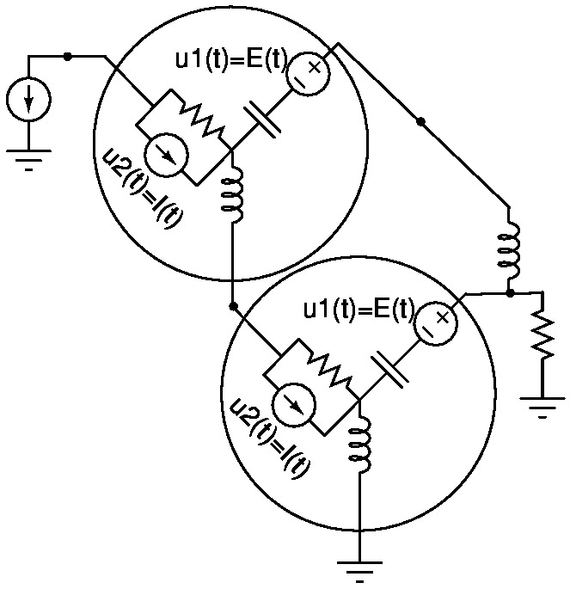
Netlists in MATLAB: an example
demo
  write the circuitdata structure in MATLAB
  run/test/debug it
'1'
I1
'2'
X1
L1
'3'
'4'
R1
X2
'gnd'

Slide 19
Making a DAE from circuitdata
MNA_EqnEngine
  takes a circuitdata structure, returns a DAE
    DAE = MNA_EqnEngine(circuitdata);
Demo
  DAE fields
    standard DAEAPI functions (see DAEAPI documentation)
      eg., DAE.f(), DAE.q(), DAE.dfdx(), etc.
    which rely on an internal data structure
      eg.: unk_names, eqn_names, element_names, input_names, parm_names, *_updates, etc.
    you should use ONLY the API functions when using DAE
      see the documentation
  test the DAE: run_DAEAPI_functions(DAE)

Slide 20
Running Analyses on the DAE
QSS (DC)
    qss = QSS(DAE);
    n = feval(DAE.nunks, DAE);
    NRguess = zeros(n,1); %bad guess! try to do better
    qss = feval(qss.solve, NRguess, qss);
    feval(qss.print, qss);
LTISSS (AC) - do a QSS first
  don't forget to set AC inputs first
  outputs = StateOutputs(DAE);%to plot all state vars
  DCus = feval(DAE.uQSS, DAE); % DC input vals
  DCsol = feval(qss.getsolution, qss);
  AC = LTISSS(DAE, DCsol, DCus);
  sweeptype = 'DEC'; % decade plot
  fstart=1; fstop=1e12; nsteps=5;% 5 pts/decade
  AC=feval(AC.solve, fstart, fstop, nsteps, sweeptype, AC);
  feval(AC.plot, AC, outputs);

Slide 21
Running Analyses on the DAE (contd.)
Transient (LMS)
  TrBE = LMS(DAE); % default method is BE
    TRmethods = LMSmethods(); % defines FE, BE, TRAP, GEAR2
    TRparms = defaultTranParms(); % has, eg, TRparms.NRparms
    TrGEAR2= LMS(DAE, TRmethods.GEAR2, TRparms); %GEAR2
  Trans = TrBE;
    Trans.tranparms.stepControlParms.doStepControl=0;
  xinit = DCsol; % DC solution
  tstart=0; tstep=1e-9; tstop=1e-7;
  Trans = feval(Trans.solve, Trans, xinit, tstart, tstep, tstop);
  [thefig,legends] = feval(Trans.plot, Trans, outputs);
Watch out for tiny +ve eigenvalues due to DAEs and finite-precision numerics!
  demo (TRAP/small timesteps/random ICs; illustrative example)
  use overstable integration methods (BE, GEAR2)
  use timesteps consistent with real eigenmodes
    helps integration method damp out spurious eigenmodes (too-small timesteps can excite them)
Notes:
- MAPP-0.0.3 transient has a bug - it does not clear tpts/vals at the start of solve
- random init conds, TRAP, small timesteps fail on the circuit - it goes unstable!
- the reason is DAEs + finite precisionnumerics: it makes zero eigenvalues (from DAEs) into very high-frequency poles (ie, very small eigenvalues) with random sign - ie, the circuit can easily turn unstable. This is easy to demonstrate by hand using a simple 3x3 LTI circuit and doing an eigenanlysis - you get tiny eigenvalues whose sign depends randomly on element values etc.. You can also see this from eig(inv(AC.Gmat)*AC.Cmat), of course.
- see [xournal-notes]/2013-01-30-Note-05-28-simpleDAE-eigenstability-debug.xoj for the circuit
- the “fix”:
- use overstable methods like BE and TRAP
- don't use too-small timesteps

Slide 22
Organization of the Code
MAPP (Model/Algorithm Prototyping Platform)
  enables you to write a model in ModSpec
    automatic differentiation facility using vecvalder
  describe simple circuits using circuitdata and MNA_EqnEngine
    + define your own DAEs in DAEAPI
    vecvalder-based AD available at the DAE level, too
  DC/AC/transient/etc. analyses supplied
    can write your own analyses
  completely in MATLAB/Octave
MAPP consists of 4 components
  vecvalder: automatic differentiation in MATLAB
  ModSpec: model specification in MATLAB
  DAEAPI: set up circuit DAEs from circuitdata
  A1oDAEAPI: basic analyses (DC/AC/transient)
    “Analyses-1 on DAEAPI”

Slide 23
“Real” Model Description Languages
Verilog-A(MS); VHDL-AMS; MAST Saber/Synopsys; Modelica/Dymola (thanks → David Smith, Synopsys)
  these are high-level languages (higher than ModSpec)
    not “directly executable”
    (don't work in MATLAB/Octave)
    (ModSpec is a low-level API: functions directly callable by simulation/equation engines)
  toolchains (mostly) closed or commercial
    exception: Modelica (but issues compiling/using the open-source version)
    exception: Verilog-A (?)
      ADMS: no longer open source; buggy
  general-purpose languages
    typically many more capabilities than needed for CT device model description
      == rope to hang yourself?

Slide 24
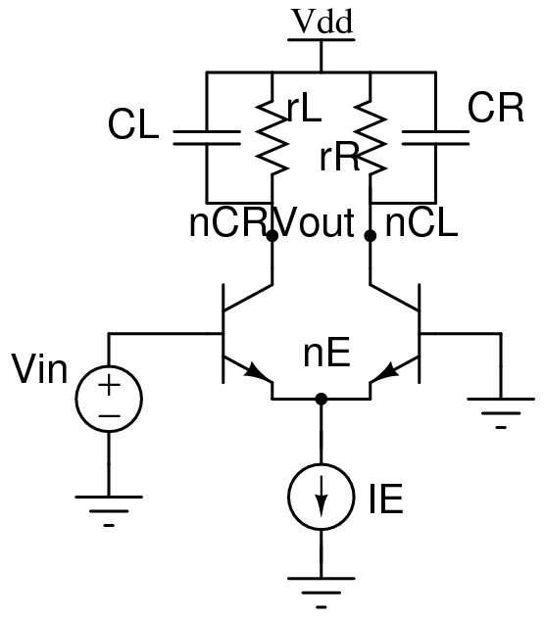
EE Networks: A Quick Recap
EE Network Layer
  nodes
    there is a special node called ground
  devices connect to nodes using branches
  network-level unknowns
    each non-ground node contributes one node voltage unknown
    each branch contributes (in principle):
      one branch current unknown
      one branch voltage unknown
        directions indicate current direction and branch voltage polarity
  network-level equations
    each non-ground nodes contributes one KCL equation
      eg, KCLN:
    each branch contributes one KVL equation:
      (each branch also contributes one BCR equation – from the device layer)
EE device layer
  each can contribute several branches (connected to network-level nodes)
    devices have access to network-level branch quantities ONLY
  each device contributes one BCR equation for each of its branches:

Slide 25
A Generic Device (not limited to EE)
Device's Network Interface Layer
(interfaces device to network level)
Core Device
(eg, only branch
quantities and
int. quantities)
Network
Level
n3
n1
n2
Network interface layer interfaces “network quantities” (eg, node voltages, node KCL current contribs) with “device quantities” (eg, branch voltages and currents)

Slide 26


Core vs NIL vs Network Level
Core device
  relates (its own) branch voltages and currents (I/Os)
    ie, supplies equations relating branch voltages/currents
  may also contribute internal unknowns
    these don't interact with network level quantities
    for each internal unknown, device supplies one equation
Network Level
  contributes node voltage unknowns
  sets up KCL equations for each node
    using each device's Network Interface Layer
Network Interface Layer
  relates core device's I/Os (branch voltages/currents) to network level quantities (node voltages, node KCL contribs)
  does not access core device's internal unknowns
n1
Network Level
3 nodes/KCL eqns
2 KVL eqns
n2
4 I/Os
Core
2 branches
2 eqns
3 device I/O to network KCL contrib. eqns
Network Interface
Layer
3 node KCL contribs.
3 node voltages
n3

Slide 27
Core Device: Basic Notions
Each device:
  has several inputs/outputs; some outputs provided explicitly, others implicit
  contributes several internal unknowns
  contributes several equations
IOs: these are the Inputs/Outputs
  2n of them. (What is n? # of “core I/O eqns”; eg, # branches)
    l of these can be designated ExplicitOutputs
      stored in
    the remaining 2n-l are called OtherIOs
      stored in
There can also be m InternalUnknowns (stored in )
Equations: total of n+m equations supplied by device
    l of these provide the ExplicitOutputs explicitly:
      l equations: : qe(), fe()
    the remaining n+m-l equations can be fully implicit:
      n+m-l equations: : qi(), fi()
    is a vector of time-varying functions, of length

Slide 28
Example: Resistor
Explicit current output formulation
  n=1; 2n = nIOs = 2
  l=1 (ib is an explicit output) → ,
  m=0 (no internal unknowns)
  only 1 (explicit-output) equation:
Implicit current formulation
  n=1; 2n = nIOs = 2
  l=0 (ib is implicit) →
  m=0 (no internal unknowns)
  only 1 (implicit) equation:
EE Network Interface Layer
  nn = n+1 = 2 nodes

Slide 29
Example: Capacitor (charge formulation)
Charge formulation, explicit output
  n=1; 2n = nIOs = 2
  l=1 (qb is an explicit output) → ,
  m=0 (no internal unknowns)
  only l=1 (explicit) equation:
Charge formulation, implicit
  n=1; 2n = nIOs = 2
  l=0 (no explicit output) →
  m=0 (no internal unknowns)
  only n+m-l=1 (implicit) equations:
EE Network Interface Layer
  nn = n+1 = 2 nodes
  2nn=4 NIF unknowns: nn=2 node voltages, nn=2 node currents:
  n + nn= 3 equations:

Slide 30
Example: Capacitor (current formulation)
Current formulation, explicit output
  n=1; 2n = nIOs = 2
  l=1 (qb is an explicit output) → ,
  m=0 (no internal unknowns)
  only l=1 (explicit) equation:
Current formulation, implicit
  n=1; 2n = nIOs = 2
  l=0 (no explicit output) →
  m=0 (no internal unknowns)
  only n+m-l=1 (implicit) equations:
EE Network Interface Layer
  nn = n+1 = 2 nodes
  2nn=4 NIF unknowns: nn=2 node voltages, nn=2 node currents:
  n + nn= 3 equations:

Slide 31
Example: Inductor (flux formulation)
Flux formulation, explicit output
  n=1; 2n = nIOs = 2
  l=1 (φb is an explicit output) → ,
  m=0 (no internal unknowns)
  only l=1 (explicit) equation:
Flux formulation, implicit
  n=1; 2n = nIOs = 2
  l=0 (no explicit output) →
  m=0 (no internal unknowns)
  only n+m-l=1 (implicit) equations:
EE Network Interface Layer
  nn = n+1 = 2 nodes
  2nn=4 NIF unknowns: nn=2 node voltages, nn=2 node currents:
  n + nn= 3 equations:

Slide 32
Example: Inductor (voltage formulation)
Voltage formulation, explicit output
  n=1; 2n = nIOs = 2
  l=1 (vb is an explicit output) → ,
  m=0 (no internal unknowns)
  only l=1 (explicit) equation:
Voltage formulation, implicit
  n=1; 2n = nIOs = 2
  l=0 (no explicit output) →
  m=0 (no internal unknowns)
  only 1=n+m-l (implicit) equations:
EE Network Interface Layer
  nn = n+1 = 2 nodes
  2nn=4 NIF unknowns: nn=2 node voltages, nn=2 node currents:
  n + nn= 3 equations:

Slide 33
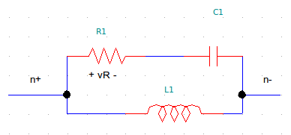
Example: 2-terminal RCL block
One way to do it
  n=1; 2n = nIOs = 2
  l=1 (1 explicit outputs) → ,
  m=3 (3 internal unknowns):
  l=1 explicit equations:
  n+m-l=3 other (implicit) equations:
EE Network Interface Layer
  nn = n+1 = 2 nodes
  2nn=4 NIF unknowns: nn=2 node voltages, nn=2 node currents:
  n + nn= 3 equations:

Slide 34
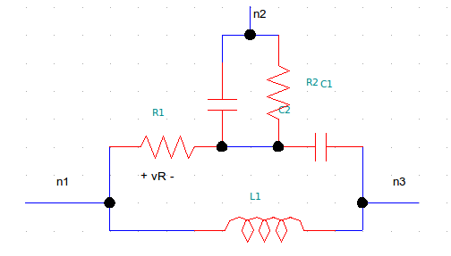
Example: 3-terminal RCLRC block
One way to do it
  n=2; 2n = nIOs = 4
  l=2 (2 explicit outputs) → ,
  m=2 (2 internal unknowns):
  l=2 explicit equations:
  n+m-l=2 other (implicit) equations:
EE Network Interface Layer
  nn = n+1 = 3 nodes
  2nn=6 NIF unknowns: nn=3 node voltages, nn=3 node currents:
  n + nn= 5 equations:

Slide 35
Biochemical Reaction Networks and Devices
“Nodes” == species (eg, A, B). Node vars: concs. ([A], [B])
“Devices” == reactions
“Branches” == which “nodes” involved in each reaction
  arrow into reaction means:
    conc. of “node” is used by reaction
  arrow into node means:
    reaction contributes term to “node's” dynamics
  bidirectional (or no arrows) means both - this is typical
“Devices” can have “internal nodes”
  ie, private species that are not shared by other reactions
A
C
F
B
reaction 3
reaction 2
reaction 4
reaction 1
I
E
D

Slide 36
Example: Enzyme-Catalyzed Reaction “Device”
I/O
: converts A (substrate) to D (product)
  B is the enzyme/catalyst; C is the intermediate
Rate equations:
  n=2; 2n = nIOs = 4
    : _d suffix for “device”
      same idea as branch quantities (as opposed to node quantities)
  l=2 (2 explicit outputs) → ,
  m=2 (2 internal unknowns):
  l=2 explicit equations:
  n+m-l=2 other (implicit) equations:
[A]d
ECR
dAdtd
[D]d
B
C
dDdtd

Slide 37
ECR: Network Interface
Reaction Network Interface Layer
  relates “node/network quantities” and “branch/device quantities”
  nn = n = 2 “nodes”: A, D
  2nn=4 NIL unknowns: nn=2 species ([A], [D]), nn=2 ddt terms: dAdt, dDdt
  2nn= 4 equations:
    2 “KCL contribs”:
    2 “KVL eqns”:
Network level equations
  at each “node” N (ie, for each species)
  write 1 “KCL” equation:
    1 term for each “branch” connecting to “node”
  “KVL”? Already taken care of at NIL level
F
dDdt2
dDdt1
D
dDdt3

Slide 38
Example: Michaelis-Menten-ECR “Device”
I/O
: converts A (substrate) to D (product)
  B is the enzyme/catalyst; C is the intermediate
Michaelis-Menten approximation:
    [B](0) == initial. conc. of the enzyme/catalyst
      we will treat [B] as a (slowly-varying) species in the network
  n=3; 2n = nIOs = 6
    ; but and [D]d is not used
  l=3 (3 explicit outputs) → ,
  m=0 (no internal unknowns)
  l=3 explicit equations:
  n+m-l=0: no other equations
Network Interface Layer
  n=3 “KCL contribs”:
  n=3 “KVL eqns”:
[B]d
[A]d
MM-ECR
dAdtd
[D]d
dDdtd

Slide 39
Example: “Species Source” Device
A
source
dAdtd
: provides A
  n=1; 2n = nIOs = 2
    ; but [A]d is not used
  l=1 (1 explicit output) → ,
  m=0 (no internal unknowns)
  l=1 explicit equation:
  n+m-l=0: no other equations
Network Interface Layer
  n=1 “KCL contribs”:
  n=1 “KVL eqns”:

Slide 40
Example: System “KCL” Equations for Two
Chained Enzyme-Catalyzed Reactions
dB2dtB2src
B2
B2
source
dAdtAsrc
A
ECR
MM-ECR
A
source
D
E
dAdtECR
B1
C
dDdtMM-ECR
dEdtMM-ECR
dDdtECR
A source supplies A (via rate of creation uA(t))
ECR converts A to D
  using “internal” species B1 (catalyst) and C (catalyst)
MM-ECR converts D to E
  using catalyst B2, supplied by B2 source
Network-level “KCLs”:
  A “KCL”:
  D “KCL”:
  B2 “KCL”:
  E “KCL”:

Slide 41
Chained ECR System: Unknown/Equation Counts
dB2dtB2src
B2
B2
source
dAdtAsrc
A
ECR
MM-ECR
A
source
D
E
dAdtECR
B1
C
dDdtMM-ECR
dEdtMM-ECR
dDdtECR
“MNA” formulation (eliminate “branch” quantities): size 6 system
  unknowns: total 6
    4 network species: [A], [B2], [D], [E]
    2 internal species from ECR: [B1], [C]
  equations: total 6
    4 network-level “KCL” equations (previous slide)
    2 internal equations from ECR (rate eqns. for [B1] and [C])
Tableau formulation (keep all “branch” and “node” quantities)
  unknowns: total 20
    4 “node” quantities == network species: [A], [B2], [D], [E]
    Asrc: n=1 “branch” → 2n=2 unknowns (NIL's [A] and dAdt)
    ECR: n=2 → 2n=4 unknowns (NIL's [A],[D],dAdt,dDdt)
      plus: m=2 internal unknowns ([B1], [C])
    B2src: n=1 “branch” → 2n=2 unknowns (NIL's [B2] and dB2dt)
    MM-ECR: n=3 → 2n=6 unknowns (NIL's [A],[D],[B2],dAdt,dDdt,dB2dt)
  equations: total 20
    4 “node KCLs” (previous slide)
    Asrc: n=1 “branch” → 2n=2 equations (NIL's “KCL contrib” and “KVL” equations)
    ECR: n=2 → 2n=4 equations (NIL's “KCL contrib” and “KVL” equations)
      plus: m=2 internal equations (rate equations for [B1], [C])
    B2src: n=1 “branch” → 2n=2 equations (NIL's “KCL contrib” and “KVL” equations)
    MM-ECR: n=3 → 2n=6 equations (NIL's “KCL contrib” and “KVL” equations)

Slide 42
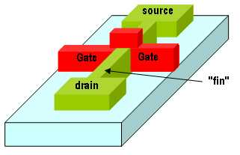
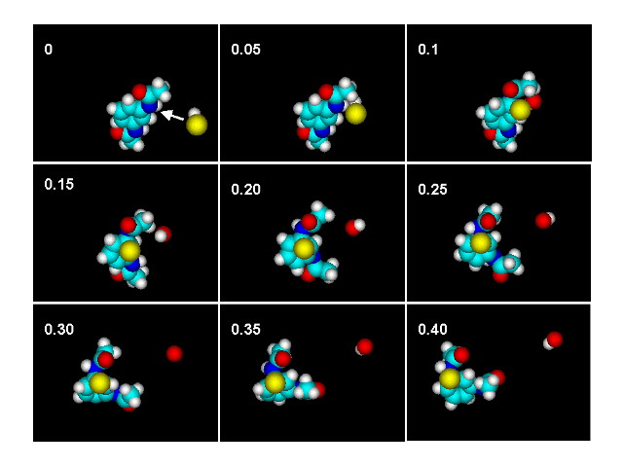

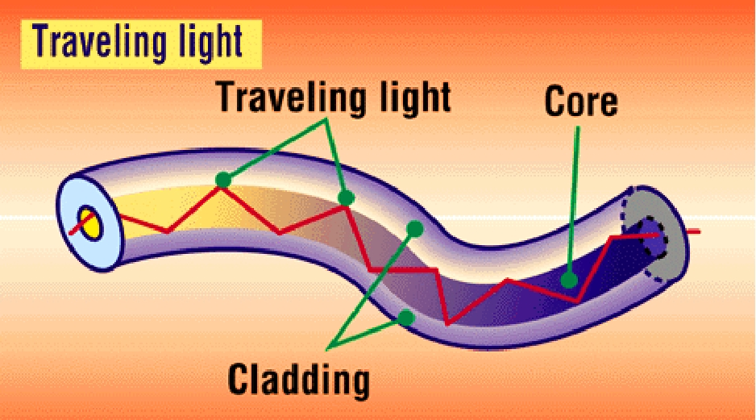



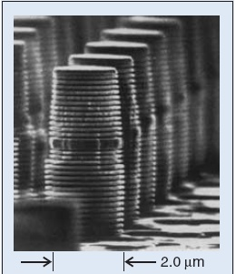
eg, chemical
sensors, “energy”
nano-mechanical
structures
optical
interconnect
transistor-like
nano-resonators
Verilog A CME
SBML
SUGAR
lasers
translator
translator
translator
ModSpec MSL (Model Specification Language)
ModSpec
Octave/MATLAB API
ModSpec
C++ API
DAEAPI + Algorithms
Xyce
Simulation Outputs
(text+ GUI)
Commercial
& Industrial
Simulators
Teaching
SPICE-compatible
Simulation Directives
SPICE-compatible
Netlists
Other
Open-Source
Simulators

Slide 43
Using ModSpec Devices in Xyce updated 2012/11/06
Notes:
Notes here

