Slide 1


VAPP
The Berkeley Verilog-A Parser and Processor
A. Gokcen Mahmutoglu, Karthik Aadithya
and Jaijeet Roychowdhury
Notes:
I'm going to tell you about MAPP, a model and algorithm prototyping platform we have been developing in my group and have just released
This talk is in 2 parts – I'll talk for about 30m and then Tianshi will talk and give a demo for about 1 hours.

Slide 2
MAPP/VAPP Model Development Flow
Step 1: model developed in ModSpec/MAPP
Step 2
ModSpec Model
(in MATLAB)
hand-coded
translate manually
to NEEDS-compatible Verilog-A
NEEDS-compatible
Verilog-A model
compare, check consistency
VAlint
ModSpec Model
(in MATLAB)
auto-generated
from Verilog-A
validate/debug
in MAPP
VAPP
Notes:
-
in this case, MVS was already developed in Verilog A (because MDE wasn't ready, it's still quite preliminary) so it's very easy to port insights from MDE back to Verilog-A
- except for some things like custom abs func/deriv definitions, for which we want to eventually propose extensions to the V-A standard.

Slide 3
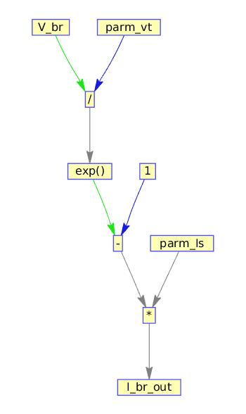
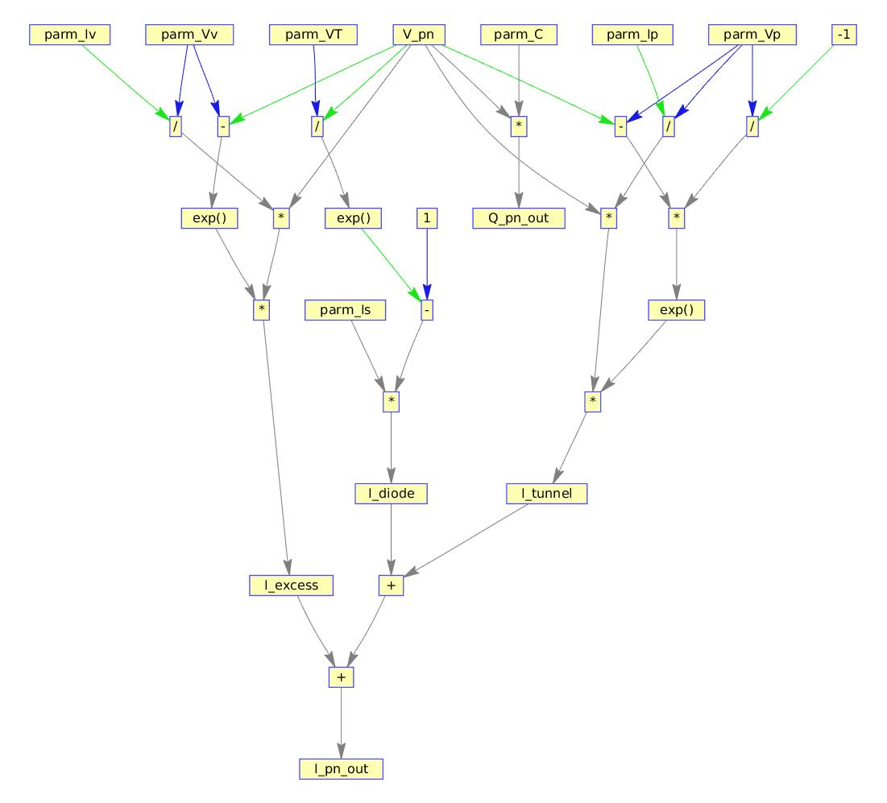
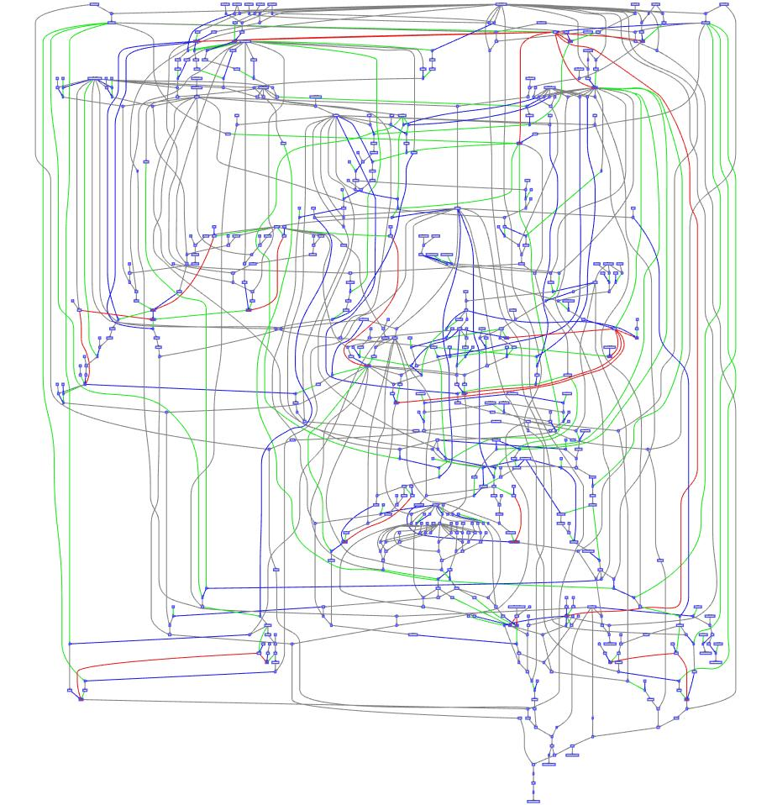
Verilog-A Parser and Processor
NEEDS-compatible
Verilog-A model
VAPP's
VA Parser
frontend
internal equation
representation
VAPP's
ModSpec
backend
translated model
in ModSpec
automatic derivative
code generation
module
visualization
module
optimization
modules
basic diode
tunnel diode
MIT MVS

Slide 4

Verilog-A to ModSpec Translation
Verilog-A
Model
ModSpec
Model
(MATLAB)
VAPP
DAE formulation
Semantic checking
Check good coding practices
Auto Diff or hardcoded Jacobians

Slide 5
Verilog-A to ModSpec Translation
Verilog-A
VAPP
AST
IR-1
IR-2
ModSpec
<+
Model
IOs
Parms
Terminals
print
I(p,n) <+ G*V(p,n)
Start with tokens
Contract representation into more abstract direction.
Create objects and link them
Top level objects directly related to ModSpec internals
Contribution
I
*
p
IO
Math
n
Contribution
lhsIO
rhsIOs
IsExplicit
DiffEqn
print
G
V
IO
p
n

Slide 6
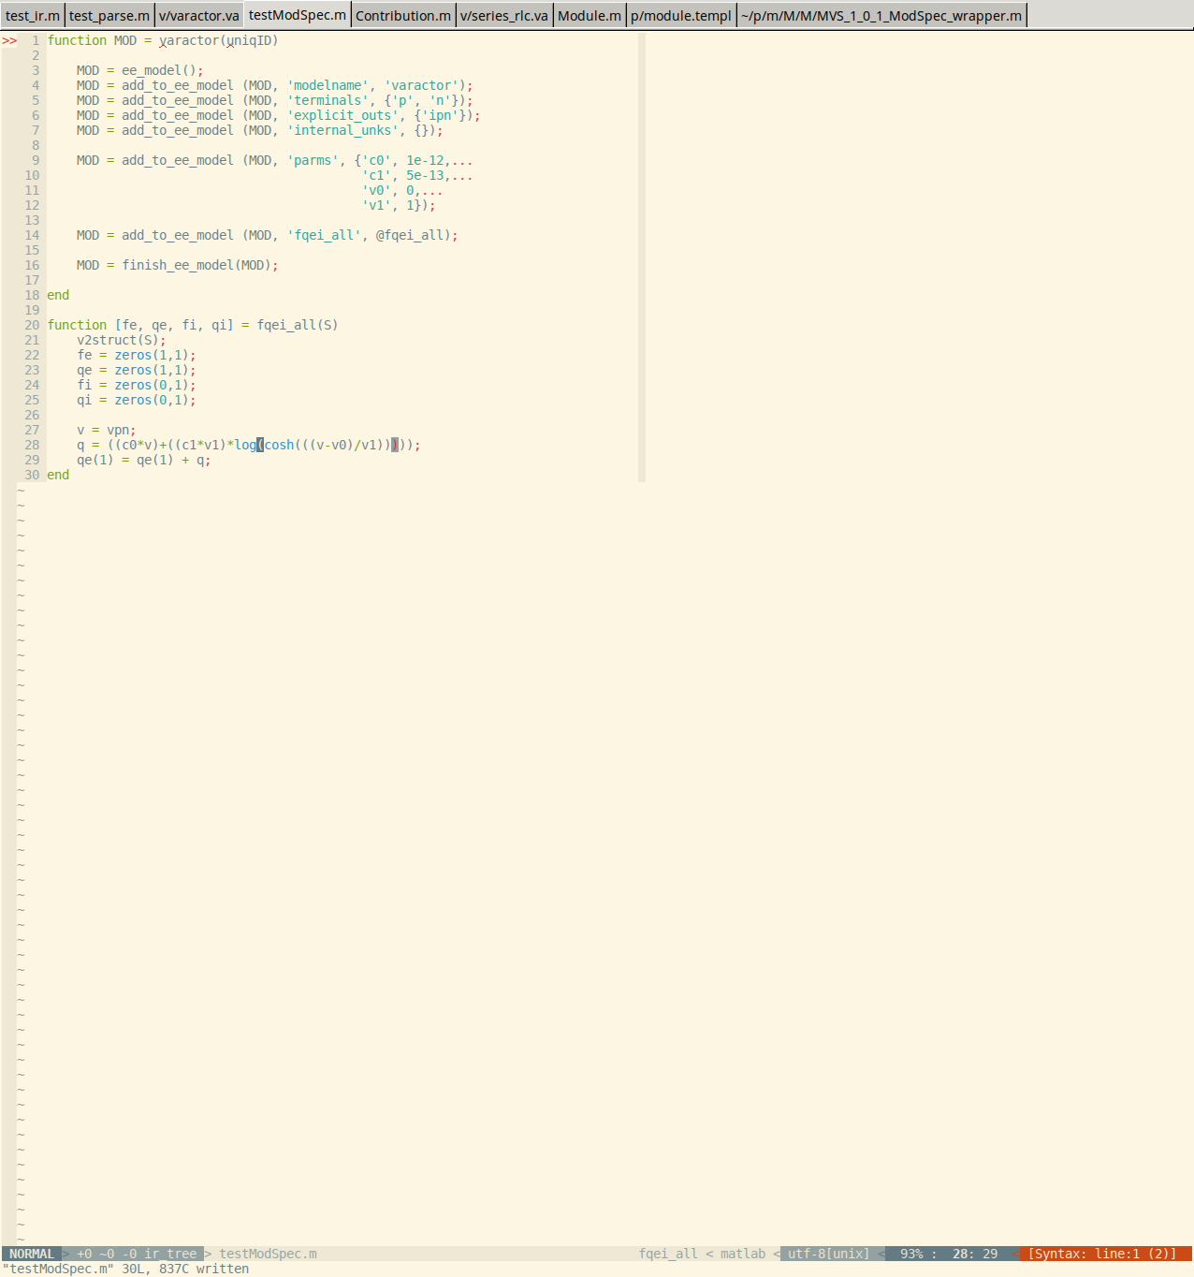
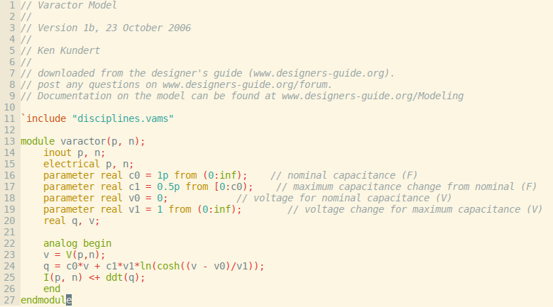
Glimpse: Verilog-A → ModSpec Translator
Verilog-A
ModSpec (MATLAB)

Slide 7
NEEDS Compatible Verilog-A
Use branches
  I(p,n) → branch (p,n) br_pn → I(br_pn)
Declare/initialize all variables
Know your implicit expressions
  I(br) <+ I(br) + ...;
  I(br) <+ fnc(I(br));
No simulation directives (e.g., @(initial_step(“tran”)))
Do not use idt()
Do not use time-varying or random functions

Slide 8
NEEDS Compatible Model Testing
Test with multiple simulators
  Spectre, Xyce, MAPP,...
In Testing: Connect all possible subsets of terminals together
  e.g., diode connect a transistor
Make sure that your model produces sensible values for DC analysis at zero bias
Check residual values and ensure that they are close to zero within machine precision

Slide 9
Hands–On VAPP Tutorial
Implement simple model in Verilog-A
  Import into MAPP
  Plot characteristic curves using MAPP
Expand/modify model to meet requirements
Investigate an unusual device: FE-FET
  Characteristic curves using homotopy
  Inverter circuit
Translate BSIM3 and run a transient simulation for a ring-oscillator

