Slide 1

Modelling using Verilog-A in MAPP
A Hands-on Workshop
Tianshi Wang*, Gokcen Mahmutoglu*, Karthik Aadithya*,
Xufeng Wang^ and Jaijeet Roychowdhury*
*EECS Department, University of California at Berkeley
^Dept of ECE, Purdue University

Slide 2
Hands-on Tutorial on MAPP/ModSpec
Model Starter
Model Exerciser
DC/AC/TRAN
in MATLAB
homotopy
Compact
Model
Equations
Write in MATLAB
(ModSpec format)
Test
immediately
(standalone)
Run Small
Circuits in
MAPP
basic debug
resistor
capacitor
RRAM
FEFET
diode
MOS
implicit equation
formulations
hysteresis
internal nodes
and unknowns
Notes:
- common mistakes eliminated by format:
- use of integrals
- including Monte-Carlo noise calculations inside the model
- using node voltages/currents/charges instead of branch
- confusion about implicit equations (Lan Wei)
- custom functions: sign(x) 0 or not

Slide 3
MAPP/VAPP Model Development Flow
Step 1: model developed in ModSpec/MAPP
Step 2
ModSpec Model
(in MATLAB)
hand-coded
translate manually
to NEEDS-compatible Verilog-A
NEEDS-compatible
Verilog-A model
compare, check consistency
VAlint
ModSpec Model
(in MATLAB)
auto-generated
from Verilog-A
validate/debug
in MAPP
VAPP
Notes:
-
in this case, MVS was already developed in Verilog A (because MDE wasn't ready, it's still quite preliminary) so it's very easy to port insights from MDE back to Verilog-A
- except for some things like custom abs func/deriv definitions, for which we want to eventually propose extensions to the V-A standard.

Slide 4
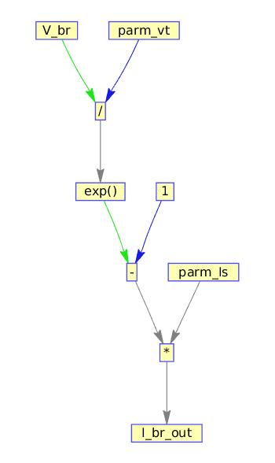
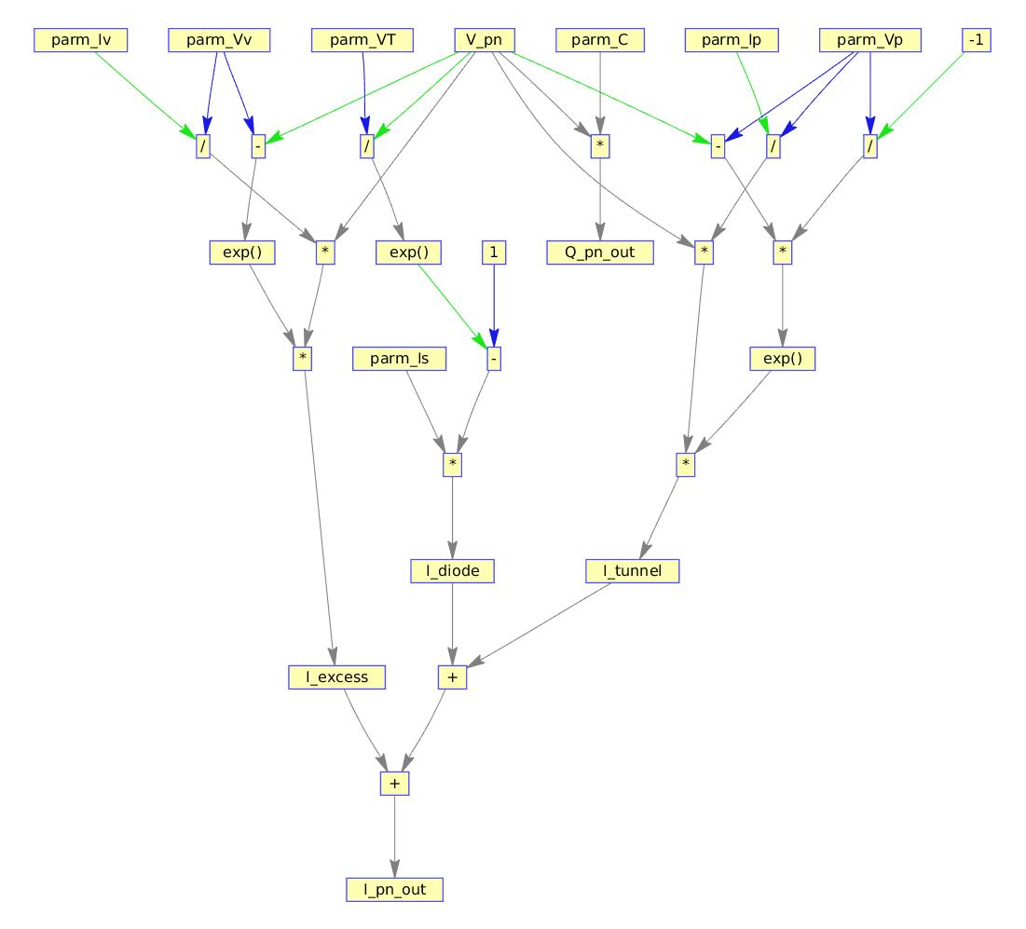
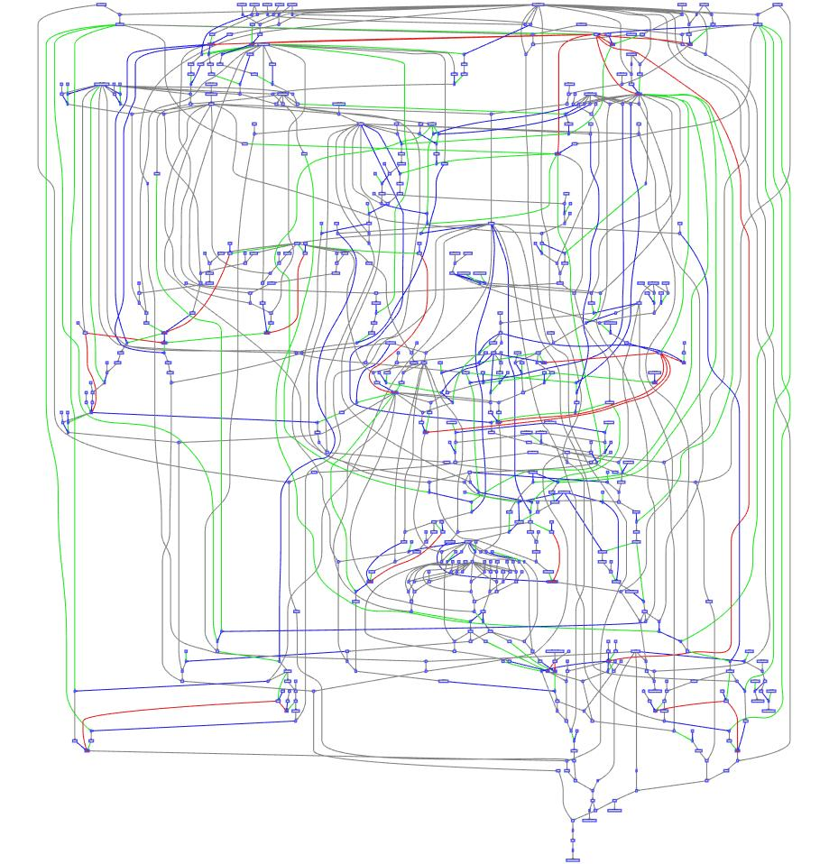
Verilog-A Parser and Processor
NEEDS-compatible
Verilog-A model
VAPP's
VA Parser
frontend
internal equation
representation
VAPP's
ModSpec
backend
translated model
in ModSpec
automatic derivative
code generation
module
visualization
module
optimization
modules
basic diode
tunnel diode
MIT MVS

Slide 5
Setup for Hands-on Work
Wireless ESSID: EECS-event-04; password: EECSevent04
Bug reporting site
  http://mapp.eecs.berkeley.edu
    (top middle) bug tracking system link
    username: workshop
    password: workshop
MAPP installed/tested on your laptop?
  URLs/instructions are in your email
    http://MAPP.eecs.berkeley.edu/MAPP-VAPP-2016-02-04-workshop.tgz
Get the hands-on scripts/files
    http://MAPP.eecs.berkeley.edu/2016-02-04--MAPP-Berkeley-workshop-scripts.tgz
    http://MAPP.eecs.berkeley.edu/2016-02-04--VAPP-Berkeley-workshop-scripts.tgz

