Slide 1
Blinq
A smart cane prototype for the visually impaired
Video Link: https://youtu.be/3uRPKjVKGm4

Slide 2
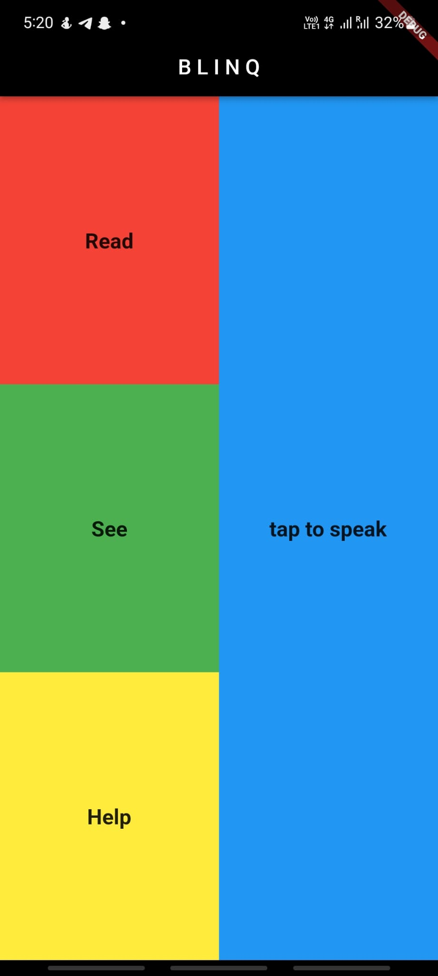
Problem Statement
In 2015, there were an estimated 253 million people with visual impairment worldwide. In context of Singapore- the problem worsens as the risk of blindness increases fifteen-fold for aged 50 to 80 and above. The visually impaired face problems in all aspects of life including travel and transport
Our Solution
Blinq incorporates a SMART cane along with a technological assistant application which utilise robotics, machine learning and IoT to provide a one stop solution to the daily struggles of a person suffering from visual impairment.

Slide 3
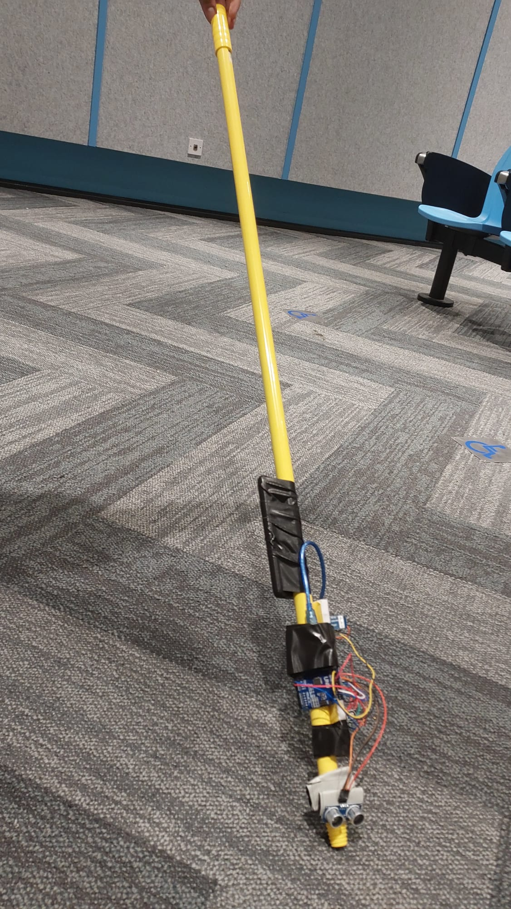
FUNCTION #1
SMART Cane Obstacle Detection
Our SMART Cane is equipped with a bluetooth enabled proximity sensor that detects any incoming obstacle within a 2 meter radius, and alerts the user in real time via the app.

Slide 4
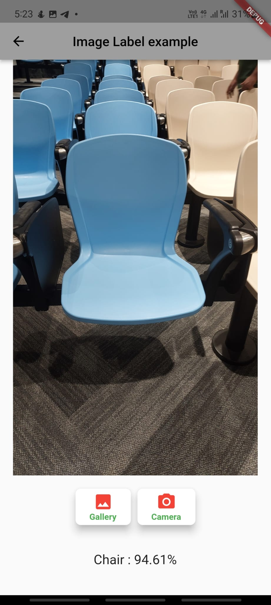
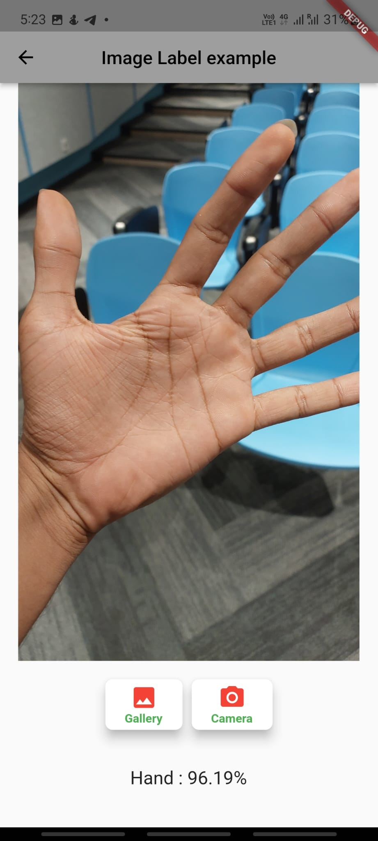
FUNCTION #2
ML Live Environment Tracker
This function enables the user to point the camera around him/her and the program will inform the user of all objects in vicinity such as Cars, Trees, Pedestrians , Electronics etc via speech - allowing the user to be completely aware of their surroundings.

Slide 5
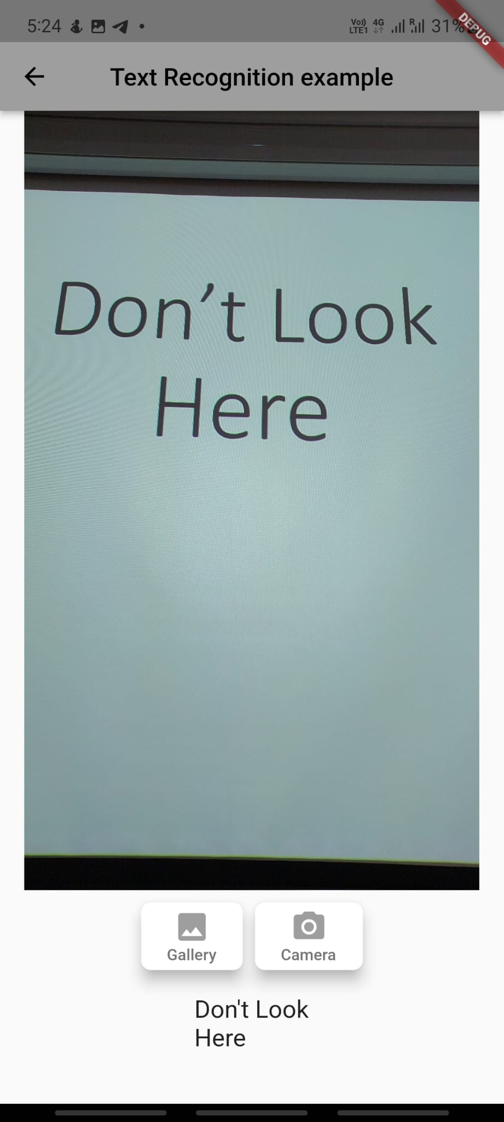
FUNCTION #3
Tesseract Text Reader
The app provides a facility for reading text from images such as food menus, notices, and sign boards, and informing the user through speech.

Slide 6
ADDITIONAL FEATURES
Temperature and Humidity Sensor - Detects and states the temperature and humidity of surroundings, and informs user about potential possibility of rain.
Speech Recognition - User can navigate different functionalities of the application with predefined spoken commands.
Text to Voice - The app is able to translate written text into speech to inform the user of the relevant information.

Slide 7
IMPLEMENTATION
Modified Yolov2 ML object detection model using Tensorflow and Keras. Exported model and labels to TFLite format for integration with Flutter. Connects with the mobile phone camera for live detection.
Implemented Text Recognizer model for reading text from images and deployed it on Flutter. Connects with the mobile phone camera to snap picture for recognition.
Connected HC-SR04 Ultrasonic sensor, and DHT 11 temperature and humidity sensors to Arduino microcontroller.
Programmed the Arduino microcontroller to connect to the mobile application using the HC-05 Bluetooth module.
Executed speech recognition model so that the application can recognize set of spoken instruction commands by the user.
Recorded data in text format on the application is converted to speech and spoken out by the application.

Slide 8
FUTURE SCOPE
‘Fall Alert’ feature that uses accelerometer to detect when the user falls down, and automatically calls user’s emergency contact.
Community feature that matches volunteers to users that might require help in certain situations such as travelling to the doctor and urgent assistance.
Inbuilt voice activated GPS system provided as an additional feature of the application.
Customizable component that can be used to fit the microcontroller onto any cane efficiently.
An option to have a smart shoe as an alternative for users that do not wish to use a cane.
Improving the structure and design of the microcontroller for greater marketability.

