Slide 1
Origin and Evolution of Popular Programming Languages
By – Jaikaran Saini

Slide 2
Main Menu
Objective
History and Timeline
Reasons for new Language
Conclusions

Slide 3
Objectives
Know the Technical difference between two Languages.
Examine the Reasons to invent a new Language.

Slide 4
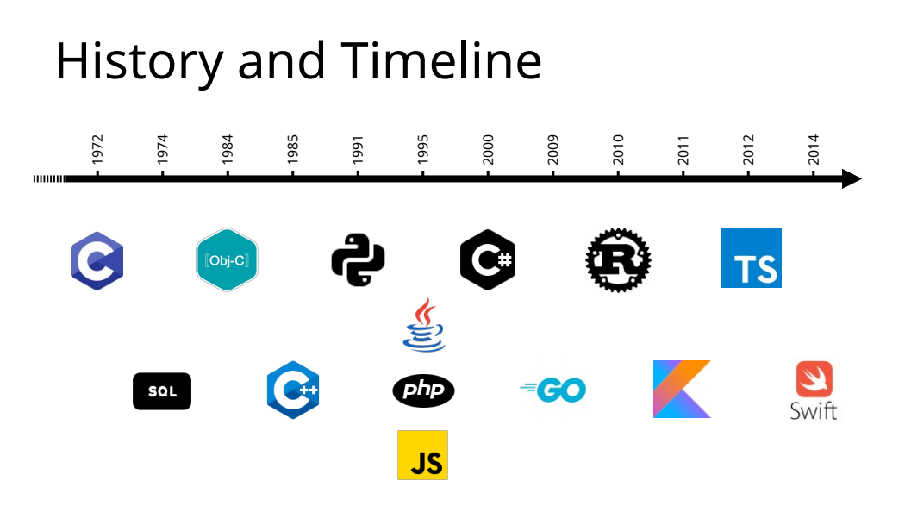

Slide 5
Reasons for new Language
Overcome the limitations of existing Language.
Fulfill the needs of new Technologies.
Big Programming Organizations decison.
Personal project.

Slide 6
Conclusions
Programming Languages will keep appearing and disappering.
We should know the use cases of Language before adopting it.

Slide 7
Jaikaran saini
B.Tech (CSE)
jaikrns@gmail.com
https://github.com/jaikarans

