Slide 1
ecommerce-point

Slide 2
strategy
Developing the API
Developing The Client-App

Slide 3
API Fuctionalities
Adding Users
User Authentication
Using Encrypted passwords
Adding, removing, updating, finding products

Slide 4

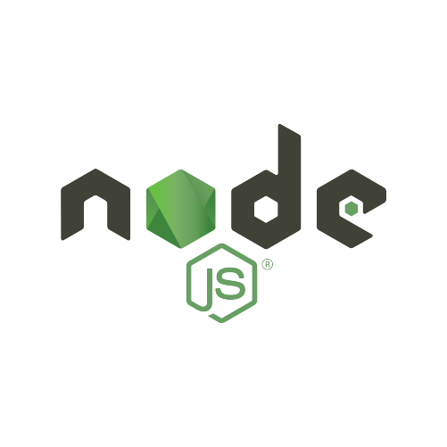







Slide 5
Utilities
Back-end
Front-end
Nodemon
MongoDB
Eslint
ExpressJs
Prettier
JSON Web Token
Morgan
Mongoose
Multer
Multer
Bcrypt

Slide 6
MongoDB
OpenSource NoSQL Database
Stores JSON Like Documents

Slide 7
ExpressJs
Backend Web Application Framework for NodeJs
Defines API Routes and Their behavior

Slide 8
Mongoose
Library to connect MongoDB with Expressjs
It Provides Object Data Modeling

Slide 9
JSON Web Token
Internet Standard for creating data with Signature
Helps with authentication

Slide 10
bcrypt
Library to support password hashing
It Provides password hashing function
It provides function to validate hash

Slide 11
Multer
NodeJs Middleware for handling form-data
Primary used for uploading files

Slide 12
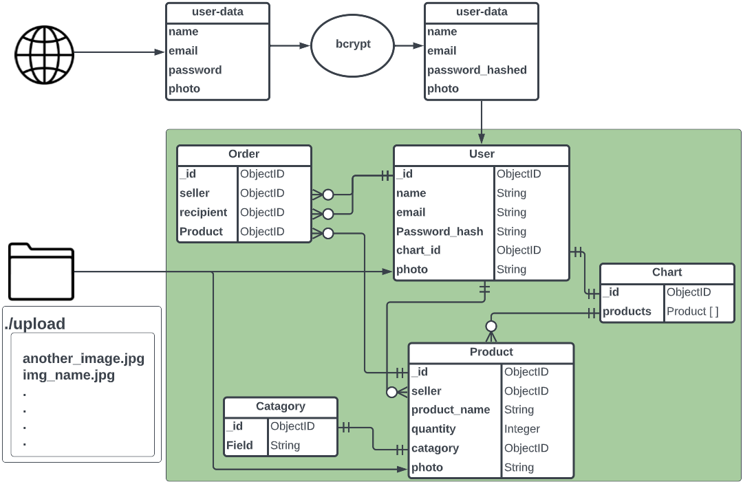

Slide 13
Promise based HTTP client for the browser and node.js
Promise based HTTP client for the browser and node.js
Promise based HTTP client for the browser and node.js

Slide 14
Jaikaran saini
B.Tech (CSE)
jaikrns@gmail.com
https://github.com/jaikarans

