Slide 1
HYPOTHESES GENERATION -BRIDGING AYURVEDA AND ALLOPATHY
AISHWARYA T 2013103030
SHIVA BALA RAKAVI A 2013103562
Guided by
Dr. AROCKIA XAVIER ANNIE R

Slide 2
INTRODUCTION
There is a large volume of biomedical information available on the internet
This has the potential to unlock new domains of knowledge in drug discovery
For example if fever is caused as an effect of cold, then the drugs that heal cold could be administered to heal fever.
If the drug in a philosophy has lurking side-effects, then the drug in another philosophy could be used
The exact chemical compound that heals a disease can be found by comparing the chemical constitution of similar drugs in two philosophies

Slide 3
OVERALL OBJECTIVE
Generate hypotheses of the diseases and the possible drugs in two systems of medicine, namely Allopathy and Ayurveda
Analyze the capacity of using neural networks to work with biomedical word embedding
Evaluate the accuracy and the precision of the generated hypotheses

Slide 4
LITERATURE SURVEY
1. Drawing on millions of biomedical journal publications to do predictive biology
IEEE, 2009.
Processes/Methods Used:
Bag of Words model (BOW)
Implicit and indirect associations to determine a predictive context
PROS | CONS
Text mining methods for extracting knowledge from biomedical literature are discussed Suggests the integration of information extraction, text mining and predictive biology for better results | Simple concept recognition techniques are used for establishing relations among objects It is restricted to analysis of DNA mutations and protein function prediction

Slide 5
LITERATURE SURVEY
2. Hypotheses Generation Pertaining to Ayurveda Using Automated Vocabulary Generation and Transitive Text Mining
IEEE, 2009.
Processes/Methods Used:
AVD over generated databank
Direct associations and transitive closure
PROS | CONS
AVD – Automated Vocabulary Discovery algorithm is suggested Transitive closure computation is used for hypotheses identification | Information retrieval methods are not clearly defined The hypotheses are restricted to one domain of medicine

Slide 6
LITERATURE SURVEY
3. Training word embeddings for deep learning in biomedical text mining tasks
IEEE, 2015.
Processes/Methods Used:
Text Analysis- use of stem, chunk and entity
Training of biomedical embeddings
PROS | CONS
Skip gram uses target words to predict the context words unlike CBOW where the context words are used to determine the target words Deep learning methods are more accurate in biomedical text mining than shallow models | Restricted to drug- drug interaction extraction and named entity recognition

Slide 7
LITERATURE SURVEY
4. A text mining model for hypothesis generation
IEEE, 2007
Processes/Methods Used:
Concept association graph
Generating paths between concepts
PROS | CONS
CAG combines information retrieval, text mining and link analysis methods CAG applied in biomedical texts identifies unknown associations | Processing of anaphors is not handled Stringent extraction of associations

Slide 8
PROPOSED SYSTEM
The system has two phases
Hypotheses generation phase
Hypotheses querying phase
Hypotheses generation phase:
Fetch diseases and drugs from Wikipedia
Extract the abstract of papers
Tokenize and extract stem , chunk and entity
Train word embedding
Hypotheses querying phase:
Query is pre-processed – spelling mistakes, typos are corrected
Query standardization and processing – Query terms are standardized and hypotheses are retrieved

Slide 9
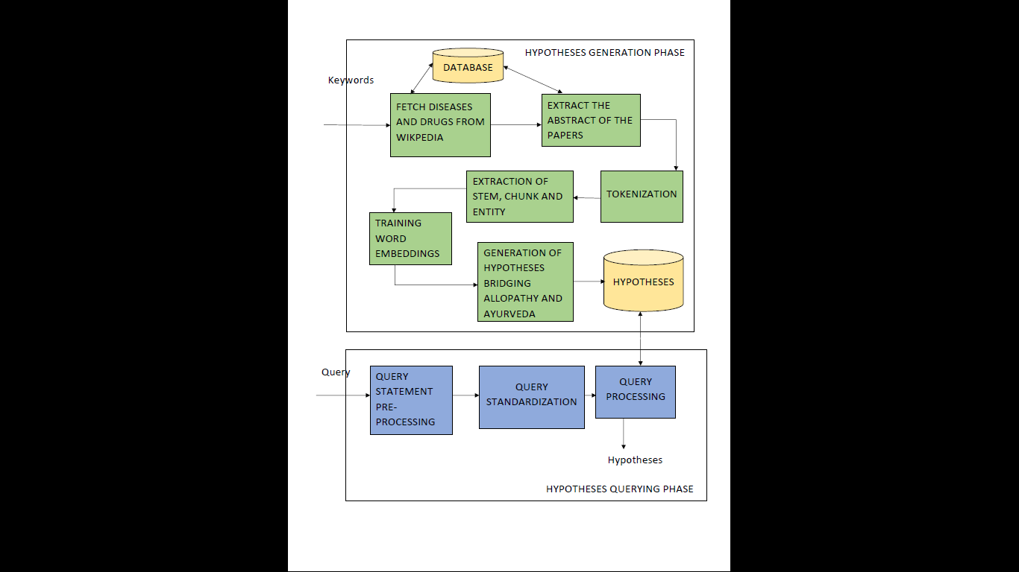
OVERALL ARCHITECTURE

Slide 10
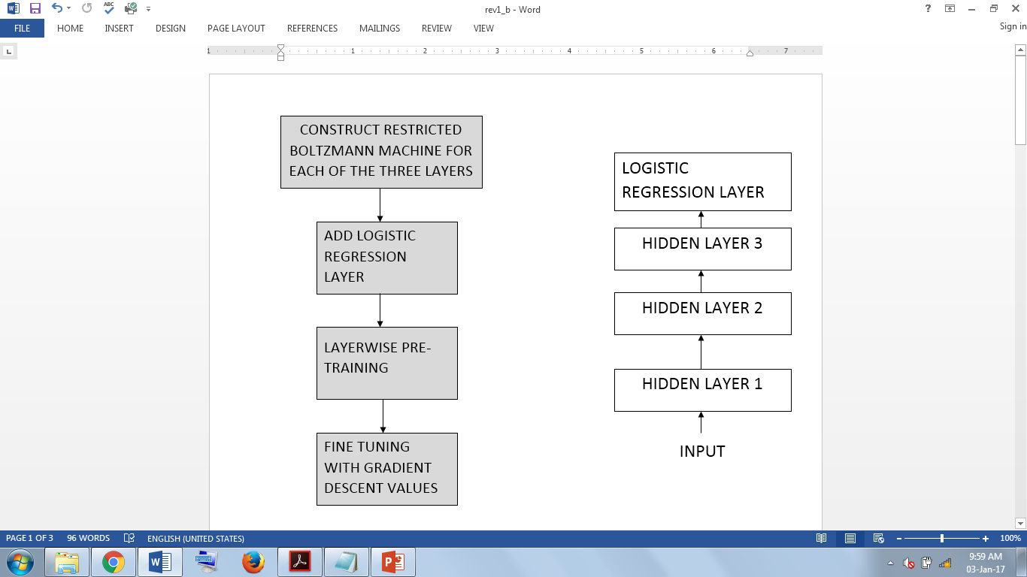
TRAINING WORD EMBEDDING
It is a multi-class classification problem
Hence, a deep belief network (DBN) along with a Logistic regression layer is used
DBN consists of three hidden layers.
This module involves is comprised of four steps

Slide 11
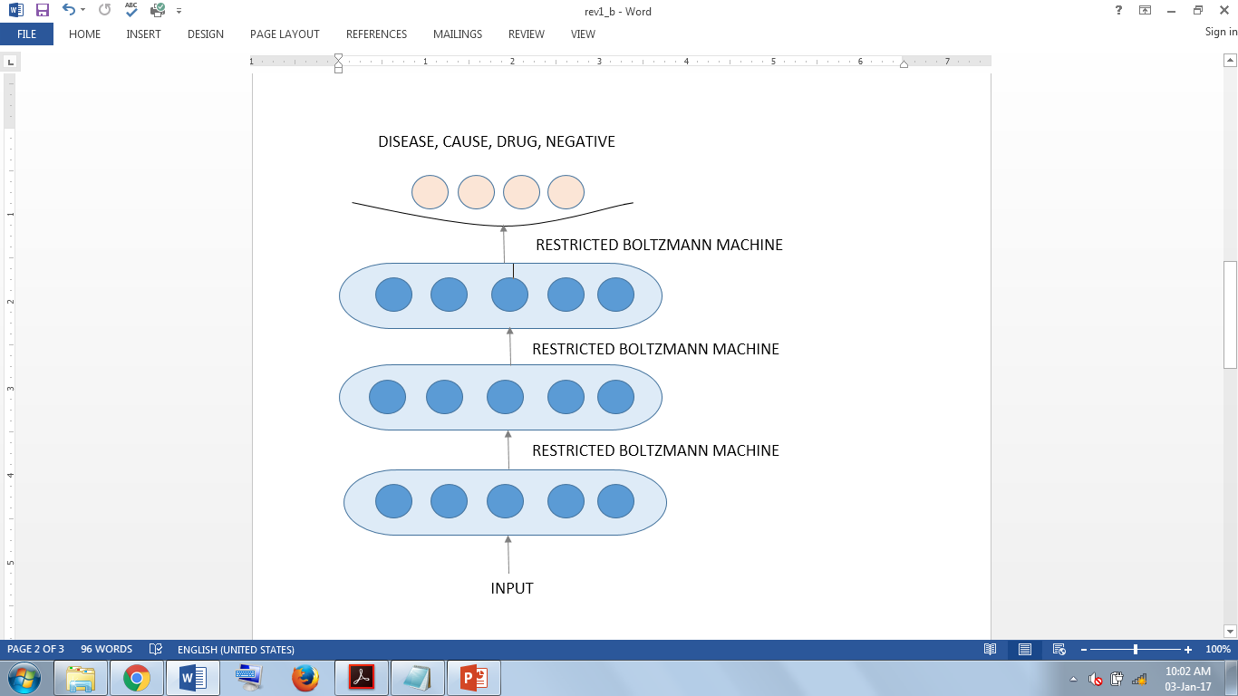
DEEP BELIEF NETWORK

Slide 12
FETCH DISEASES AND DRUGS FROM WIKIPEDIA
INPUT:
“list of drugs ” , ” list of diseases ” , ” list of medicinal plants”
OUPUT:
Dataset of disease names, drug names and herbs
ALGORITHM:
fetch_disease_drug(String keywords[])
{
list=null
for i=1 to n
keyword=keywords[i]
list=wikipedia.search(keyword)
store list in database
}

Slide 13
EXTRACT THE ABSTRACT FROM PAPERS
INPUT:
Dataset of disease names, drug names and herbs
OUTPUT:
Abstract of all papers
ALGORITHM:
extract_abstract()
{
open_or_create(data.txt)
get list of pid of the corresponding papers //pid—pubmed id
for each pid
url_to_download=‘http://www.ncbi.nlm.nih.gov/pubmed’+pid
abstract=url_to_download.getAbstract()
write abstract to the text file
}

Slide 14
TOKENIZATION
INPUT:
Abstract of all papers as text file
OUTPUT:
Tokens
ALGORITHM:
tokenization(abs.txt)
{
while(!EOF(abs.txt))
{
phrases_by_space=split_using_space(abstract)
phrases_by_char=split_using_special_characters(phrases_by_space)
if(phrases_by_char.contains(single_char_at_end)
t=strip_end_char(phrases_by_char)
tokens.add(t)
else
phrases_by_space.add(phrases_by_char)
}
}

Slide 15
EXTRACTION OF STEM , CHUNK AND ENTITY
INPUT:
Tokens
OUTPUT:
Stem, chunk and entity
ALGORITHM:
Use GENIA Dependency parser for biomedical text
Get the input tokens from a file
Write the output stem , chunk and entity to the file

Slide 16
TRAINING WORD EMBEDDINGS
INPUT:
words
OUTPUT:
trained neural network
ALGORITHM:
It involves four sub-modules:
1. construction of Restricted Boltzmann Machine(RBM) for each of the 3 layers
2. addition of logistic regression layer
3. layer wise pre-training
4. fine tuning with gradient descent values

Slide 17
RESTRICTED BOLTZMANN MACHINE CONSTRUCTION

Slide 18
ADDITION OF LOGISTIC REGRESSION LAYER

Slide 19
LAYERWISE PRE-TRAINING

Slide 20
FINE TUNING WITH GRADIENT DESCENT VALUES

Slide 21
QUERY STATEMENT PREPROCESSING
INPUT:
query
OUTPUT:
pre-processed query
ALGORITHM:
prepocessing(query)
{
remove_punctuations(query)
mis_spelt=find_mis_spelt_words(query)
replace_correct_terms(mis_spelt,query)
if(query.complex()==true)
query_list=query.split_to_simple()
else
query_list=query
}

Slide 22
QUERY STANDARDISATION
INPUT:
Pre-processed query
OUTPUT:
standardized query
ALGORITHM:
query_standardisation(pre_processed_query)
{
construct BOW_model of common terms and medical terms
for each term ∈ pre_processed_query
BOW_model.search(term)
term.replace(standard_medical_terms)
}

Slide 23
QUERY PROCESSING
INPUT:
Standardized query
OUTPUT:
Hypotheses
ALGORITHM:
query_processing(standardized query)
{
drug_list=select drugs from hypothesis.disease_drug where
disease=“standardized query”
do
{
drug=drug_list.head()
print(drug);
drug_list=drug_list.next()
}while(drug_list!=null)
}

Slide 24
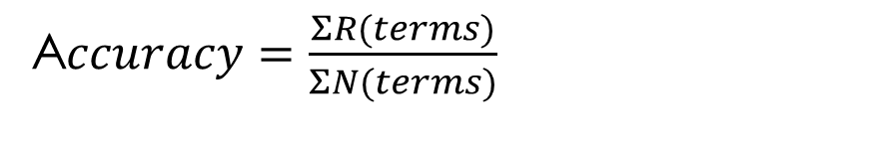
EVALUATION METRICS
Accuracy
Accuracy refers to the closeness of a measured value to a standard or known value.
A$ccuracy=\frac{ΣR(terms)}{ΣN(terms)}$

Slide 25

EVALUATION METRICS
Precision
Precision refers to the closeness of two or more measurements to each other.
$$precision\left(positive\right)=\frac{a}{(a+b)}$$
$$precision\left(negative\right)=\frac{d}{(c+d)}$$
Where,
a = True positive
b = False positive
c = True negative
d = False negative

Slide 26
REFERENCES
[1] Schmidhuber, Jürgen. "Deep learning in neural networks: An overview." Neural Networks 61 (2015): 85-117.
[2] Verspoor, Karin M. "Drawing on millions of biomedical journal publications to do predictive biology." 2015 International Conference on Big Data and Smart Computing (BIGCOMP). IEEE, 2015.
[3] Vaka, Harsha Gopal Goud, and Snehasis Mukhopadhyay. "Hypotheses Generation Pertaining to Ayurveda Using Automated Vocabulary Generation and Transitive Text Mining." 2009 International Conference on Network-Based Information Systems. IEEE, 2009.
[4] Jiang, Zhenchao, et al. "Training word embeddings for deep learning in biomedical text mining tasks." Bioinformatics and Biomedicine (BIBM), 2015 IEEE International Conference on. IEEE, 2015.

Slide 27
REFERENCES
[5] Jin, Wei, Rohini K. Srihari, and Hung Hay Ho. "A text mining model for hypothesis generation." 19th IEEE International Conference on Tools with Artificial Intelligence (ICTAI 2007). Vol. 2. IEEE, 2007.
[6] W. Zhang, T. Yoshida, and X. Tang, "A comparative study of TF*IDF, LSI and multi-words for text classification," Expert Systems with Applications, vol. 38, no. 3, pp. 2758–2765, Mar. 2011.
[7] Lee, Sangno, et al. "An empirical comparison of four text mining methods." System Sciences (HICSS), 2010 43rd Hawaii International Conference on. IEEE, 2010.

Slide 28
REFERENCES
[8] Ayyadurai, VA Shiva. "The control systems engineering foundation of traditional Indian medicine: the Rosetta Stone for Siddha and Ayurveda." International Journal of System of Systems Engineering 5.2 (2014): 125-149.
[9] Lanier, William L., and S. Vincent Rajkumar. "Empiricism and rationalism in medicine: can 2 competing philosophies coexist to improve the quality of medical care." Mayo Clinic Proceedings. Vol. 88. No. 10. Elsevier, 2013.
[10] Zhao, Xin-feng, et al. "A novel drug discovery strategy inspired by traditional medicine philosophies." Science 347.6219 (2015): S38-S40.

Slide 29
REFERENCES
[11] S. R. Shrivastava, P. S. Shrivastava, and J. Ramasamy, "Mainstreaming of Ayurveda, yoga, Naturopathy, Unani, Siddha, and Homeopathy with the health care delivery system in India," Journal of Traditional and Complementary Medicine, vol. 5, no. 2, pp. 116–118, Apr. 2015.
[12] Y.-C. Cheng, "Opportunities for traditional Chinese medicine to address unmet challenges in modern healthcare," Journal of Traditional and Complementary Medicine, vol. 5, no. 1, pp. 2–4, Jan. 2015.

