Slide 1


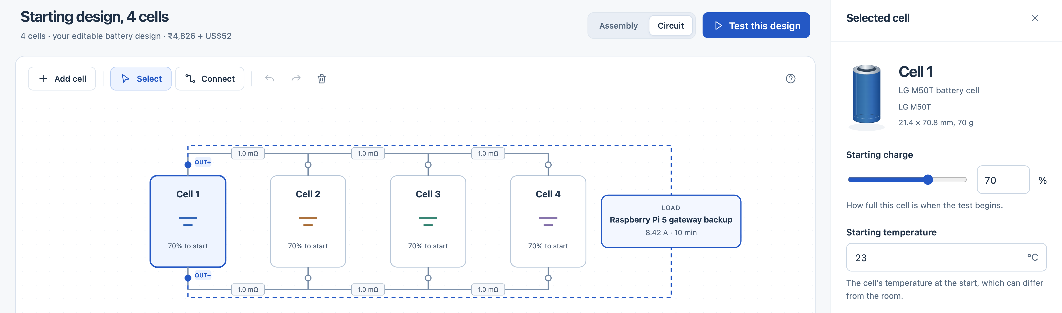
VOLT-FORGE
CASE STUDY 2
A visual workspace for battery trade-offs
Two cells are a simulation candidate
Smallest qualifying count tested (1-4 cells): half the baseline's cell cost and mass, with less electrical margin.
Pi 5 backup | LG M50T | 25 W supply-rating scenario | 10 min | 23°C | 70% starting SOC
90% converter assumed | 3.3 V study floor | 8.42 A constant-current proxy | actual Pi draw not measured
BUILD, TEST, UNDERSTAND
BASELINE + TWO ALTERNATIVES
Parallel design | Required passes | Worst cell current | Worst cell temperature | Cell mass | Listed cell cost
4 cells | 51/51 | 3.34 A | 26.1°C | 280 g | ₹4,824
3 cells | 42/42 | 3.86 A | 27.7°C | 210 g | ₹3,618
2 cells | 33/33 | 5.49 A | 31.8°C | 140 g | ₹2,412
Original V4 editor; illustrative circuit, not the study table.
For students and lab instructors: edit a circuit, inspect
current, voltage and simulated temperature, then
compare alternatives and export the evidence.
Frozen V4: same-end outputs; mismatch, thermal and converter sensitivity cases.
Counts vary by cell position. Temperatures simulated; cell-only cost and mass.
EVIDENCE
LIMITS THAT MATTER
USER + BUYER HYPOTHESIS
15/15 numerical checks passed
Conditional, not build-ready
Start with teaching labs
All 12 comparison cases missed voltage and
temperature bands. Measured accuracy is
not established.
No spare cell. Board current limits unverified.
Virtual cutoffs modelled; physical protection
has not been demonstrated.
Free student use; paid lab licences untested.
No observed user trials yet. Next user task:
complete and explain a comparison.
NEXT Measure load and converter behavior; bench-check with supervised cutoffs; observe student tasks.
Source + code: github.com/jaikaushik-prog/VOLT-FORGE
Team StratWise | Frozen V4 study | Submission draft
Notes:
Slide purpose: one-page submission draft; not submitted.
Two cells are the smallest qualifying simulated count among the tested 1-4-cell parallel arrangements. No claim of a global optimum, measured improvement, hardware approval or total-system cost reduction.
Table: frozen same-end-output baseline rows, not the opposite-output recommendation and not the new nominal examples. Worst values are across the declared required cases; counts differ with cell positions. Source software 97ca199f2fd21aac, pinned commit c2339a569876da5fc20969ea578a91ae57f33384.
25 W is a supply-rating scenario, not measured Pi workload. 90% conversion and 3.3 V floor are study assumptions. 8.42 A is a constant-current proxy, not a dynamic constant-power converter simulation.
15/15 numerical checks use synthetic electrical/heat-generation cases; they do not validate temperature predictions. All 12 measured-comparison cases missed both bands; cases are not 12 independent module experiments. Current reconciliation and transfer to new assemblies remain uncertain.
Screenshot: original V4 circuit image, not the revised UI and not the comparison-table topology.
Latest implementation changes: d184a49; 515 Python and 71 JavaScript checks passed, 8 archive-dependent checks skipped. They establish software behavior, not experimental battery accuracy. No live browser/user trial claimed.
Buyer/pricing proposal is a hypothesis. No real participant study is claimed. Next actions require suitable measurement access; no outreach performed.
Sources:
https://github.com/jaikaushik-prog/VOLT-FORGE/blob/c2339a569876da5fc20969ea578a91ae57f33384/reports/design_study_v2/run1/summary.json
https://github.com/jaikaushik-prog/VOLT-FORGE/blob/c2339a569876da5fc20969ea578a91ae57f33384/reports/v4_release/study_repeat.json
https://github.com/jaikaushik-prog/VOLT-FORGE/blob/c2339a569876da5fc20969ea578a91ae57f33384/configs/round1_design_study_v2.json
https://github.com/jaikaushik-prog/VOLT-FORGE/blob/c2339a569876da5fc20969ea578a91ae57f33384/reports/numerical_reference_v2/locked_97ca199/verification.json
https://github.com/jaikaushik-prog/VOLT-FORGE/blob/c2339a569876da5fc20969ea578a91ae57f33384/reports/numerical_reference_v2/locked_97ca199/protocol.json
https://github.com/jaikaushik-prog/VOLT-FORGE/blob/c2339a569876da5fc20969ea578a91ae57f33384/reports/measured_comparison_v1/final/result.json
https://github.com/jaikaushik-prog/VOLT-FORGE/blob/c2339a569876da5fc20969ea578a91ae57f33384/configs/measured_comparison_v1.json
https://github.com/jaikaushik-prog/VOLT-FORGE/blob/c2339a569876da5fc20969ea578a91ae57f33384/reports/design_study_v2/RECOMMENDATION.md
https://github.com/jaikaushik-prog/VOLT-FORGE/blob/c2339a569876da5fc20969ea578a91ae57f33384/reports/user_trial_v1/KIT.md
https://github.com/jaikaushik-prog/VOLT-FORGE/blob/c2339a569876da5fc20969ea578a91ae57f33384/configs/business_case_v1.json
https://github.com/jaikaushik-prog/VOLT-FORGE/blob/c2339a569876da5fc20969ea578a91ae57f33384/reports/slide_v4/assets/circuit.png
https://github.com/jaikaushik-prog/VOLT-FORGE/blob/c2339a569876da5fc20969ea578a91ae57f33384/reports/slide_v4/assets/logo_teliport.png
https://github.com/jaikaushik-prog/VOLT-FORGE/blob/c2339a569876da5fc20969ea578a91ae57f33384/reports/slide_v4/assets/logo_tata.png

