Slide 1


Team Details
Case Study 2

Slide 2


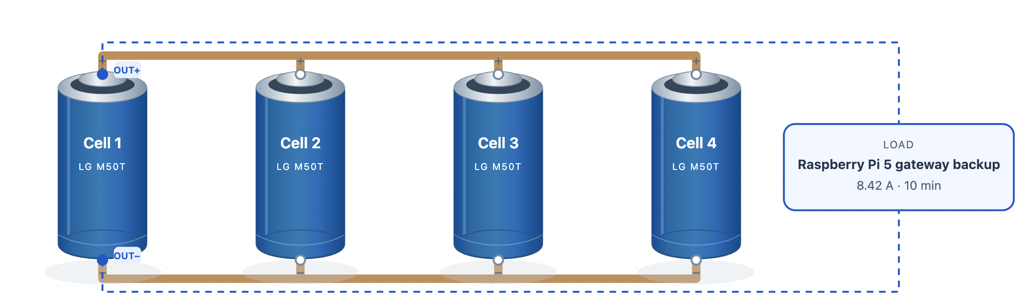
A Raspberry Pi 5 backup passes on 2 cells, not 4
VOLT-FORGE lets students and engineers test a battery design before buying parts
Define
Build
Test
Improve
Decide
Keep a Pi 5 gateway alive through a power cut: 10 minutes at 25 W
Wire real cells on a canvas, with the load shown on the design
Circuit and heat solved in seconds, with cell limits enforced
Find the smallest design rebuilds and tests 1 to 4 cells
Compare cost, mass and margin, then stress the winner
The starting design: Geekworm X1206 V2.0, four 21700 slots
What the tool found, with same-end outputs
2 cells
₹2,412
140 g
33 of 33
smallest qualifying, from 4
less on cells, ₹4,824 to ₹2,412
less cell mass, 280 to 140 g
required Pi cases passed
Cells | Verdict | Lowest V | Peak cell A | Warmest | Worst-case A | Worst-case °C | Cell cost | Cell mass
1 | Refused | — | — | — | — | — | ₹1,206 | 70 g
2 | Qualifies | 3.53 | 4.37 | 27.5 | 5.49 | 31.8 | ₹2,412 | 140 g
3 | Qualifies | 3.63 | 3.16 | 25.4 | 3.86 | 27.7 | ₹3,618 | 210 g
4 | Qualifies | 3.69 | 2.64 | 24.6 | 3.34 | 26.1 | ₹4,824 | 280 g
25 W supply · sourced
90% converter · assumed
8.42 A · calculated
10 min · assumed
3.3 V floor · assumed
23 °C room · assumed
How far to trust it
Who it is for, and what it is worth
Honest finding
Less margin: 2 of 62 mixed samples were refused at 12 A, while all 62 passed at the Pi load.
No link option wins every case: moving the output to the far cell eased worst-case current from 5.49 to 5.33 A, yet raised peak current in 35 of 81 pairs.
Not proven: the board on two cells, a real Pi draw or measured accuracy. The saving is cells only.
Next, Round 2: bench-test two cells on the board and run user trials.
Peak rise in K. All 12 pre-set real-data cases missed their bands, so temperatures are a range.
PyBaMM 15 of 15 on voltage and heat. Energy balance closes.
TAM
41.3 lakh
engineering students in India
SAM
15.6 lakh
electrical, electronics, mechanical
SOM
130 colleges
5% of 2,610, assumed
Free for students, paid for labs and teams. At an assumed ₹50,000 a lab, that is ₹65 lakh a year. Works with any cell through custom imports.
Test a design in seconds before you buy parts: the tool found a smaller battery that still does the job in simulation, at half the cell cost and mass.
Simulation, not hardware. 4,006 simulated cases on published LG M50T tables. Smallest qualifying design among the parallel arrangements tested. 8.42 A = 25 W ÷ (0.9 × 3.3 V), held constant. Prices checked 30 Oct 2026, excluding shipping and fabrication: Robu ₹1,206 incl. GST, out of stock; Geekworm US$52, one listing. Measured: Chen et al. 2020 (LG M50, zenodo.4032561) and Piombo et al. 2024 test 28 (M50T, 10.17632/zh58byr53c.2); low-cooling bars are post-hoc. Market: AISHE 2021-22; price and 5% reach are assumptions.

