Slide 1
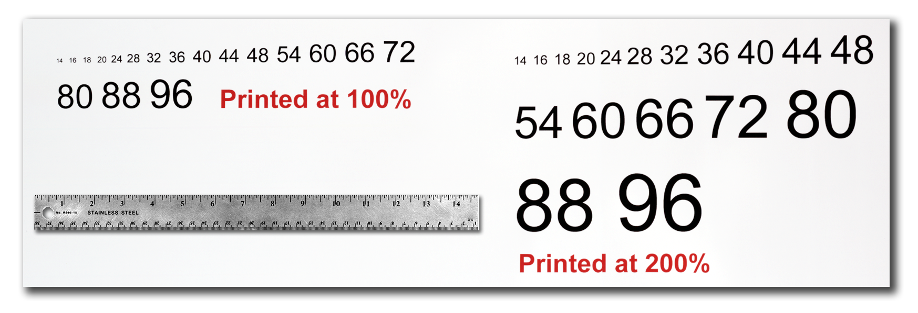




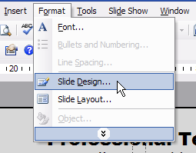
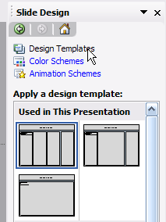
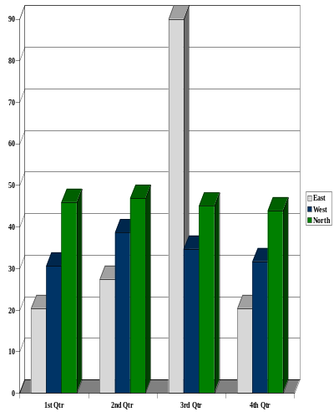
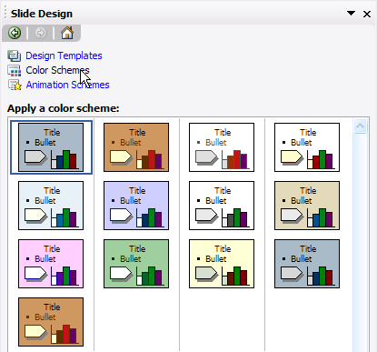
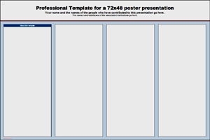
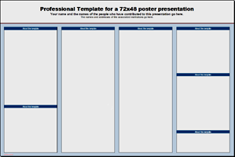



OPTIONAL
LOGO HERE
Professional Template for a 38x50 poster presentation
Your name and the names of the people who have contributed to this presentation go here.
The names and addresses of the associated institutions go here.
OPTIONAL
LOGO HERE
ABSTRACT
MATERIALS & METHODS
Importing Photographs
CONCLUSIONS
Use light color for background other than this color also according to your theme.
It is highly recommended to use the largest images you have access to for your poster. Avoid images downloaded from the web and avoid copying and pasting images instead of using the “Insert” command. To insert an image to your poster go to INSERT>PICTURE>FROM FILE (Figure 9).
(Figure 9)
Figure 4
When the only source of a needed photo or graphic is the Web, scaling has to be applied with caution. Scaling an image more than three times its original size may introduce pixelization artifacts. Refer to figure 10 as an example. A simple way to preview the printing quality of an image is to zoom in at 100% or 200%, depending on the final size of the poster. What you’ll see is likely what you’ll get at printing time.
RESULTS & DISCUSSION
Depending on how you layout your poster, you may want to change the column layout configuration.
For your convenience, we have included alternate master layouts. To select a different layout go to FORMAT>SLIDE DESIGN (Figure 5). The slide design pane will open. From there you can select an alternate layout (Figure 6).
INTRODCUTION
Figure 10: Original image at 100%, enlarged 200% and 400%.
Importing Tables & Graphs
REFERENCES
Importing tables, charts and graphs is easier than importing photos. To import charts and graphs from Excel, Word or other applications, go to EDIT>COPY, copy your chart and come back to PowerPoint. Go to EDIT>PASTE and paste the chart on the poster. You can scale your charts and tables proportionally by holding down the Shift key and dragging in or out one of the corners.
Figure 5
Figure 6
For those who wish to further personalize their poster presentation, we have included a number of printer-tested alternative color schemes for this poster template.
If you want to change the default colors and use your own color scheme, go to FORMAT>SLIDE DESIGN (Figure 7). The SLIDE DESIGN pane will open. Select COLOR SCHEMES (Figure 8). There, you can try different color schemes until you find the one you like.
TABLE ONE
1998 | 1999 | 2000
2001 | 2002 | 2003
2004 | 2005 | 2006
The blue headers are used to identify and separate the main topics of your presentation. The most commonly used headers in poster presentations are:
Contact information
Introduction, Summary or Abstract | Conclusion
Materials and Methods | Literature Cited
Results | Acknowledgements
A
B
Figure 1
Figure 2
Figure 3
Figure 7
Figure 8

