Slide 1
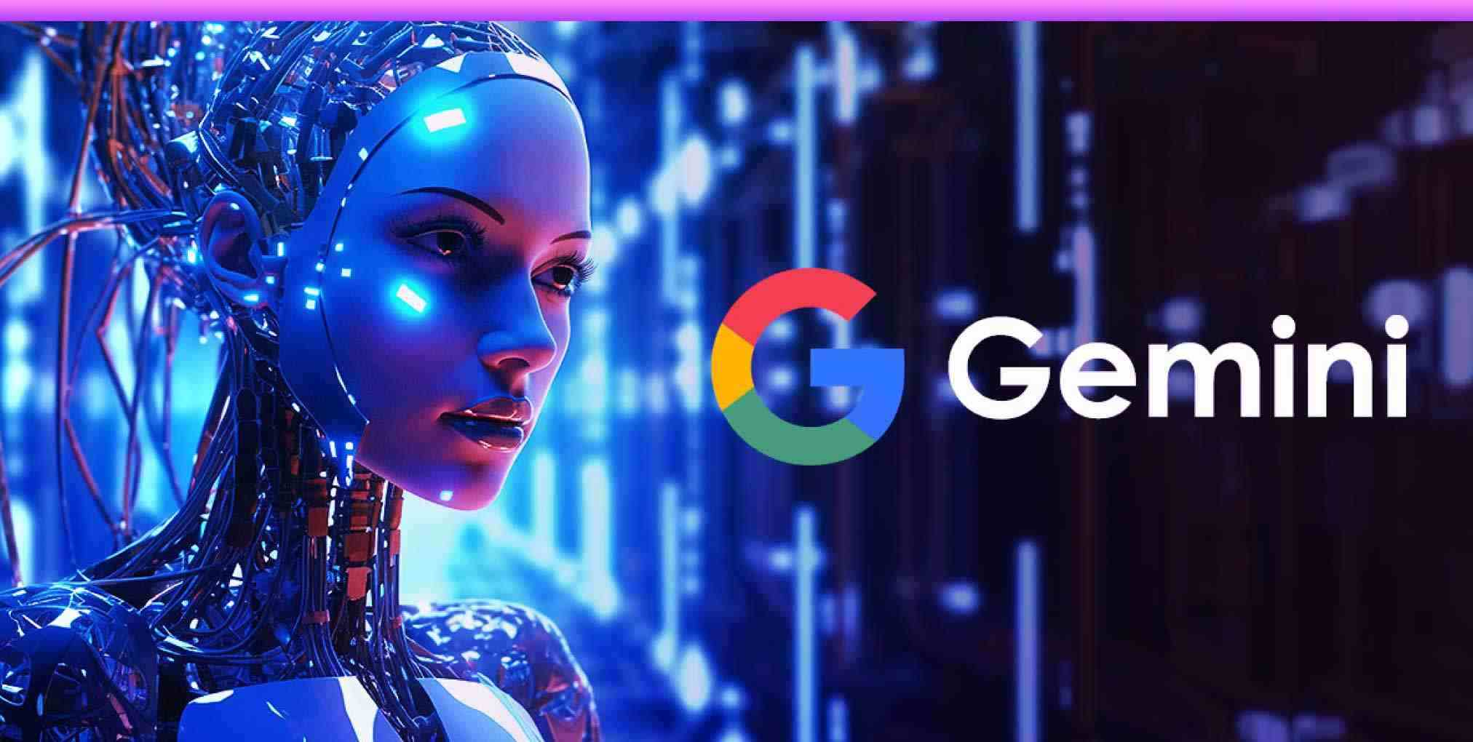
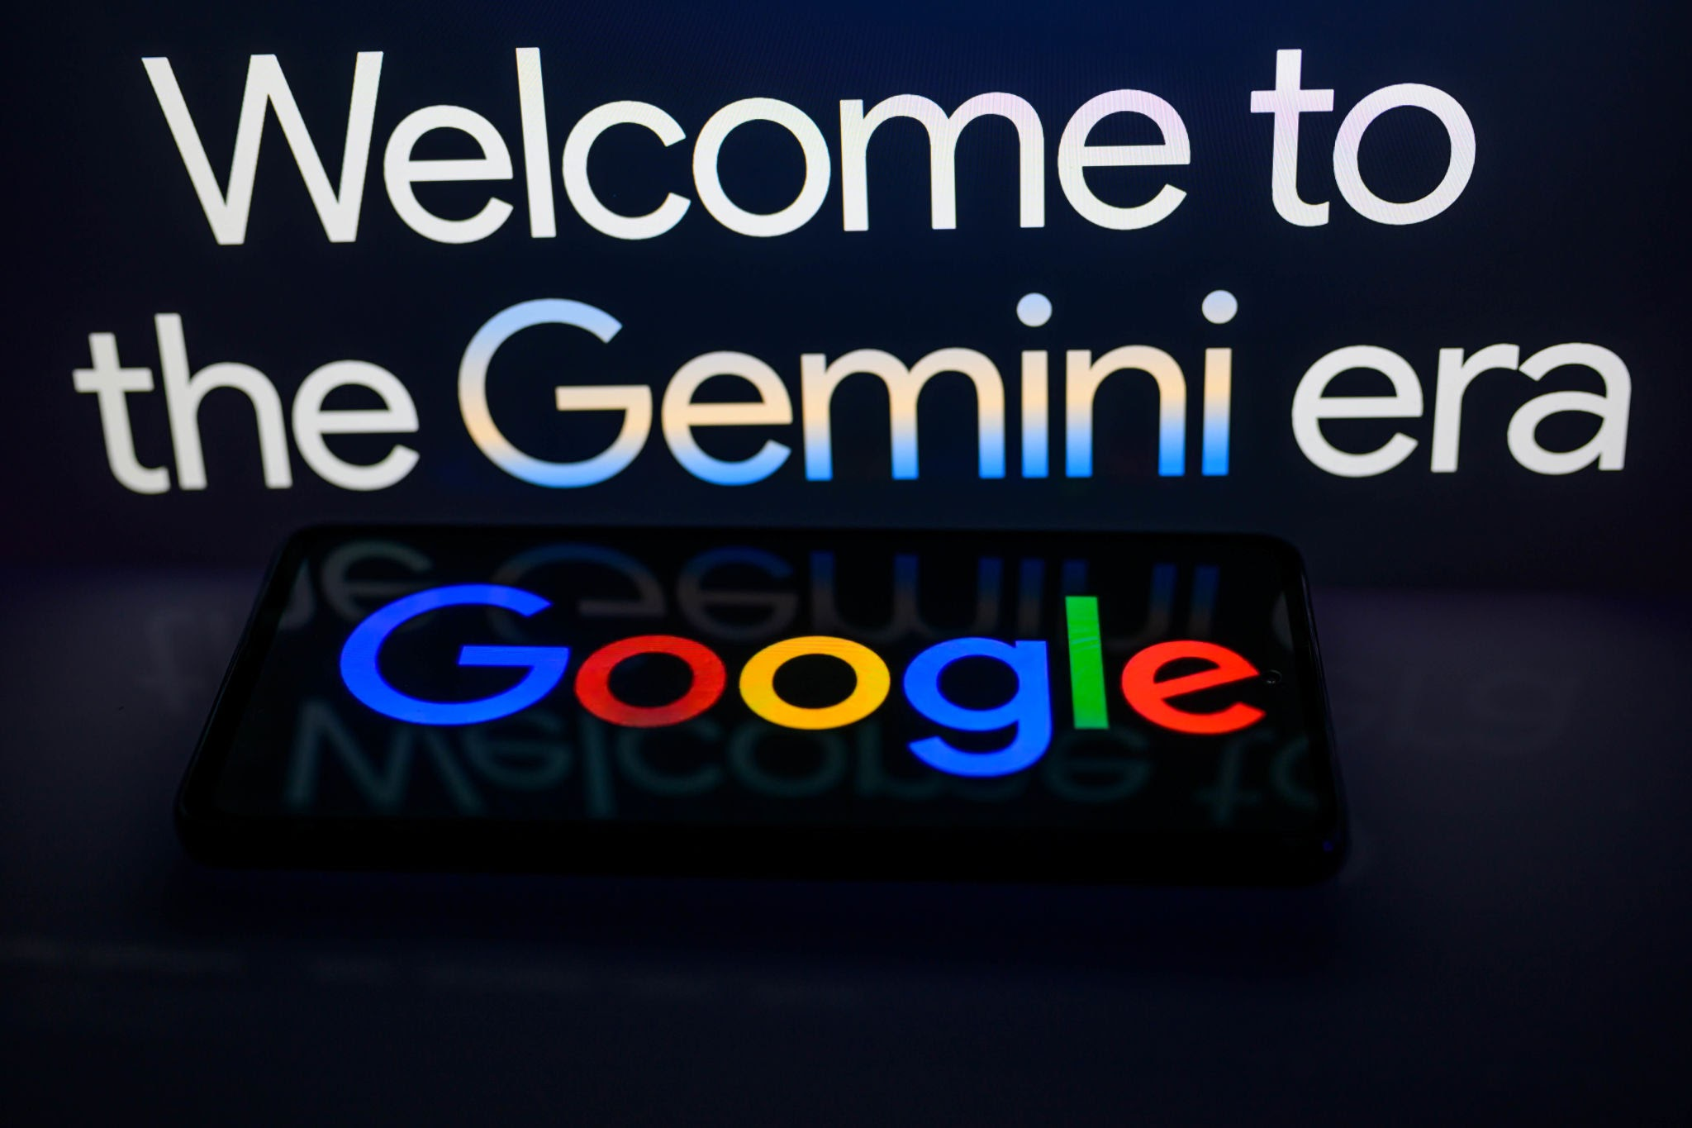
GEMINI
THE GENERATION OF AI
*Gemini is a family of large language models (LLMs) and a generative AI chatbot developed by Google AI.
*Modalities: Text, images, audio, video, and code.
*The Gemini Family of Models:Gemini Ultra,Gemini Pro,Gemini Flash, Gemini nano.
*Gemini can generate a wide range of creative text formats, including poems, scripts, musical pieces, and code.
*Gemini can translate languages with remarkable accuracy and understand complex grammar and cultural nuances.
*Gemini Can Acts as a research assistant, helping to spot trends, synthesize information, and compile reports.
*Generates campaign briefs for marketing, drafts personalized customer service replies, and creates job descriptions for HR.
*Used for advanced data analysis and security in Google Cloud.
*A strong commitment to developing AI with safety, security, and ethical considerations at its core.
*The development of more "agentic" models that can understand the world, think multiple steps ahead, and take actions on a user's behalf with supervision.
*Innovation: Continued investment in hardware like custom TPUs to power more efficient and capable models.

