Slide 1
UIDAI Hackathon
Team Reference ID : ErF9u5l90e
Team Member Details
Sl No | Name | E Mail ID
1. | JAI KISHORE N | sec19ec069@sairamtap.edu.in
2. | SATHYA PRAKASH S | sec19ec145@sairamtap.edu.in
3. | PRANAV S | sec19ec099@sairamtap.edu.in
4. | DEEPAK S | sec19ec191@sairamtap.edu.in

Slide 2
About the Problem Statement
Theme : Address Update.
Problem Statement 1: Address update challenges in urban areas
A common problem being faced by many migrant residents.
Imagine you move to a new city, For getting basic needs like gas connection or to get hold of internet to be online using broadband, you are asked for current Proof of Address.
This problem statement designed to solve the address update problem even when Proof of Address (PoA) Document is not there.

Slide 3
Approach
In order to do address update to your Aadhaar, A request is made to landlord for borrowing his address that used to update your Aadhaar through the App/Portal in auditable manner.
By posting your request to borrow address, landlord gets OTP notification on the phone and review the request for address.
If landlord agrees to share address, the verification process is done through a consent logs preserved for audit purpose.

Slide 4
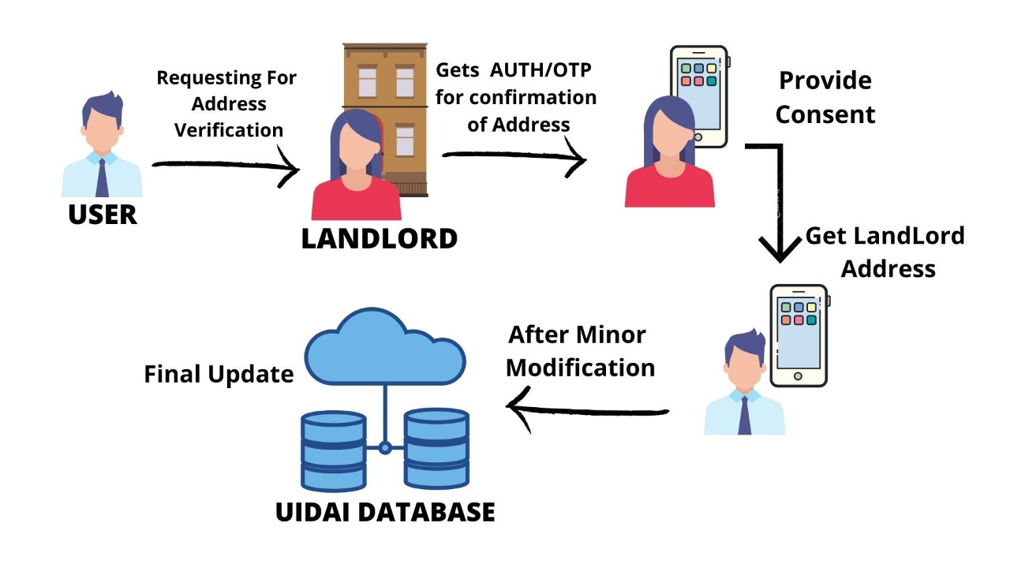
Architectural Diagram

Slide 5
Software used
Visual studio code : PHP, JS, CSS
XAMPP :cross-platform, Apache, MySQL, PHP and Perl, and it allows you to build , on a local web server on your computer.
Firebase :
For generating OTP and verification.
A storage database for address update to a particular Aadhaar number.

Slide 6
Proposed concept
An web application is developed as a portal page for agreement between resident and landlord for sharing his address.
After log in to update page by otp verification, if only the verfied code is correct it will redirect into address update page.
In Address Update page after entering the specified Aadhaar number then the address can be updated in viceversa.

Slide 7
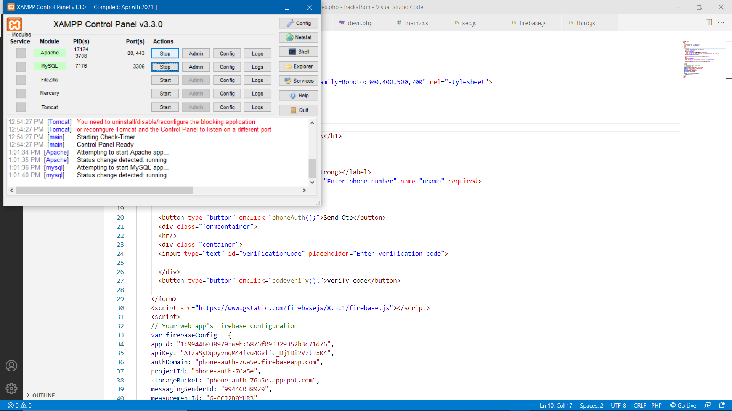
Localhost for website by XAMPP

Slide 8
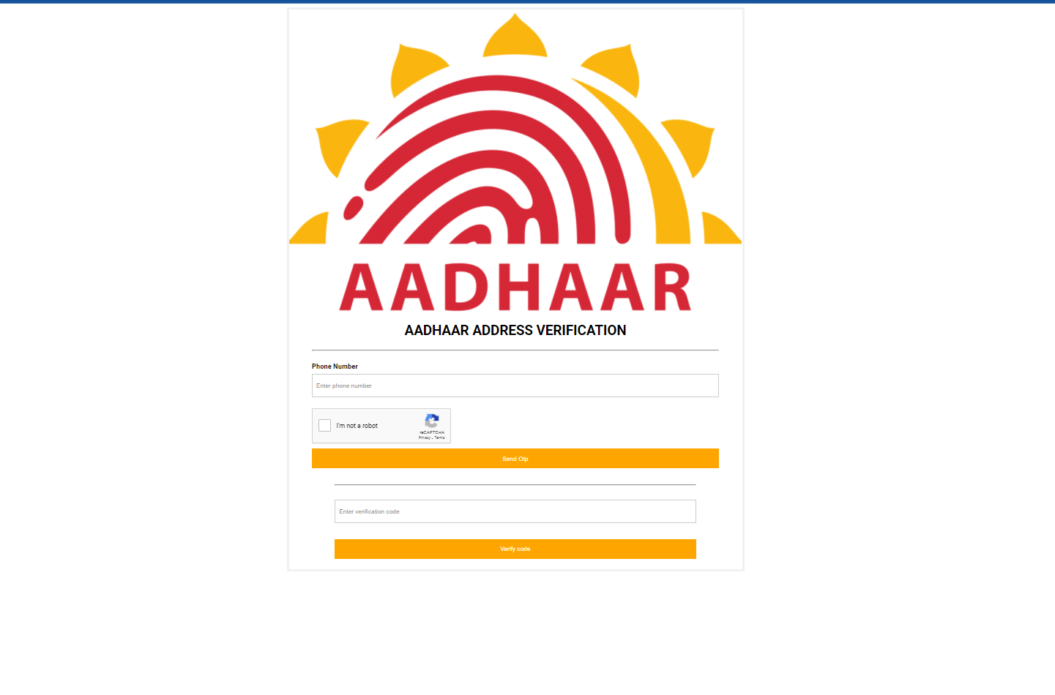
User Login Page
Files in this page
Index.php
Firebase.js
Main.css

Slide 9
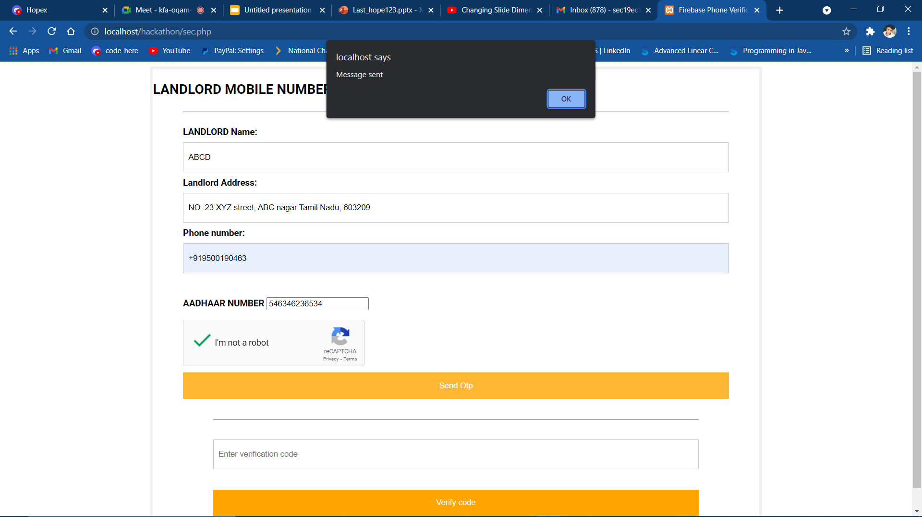
LAND LORD VERIFICATION PAGE
Files in this page
sec.php
Sec.js
main.css

Slide 10
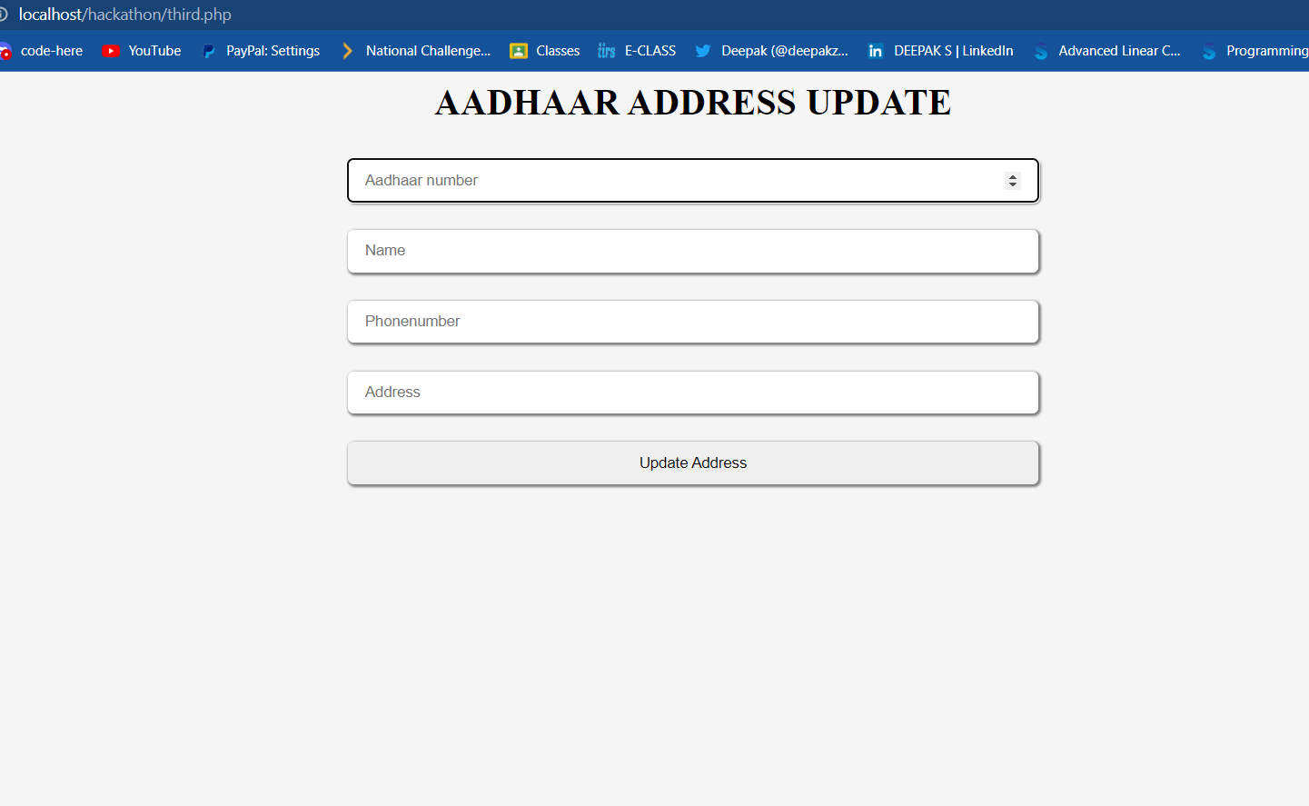
ADDRESS UPDATE PAGE
Files in this page
Third.php

Slide 11
API Usage
Authentication API: Authentication schemes provide a secure way of identifying the calling user.
OTP API : From this, you can programmatically obtain an OTP from an SMS message and verify a phone number for the user more easily.
Here, the Aadhaar API is used to fetch and update landlords address, which is protected by OTP Authentication.

Slide 12
Security considerations
Entering the invalid Aadhaar number won't show any response in portal.
This portal can be accessed only between landlord and resident
Process is auditable and free from fraudulent usage.
The OTP generation is sent to the landlord and verified, if the OTP is wrong, it will notify the error message and won't redirect into address update page.

Slide 13
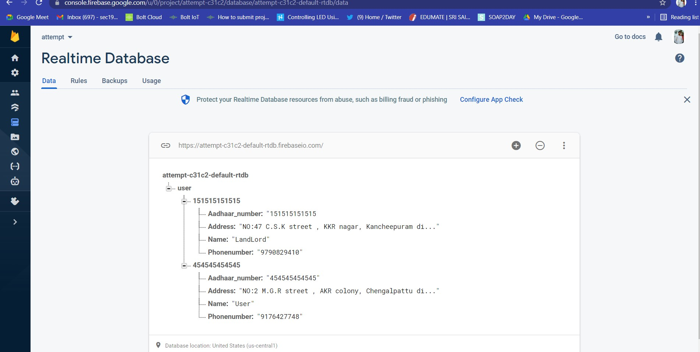
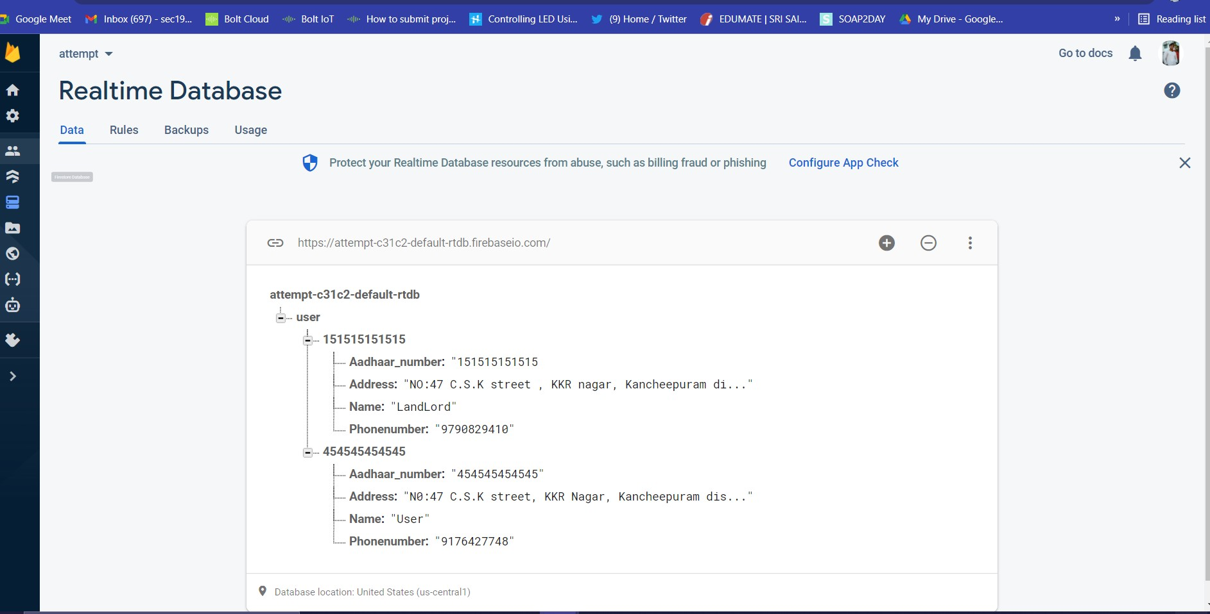
Firebase database
The address will update, only if the Aadhaar number is valid.
Before updating
After updating

Slide 14
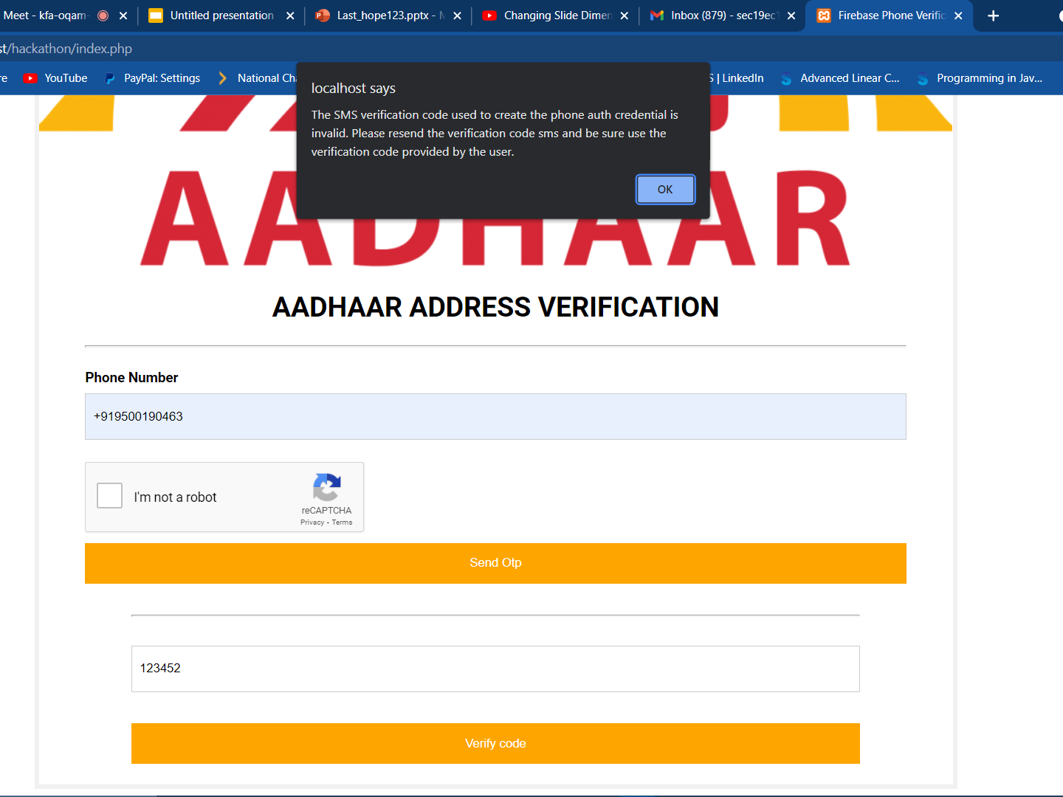
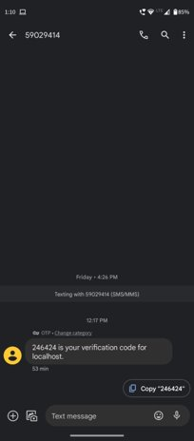
The OTP generation is sent to the landlord and verified, if the OTP is wrong, it will notify the error message and won't redirect into address update page.

Slide 15

Thank you

