Slide 1


Slide 2

PYTHON PROGRAMMING

Slide 3
AGENDA
Programing Language and Program execution ?
What is python ?
Why python ?
Features of python ?
First Program in python.
Python setup.
Data types in python.
Python operators.

Slide 4
PYTHON
Python is a widely used general-purpose, high level programming language. It was created by Guido van Rossum in 1991.
Why Python ?
Readable and Easy to Learn
Object Oriented
Interpreted
High-Level Language
Dynamic Typing
Cross-platform
large standard library

Slide 5
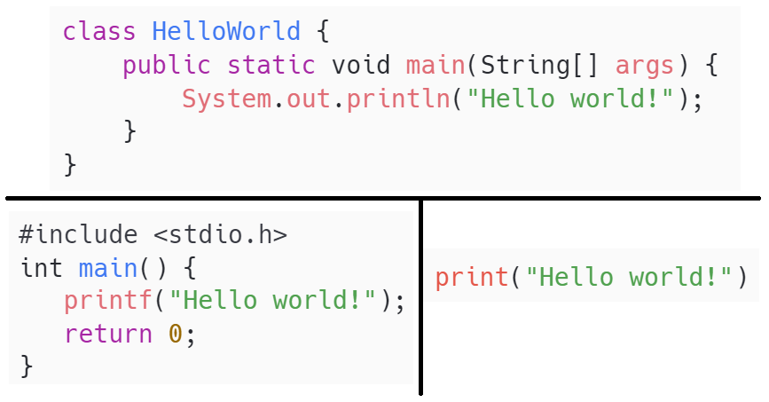
PROGRAM COMPARISON

Slide 6
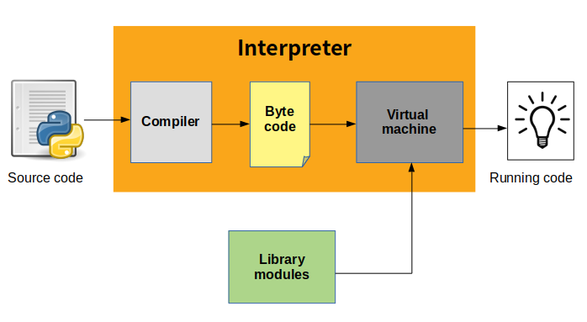
Programing Language and Program execution

Slide 7
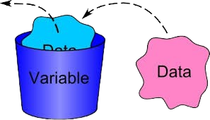
VARIABLES
Think of a variable as a small storage compartment in the computer's memory. It's like having a tiny box where we can keep different kinds of information, such as numbers, words, or even more complex data like lists or sets. Each box has a name,

Slide 8
VARIABLE NAMES RULES
A variable name must start with a letter or the underscore character
A variable name cannot start with a number
A variable name can only contain alpha-numeric characters and underscores (A-z, 0-9, and _ )
Variable names are case-sensitive (age, Age and AGE are three different variables)
A variable name cannot be any of the Python keywords.

Slide 9
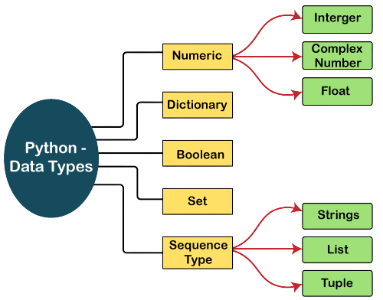
DATA TYPES IN PYTHON

Slide 10
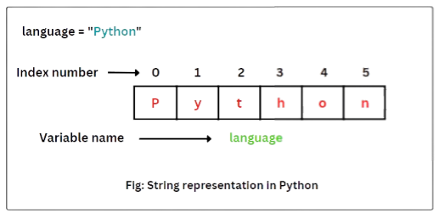
STRING

Slide 11
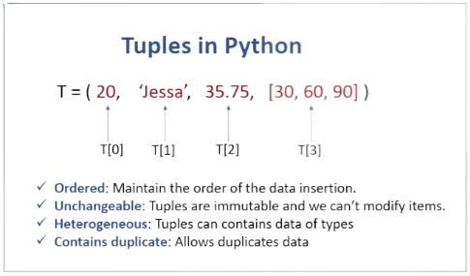
TUPLE

Slide 12
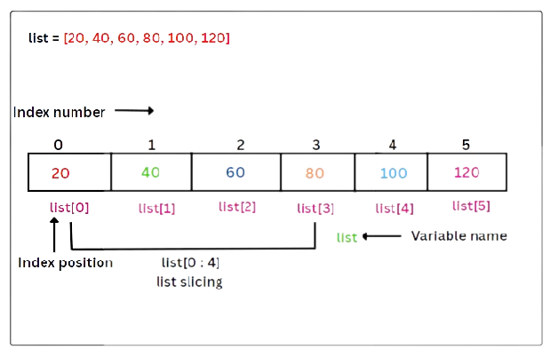
LIST

Slide 13
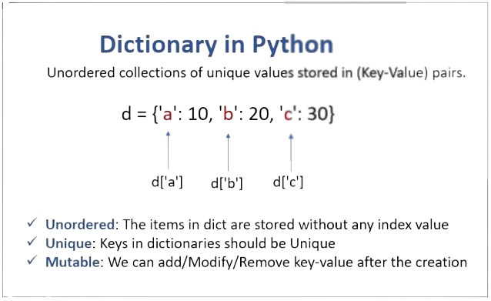
Dictionary

Slide 14
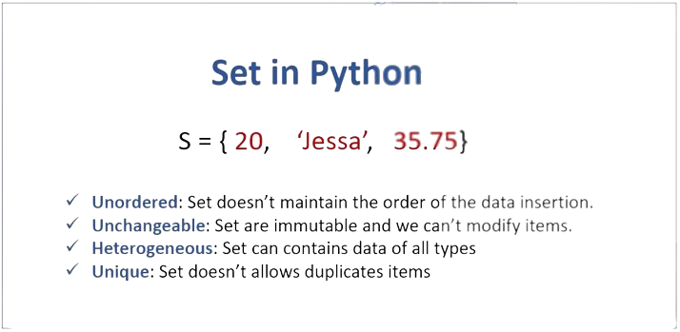
SET

Slide 15

PYTHON OPERATORS
Comparison
Arithmetic
Logical
Identity
Assignment
Bitwise
Membership

Slide 16
ARITHMETIC OPERATORS
+ Addition x+ y
- Subtraction x - y
* Multiplication x * y
/ Division x / y
% Modulus x % y
** Exponentiation x ** y
// Floor division x // y

Slide 17
COMPARISON OPERATORS
== Equal x == y
!= Not equal x != y
> Greater than x > y
< Less than x < y
>= Greater than or equal to x >= y
<= Less than or equal to x <= y

Slide 18
ASSIGNMENT OPERATORS
= x = 5 x = 5
+= x += 3 x = x + 3
-= x -= 3 x = x - 3
*= x *= 3 x = x * 3
/= x /= 3 x = x / 3
%= x %= 3 x = x % 3
//= x //= 3 x = x // 3
**= x **= 2 x = x ** 2

Slide 19
LOGICAL OPERATORS
Operator | Description | Syntex
and | Logical AND: True if both the operands are true | x and y
or | Logical OR: True if either of the operands is true | x or y
not | Revert result | not x

Slide 20
BITWISE OPERATORS
Operator | Description | Syntex
& | AND | x & y
| | OR | x | y
^ | XOR | x^y

Slide 21
IDENTITY OPERATORS
Operator | Description | Syntex
is | Returns True if both variables are the same object | x is y
is not | Returns True if both variables are not the same object | x is not y

Slide 22
MEMBERSHIP OPERATORS
Operator | Description | Syntex
IN | True if exist | x in y
not in | True if not exist | x not in y

Slide 23
CONDITIONAL STATEMENT
A conditional statement in programming is a control structure that allows a program to execute different blocks of code based on specific conditions. It enables the program to make decisions and choose between alternative actions.
Syntax :-
if condition1:
# Code to execute if condition1 is true
elif condition2:
# Code to execute if condition2 is true
else:
# Code to execute if none of the conditions are true

Slide 24
LOOPING
In Python, loops are control structures that allow you to execute a block of code repeatedly. There are two main types of loops: -
For
While

Slide 25
FOR LOOP
A for loop is used when you know in advance how many times you want to iterate over a sequence (e.g., a list, tuple, or string).
Here's the basic syntax of a for loop in python :-
#Syntax in python
for i in range(10):
# for loop body
print(i)
# Syntaxt in c
for (i = 0; i < 5; i++) {
# for loop body
printf("%d\n", i);
}

Slide 26
WHILE LOOP
A while loop is used when you want to repeatedly execute a block of code as long as a specified condition is True.
Here's the basic syntax of a while loop:
initialiazation
while condition:
#body of while loop
increament
i = 0
while i <=5:
print(‘Hello World’)
i+=1

Slide 27
FUNCTION
A function is a block of reusable code that performs a specific task or a set of tasks and function allows modularity , reusability , abstraction.
There are mainly 2 kind of functions in python:-
Built-in Functions ( print(), len(), range(), max(), min() ).
User-Defined Functions.

Slide 28
User-Defined Functions
Syntax for Defining function :-
def function_name(parameters):
# Code block
# ...
return result
Calling a function
function_name(argument)

Slide 29
Anonymous Function
An anonymous function in Python is a function without a name. They are also known as "lambda" functions, Lambda functions are typically used for short, simple operations , They are especially useful in situations where you need to pass a function as an argument to another function.
Syntax of Lambda Function :-
lambda arguments: expression
lambda arguments: expression_if_true if condition else expression_if_false
check_even = lambda x: "Even" if x % 2 == 0 else "Odd"

Slide 30
Map()
The map() function in Python is used to apply a specified function to each item in an iterable (like a list) and return an iterator of the results.
Syntax of Lambda Function :-
# Define a list of numbers
numbers = [1, 2, 3, 4, 5]
# Define a function that squares a number
def square(x):
return x ** 2
squared_numbers = map(square, numbers)
squared_numbers_list = list(squared_numbers)

Slide 31
Filter()
The filter() function in Python is used to construct an iterator from elements of an iterable for which a function returns true. :-
# Define a list of numbers
numbers = [1, 2, 3, 4, 5]
# Define a function that squares a number
def even(x):
return x%2==0
filter_numbers = filter(even, numbers)
filter_numbers_list = list(filter_numbers)

Slide 32
Filter()
The filter() function in Python is used to construct an iterator from elements of an iterable for which a function returns true. :-
# Define a list of numbers
numbers = [1, 2, 3, 4, 5]
# Define a function that squares a number
def even(x):
return x%2==0
filter_numbers = filter(even, numbers)
filter_numbers_list = list(filter_numbers)

Slide 33
EXCEPTIONAL HANDLING
Exception handling in Python allows you to handle errors or exceptional situations that may occur during the execution of a program. It prevents your program from crashing and provides a way to gracefully recover from errors .
The key components of exception handling in Python are :
try
except
else
finally

Slide 34
TYPE OF EXCEPTIONS
SyntaxError
TypeError
NameError
IndexError
KeyError
ValueError
AttributeError
ZeroDivisionError
Indentation Error
ImportError

Slide 35
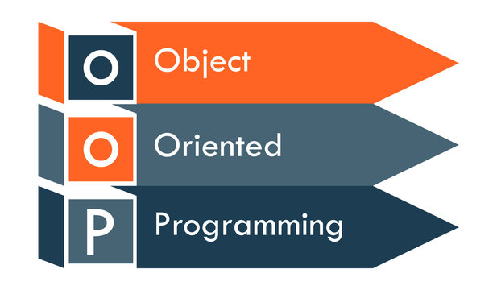
Object Oriented Programing
Object-oriented programming (OOP) is a way of writing computer programs using objects that represent real-world entities.

Slide 36
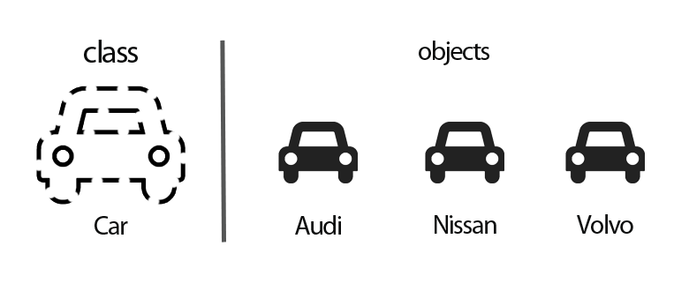
Class
a class is a blueprint or template for creating objects (instances).
It defines the structure and behaviors that objects, it has attributes
(data members) and methods (functions).

Slide 37
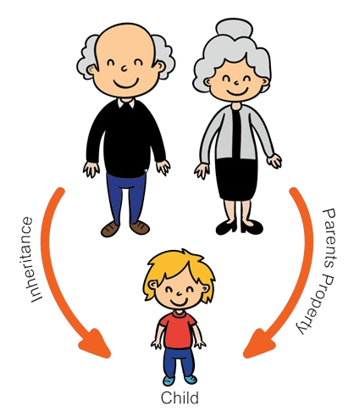
INHERITANCE
Inheritance is a concept in object-oriented programming where a new class (subclass or derived class) can inherit attributes and methods from an existing class (superclass or base class).
it's like a parent passing down traits to their child
Types of Inheritance:
Single Inheritance
Multiple Inheritance
Multilevel Inheritance
Hierarchical Inheritance

Slide 38

CHAT APPLICATION

Slide 39

NETWORK

Slide 40

NETWORK

