Slide 1






PYTHON PROGRAMMING

Slide 2
AGENDA
Programing Language and Program execution ?
What is python ?
Why python ?
Features of python ?
First Program in python.
Python setup.
Data types in python.
Python operators.

Slide 3
PYTHON
Python is a widely used general-purpose, high level programming language. It was created by Guido van Rossum in 1991.
Why Python ?
Readable and Easy to Learn
Object Oriented
Interpreted
High-Level Language
Dynamic Typing
Cross-platform
large standard library

Slide 4
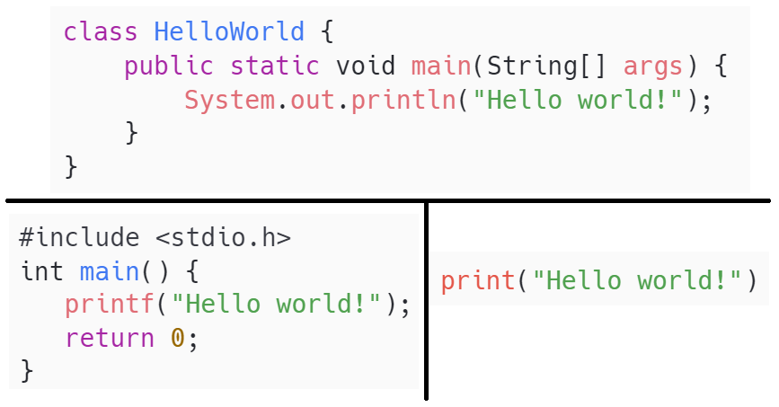
PROGRAM COMPARISON

Slide 5
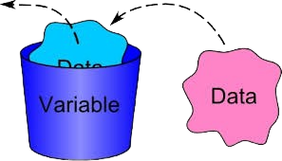
VARIABLES
Think of a variable as a small storage compartment in the computer's memory. It's like having a tiny box where we can keep different kinds of information, such as numbers, words, or even more complex data like lists or sets. Each box has a name,

Slide 6
VARIABLE NAMES RULES
A variable name must start with a letter or the underscore character
A variable name cannot start with a number
A variable name can only contain alpha-numeric characters and underscores (A-z, 0-9, and _ )
Variable names are case-sensitive (age, Age and AGE are three different variables)
A variable name cannot be any of the Python keywords.

Slide 7
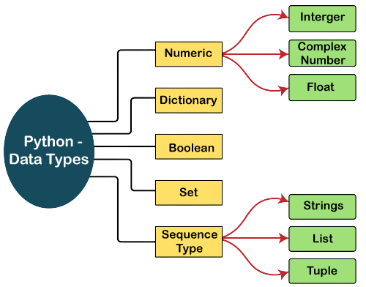
DATA TYPES IN PYTHON

Slide 8
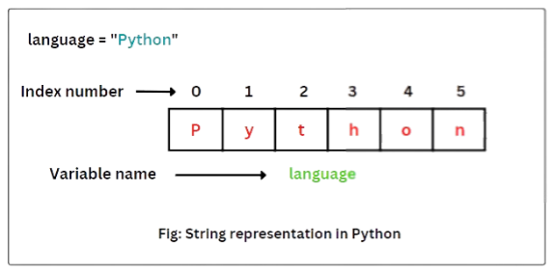
STRING

Slide 9
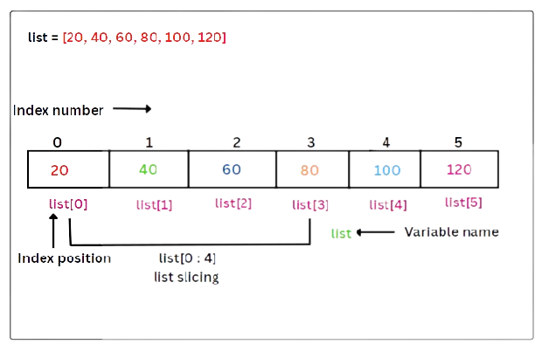
LIST

Slide 10
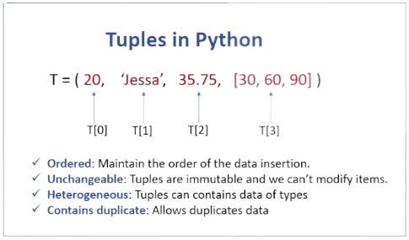
TUPLE

Slide 11
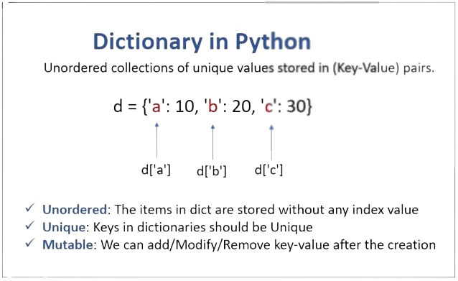
Dictionary

Slide 12
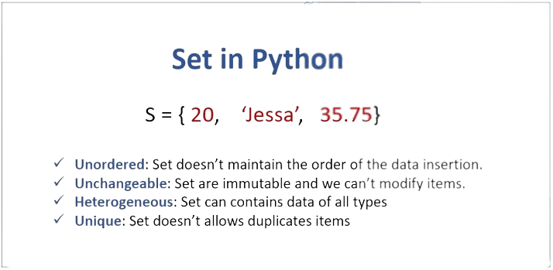
SET

Slide 13

PYTHON OPERATORS
Comparison
Arithmetic
Logical
Identity
Assignment
Bitwise
Membership

Slide 14
ARITHMETIC OPERATORS
+ Addition x+ y
- Subtraction x - y
* Multiplication x * y
/ Division x / y
% Modulus x % y
** Exponentiation x ** y
// Floor division x // y

Slide 15
COMPARISON OPERATORS
== Equal x == y
!= Not equal x != y
> Greater than x > y
< Less than x < y
>= Greater than or equal to x >= y
<= Less than or equal to x <= y

Slide 16
ASSIGNMENT OPERATORS
= x = 5 x = 5
+= x += 3 x = x + 3
-= x -= 3 x = x - 3
*= x *= 3 x = x * 3
/= x /= 3 x = x / 3
%= x %= 3 x = x % 3
//= x //= 3 x = x // 3
**= x **= 2 x = x ** 2

Slide 17
LOGICAL OPERATORS
Operator | Description | Syntex
and | Logical AND: True if both the operands are true | x and y
or | Logical OR: True if either of the operands is true | x or y
not | Revert result | not x

Slide 18
IDENTITY OPERATORS
Operator | Description | Syntex
is | Returns True if both variables are the same object | x is y
is not | Returns True if both variables are not the same object | x is not y

Slide 19
MEMBERSHIP OPERATORS
Operator | Description | Syntex
IN | True if exist | x in y
not in | True if not exist | x not in y

Slide 20
CONDITIONAL STATEMENT
A conditional statement in programming is a control structure that allows a program to execute different blocks of code based on specific conditions. It enables the program to make decisions and choose between alternative actions.
Syntax :-
if condition1:
# Code to execute if condition1 is true
elif condition2:
# Code to execute if condition2 is true
else:
# Code to execute if none of the conditions are true

Slide 21
LOOPING
In Python, loops are control structures that allow you to execute a block of code repeatedly. There are two main types of loops: -
For
While

Slide 22
FOR LOOP
A for loop is used when you know in advance how many times you want to iterate over a sequence (e.g., a list, tuple, or string).
Here's the basic syntax of a for loop in python :-
#Syntax in python
for i in range(10):
# for loop body
print(i)
# Syntaxt in c
for (i = 0; i < 5; i++) {
# for loop body
printf("%d\n", i);
}

Slide 23
WHILE LOOP
A while loop is used when you want to repeatedly execute a block of code as long as a specified condition is True.
Here's the basic syntax of a while loop:
initialiazation
while condition:
#body of while loop
increament
i = 0
while i <=5:
print(‘Hello World’)
i+=1

Slide 24
FUNCTION
A function is a block of reusable code that performs a specific task or a set of tasks and function allows modularity , reusability , abstraction.
There are mainly 2 kind of functions in python:-
Built-in Functions ( print(), len(), range(), max(), min() ).
User-Defined Functions.

Slide 25
User-Defined Functions
Syntax for Defining function :-
def function_name(parameters):
# Code block
# ...
return result
Calling a function
function_name(argument)

Slide 26
Anonymous Function
An anonymous function in Python is a function without a name. They are also known as "lambda" functions, Lambda functions are typically used for short, simple operations , They are especially useful in situations where you need to pass a function as an argument to another function.
Syntax of Lambda Function :-
lambda arguments: expression
lambda arguments: expression_if_true if condition else expression_if_false
check_even = lambda x: "Even" if x % 2 == 0 else "Odd"

Slide 27
Map()
The map() function in Python is used to apply a specified function to each item in an iterable (like a list) and return an iterator of the results.
Syntax of Lambda Function :-
# Define a list of numbers
numbers = [1, 2, 3, 4, 5]
# Define a function that squares a number
def square(x):
return x ** 2
squared_numbers = map(square, numbers)
squared_numbers_list = list(squared_numbers)

Slide 28
Filter()
The filter() function in Python is used to construct an iterator from elements of an iterable for which a function returns true. :-
# Define a list of numbers
numbers = [1, 2, 3, 4, 5]
# Define a function that squares a number
def even(x):
return x%2==0
filter_numbers = filter(even, numbers)
filter_numbers_list = list(filter_numbers)

Slide 29
EXCEPTIONAL HANDLING
Exception handling in Python allows you to handle errors or exceptional situations that may occur during the execution of a program. It prevents your program from crashing and provides a way to gracefully recover from errors .
The key components of exception handling in Python are :
try
except
else
finally

Slide 30
TYPE OF EXCEPTIONS
SyntaxError
TypeError
NameError
IndexError
KeyError
ValueError
AttributeError
ZeroDivisionError
Indentation Error
ImportError

Slide 31
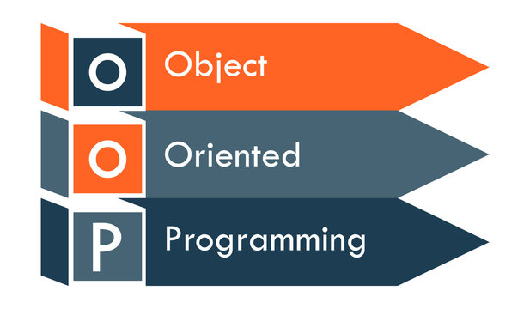
Object Oriented Programing
Object-oriented programming (OOP) is a way of writing computer programs using objects that represent real-world entities.

Slide 32
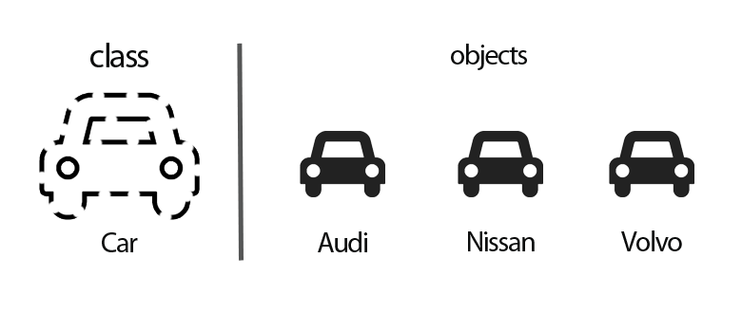
Class
a class is a blueprint or template for creating objects (instances).
It defines the structure and behaviors that objects, it has attributes
(data members) and methods (functions).

Slide 33
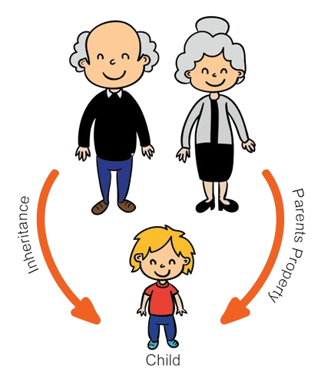
INHERITANCE
Inheritance is a concept in object-oriented programming where a new class (subclass or derived class) can inherit attributes and methods from an existing class (superclass or base class).
it's like a parent passing down traits to their child
Types of Inheritance:
Single Inheritance
Multiple Inheritance
Multilevel Inheritance
Hierarchical Inheritance

