Slide 1


Slide 2

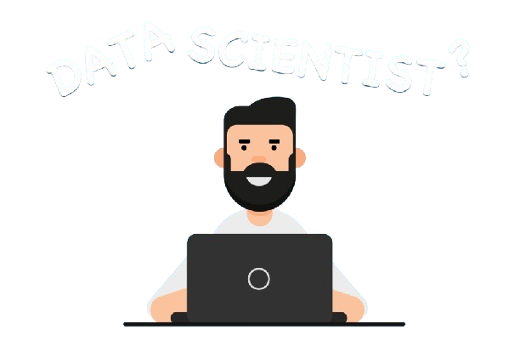
What Is DATA SCIENCE ?
Data Science is like being a Detective for information in a world of data. It uses math, computer skills, and knowledge from different areas to find hidden patterns and useful insights in all sorts of information. The main aim is to help people and organization to make smarter decisions , and helps in to run business , and discover new things from data.

Slide 3
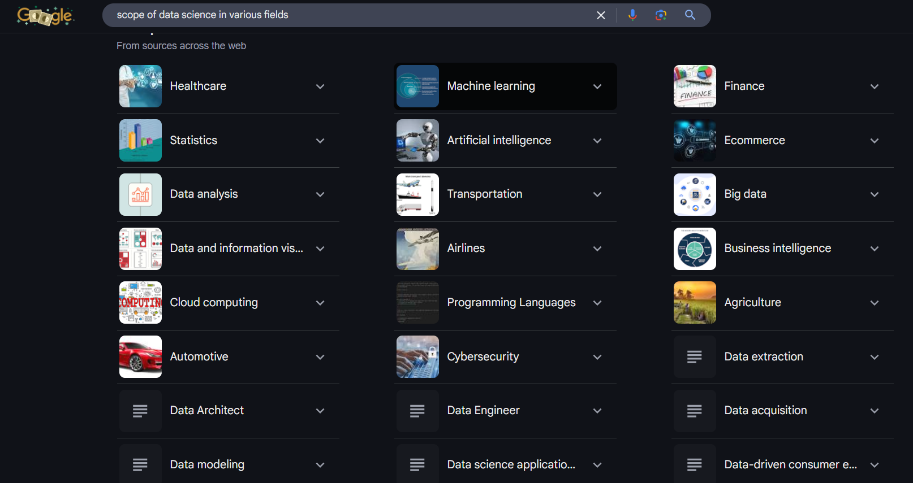
Scope Of Data Science

Slide 4
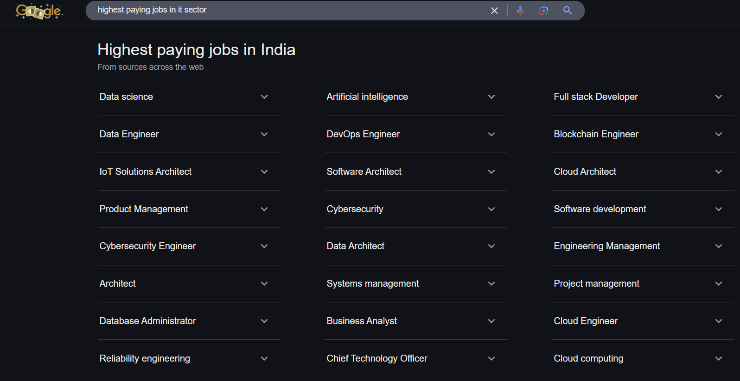
Highest Paid Jobs In IT Sector In 2025

Slide 5
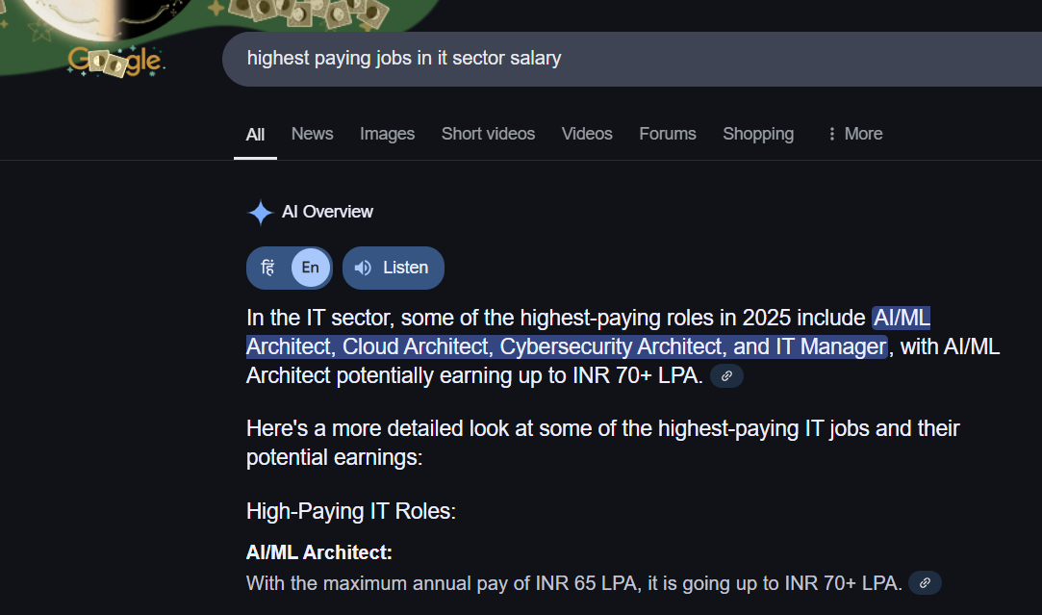
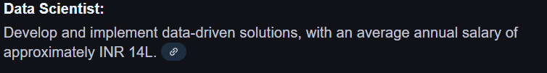
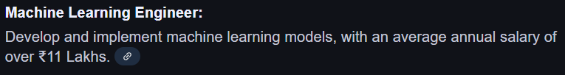
Salary Package

Slide 6
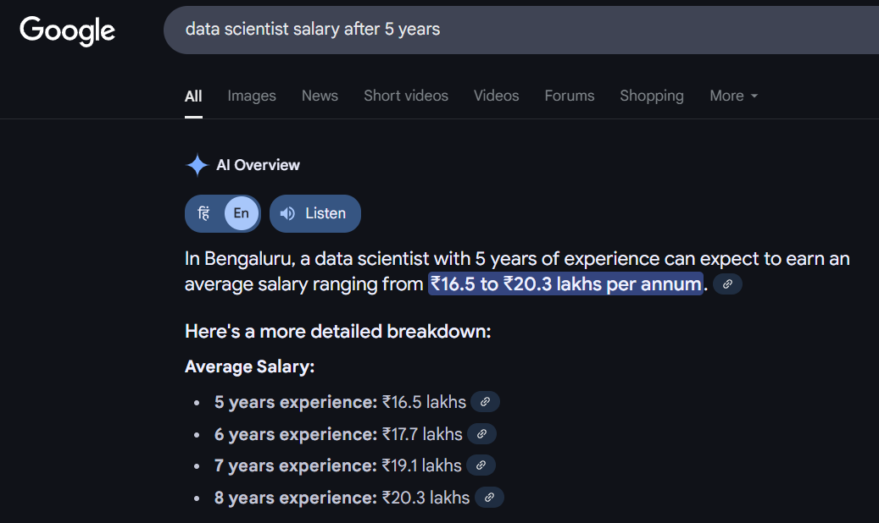
Salary Package After 5 Years

Slide 7
JOB PROFILES
Data Scientist
Data Analyst
Machine Learning Engineer
Python Developer
Database Administrator
Business Intelligence (BI) Analyst
Data Engineer
Statistician expert Engineer
Quantitative Analyst
Research Scientist
AI/ML Researcher

Slide 8
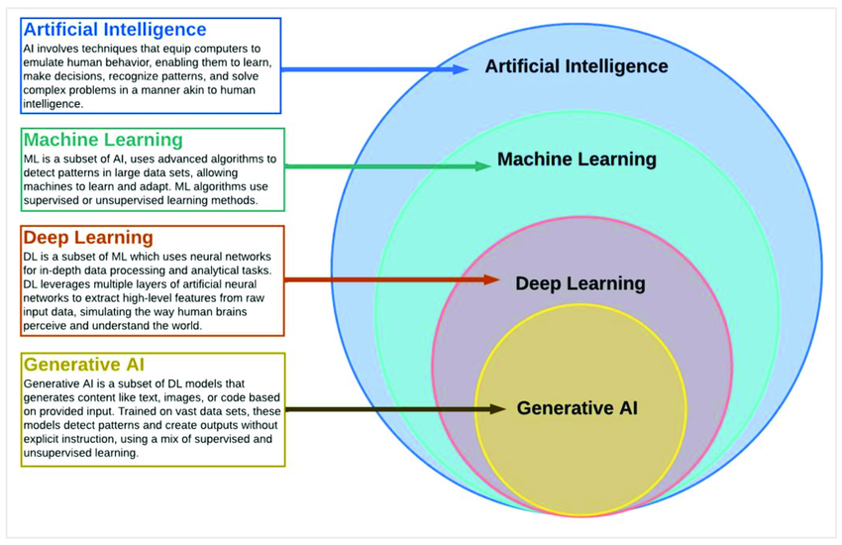

Slide 9

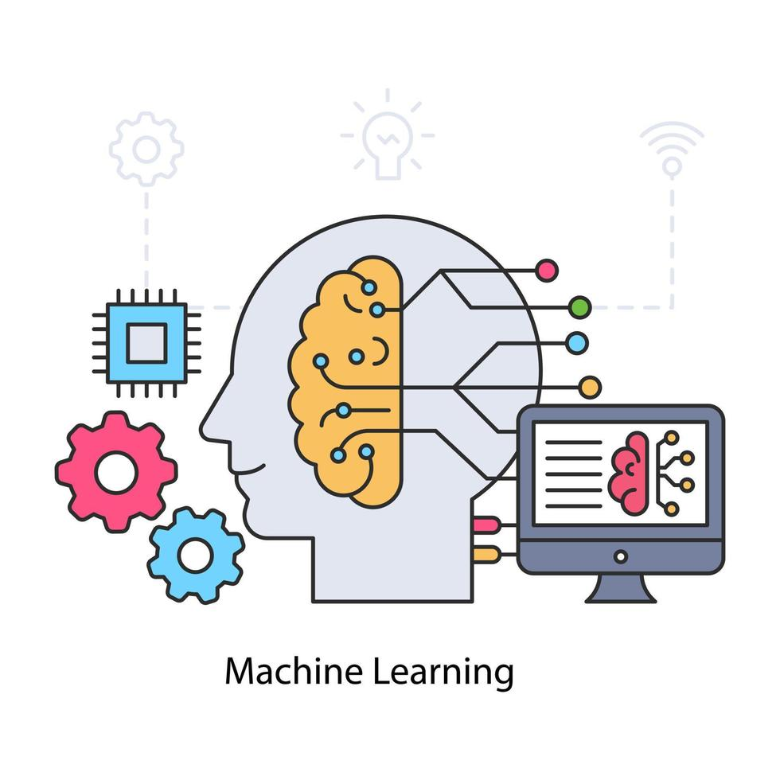
What Is Machine Learning?
Machine learning (ML) is a branch of artificial intelligence that enables computers to learn from data and improve their performance on tasks without being explicitly programmed. It involves developing algorithms that can identify patterns, make predictions, or make decisions based on input data. Common applications include recommendation systems, image classification, and fraud detection.

Slide 10
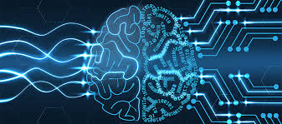
What Is Deep Learning?
Deep learning is a subset of machine learning that uses artificial neural networks with multiple layers to model and learn complex patterns and representations from large amounts of data. It mimics the way the human brain processes information, making it particularly effective for tasks like image and speech recognition, natural language processing, and autonomous systems.

Slide 11
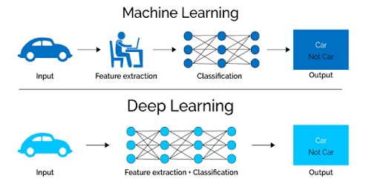
Machine Learning Vs Deep Learning

Slide 12
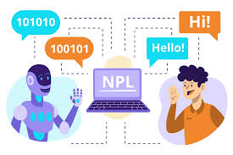
What is NLP ?
Natural Language Processing (NLP) is a field of artificial intelligence that focuses on enabling computers to understand, interpret, and generate human language. It combines linguistics, machine learning, and deep learning techniques to process text and speech. Applications include language translation, sentiment analysis, chatbots, and speech recognition.

Slide 13
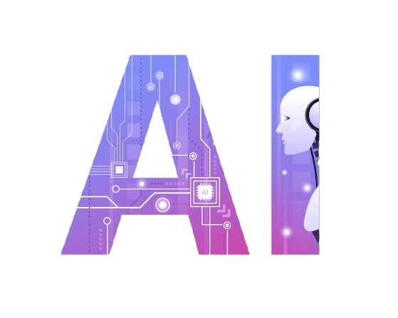
Generative

Slide 14
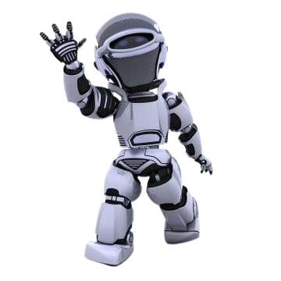
What we will learn
Introduction of AI
Introduction to Generative AI
What we can Generate with generative ai?
Applications of Generative AI
Future of Generative AI
Large Language Models
Top LLM in AI
The Working Principle of LLMs

Slide 15
INTRODUCTION OF AI
Artificial Intelligence (AI) is the branch of computer science that focuses on creating systems capable of performing tasks that typically require human intelligence.
AI enables machines to Think, Learn, and Act like humans to automate complex tasks efficiently that require human intelligence.
Examples:
Smart homes
Autonomous vehicles
Recommendation systems
Voice assistants
ChatGpt.

Slide 16
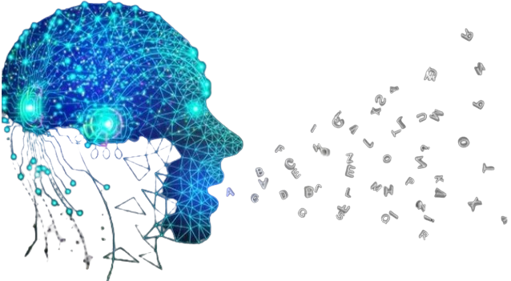
INTRODUCTION OF GENERATIVE AI
Generative AI is a branch of artificial intelligence focused on creating new content, We can generate various types of data, such as images, text, music, or even videos, that closely mimic human-created content.
Generative AI is like a digital imagination engine: it learns from massive amounts of data and then invents new content.

Slide 17
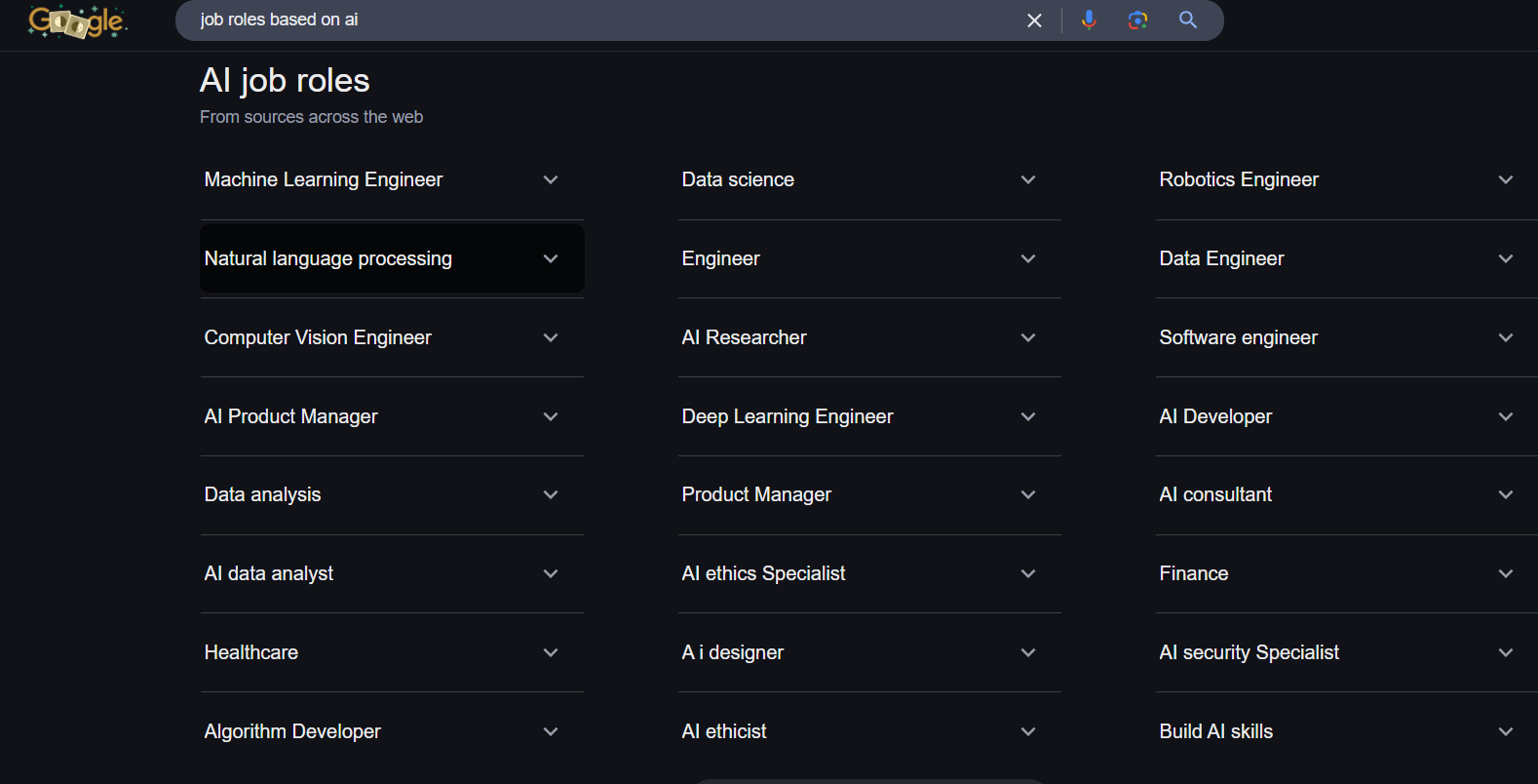
Job Roles In AI

Slide 18
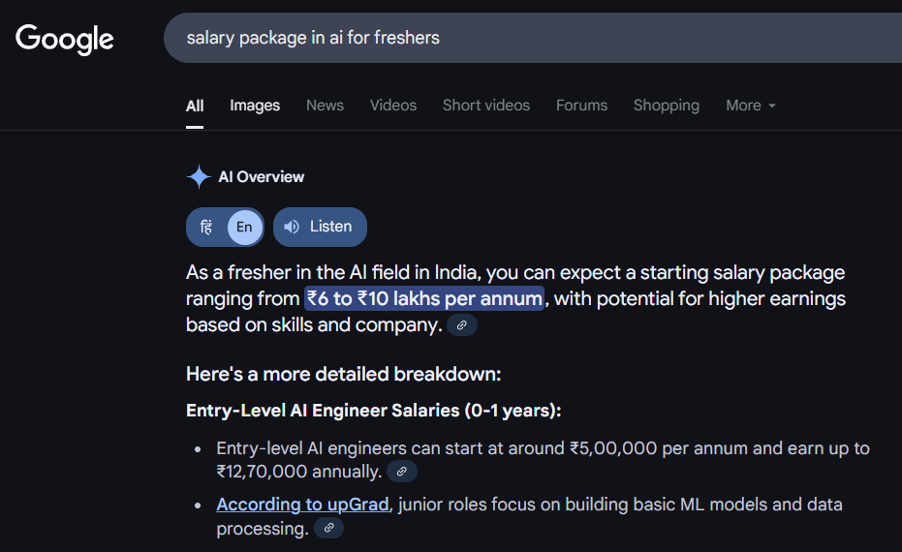
Salary Package In AI For Freshers

Slide 19
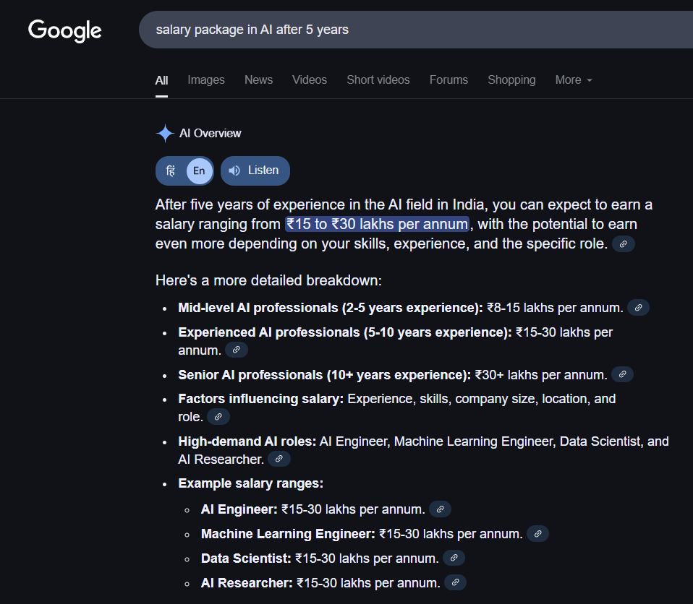
Salary Package In AI After 5 Years

Slide 20
GENAI IMPACT AREAS
Content Creation
Software Development
Customer Support
Education

Slide 21
\
What we can Generate with GenAi
Content Creation
Images & Art
Videos & Animation
Music & Audio
Virtual Assistants (ChatBot)
Code & Software Development
Code Debugging
Data Generation

Slide 22
Application of GenAI
ChatGpt
DeepSeek
Gemini
LLAMA
Dall-e
Stable Diffusion
Midjourney
Codex
Jukebox
AI resume maker
Whisper (audio to text)

Slide 23
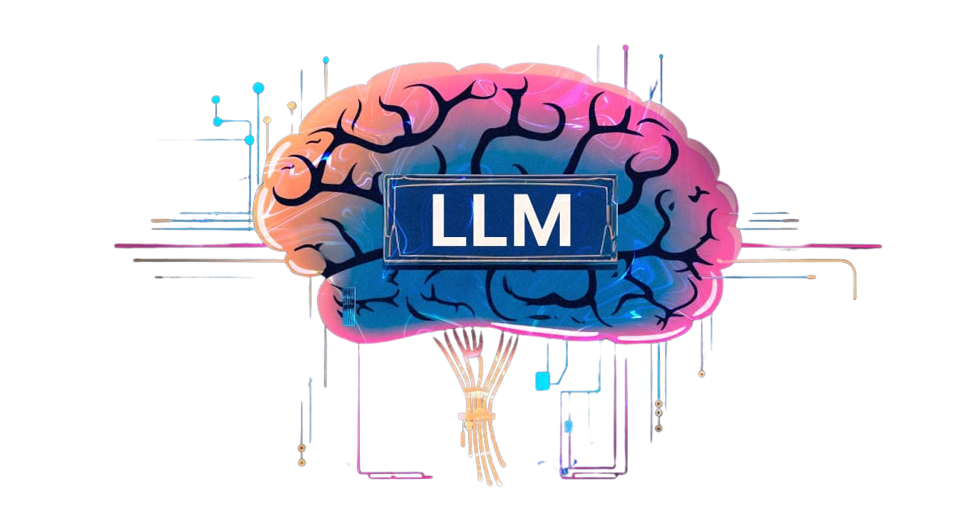
Large Language Model

Slide 24
What are LLMs ?
Large Language Models (LLMs) are powerful AI systems that can read, understand, and generate text like a human.
LLM are trained on massive amount of data to understand and generate human like language.
These models are built using deep learning techniques, specifically with architectures like transformers, LLM are learn from diverse sources such as books, articles, websites, and more.

Slide 25

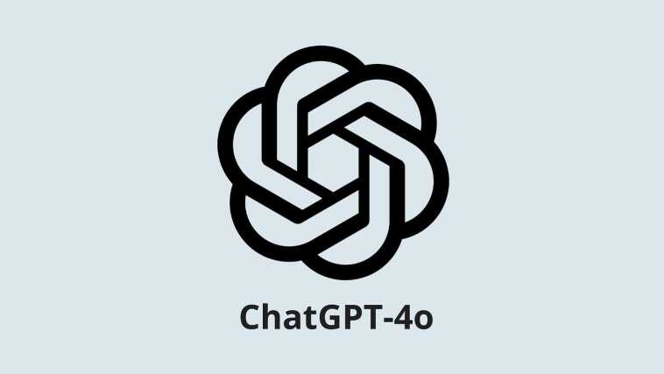

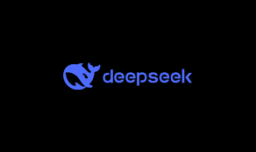

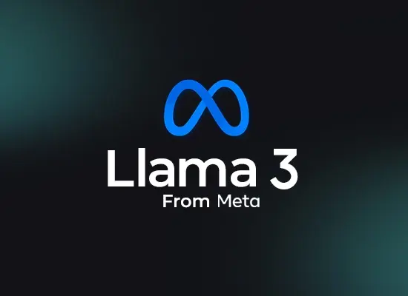

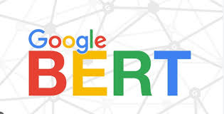

Top Ai LLMs

Slide 26

The Working Principle of LLMs
LLMs learn from a huge amount of text to understand how language works. When you ask them something, they use the knowledge gained from learning to generate a reply that fits the question or context.

Slide 27
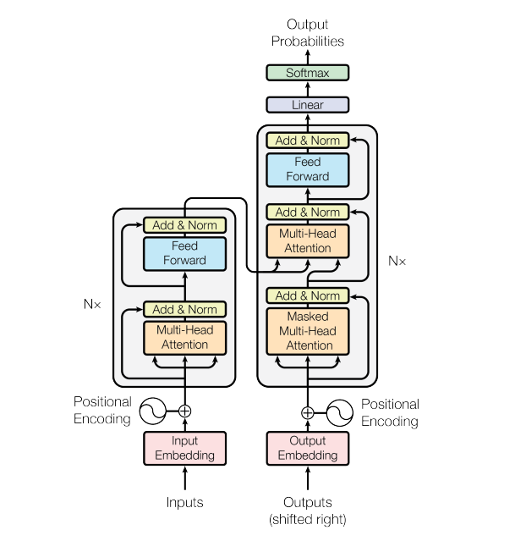
Transformer

Slide 28
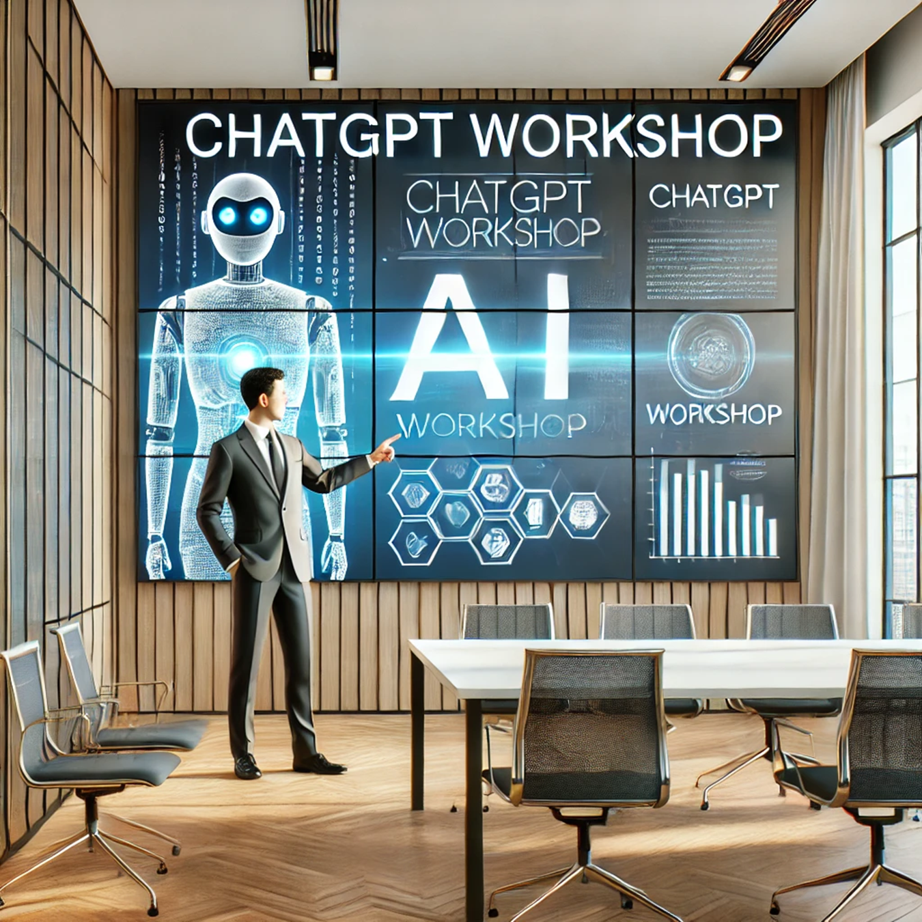
What Is ChatGPT ?
ChatGPT is an AI language model developed by OpenAI designed to understand and generate human-like text. It uses deep learning techniques, specifically transformer-based architectures, to process and generate text.

Slide 29
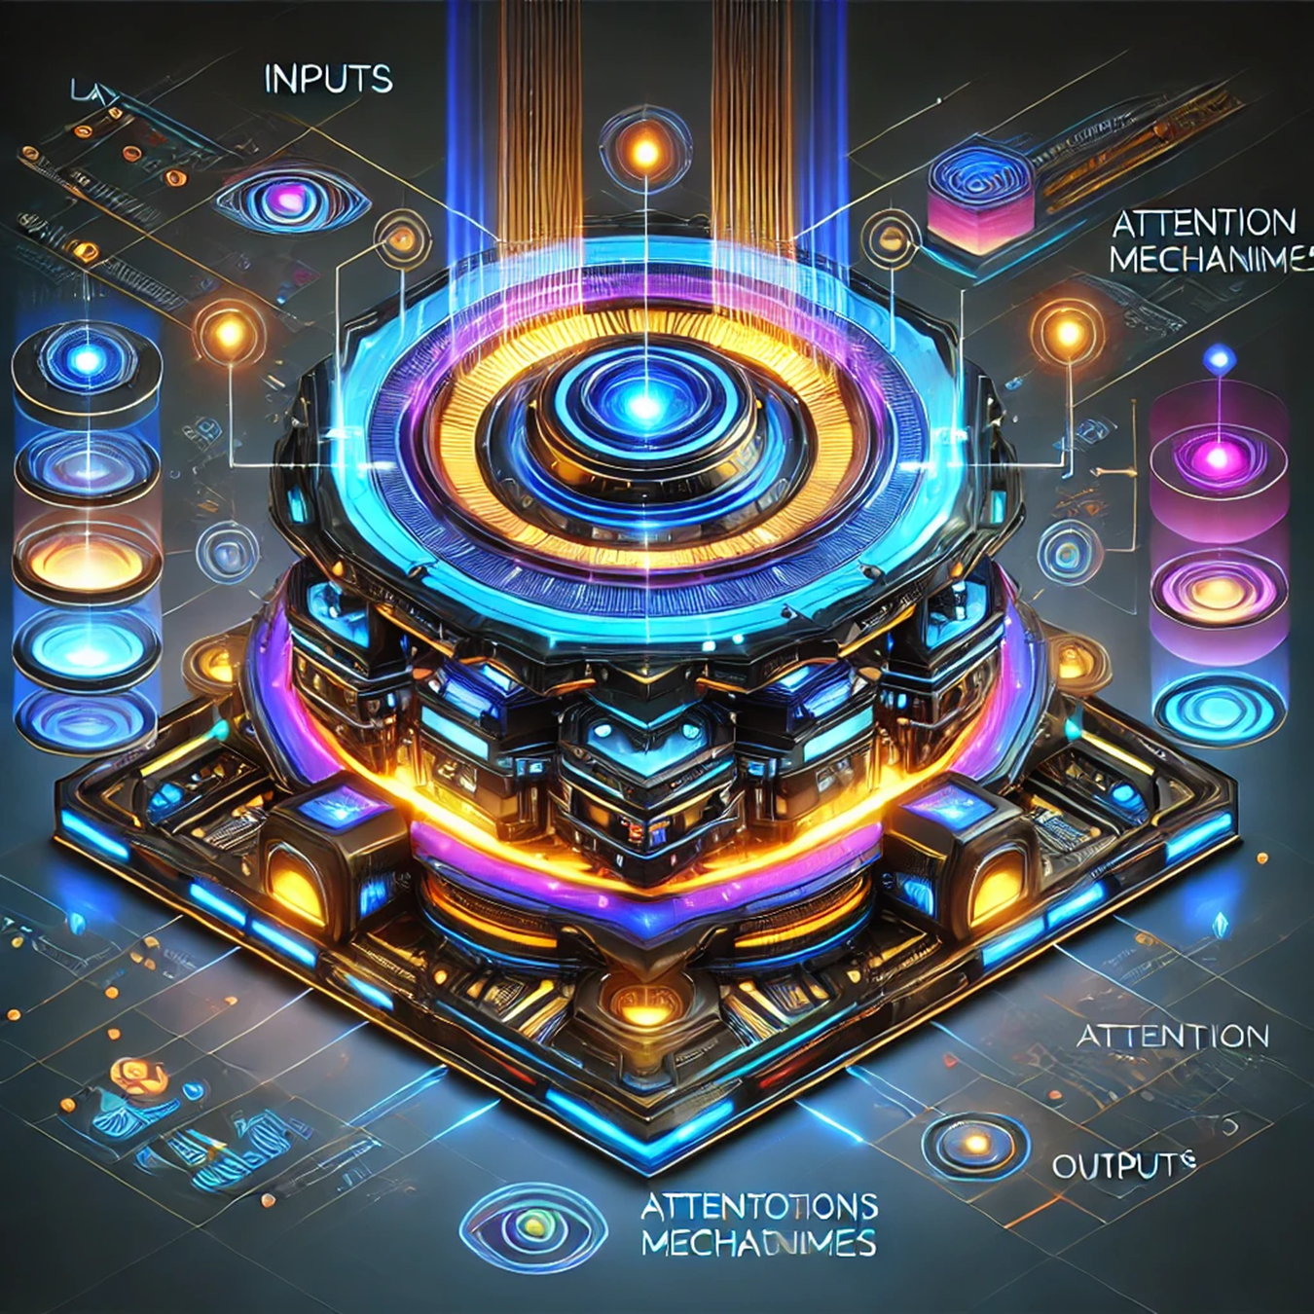
How Does ChatGPT Work?
Based on GPT (Generative Pre-trained Transformer). Trained on large datasets and fine-tuned for specific tasks. Capable of text generation, conversation, summarization, and more.

Slide 30
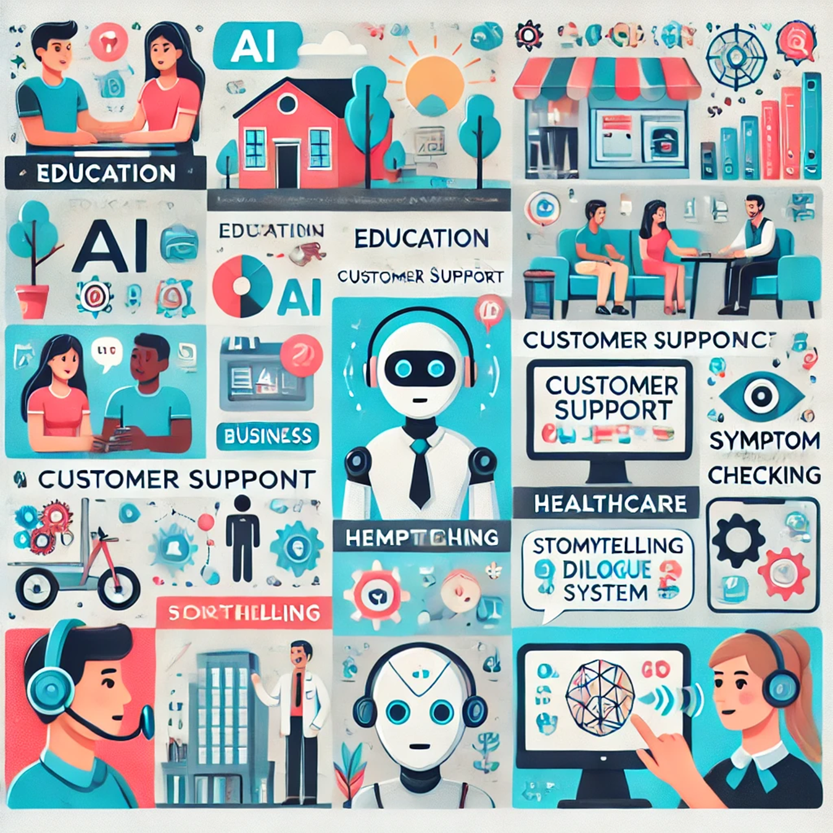
Applications of ChatGPT
Education, Business, Healthcare, Entertainment
Examples: Tutoring, customer support, storytelling, symptom checking.

Slide 31
THANK YOU !

