Slide 1
L2/L3 multicast proposals
Min Yao
2016/7/28
CentecNetworks

Slide 2
L2 multicast-Overview
Two solutions to implement L2MC
Multicast FDB (MAC based L2MC)
lookup-key: vlan_id + dst_mac
With limitation that 32 IP mc groups mapped to 1 mcast mac address, not support IGMPv3
Reuse FDB module APIs which is already supported
SG/*G lookup table (IP based L2MC)
Lookup-key: vlan_id + dst_ip + src_ip(not needed for *G)]
No limitations and supports IGMPv3
Need to add new L2MC module/data structure/APIs
Centec suggests to provide both solutions and let the control stack choose.
Notes:
It is well known that there are two solutions to implement L2MC.
One is multicast-fdb, which is referred to as “MAC based L2MC”. The other is SG/*G lookup table, which is referred to as “IP based L2MC”.
For multicast-fdb, the lookup keys are vlan_id and dst_mac. ASIC will not snoop the L3 payload. But there is a limitation, 32 IP multicast groups are mapped to 1 multicast mac address and IGMPv3 can not be supported. Anyway, we can just reuse the saifdb module and do a little extension to implement this solution.
For SG/*G lookup table, the lookup keys are vlan_id, dst_ip and src_ip (src_ip is not needed for *G lookup through). There will be no limitations and IGMPv3 can be supported. However, we need to implement a new sai module(L2MC) for this solution.
Centec suggests to provide both solutions and let the control stack choose.

Slide 3
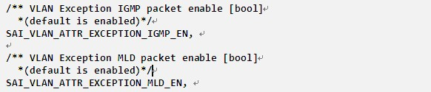
L2 multicast-Protocol Packets
Support exception protocol packets to CPU
Controlled per vlan
new attributes in vlan entry:
Notes:
For both solutions, the switch should support to exception the IGMP/MLD protocol packets to CPU.
This action is enabled per vlan. So we will add two new attributes for a vlan entry, SAI_VLAN_ATTR_EXCEPTION_IGMP_EN and SAI_VLAN_ATTR_EXCEPTION_MLD_EN, both enabled by default.

Slide 4
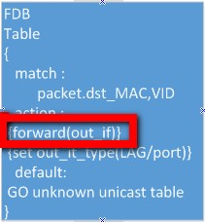
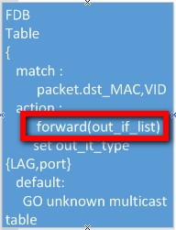
L2 multicast-multicast fdb
Pipeline (page L2flow-port2mc(multicast-fdb))
For unicast fdb, after FDB table lookup, one out_if can be found
For multicast fdb, after FDB table lookup, multiple out_if can be found
(“Unknown unicast table” in the original pipeline should be changed to “unknown FDB table” now)
Unicast fdb lookup
multicast fdb lookup
Notes:
Now let’s talk about the multicast-fdb solution.
The pipeline of multicast-fdb is described in page L2flow-port2mc(multicast-fdb).
First of all, multicast fdb and unicast fdb entries have same matching keys (vlan_id and dst_mac), they share the same lookup table – the FDB table.
For multicast-fdb, the only difference in pipeline with unicast-fdb is that there is only one out interface for unicast-fdb while there are multiple out interfaces for mcast-fdb.
So the control stack must be able to associate multiple out interfaces with a multicast fdb entry.

Slide 5
L2 multicast-multicast fdb
Management of out_interfaces of a multicast fdb entry
Use sal_object_list in fdb_entry_attr
Control stack has to provide whole list of interface even when adding/removing one out_interface
Use a data structure to maintain all out interfaces and the fdb entry could point to this data structure. Meanwhile support to add/remove one interface for this data structure
Centec’s proposal is to extend sainexthopgroup to maintain the out interfaces of a multicast fdb entry.
Notes:
There are two ways to manage the out interfaces of a multicast fdb entry.
One is to add a sal_object_list in fdb entry attributes directly. In this case, the control stack has to provide whole list of interfaces even when adding or removing just one interface, which I think is not a very convenient solution.
The other one is to use a data structure to maintain all out interfaces and the multicast fdb entry could point to this data structure. Meanwhile we should support to add and remove just one interface.
Center's proposal is to extend the sainexthopgroup to maintain the out interfaces of a multicast fdb entry.

Slide 6

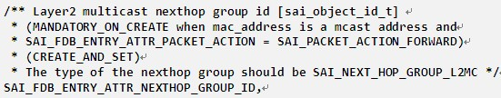
L2 multicast-multicast fdb
Nexthopgroup and FDB entry
Add a new nexthopgroup type L2MC, indicating this group contains an out interface list of a L2MC group
Port/LAG should be supported in the object list for now, and ASIC vendor should check the object type in the list
Add a new attribute in fdb entry attributes so the fdb entry can point to a nexthop group
Notes:
Currently nexthopgroup supports type ECMP, the group members are IP nexthops, which means the pipeline will pick one IP nexthop in the group.
To reuse the module, we will add a new type L2MC, indicating this group contains an out interface list of a L2MC group. The members of this group should be PORT/LAG, or L2tunnel in the future. The pipeline will take all members of the group and perform packet replication to all out interfaces.
Then we should add an attribute in the fdb entry attributes to allow the fdb entry to point to the nexthop group, which is referred to as SAI_FDB_ENTRY_ATTR_NEXTHOP_GROUP_ID.

Slide 7
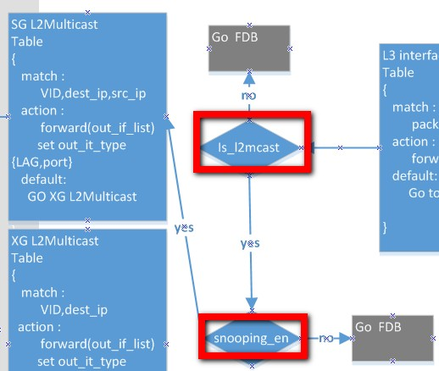
L2 multicast-SG/*G lookup
Pipeline (page L2flow-port2mc(snooping))
Parallel to FDB lookup
The conditions that the packet goes to SG/*G lookup other than FDB lookup are as following:
dst_mac is multicast mac address
payload is valid v4/v6
multicast packet
(v4_snooping enabled when
packet is v4) || (v6_snooping
enabled when packet is v6)
Notes:
Now let’s move on to SG/*G lookup solution.
The pipeline of SG/*G lookup is described in page L2flow-port2mc(snooping).
It is parallel to the FDB lookup.
If the packet matches the following conditions, the pipeline will do SG/*G lookup instead of FDB lookup:
1.The dst mac is a multicast mac address
2.The packet is valid v4/v6 multicast packet
3.(v4_snooping enabled when packet is v4) or (v6_snooping enabled when packet is v6)

Slide 8
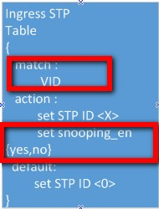
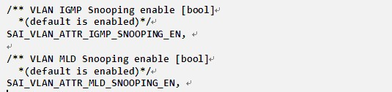
L2 multicast-SG/*G lookup
Snooping control of a vlan
V4_snooping_en and V6_snooping_en are derived from the vlan entry in the previous pipeline
Add new attributes for vlan entry
Notes:
The snooping behavior is controlled per vlan. And the v4_snooping_en and v6_snooping_en are derived from ingress vlan attributes in the previous pipeline.
So we should add new attributes in the vlan entry: SAI_VLAN_ATTR_IGMP_SNOOPING_EN and SAI_VLAN_ATTR_MLD_SNOOPING_EN.

Slide 9
L2 multicast-SG/*G lookup
SG/*G lookup behavior
Lookup keys:
SG: vlan_id+dst_ip+src_ip
*G: vlan_id+dst_ip
Lookup order:
1.SG lookup first, if fails, *G lookup next, if fails, trap packet to CPU
2.do SG/*G lookup at the same time, if SG lookup hits a entry, use SG result, else use *G result or trap to CPU
Both lookup orders are OK for ASIC vendors
After SG/*G lookup, will get an out_if_list same as multicast FDB and rest of the pipeline is same as original.
Notes:
Next let’s talk about the SG/*G lookup behavior.
The lookup keys for SG are vlan_id, dst_ip and src_ip, for *G they are vlan_id and dst_ip.
There might be two logical lookup orders:
SG lookup first, if fails, *G lookup next, if fails again, trap packet to CPU
Do SG and *G lookup at the same time, use SG result if exists, if not then use *G result or trap packet to CPU
ASIC vendor could support either of the lookup order because the final behavior looks the same to the control stack.
After the SG/*G lookup, we can get the out interface list same as multicast fdb and the rest of the pipeline is same as original.

Slide 10
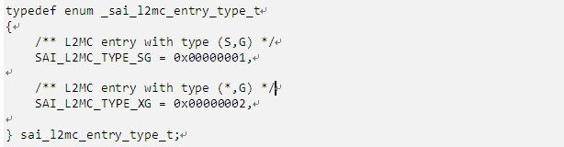
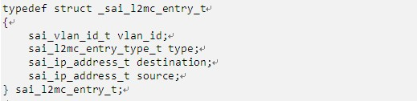
L2 multicast-SG/*G lookup
Entry type to indicate SG or *G
L2MC entry keys
Notes:
The following are the main definitions of L2MC(SG/*G)

Slide 11
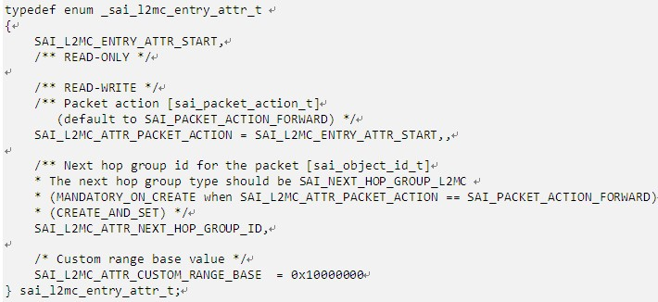
L2 multicast-SG/*G lookup
L2MC entry attributes
L2MC entry also points to a nexthop group to derive an out interface list.
Notes:
Main definitions of L2MC(SG/*G)
That’s all for L2 multicast.

Slide 12
L3 multicast
Functions for L3 multicast
RPF check and trap the packet to CPU
SG/*G lookup Table
Lookup keys:
SG: vrf+dst_ip+src_ip
*G: vrf+dst_ip
Lookup order:
1.SG lookup first, if fails, *G lookup next, if fails, trap packet to CPU
2. do SG/*G lookup at the same time, if SG lookup hits a entry, use SG result, else use *G result or trap to CPU
Both lookup orders are OK for ASIC vendor
After SG/*G lookup, will get multiple out routerinterfaces.
Notes:
Next is L3 multicast.
The following functions are important to implement L3 multicast:
1.RFP check and trap the packet to CPU
2.SG/*G lookup table, in L3 multicast, the SG/*G lookup takes vrf as part of the keys. The lookup order is similar with that in L2 multicast. The output of SG/*G lookup would be multiple routerinterfaces.

Slide 13
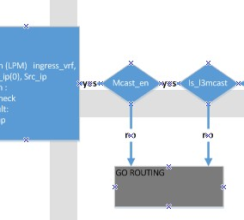
L3 multicast
Pipeline (page L3portInterface-port2mc)
Parallel to ROUTING in pipeline
The conditions that the packet goes to SG/*G lookup other than ROUTING are as following:
Valid l3 mcast packet
IN_PORT is routerinterface
(v4_mcast_en when packet is v4) or
(v6_mcast_en when packet is v6)
Notes:
The pipeline of SG/*G lookup is described in page L3portInterface-port2mc.
It is parallel to the Router Table lookup.
If the packet matches the following conditions, the pipeline will do SG/*G lookup instead of Router lookup:
1.The packet is a valid L3 mcast packet.
2.IN_PORT is routerinterface or member of a vlan interface
3.(v4_snooping enabled when packet is v4) or (v6_snooping enabled when packet is v6)

Slide 14
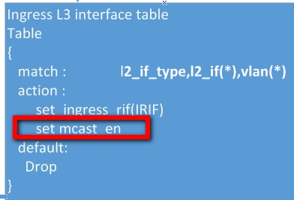
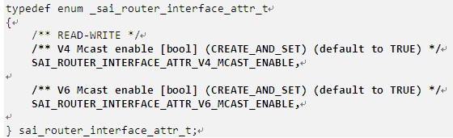
L3 multicast
Mcast_en control of a routerinterface
V4_mcast_en and V6_mcast_en are derived from the l3 interface in the previous pipeline
Add new attributes for routerinterface entry
Notes:
The mcast enabling behavior is controlled per routerinterface. And the v4_snooping_en and v6_snooping_en are derived from ingress L3 interface in the previous pipeline.
So we should add new attributes in the vlan entry: SAI_VLAN_ATTR_IGMP_SNOOPING_EN and SAI_VLAN_ATTR_MLD_SNOOPING_EN.

Slide 15
L3 multicast
Notice, for vlan interface:
A mcast packet comes into a member port, it goes to L3 multicast pipeline only when mcast_en is set to TRUE for the vlan interface. If it was set to FALSE, the mcast packet goes to “Bridge Flow”
This requires the pipeline could retrieve l3interface info for the mcast packet, but in the original pipeline, l3interface is retrieved by matching vid+dst_mac. So it’s not possible to retrieve l3interface info for mcast packets for now. I think this must be changed.
Need to check with the original author of the pipeline to confirm how to retrieve l3interface for the mcast packets.
Notes:
There is something special for a vlan interface.

Slide 16
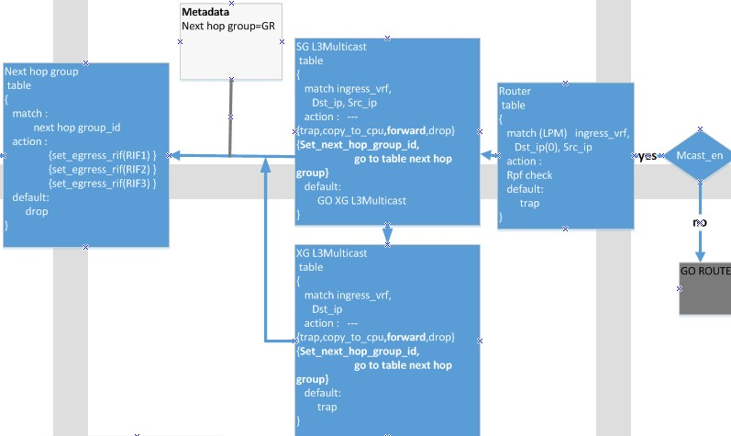
L3 multicast
Main Pipeline
Notes:
This is the most important part of the L3 multicast pipeline.
ASIC will first use vrf and src_ip info to do RFP check.
After RPF check, ASIC will do SG/*G lookup, and get a nexthop group id, which contains all out routerinterfaces of the L3 mcast group.

Slide 17
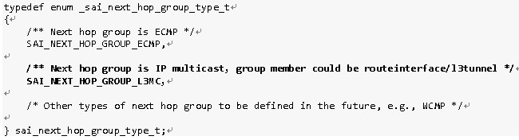
L3 multicast
Management of out interfaces of L3 mcast
For L2mcast, the out interfaces are ports/LAGs.
For L3mcast, the out interfaces are routerinterfaces.
Add a new type L3MC to nexthop group to manage the routerinterfaces of a L3MC group

Slide 18
L3 multicast
Difference with L3 unicast in later Pipeline
In L3 unicast, IP nexthops retrieved after Router Table lookup, need to get the nexthop ip address and look it up in the Neighbor Table to get dest mac address.
In L3 multicast, out routerinterfaces retrieved after SG/*G lookup, dst_ip remains unchanged, and dst_mac address is mapped from dst_ip.
Notes:
In the pipeline after SG/*G lookup, there are some differences between L3unicast and L3multicast.
In L3 unicast pipeline, IP nexthops are retrieved after Router Table lookup, nexthop IP address is obtained, then ASIC need to get the dst_mac by matching the ip address in the neighbor Table.
In L3 multicast pipeline, out routerinterfaces are retrieved after SG/*G lookup, dst_ip remains unchanged, and dst_mac is mapped from dst_ip.

Slide 19
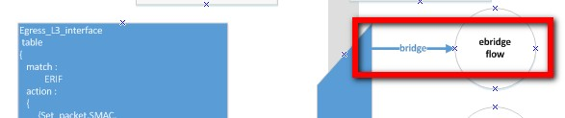
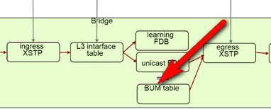
L3 multicast
Notice, when egress routerinterface is a vlan interface
The packet should go to ebridge flow, in the ebridge flow pipeline, ASIC will do multicast fdb lookup or L2 SG/*G lookup again accroding to the egress vlan attributes.
I should add something in this
diagram but it’s a picture in the doc
so I can not edit it.

Slide 20
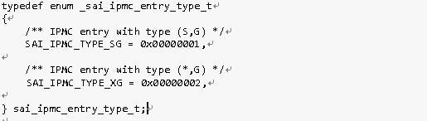
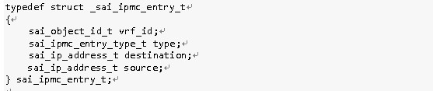
L3 multicast
Entry type to indicate SG/*G
IPMC Entry keys
Notes:
The following are the main definitions of L3 multicast.

Slide 21
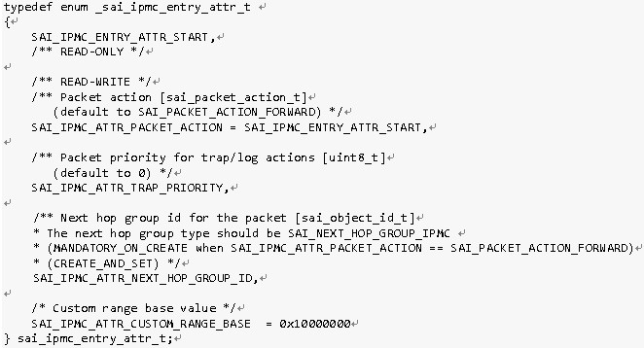
L3 multicast
IPMC entry attributes

Slide 22
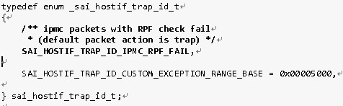
L3 multicast
Hostif trap for RPF check fail

Slide 23
Thanks!

