Slide 1



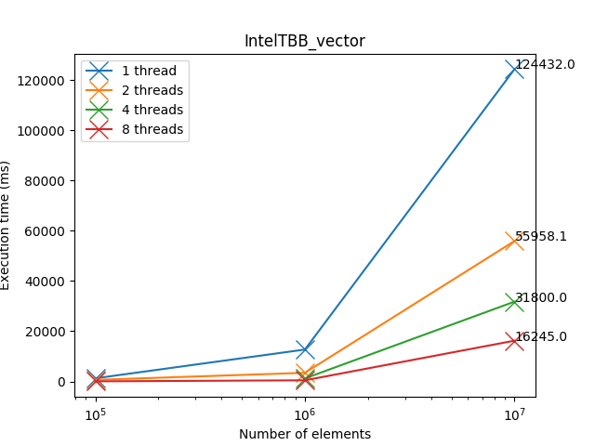
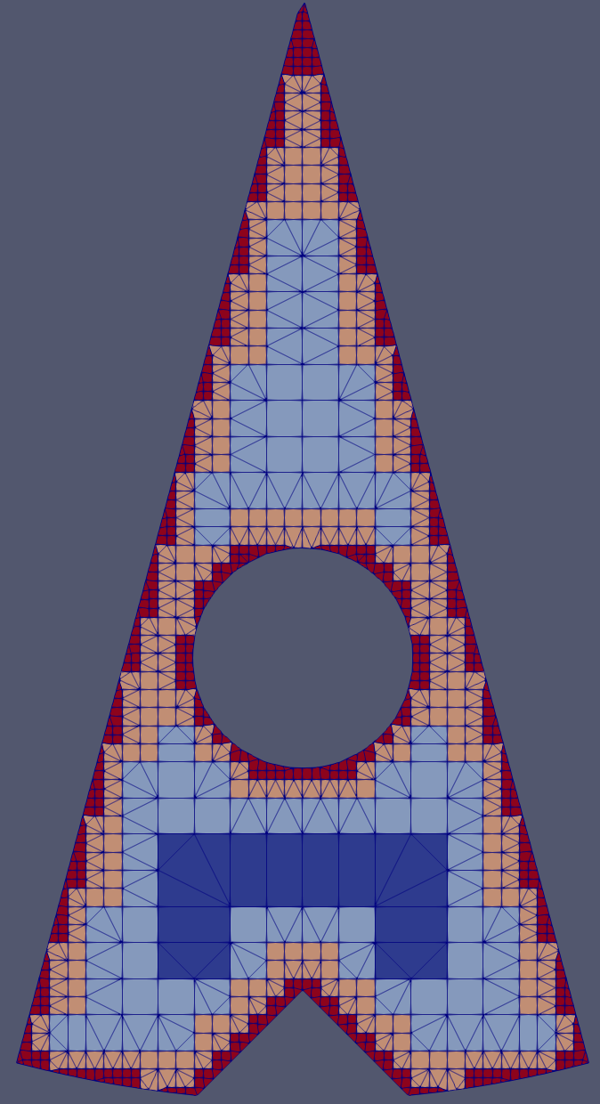
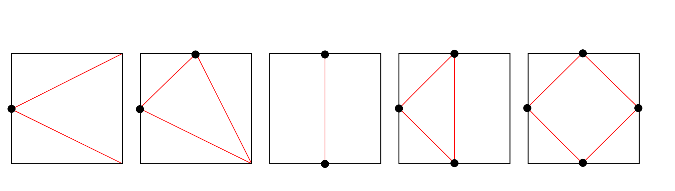

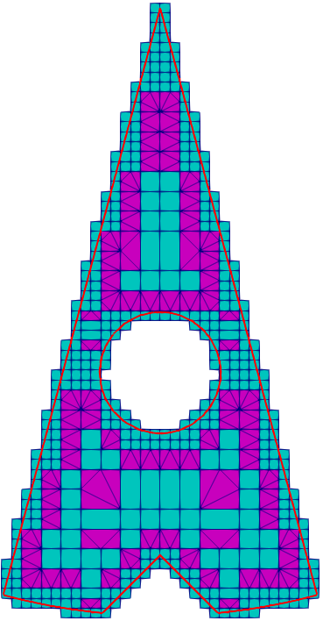
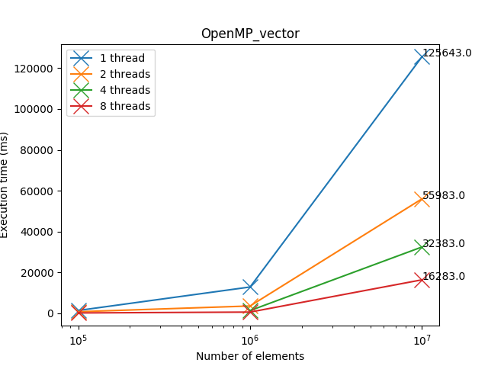
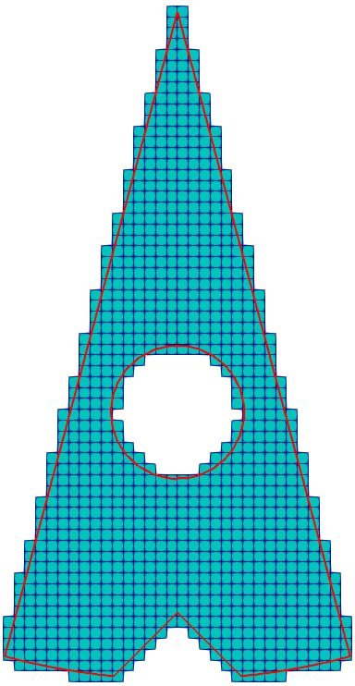
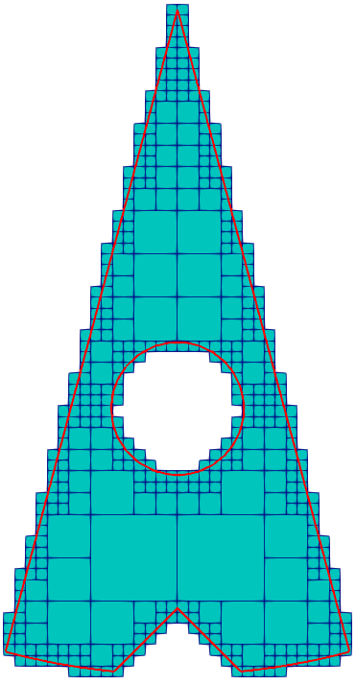
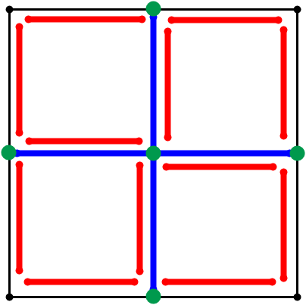
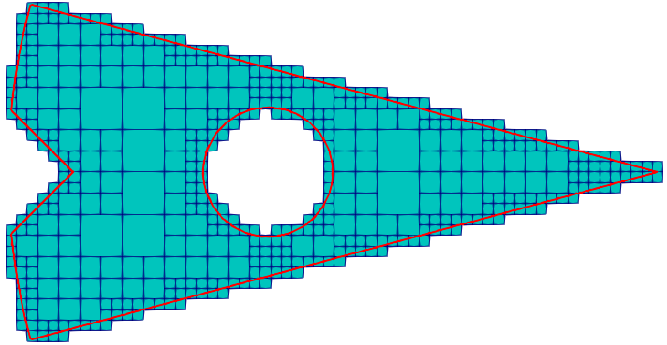
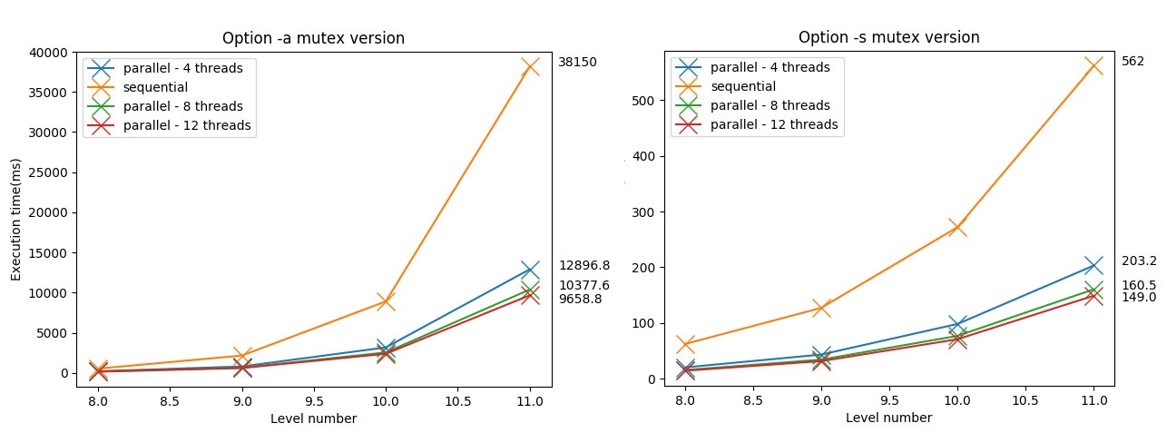
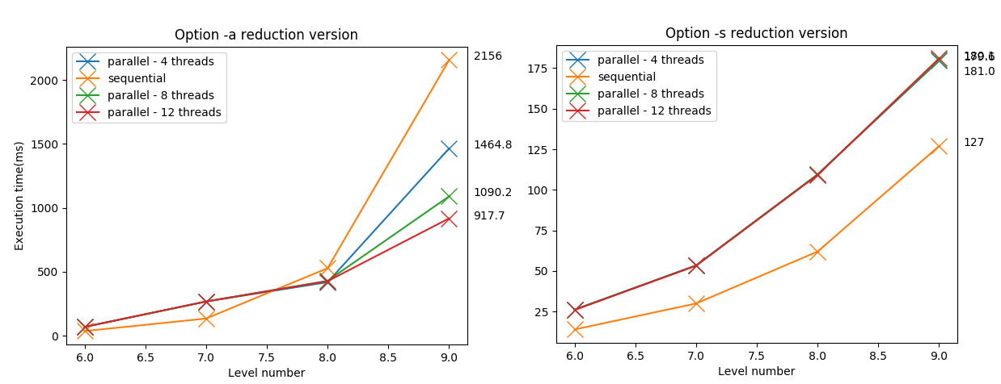
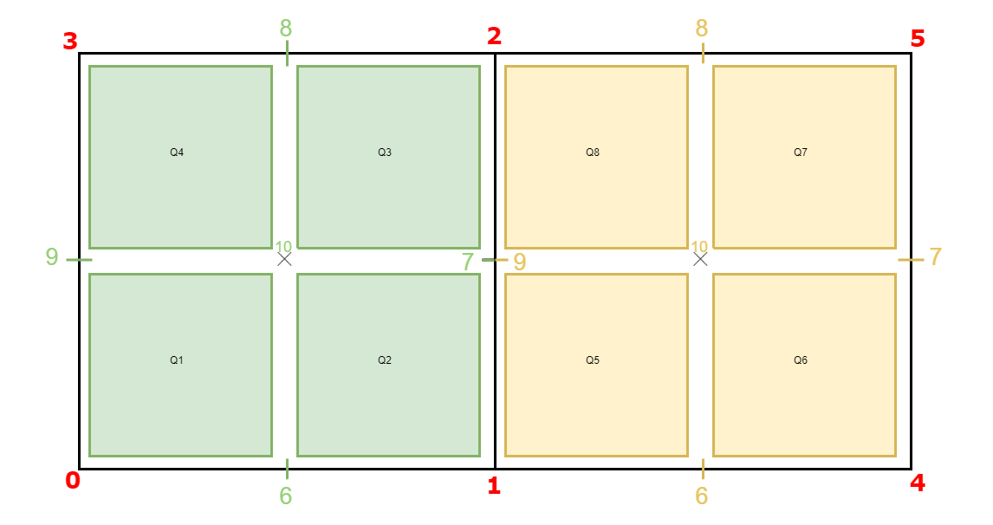
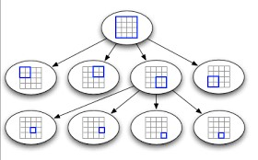
Paul LAFOIX-TRANCHANT, Antoine OLEKSIAK
Lyon university
Supervised by Fabrice JAILLET and Florence ZARA
Context
Mesh refinement (Region Of Interest)
Real time simulation
Simulation
Objective
Analyze the existing library
Find data structure to optimize parallelization
Speed up the meshing process
Libraries for C++ parallelism
IntelTBB
+ Thread-safe containers
- ..code? Doc hard to find?
Compute the Bounding Box
Mesh construction
Apply the transition patterns
Create the minimal number of initial quadrants
that contains input surface
1
4
(i.e. to produce a conformal mesh)
The transitions patterns
Generate Quadrants
Transitions patterns applied on output of meshing on surface region
Process :
Repeat until desired Refinement Level
For each Quadrant :
If the quadrant intersects the chosen region
Split the quadrant into 4 new identical quadrants.
Remove those which are outside.
OpenMP
+ Pre-processing directives
2
3
Splitting process :
in red and blue new edges
in green new points
Split all region
Split surface region
Create a balanced structure
(i.e. at most 1 subdivision level between two adjacent quadrants)
For each Quadrant :
if the quadrant has a subdivided edge (midpoint != 0)
check if the subdivided edge are subdivided
Balanced with surface region
Mutex version
Reduction version
Perspective
Adapt parallelization method to the input of the mesher. For example, for high level of refinement, use reduction, etc..
Build a quadtree structure to represent all the Quadrants
Make the reduction process only when the desired refinement level is reached
Notes:
Copyright Colin Purrington (http://colinpurrington.com/tips/academic/posterdesign).

