Slide 1



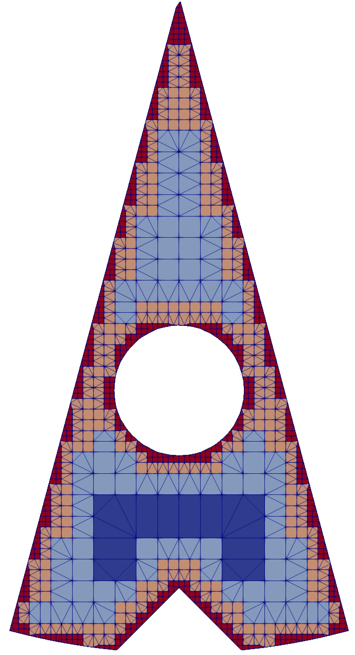
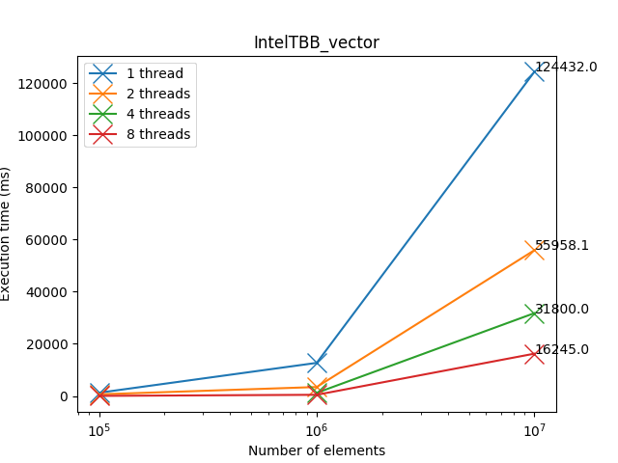

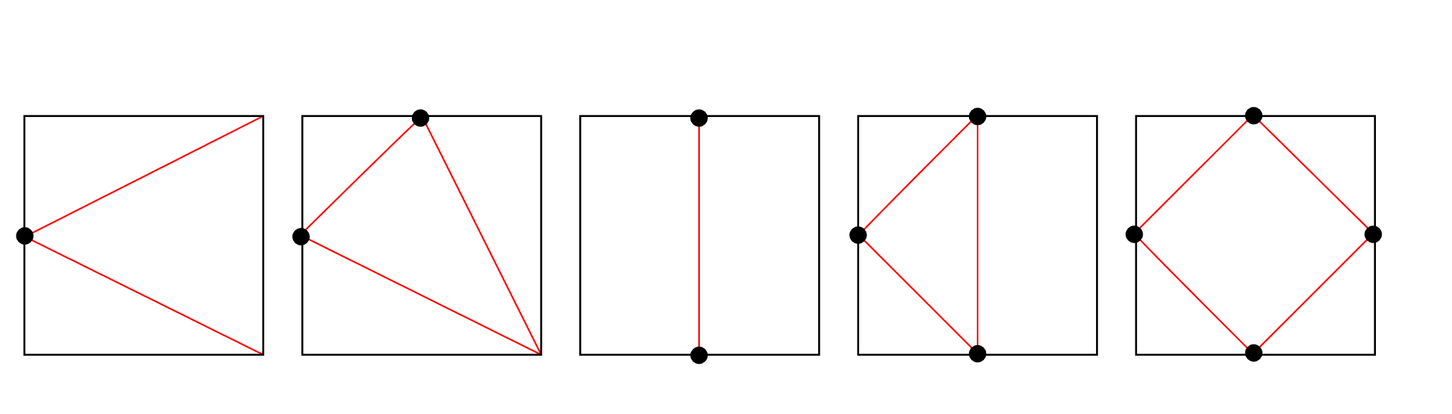
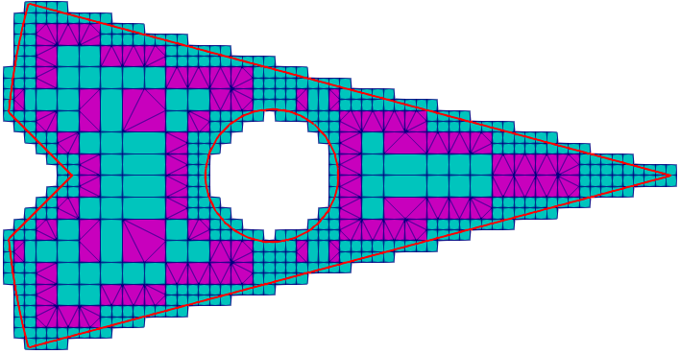
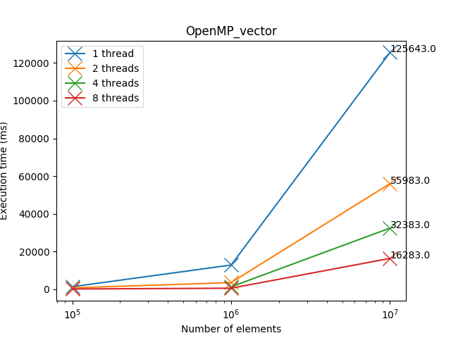
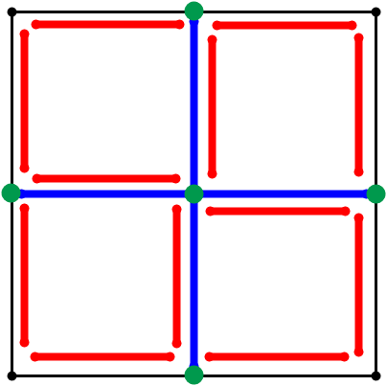
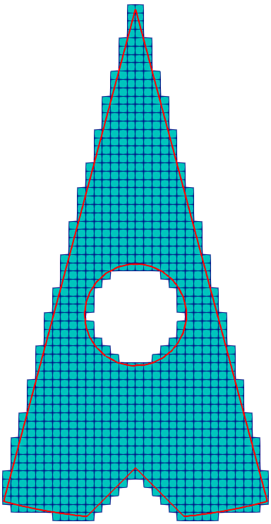
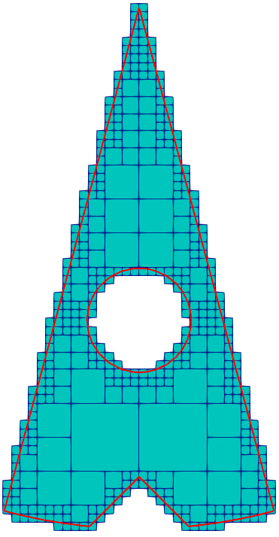
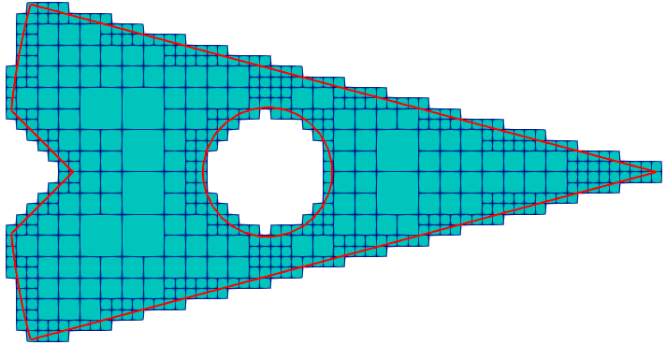
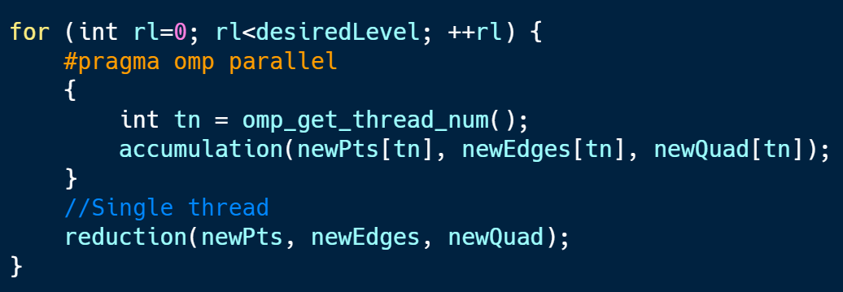
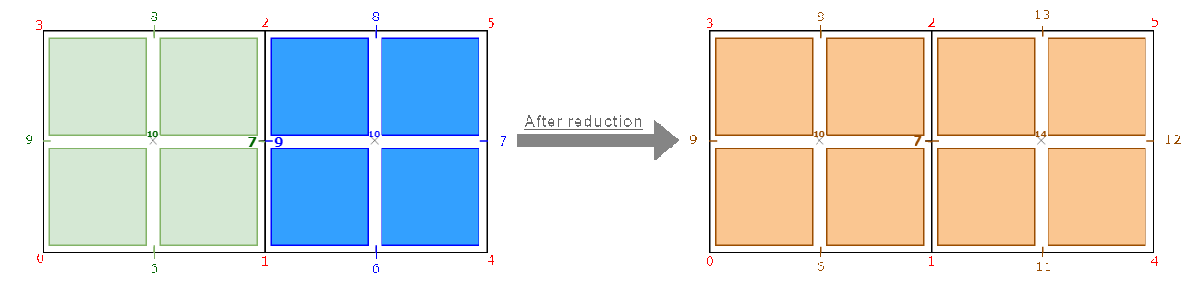
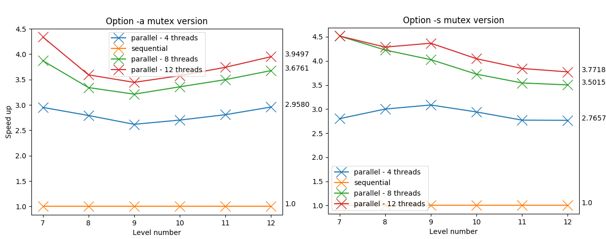
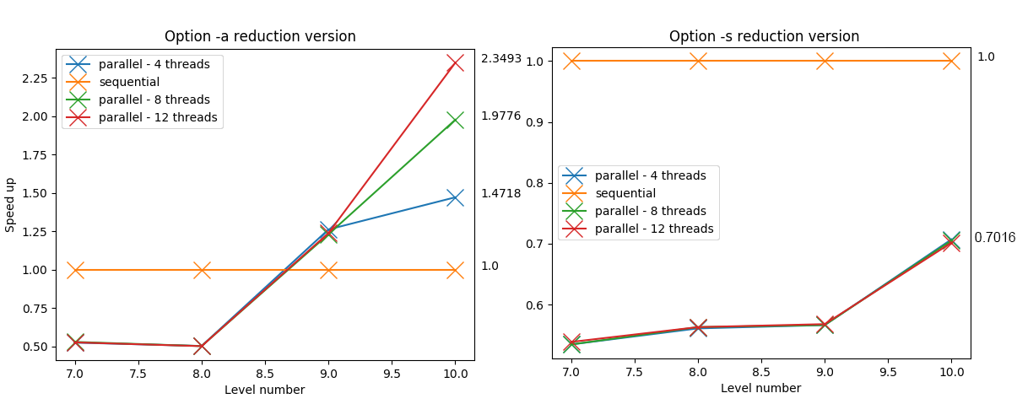
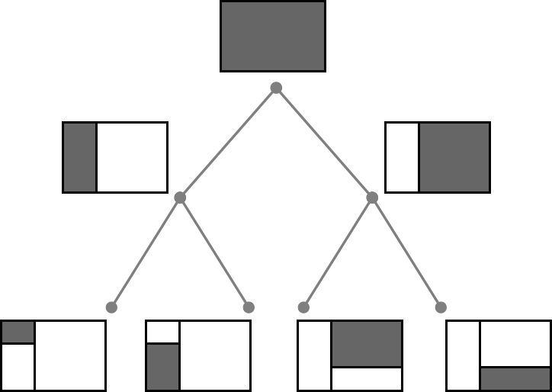
Paul LAFOIX-TRANCHANT, Antoine OLEKSIAK
Lyon university
Supervised by Fabrice JAILLET and Florence ZARA
Context
Mesh generation and adaptation with quality mixed elements
Real time simulation and deformation
Objective
Analyze existing library
Study data structure to optimize parallelization
Speed up the meshing process
Tools : Libraries for C++ parallelism
1) IntelTBB
A C++ template library developed by Intel that provides tasks, low-level synchronization primitives, concurrent containers, and is compatible with other threading packages.
1. Compute the Bounding Box
Mesh generation
4. Apply the transition patterns
(i.e. create the minimal number of initial quadrants
that contains the input surface)
1
4
(i.e. to produce a conformal mesh, create sub-elements following a pattern in a Quadrant if he has a refinement level < adjacent Quadrant)
2. Generate Quadrants
The transition patterns
Process :
Repeat until desired Refinement Level
For each Quadrant :
If the quadrant intersects the chosen region
Split the quadrant into 4 new identical quadrants.
Remove those which are outside.
2) OpenMP
2
3
Transition patterns applied on output of the meshing on surface region
An API that runs on most platform and provides a set of compiler directives, library routines and environment variables that influence run-time behaviour.
Splitting process :
in red and blue new edges,
in green new points
Split all region (-a)
Split surface region (-s)
3. Create a balanced structure
(i.e. at most 1 subdivision level between two adjacent quadrants)
Process :
For each Quadrant q :
if one neighboring quadrant has a subdivision level >= q.level + 2 :
Split q into 4 new quadrants
Mutex version
Balanced with surface region
Reduction version
Protect the critical regions with different mutex.
Use of concurrent data structures, such as tbb::concurrent_unordered_set to replace the set of QuadEdges.
Parallelize the mesh generation
No more critical regions.
All threads have their own copy of Edges, Points and Quadrants filled in the accumulation part.
The reduction part is done by a single thread and creates the final Edges, Points and Quadrants.
Detection of identical points and update the local index to global index.
Critical regions
Problems
Read/write in concurrency in the set of quadedge = one edge could be split twice by 2 neighboring quadrants
Not possible to modify an element in a set (e.g. in the set of QuadEdges) due the use of hashtable for sorting.
=> Use of mutable attributes
Write new points and new quadrants
Results
Refinement restricted to SURFACE Quadrants
Refinement applied on ALL Quadrants
At the end :
4,095,572 points, 13,653,086 QuadEdges and
4,057,578 Quadrants
At the end :
106,819 points, 320,520 QuadEdges and
55,533 Quadrants
Before/after the reduction process. In red points before the accumulation done by green and blue threads. Notice that they start creating points at index 6 (the number of points before the accumulation)
The mutex version speeds the -a option up to 3,5 times faster, and up to 4 times faster for the -s option. An increase in the number of threads speed up the generation. However the gain decreases because of the exchange and lock due to the mutex.
The reduction version speeds the generation process up to 2,3 times faster, but only for the -a option, after refinement level 8. This version is efficient when there are enough quadrants (> 200,000) because of the slow sequential part of the reduction.
Conclusion
Perspectives
The mutex version is efficient especially when there are few quadrants
Build a quadtree structure to represent all the Quadrants
The reduction version should be used only when there are a lot of quadrants : high level of refinement ( > 9) and/or option for all quadrants (-a)
The reduction part is still performed sequentially and would require optimizations : a better algorithm for the reduction and/or the use of parallelism
Implementations avoiding critical sections produce a lot of new code, and it makes the whole project less maintainable
Make the reduction process only when the desired refinement level is reached
Parallelism on this process is far from being trivial !
Notes:
Copyright Colin Purrington (http://colinpurrington.com/tips/academic/posterdesign).

