Slide 1



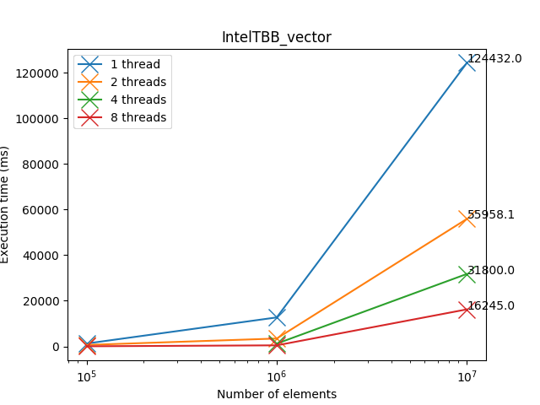
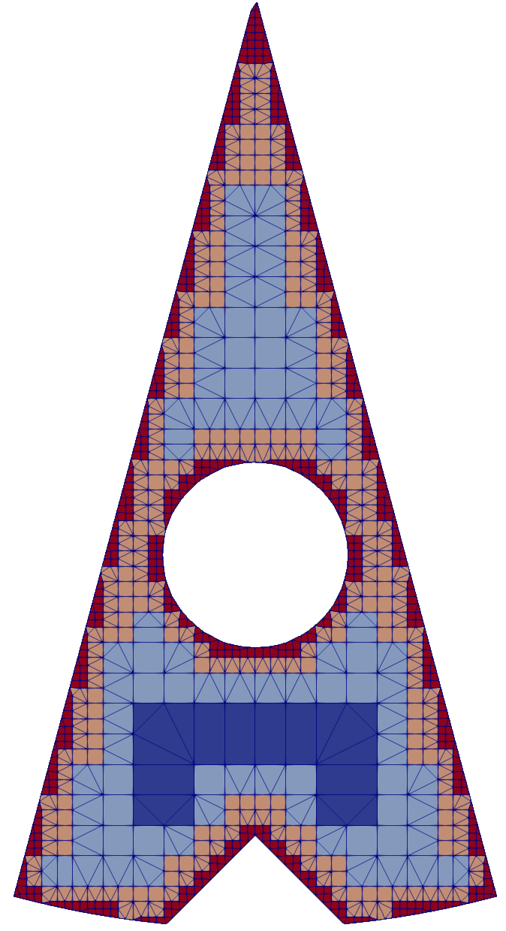
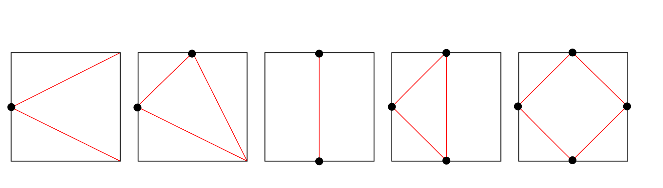

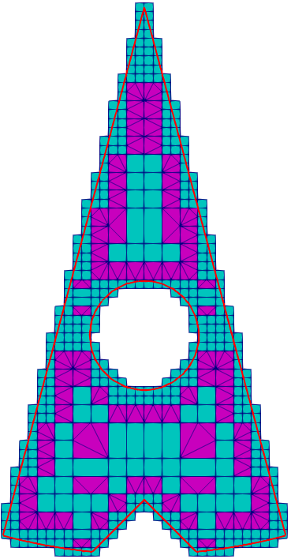
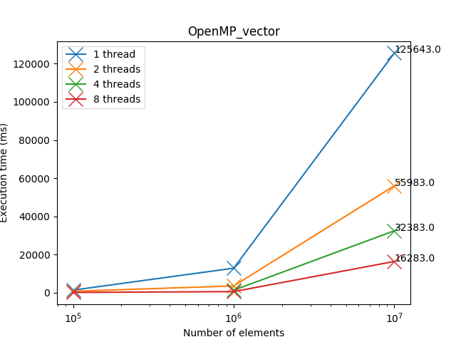
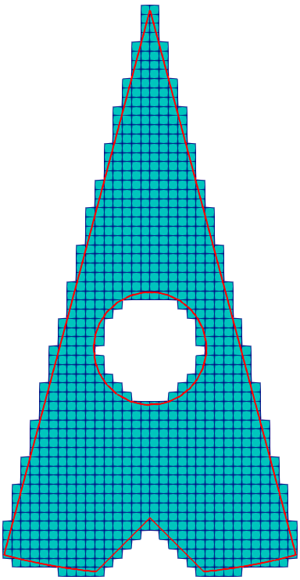
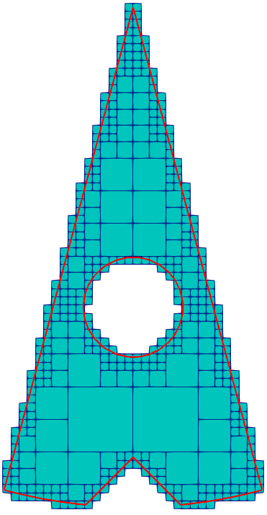
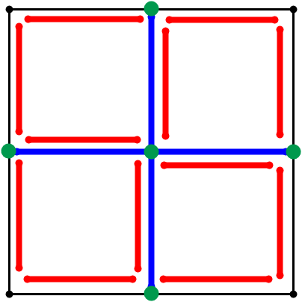
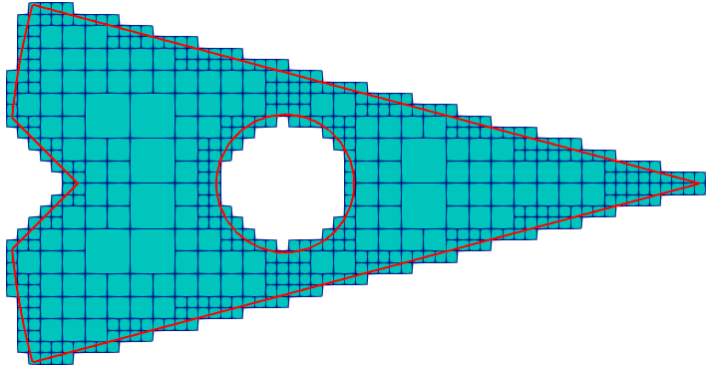
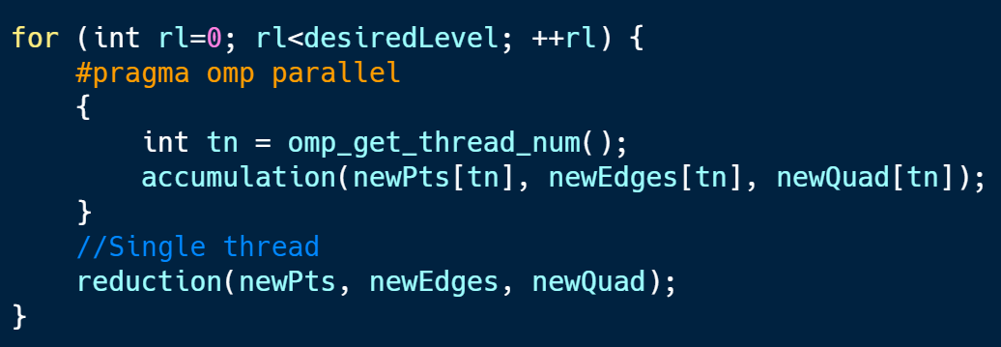
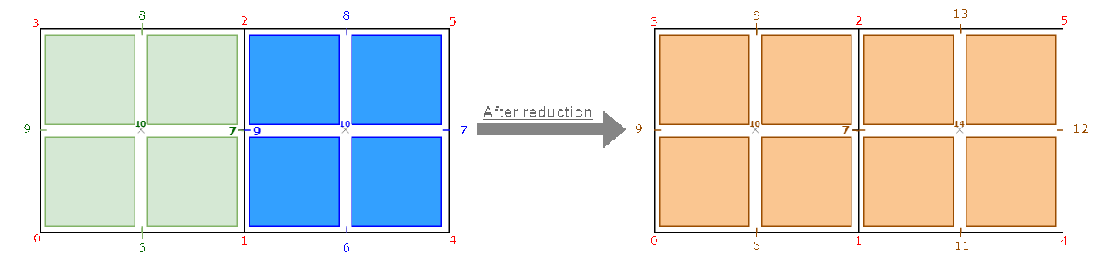
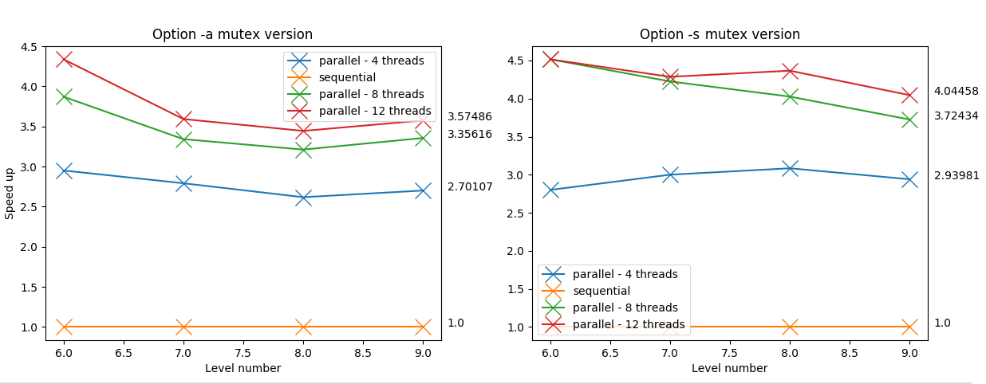
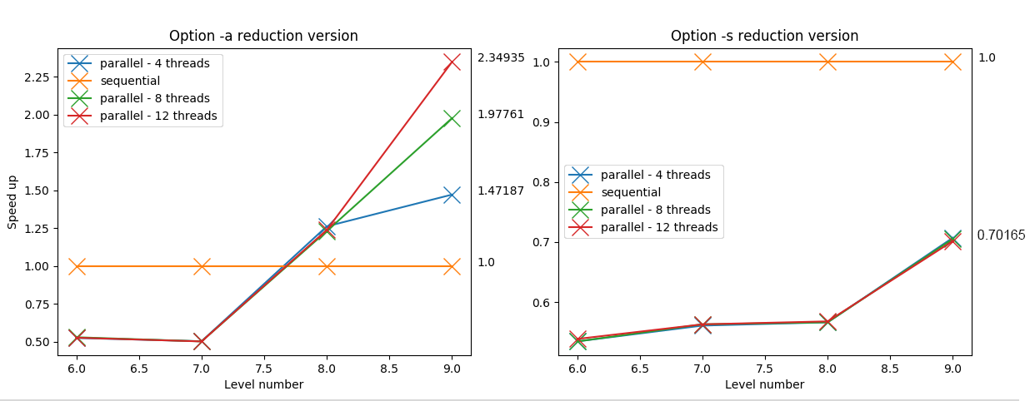
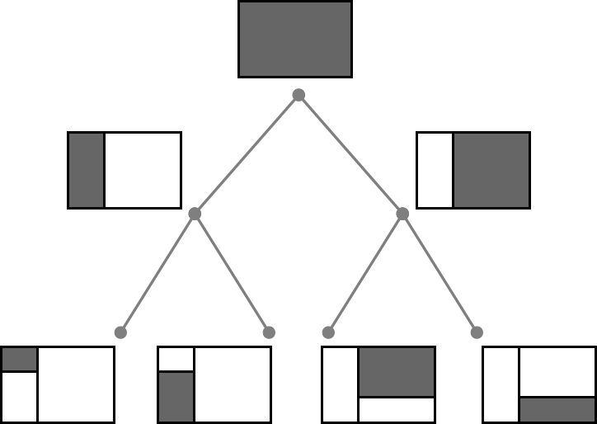
Paul LAFOIX-TRANCHANT, Antoine OLEKSIAK
Lyon university
Supervised by Fabrice JAILLET and Florence ZARA
Context
2D / 3D Mesh refinement (Region Of Interest)
Real time simulation
Objective
Analyze the existing library
Find data structure to optimize parallelization
Speed up the meshing process
Libraries for C++ parallelism
IntelTBB
+ Thread-safe containers
- Only few examples
1. Compute the Bounding Box
Mesh construction
4. Apply the transition patterns
Create the minimal number of initial quadrants
that contains input surface
1
4
(i.e. to produce a conformal mesh)
The transitions patterns
2. Generate Quadrants
Transitions patterns applied on output of meshing on surface region
Process :
Repeat until desired Refinement Level
For each Quadrant :
If the quadrant intersects the chosen region
Split the quadrant into 4 new identical quadrants.
Remove those which are outside.
OpenMP
+ Pre-processing directives
2
3
Splitting process :
in red and blue new edges
in green new points
Split all region
Split surface region
3. Create a balanced structure
(i.e. at most 1 subdivision level between two adjacent quadrants)
For each Quadrant :
if the quadrant has a subdivided edge (midpoint != 0)
check if the subdivided edge are subdivided
Balanced with surface region
Mutex version
Parallelize the mesh construction
Reduction version
Protect the critical regions with different mutex.
Use of concurrent data structures, such as tbb::concurrent_unordered_set to replace the set of QuadEdges.
No more critical regions.
All threads have their own copy of Edges, Points and Quadrants filled in the accumulation part.
The reduction part is done by a single thread and creates the final Edges, Points and Quadrants.
Detection of identical points and update the local index to global index.
Critical regions
Problems
read/write in concurrency in the set of quadedge = one edge could be split twice
It is not possible to modify an element in a set (eg. In the set of QuadEdges) because of the hashtable used to sort elements. However, it is possible to modify a mutable attribute of an element if it’s not used for sorting.
Write new points and new quadrants
Results
Refinement applied on SURFACE Quadrants
Refinement applied on ALL Quadrants
Before/after the reduction process. In red points before the accumulation done by green and blue threads. Notice that they start creating points at index 6 (the number of points before the accumulation)
At the end :
4,095,572 points, 13,653,086 QuadEdges and
4,057,578 Quadrants
At the end :
106,819 points, 320,520 QuadEdges and
55,533 Quadrants
Conclusion
Perspectives
The mutex version is more performant than the reduction, even for high number of quadrants ( > 10^9 ). The reduction part is done sequentially and should need optimizations
Build a quadtree structure to represent all the Quadrants
Implementations avoiding critical sections produce a lot of new code, and it makes the whole project less maintainable
Speed up the reduction part of the version with reduction
with a better algorithm and/or the use of parallelism
Parallelism is not easy !
Make the reduction process only when the desired refinement level is reached
Notes:
Copyright Colin Purrington (http://colinpurrington.com/tips/academic/posterdesign).

