Slide 1


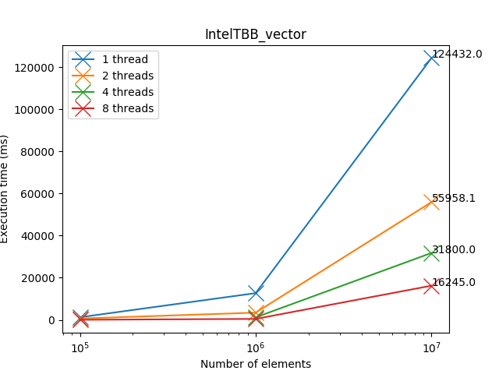

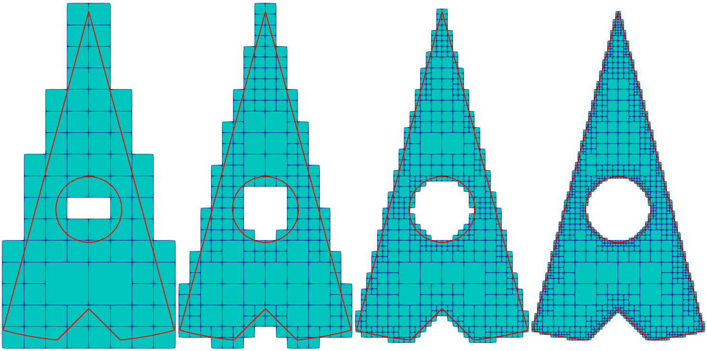
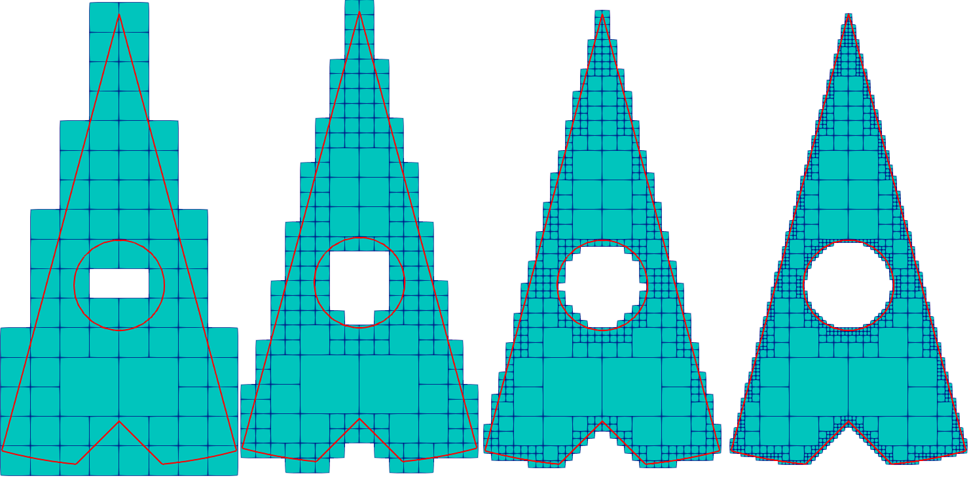
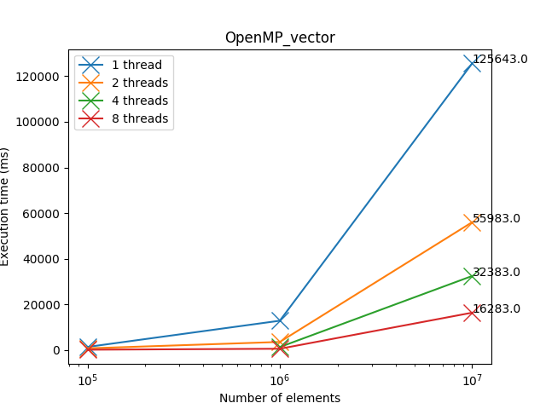
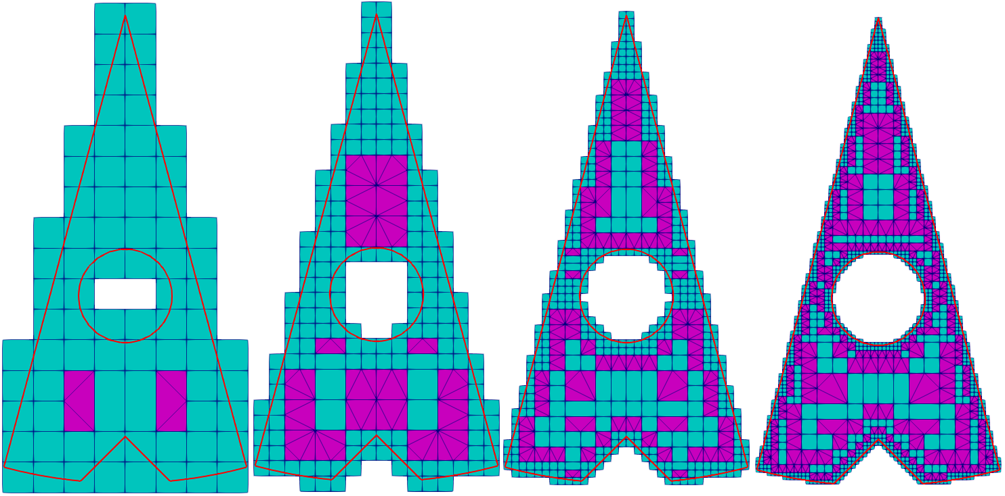
Paul LAFOIX-TRANCHANT, Antoine OLEKSIAK
Lyon university
Supervised by Fabrice JAILLET and Florence ZARA
Context
Mesh refinement (Region Of Interest)
Real time simulation
Simulation
Objective
Analyze the existing library
Find data structure to optimize parallelization
Speed up the meshing process
Libraries for C++ parallelism
Intel TBB
Mesh construction
1
Compute the Bounding Box of the input surface
3
Create a balanced structure
2
Generate Quadrants
(i.e. at most 1 subdivision level between two adjacent quadrants)
For each Quadrant :
if the quadrant has a subdivided edge (midpoint != 0)
check if the subdivided edge are subdivided
OpenMP
4
Apply transition patterns
Process :
Repeat until desired Refinement Level
For each Quadrant :
If the quadrant intersects the chosen region (All and/or Surface) :
Split the quadrant into 4 new identical quadrants.
Remove those which are outside.
(i.e. to produce a conformal mesh)
Mutex version
Reduction version
Perpective
Notes:
Copyright Colin Purrington (http://colinpurrington.com/tips/academic/posterdesign).

