Slide 1
Project Two Tic Tac Toe with Minimax and Alpha-Beta Pruning

Slide 2
Presented by
Presented by:
Zidny Talukder(20201015)
Munimah Mahreen(20201017)
Najmul Hassan Ove(20201020)
Ishrat Jahan(20201025)

Slide 3
Problem Statement
Implementing Tic Tac Toe Game with Minimax and Alpha-Beta Pruning Algorithm
In this assignment, we need to implement the classic game of Tic Tac Toe as an adversarial search problem and develop an AI player using the minimax algorithm with alpha-beta pruning.
We have to create a program that allows human vs. computer and computer vs. computer gameplay and should print the game board on the console after every move.

Slide 4
Project Functionalities
● Understanding Minimax and Alpha-Beta Pruning Techniques
● Implementing Advanced AI Algorithms for Game Development
● Creating an Optimal Game-playing AI System
● Developing an Educational Tool with Enhanced Scalability
● Exploring Challenging Logic and Debugging Techniques

Slide 5
Adversarial Search
Adversarial search constitutes a pivotal algorithm in game theory, utilized for scenarios involving multiple opponents making alternating moves. Its primary goal is to maximize one's own advantage while simultaneously minimizing the opponent's advantage.
When applied to the development of a Tic Tac Toe game, adversarial search enables the creation of an intelligent computer player (AI) capable of strategically optimal or near-optimal moves in response to human actions.

Slide 6
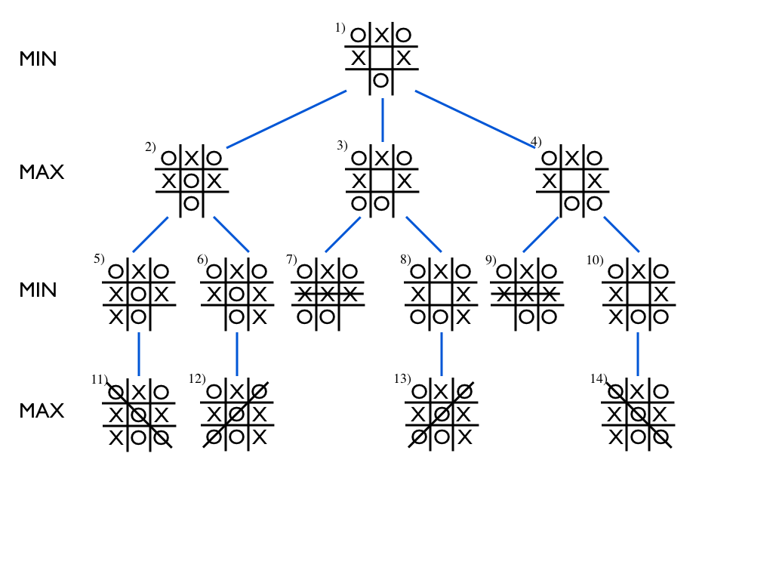
Minimax Algorithm
The Minimax algorithm is a vital component of adversarial search, operating by minimizing the potential loss for the player initiating the move. It selects the move that results in the best possible outcome, taking into account the opponent's best responses.
Minimax finds application in Tic Tac Toe to facilitate the creation of an intelligent computer player capable of making optimal decisions. It achieves this by meticulously evaluating all feasible game states and anticipating the potential moves of the opponent

Slide 7
Alpha-Beta Pruning
Alpha-Beta pruning serves as a crucial technique within the Minimax algorithm, designed to curtail the number of nodes assessed in the game tree. It effectively removes branches that hold no potential to impact the final decision, thus streamlining the search process.
Even within the relatively small game tree of Tic Tac Toe, Alpha-Beta pruning remains an invaluable tool for optimizing the decision-making process of the AI. Its implementation ensures a quicker identification of the best move by reducing the evaluation of redundant and unproductive game states."

Slide 8
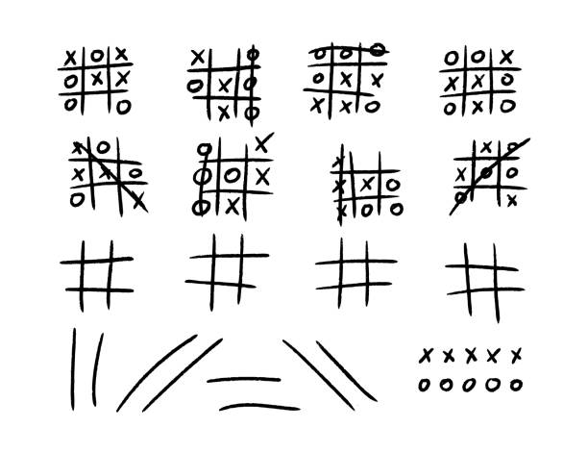
Tic Tac Toe Representation

Slide 9
Game Modes
● Human vs Computer : A game mode where a human plays against a computer opponent.
● Computer vs Computer : A game mode where two computer programs or AI agents play against each other.

Slide 10
Functions
1. def print_board(board):
This function is used to print the Tic Tac Toe board in the console.
2. def check_winner(board, player):
This function checks whether a player has won the game by checking all the rows, columns, and diagonals.
3. def is_full(board):
This function checks if the board is completely filled with player symbols.
4. def available_moves(board):
This function returns a list of available moves on the board.
5. def minimax(board, depth, alpha, beta, is_maximizing):
This function implements the minimax algorithm for the AI player to make the best possible move.
6. def find_best_move(board, player):
This function finds the best move for the AI player based on the current board state and the player's symbol.

Slide 11
Technical Report : Link
Source Code : Link

Slide 12
Conclusion
The implementation of the Minimax algorithm and Alpha-Beta Pruning in the Tic Tac Toe game illustrates the prowess of artificial intelligence in strategic decision-making. This project not only deepens one's comprehension of adversarial search but also underscores the importance of efficient algorithmic The implementation of the Minimax algorithm and Alpha-Beta Pruning in the Tic Tac Toe game illustrates the prowess of artificial intelligence in strategic decision-making. This project not only deepens one's comprehension of adversarial search but also underscores the importance of efficient algorithmic optimization. By fostering problem-solving skills and proficiency in coding, it paves the way for the development of more complex AI applications.

Slide 13
Thank you

