Slide 1





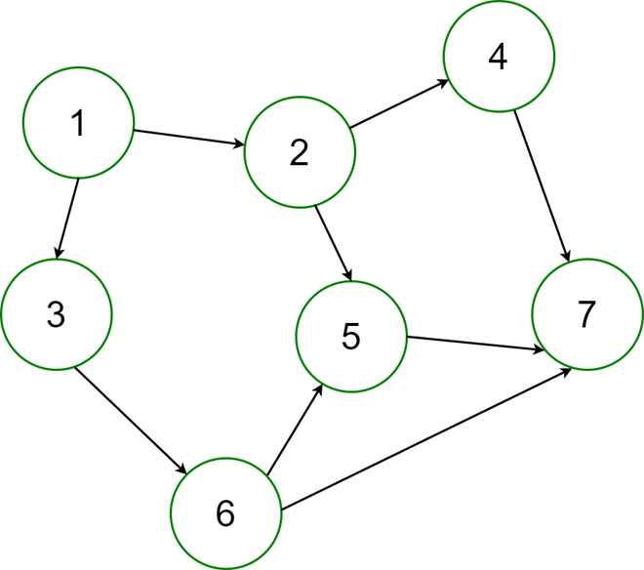





Job scheduler/orchestrator
Model training
POD
POD
Docker registry
POD
Scoring
Model metadata
Predictions
DAG
Push predictions to Pardot
Classifier
Count vectorizer
Tf-idf transformer
Pardot data
Continuous integration/deployment

Slide 2
department
Training
(once a week)
Model performance monitoring
start
sector
seniority
Model artifacts
Model metadata
Pardot data
department
Inference
(once a day)
predictions
start
sector
Pardot push
seniority
Pardot

Slide 3
Job scheduler/orchestrator
Model training
POD
POD
Docker registry
POD
Scoring
Model metadata
Predictions
DAG
Clickhouse
Push predictions to Pardot
Classifier
Count vectorizer
Tf-idf transformer
Pardot data
Clickhouse?
Kafka

