Slide 1
DATA-DRIVENSOLAR
AEROPONICS
DESIGN, BUILD, AND IMPLEMENTATION PLAN
Project Lead: Jaime Conde and Shazia Khan
Team: Flora, Torrin, Citlaly, Luke

Slide 2

OBJECTIVE
Goal of this meeting:
Finalize required materials and identify missing components
Assign clear roles and responsibilities for each subsystem
Establish a realistic build timeline and work location
Confirm team commitment, availability, and long-term ownership

Slide 3
SYSTEM OVERVIEW
Flow System
Structure
Water pumps
Tubing + mist nozzles
Flow meters
PVC frame + vertical columns
Reservoir tanks
System Type
Energy
Control System
Vertical aeroponic growing system
Soil-free, mist-based root nourishment
Sensor-driven (pH, TDS, temperature)
Solar panel (Optional)
battery
controller (Optional
Raspberry Pi
Sensors (pH, TDS, water level, light)
Relay module + power supply
Lighting
Nutrients
LED grow lights
Nutrient solution
Doser pumps
Net cups + growing medium

Slide 4
RISKS AND MITIGATION
System Failure Risks
Measurement & Control Risks
Project Execution Risks
Pump Failure (Flow System)
→ Loss of mist → plants die within ~30 minutes
Solution:
Use reliable pump (rated continuous use)
Keep backup pump available
Test before full operation
Clogged Tubing / Nozzles
→ Uneven or no nutrient delivery
Solution:
Use filtered water
Regular cleaning schedule
Easy-access tubing design
Power Failure
→ Entire system shuts down
Solution:
Add battery backup (later phase)
Manual check schedule
Alert system (future upgrade)
Sensor Failure (pH / TDS / Water Level)
→ Incorrect nutrient conditions
Solution:
Manual verification (weekly)
Calibrate sensors regularly
Redundant checks (visual + measurement)
Relay / Electrical Failure
→ Pump or system not triggered
Solution:
Test wiring before deployment
Use fused connections
Keep spare relay module
No Summer Maintenance
→ System dries out and fails
Solution:
Assign weekly maintenance roles
Create schedule before build
Transfer ownership if needed
Delayed Structure Build
→ Entire project timeline pushed back
Solution:
Prioritize structure materials first
Assign structure lead
Set early build deadline

Slide 5
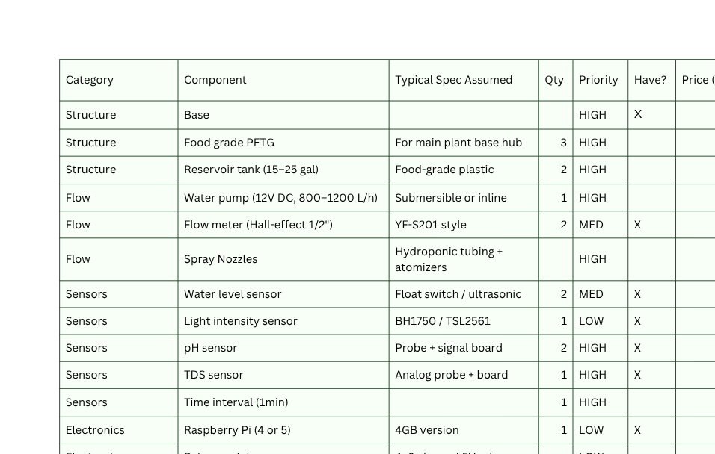
BOM

Slide 6
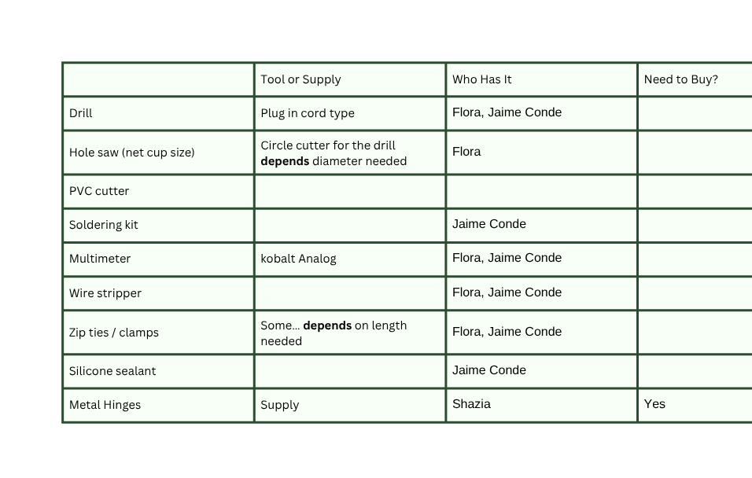
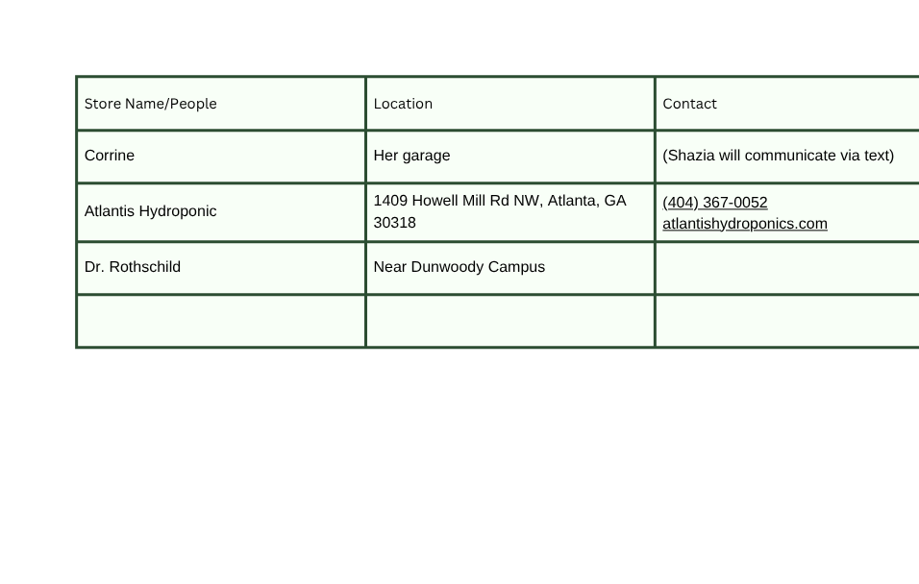
TOOLS AND SPONSORSHIPS

Slide 7
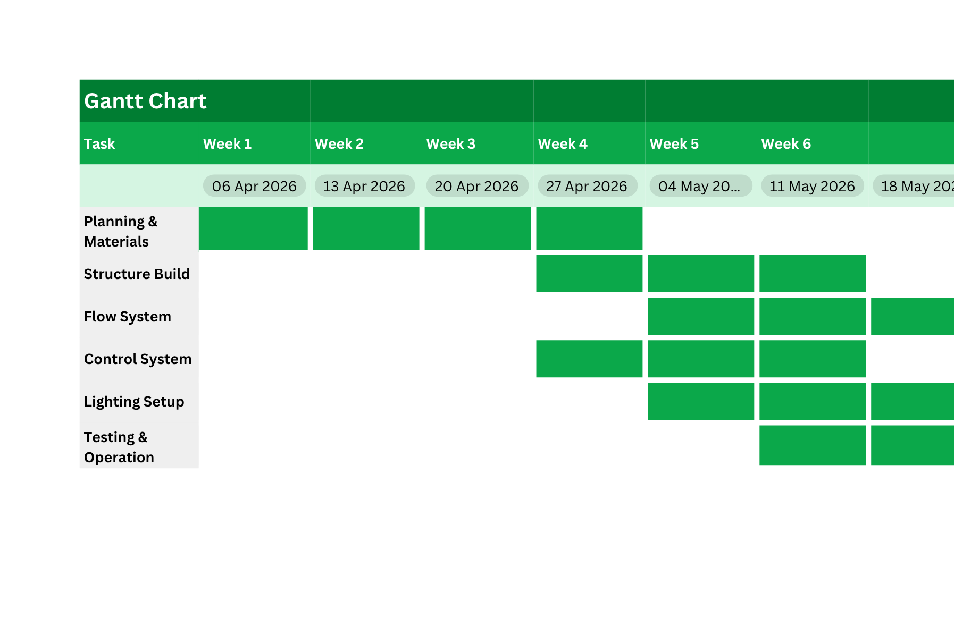
BUILD PROCESS

Slide 8
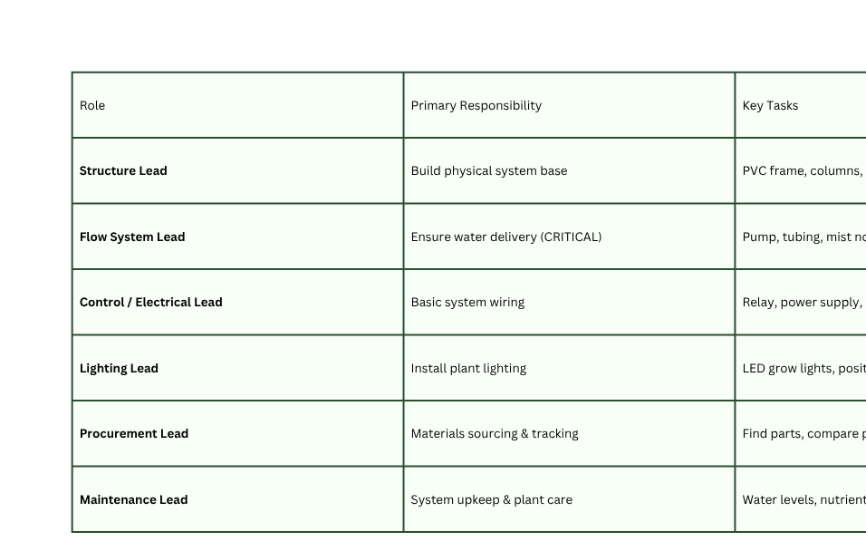
ROLES AND RESPONSIBILITIES
THIS CHART IS MEANT AS A GENERAL REPRESENTATION OF WHAT TASKS NEED TO BE DONE, NOT A STRICT ASSIGNMENT SHEET. I ENCOURAGE PEOPLE TO WORK TOGETHER IN AN INTERCONNECTED WAY. IF WE KNOW SOMEONE WILL BE GONE FOR A SPECIFIC WEEK/TIME PERIOD WE CAN MOVE AROUND WHO DOES WHAT.

