Slide 1
MOVIELENS RECOMMENDATION SYSTEM
Phase 4 DSC Group project
GROUP 2 MEMBERS
James Owiti
Pelly Kagwe
Sheila Muli
Amos Obaga
Nancy Muriithi

Slide 2
General Overview
In today’s digital entertainment landscape, users are presented with thousands of movie choices across streaming platforms. This abundance of options often leads to decision fatigue, making it difficult for users to quickly find content that matches their preferences. Recommendation systems help solve this problem by filtering large volumes of data and delivering personalized suggestions that enhance user experience.
The goal of this project was to design and build a movie recommendation system using the MovieLens dataset. The system analyzes user ratings to identify patterns in viewing behavior and predict movies that a user is likely to enjoy. By leveraging collaborative filtering techniques, the model generates personalized recommendations based on similarities between users and their past ratings.

Slide 3
BUSINESS UNDERSTANDING
Problem Statement
Streaming platforms have thousands of movies, making it difficult for users to find content they enjoy. When users spend too much time searching, they get frustrated and stop using the service. To solve this, our project uses the MovieLens dataset to build a system that generates top-5 movie recommendations by learning patterns from users with similar preferences, making discovery faster and more personal.

Slide 4
Objectives
To build a movie recommendation system using the MovieLens dataset.
To analyze user rating patterns to understand viewing preferences.
To implement collaborative filtering techniques for personalized recommendations.
To evaluate the model’s performance using appropriate metrics.
To demonstrate how recommendation systems can improve user experience and support business growth.

Slide 5
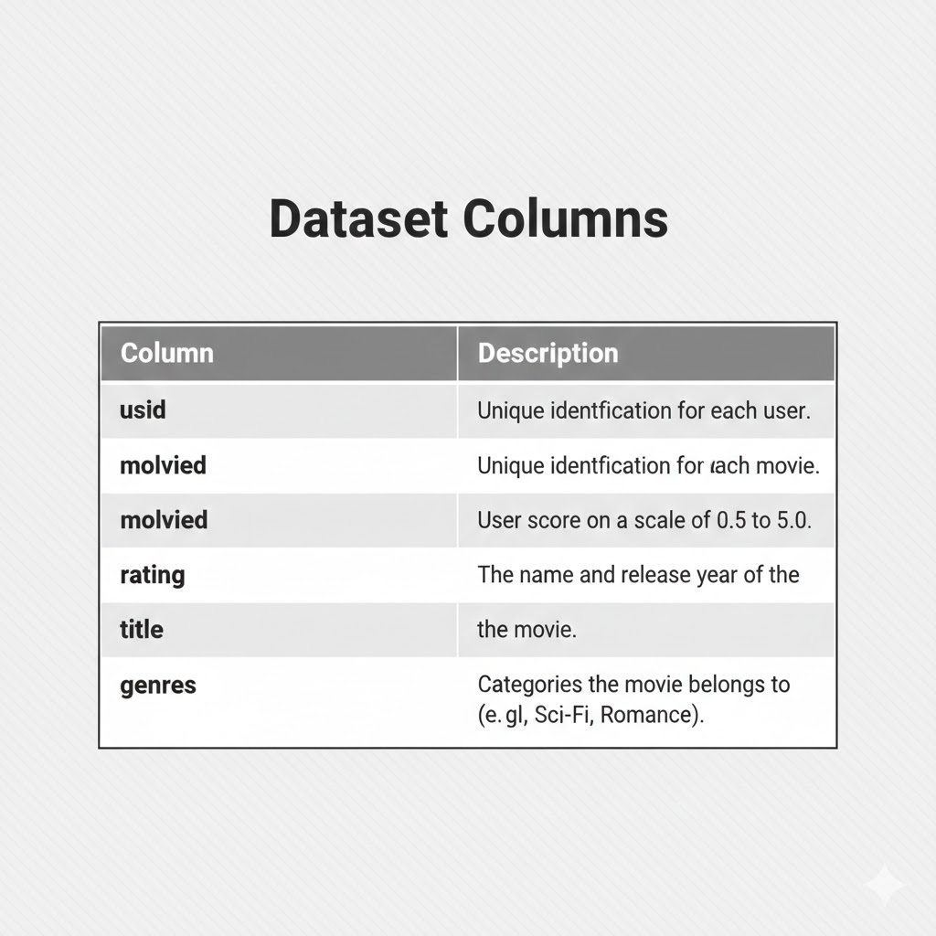
DATA UNDESTANDING
Data Source
We utilized the MovieLens "small" dataset, consisting of 100,836 ratings, 9,724 movies, and 610 unique users.
Data Quality Assessment
Completeness: Checked for missing values (None found).
Consistency: Verified that all ratings fall within the standard 0.5–5.0 range.
Format: Confirmed data types are correct (Integers for IDs, Floats for ratings).
Uniqueness: Checked for and removed any duplicate user-movie interactions.
Sparsity: Identified a 98.3% sparsity rate, meaning most users have only rated a small fraction of the total movies available.

Slide 6
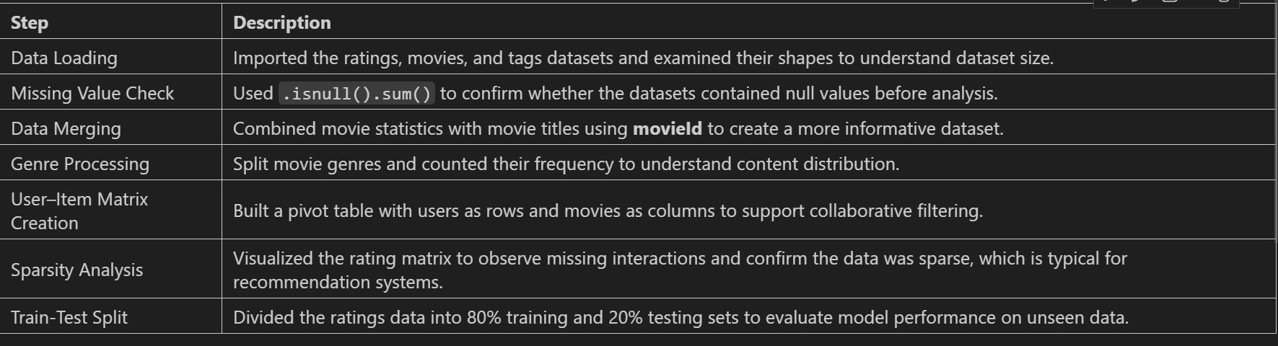
DATA PREPARATION
Data preparation involved cleaning, structuring, and transforming the MovieLens dataset to make it suitable for building an accurate recommendation system.

Slide 7
Exploratory Data Analysis
The goal of EDA is to uncover hidden patterns, detect anomalies (like outliers), and check our assumptions. By analyzing the relationships between users, movies, and ratings through six key visualizations, we gain the necessary insights to ensure our model is built on a solid understanding of user behavior.

Slide 8
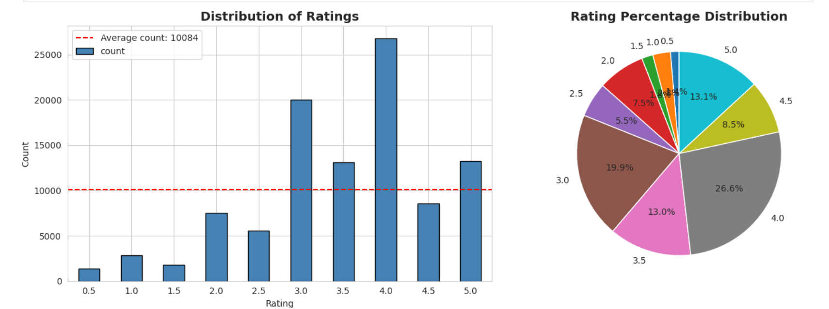
1. Rating Distribution

Slide 9
Key Insights:
Positive Sentiment Bias: The data is heavily skewed toward higher ratings, with a significant majority of users giving scores of 3.0 or above.
Most Frequent Rating: The most common score given by users is 4.0, accounting for 26.6% of all ratings in the dataset.
Engagement Threshold: Ratings of 3.0, 3.5, and 4.0 make up nearly 60% of the total volume, suggesting that users are more likely to rate movies they actually enjoyed rather than those they disliked.
Low Negative Feedback: Extreme negative ratings (0.5 to 1.5) are rare, representing only a small fraction of the data. This indicates that the system primarily learns from "positive" preferences.
Data Density: The average count per rating level is 10,084, but the 4.0 rating significantly exceeds this average, acting as a major anchor for the recommendation model.

Slide 10
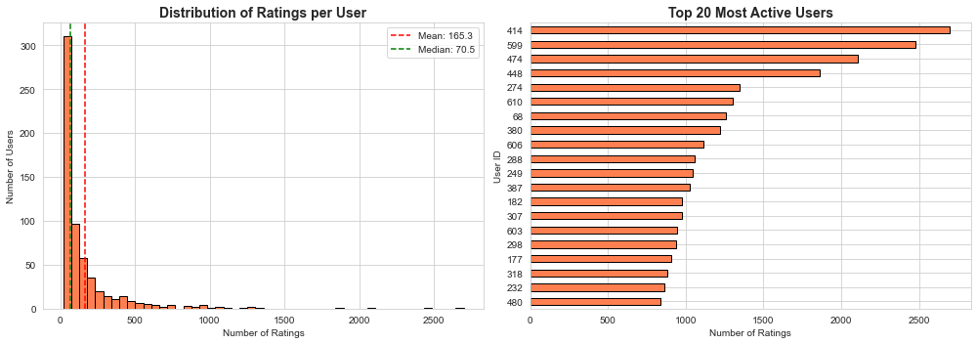
2. User Activity Analysis
User activity is highly variable. Most users rate 20-200 movies, but some power users rate 1000+ movies. This variability is good for collaborative filtering as it provides both broad coverage and deep preferences.

Slide 11
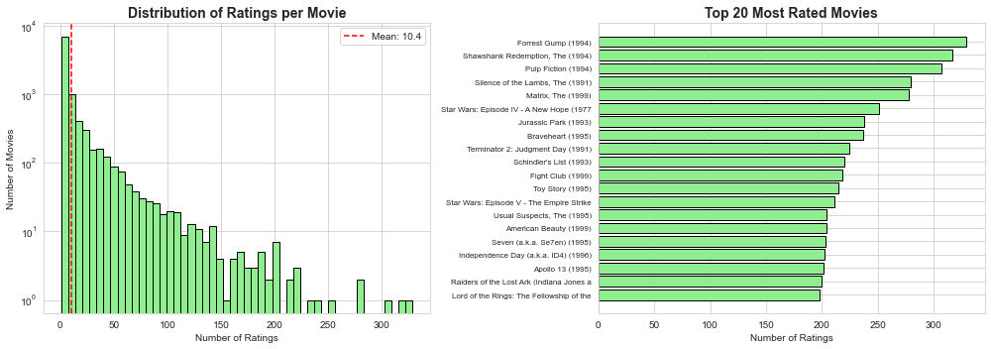
Movie Popularity Analysis

Slide 12
Key Insights:
Engagement Anchors: A small group of "Blockbuster" titles (e.g., Forrest Gump) drives the highest volume of ratings, acting as the platform's primary traffic drivers.
Quality vs. Quantity: There is a positive correlation between popularity and score; most highly-rated movies also have the highest number of reviews (3.5+ stars).
Genre Dominance: Popularity is concentrated in Drama, Comedy, and Action, which generate the most consistent user interaction.
The Long Tail: While a few movies are hits, the vast majority have very few ratings. This confirms the need for a recommendation system to surface "hidden gems."
Business Impact: By identifying popular content, we can optimize the homepage to show trending movies, reducing the time users spend searching.

Slide 13
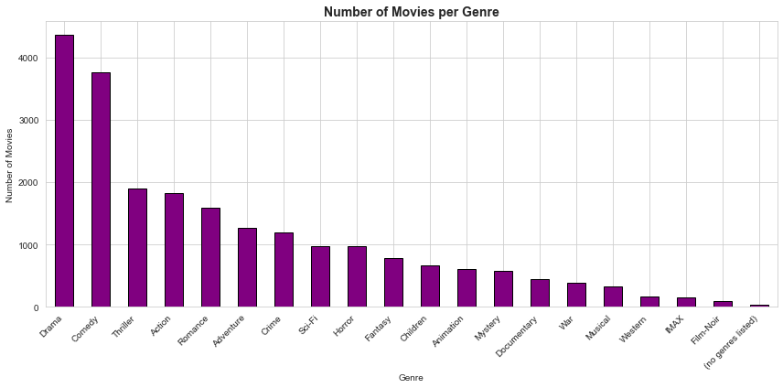
Genre Distribution Analysis
Drama is the most common genre, followed by Comedy and Thriller. This reflects the composition of the movie industry and user preferences.

Slide 14
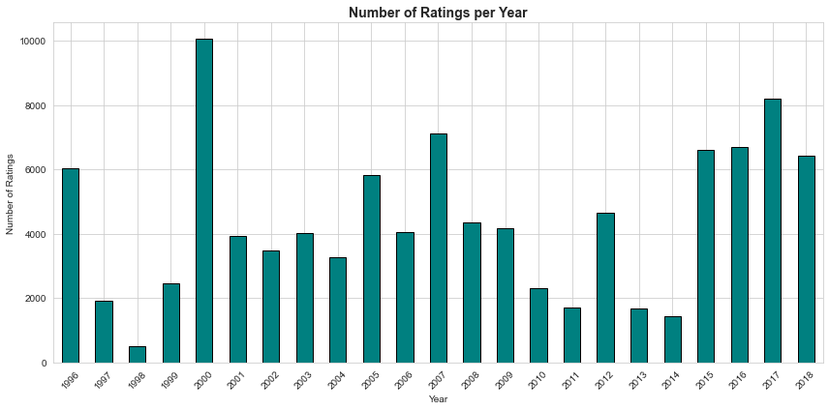
Rating Patterns Over Time
High ratings: 2000 (~10,000), 2017 (~8,200), 2015-2016 (~6,600)
Moderate ratings: 1996 (~6,000), 2005 (~5,800), 2007 (~7,100), 2012 (~4,600)
Low ratings: 1998 (~500), 1997 (~1,900), 2010 (~2,300), 2011 (~1,700), 2013 (~1,600), 2014 (~1,400)
Observation: Ratings fluctuate over the years, with peaks around 2000 and 2017.

