Slide 1
Carta
The Modern Capitalization Table

Slide 2
Overview and Origin
Founded in 2012 by Henry Ward and Manu Kumar
Lack of transparency, time-consuming
Digitized stock certificates
$447.8 million - Andreessen Horowitz, Spark Capital, Tribe Capital, Meritech

Slide 3
Business Activities
Previews issues in the industry
Broken cap tables
Lengthy process to buy, sell, exercise stock options
Law firms handled paperwork
Intended users and market size
Companies, investors, and employees
Venture firms, Limited Partners and funds
Technologies used
Django - Python-based framework

Slide 4
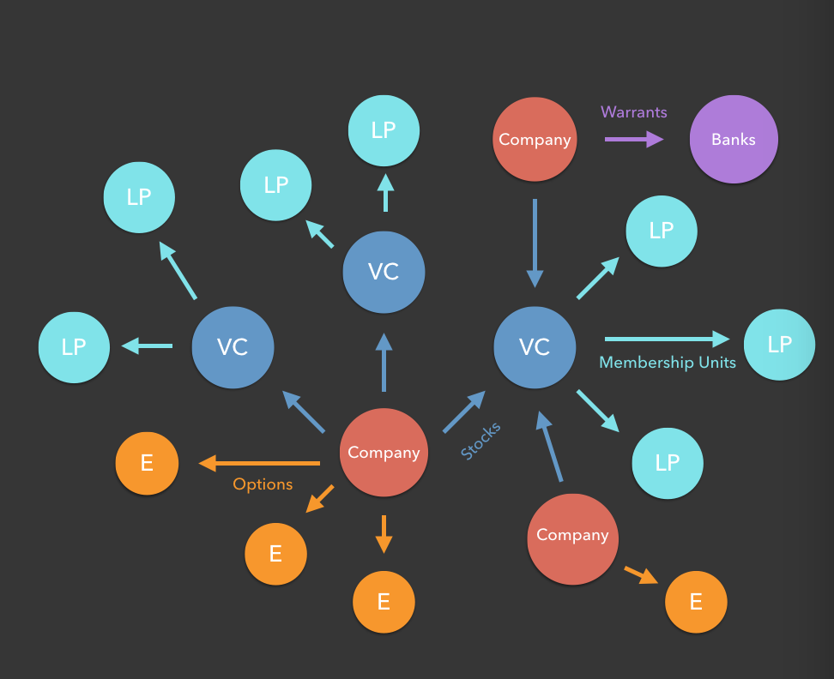
https://carta.com/blog/eshares-is-now-carta/

Slide 5
Business Landscape
FinTech Domain
Investment Management
Major Trends in Domain
Big Data, Machine Learning, Artificial Intelligence
Automated trading,
Competition
Shareworks
Captable.io

Slide 6
Results
Business Impact and Metrics
Over 700,000 shareholders
$575 billion in assets
In comparison
Shareworks - 10,000 shareholders
Captable - 50,000 shareholders

