Slide 1
MMF 1941 PROJECT PROGRESS UPDATE
Comparative Analysis of Bid-Ask
Spread Estimators Across Asset Classes
How do daily-OHLC spread estimates compare with an intraday
realized-cost benchmark across asset classes and liquidity tiers?
MMF 1941 | First progress checkpoint
Project 1 | Proposal A04-03 | 2015-2025 asset-day framework
Data validation and design readiness
Progress update | Descriptive diagnostics; estimator comparison remains planned
Notes:
Source: Proposal A04-03 and accepted exploratory notebook. Benchmark remains undefined; this is not an estimator-results deck.

Slide 2
RESEARCH DESIGN
Compare spread estimates after the design is frozen
PLANNED METHODOLOGY | Asset-day observations, 2015-2025
EVENTUAL COMPARISON
DESIGN DIMENSIONS
Corwin-Schultz (CS)
Abdi-Ranaldo (AR)
EDGE
Against an intraday realized-cost benchmark
Stocks, ETFs, futures, crypto; FX unresolved
Liquidity-stratified final universe
Cross-class and within-class diagnostics
Exact benchmark and session rules: OPEN
OPEN DECISION
Choose the benchmark for its economic meaning, not estimator performance.
MMF 1941 Project progress update
02

Slide 3
DATA REQUIREMENTS
Separate local intraday inputs from Bloomberg daily data
REQUIREMENTS | Identifiers, timing and units must connect the sources
Input | Source / frequency | Role / current boundary
Daily OHLC + volume | Daily/EOD source; aggregation TBD | Inputs for eventual daily estimators
Intraday OHLCV | Local RiskLab / First Rate Data | Benchmark feasibility + diagnostics
Daily bid / ask | Bloomberg equity / ETF pilot | PX_BID / PX_ASK; not intraday quotes
Identifiers + metadata | Provider records + Bloomberg BDP | IDs, currency, adjustments, timezone
SOURCE RULE
Bloomberg is daily/EOD/reference only; all intraday data stay local.
MMF 1941 Project progress update
03

Slide 4
LOCAL DATA INVENTORY
Four asset classes available; FX remains unresolved
FACTS | Local RiskLab / First Rate intraday archive
Asset class | Availability | Pilot / limitation
Stocks | AVAILABLE | AAPL, GME
ETFs | AVAILABLE | SPY, IWM
Futures | AVAILABLE; methodology review | ES_Z24, CL_Z24: individual contracts
Crypto | AVAILABLE | BTC, ETH
FX | METADATA REVIEW | Expected by metadata; physically unavailable
LIMITATION
No FX substitute. Futures files do not form a continuous history.
MMF 1941 Project progress update
04
Notes:
Inputs resolve via RISKLAB_DATA_ROOT/intraday_data. Availability refers to the accepted pilot inventory, not universal 2015-2025 coverage.

Slide 5
BLOOMBERG ACQUISITION
AAPL + SPY daily/reference pilot is preserved
PILOT | 2024-11-04 to 2024-11-15; BDP / BDH
ACQUISITION SCOPE
EVIDENCE / NEXT PULL
BDP: names, FIGI, ISIN, CUSIP,
ticker/exchange and currency
BDH daily: PX_OPEN, PX_HIGH, PX_LOW,
PX_LAST, PX_VOLUME, PX_BID, PX_ASK
Raw workbook + values-only snapshot
26 source-log entries; SHA-256 verified
Retrieval dates: 2026-09-24 / 2026-09-25
Full 2015-2025 pull deferred until
final equity/ETF universe is frozen
BOUNDARY
Daily bid/ask fields do not establish the intraday benchmark.
MMF 1941 Project progress update
05
Notes:
Source: static workbook, source log and Acquisition evidence sheets. Read only metadata, not new empirical observations. Logged timezone is Bloomberg daily metadata, not evidence for local intraday timezone. Default BDH adjustments remain unverified.

Slide 6
INTRADAY PILOT VALIDATION
The local pilot is parsed, checked and traceable
FACTS | AAPL, GME, SPY, IWM, ES_Z24, CL_Z24, BTC, ETH
Validation item | Accepted diagnostic
Raw schema | Six columns; headerless timestamp + OHLCV
Project-window rows | 18,086,973 | 2015-2025
Post-2025 rows excluded | 20,097 | audit only
Duplicates / invalid OHLC / missing / non-numeric | 0 in project-window diagnostics
Zero-volume rows retained | AAPL: 94 | GME: 1,277
Manual raw-row checks | 10/10 passed
SCOPE
Parsing checks passed; session, timezone and volume-unit metadata remain open.
MMF 1941 Project progress update
06
Notes:
Sources: pilot_schema.csv; pilot_coverage.csv; file_scan_audit.csv; data_quality_summary.csv; manual_checks.csv. Flags and validity definitions are those of the accepted notebook.

Slide 7
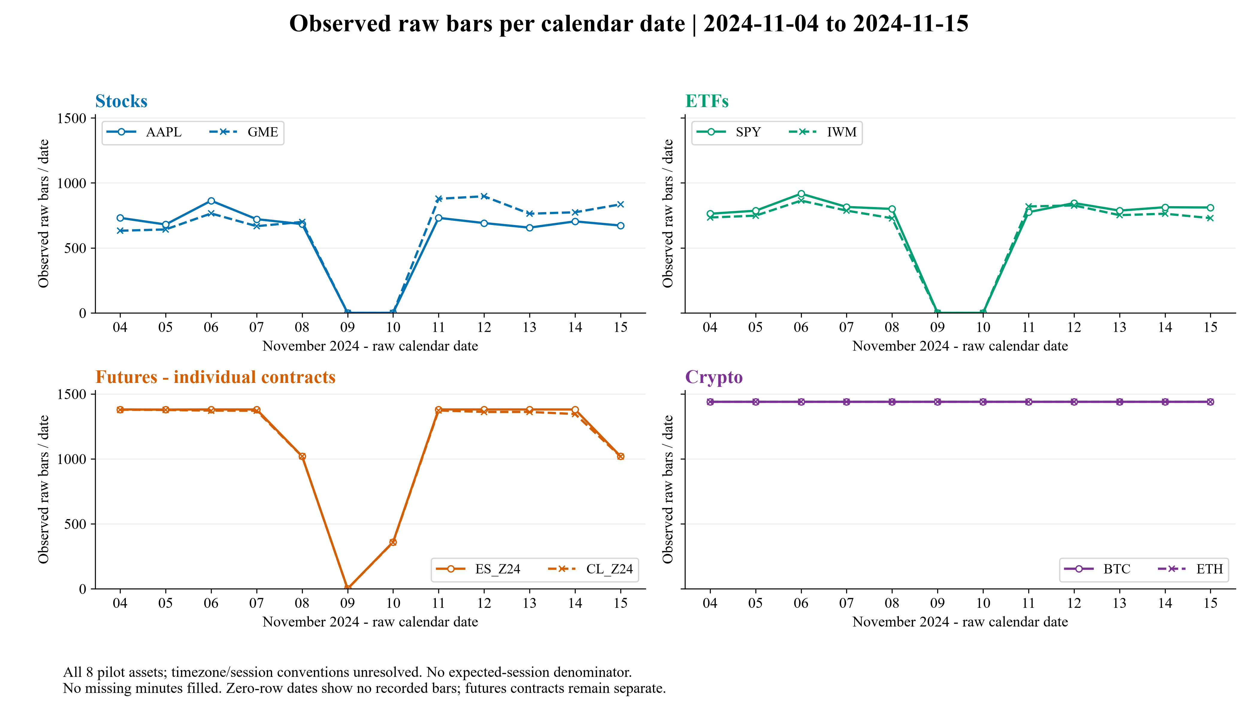
COMMON-WINDOW DIAGNOSTIC
Observed raw bars differ across asset classes
DIAGNOSTIC | 2024-11-04 to 2024-11-15; no expected-session denominator
DIAGNOSTIC
Observed bar structure differs materially across asset classes before any session convention is imposed.
MMF 1941 Project progress update
07
Notes:
Source: common_window_bars_per_day.png, generated by notebook from bars_per_calendar_day.csv. Counts retain all recorded hours; no minute filling. Calendar-date zeros are not missing-minute estimates.

Slide 8
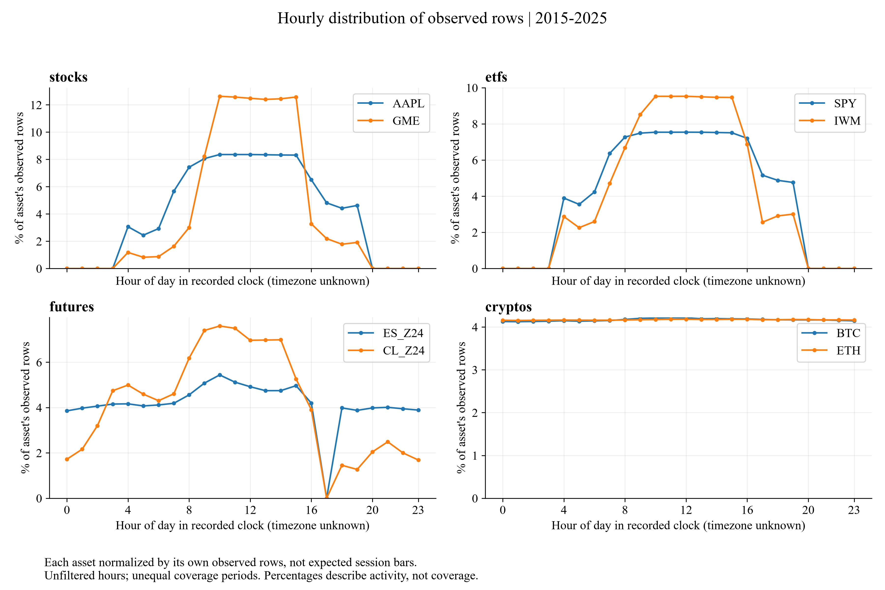
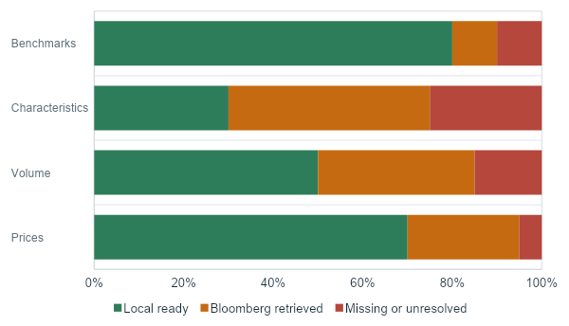
INTRADAY CLOCK DIAGNOSTIC
Resolve clock interpretation before aggregation
DIAGNOSTIC | Recorded-clock activity; percentages describe activity, not coverage
DIAGNOSTIC
Recorded-clock patterns differ across assets/classes; resolve timezone and session interpretation before benchmark aggregation.
MMF 1941 Project progress update
08
Notes:
Source: hourly_activity_by_asset_class.png, generated from hourly_activity.csv. Each asset normalized by its own observed rows. Different date spans and unlocalized clocks limit interpretation.

Slide 9
PREPARATION AND REPRODUCIBILITY
One reproducible path from raw data to this deck
IMPLEMENTED | Raw data remain read-only
DATA HANDLING
REPRODUCIBILITY
RISKLAB_DATA_ROOT / intraday_data
Chunked full-file scanner
No forward filling or inserted minute bars
Duplicates retained and flagged
Explicit date exclusions and quality flags
CSV tables + 300-DPI figures from code
Source log, hashes and raw-row checks
Notebook -> CSV/PNG -> template -> deck
Package versions + run manifest retained
Numeric outputs reconcile unchanged
STATUS
The analytic asset-day panel is a later step; this checkpoint produces diagnostics.
MMF 1941 Project progress update
09

Slide 10
PRELIMINARY IMPLICATION
Session/calendar rules must precede the benchmark
DESCRIPTIVE IMPLICATION | Not an estimator result
Asset | Observed dates | Median rows / observed day | Min - max
AAPL | 10 | 697.5 | 656 - 863
GME | 10 | 764.0 | 632 - 897
SPY | 10 | 805.5 | 763 - 917
IWM | 10 | 757.5 | 728 - 864
ES_Z24 | 11 | 1,380.0 | 360 - 1,380
CL_Z24 | 11 | 1,361.0 | 357 - 1,378
BTC | 12 | 1,440.0 | 1,440 - 1,440
ETH | 12 | 1,440.0 | 1,440 - 1,440
BTC / ETH
1,440 per raw date
Stocks / ETFs
Fewer bars; zero-row dates
Futures
Distinct calendars
DIAGNOSTIC
Freeze class-specific session/calendar rules before constructing a comparable intraday benchmark.
MMF 1941 Project progress update
10
Notes:
Source: common_window_presentation_summary.csv. Dates are raw calendar dates. Equity/ETF zero-row dates coincide with non-trading weekend dates, but session conventions are not frozen. Futures are individual contracts. No expected-session coverage percentage.

Slide 11
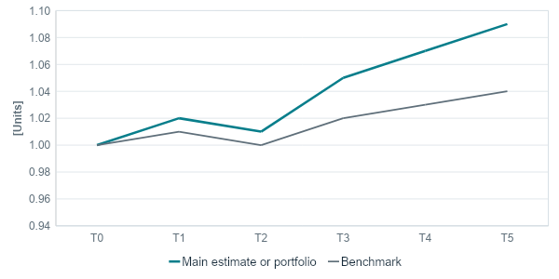
OPEN DECISIONS AND NEXT STEPS
Freeze the design before estimating spreads
NEXT STEPS | Sequence, not completed methodology
1. METADATA
2. DESIGN
3. EXECUTION
Confirm timezone / bar labels
Freeze class-specific sessions
Resolve FX availability
Review adjustments and units
Define exact intraday benchmark
Freeze negative / undefined treatment
Choose liquidity-stratified universe
Set futures contract policy
Full Bloomberg daily pull
Build asset-day framework
Only after design freeze:
estimate CS / AR / EDGE
DISCUSSION
Feedback sought: benchmark feasibility and class-specific session conventions.
MMF 1941 Project progress update
11

Slide 12
APPENDIX - SOURCES AND LINEAGE
Every displayed result maps to a saved artifact
LINEAGE | Sources, parser, diagnostics and presentation
Source / stage | Retained evidence | Role / restriction
First Rate via RiskLab | intraday_data; source paths + scan audit | Local intraday OHLCV only
Bloomberg | Raw + static workbook; source log + hashes | Daily/EOD/reference only
Parser + diagnostics | data_io.py; eda_diagnostics.py; CSV/PNG | Accepted EDA; no estimators
Presentation | Supplied MMF template + build_presentation.py | Reads accepted outputs; no new analysis
Raw -> parser -> diagnostics -> analytic output (planned) -> presentation
STATUS
Current deck uses diagnostics directly; the analytic asset-day output is still planned.
MMF 1941 Project progress update
12
Notes:
Source paths and SHA-256 values for deck dependencies are saved in outputs/diagnostics/presentation_build.json. Template master/layout/theme retained.

Slide 13
APPENDIX - ACQUISITION AND VALIDATION
Bloomberg lineage and raw-row evidence
AUDIT EVIDENCE | Source-log metadata; accepted manual checks
BLOOMBERG SOURCE LOG
MANUAL VALIDATION: 10/10
AAPL US Equity + SPY US Equity
BDP reference / BDH daily OHLCV + bid/ask
26 entries | retrieval: 2026-09-24 / 2026-09-25
Raw + static SHA-256: verified
Logged filename has '(1)'; local name differs.
Raw hash matches; adjustment defaults unverified.
Asset | Raw line | Check
AAPL | 3,796,340 | PASS
SPY | 4,238,251 | PASS
ES_Z24 | 76,450 | PASS
BTC | 5,344,971 | PASS
Raw path / line / text + parsed values, range, gap and return checks retained.
LIMITATION
Bloomberg daily metadata do not resolve the local intraday timezone.
MMF 1941 Project progress update
13
Notes:
Bloomberg raw SHA-256: e9673edb37db8935e1d31eeac006b0f5111f8258017df481f9b38288e427f703
Static SHA-256: 358a84837aa6d5346b0e2ec4e9931040d7afba050e37e0ef1c2b2a1f9ef4d440
Source log filename: bloomberg_pilot_AAPL_SPY_20241104_20241115(1).xlsx
Actual local raw path: data\raw_bloomberg\bloomberg_pilot_AAPL_SPY_20241104_20241115.xlsx
Raw content hash agrees despite filename suffix difference. See manual_checks.csv for all 10 examples and full raw-row text.

