Slide 1
THE PROBLEM
The model flags risk.
Can we explain why?
Explainability means tracing a model’s prediction back to the inputs that drove it, in terms a person can check and challenge.
WHO NEEDS THE EXPLANATION
The client
The bank
The regulator
A declined applicant must be given the specific reasons, with no exception for complex models.
Independent model review must assess how explainable each model is, AI and ML included.
Credit scoring is a high-risk AI use: it needs transparency and human oversight.
US · Regulation B
Canada · OSFI E-23, from May 2027
EU · AI Act, from Dec 2027
Explainable Credit Risk
01
Notes:
Imagine a credit analyst sees a high default-risk score. If the client asks why, repeating the score is not an answer. Explainability means tracing a prediction back to the inputs that drove it.
Three groups need that. In the US, a declined client must get the specific reasons, even when the model is complex. In Canada, OSFI now asks model reviewers to assess how explainable a model is, AI included. And the EU AI Act treats credit scoring as high-risk.
Source note — not spoken: US Regulation B, 12 CFR 1002.9(b)(2): the statement of reasons for adverse action must be specific and indicate the principal reason(s); CFPB Circular 2022-03 applies this to credit decisions based on complex algorithms (consumerfinance.gov). OSFI Guideline E-23 (2027), effective 1 May 2027: model definition includes AI/ML; model review scope includes evaluating the level of explainability of model workings, including AI/ML models (osfi-bsif.gc.ca). EU AI Act, Regulation (EU) 2024/1689, Annex III point 5(b): creditworthiness assessment and credit scoring of natural persons is high-risk; the AI Omnibus (in force 27 July 2026) defers Annex III obligations to 2 December 2027. Transparency (Art. 13) and human oversight (Art. 14) apply to high-risk systems. No claim is made that these rules apply to our models or data; they motivate why explanations matter.

Slide 2
OUR APPROACH
Three tools, tested as the model gets more opaque
30,000 credit-card clients · 23 inputs · the three tools all explain one declined client, 24155
Transparent
Opaque
Logistic regression
XGBoost
Neural network
Read it directly
Tools can use its trees
Tools can only probe it from outside
01
02
03
04
The glass box
SHAP
LIME
Counterfactuals
Can we read the calculation?
How much did each input push the score?
What simple model mimics it nearby?
What would flip the decision?
Coefficients: no tool needed
Exact on XGBoost, estimated on the network
Fit quality and 20 re-runs
Unconstrained vs feasible changes
For each tool: what it reveals, and where it falls short as opacity rises.
Explainable Credit Risk
02
Notes:
Source note — not spoken: Structure of slides 3–11. Opacity here means how much an explanation tool can see inside the model: logistic regression is read directly, TreeSHAP uses XGBoost's trees, and the network can only be probed through its inputs and outputs. Data: UCI Default of Credit Card Clients (Yeh & Lien, 2009), 30,000 clients, 23 predictors, stratified 80/20 split, seed 42. The glass-box slides use test applicant 4387; the tool slides use client 24155.

Slide 3
01 / THE GLASS BOX
Readable coefficients still need interpretation
Selected feature | Coefficient | exp(coefficient)
PAY_0 | 0.661 | 1.937
PAY_AMT1 | -0.200 | 0.819
BILL_AMT1 | -0.321 | 0.726
EDUCATION_5 | -1.040 | 0.353
MARRIAGE_0 | -0.995 | 0.370
PAY_0
×1.937
Conditional odds per
standard-deviation
increase
A large coefficient
is not automatically
a useful explanation.
Numeric inputs are standardized; category effects require contrasts.
Explainable Credit Risk
03
Notes:
Logistic regression is our transparent starting point: the model is its own explanation. PAY_0, the latest repayment status, has a coefficient of 0.661. A one-standard-deviation increase multiplies the odds of default by about 1.94, holding other inputs fixed. That fits intuition.
But the largest coefficients belong to rare, undocumented education and marriage categories, and the monthly bills are highly correlated. Even in a transparent model, an easy-to-read number is not always an easy-to-trust explanation.
Source note — not spoken: 01_logistic_regression.ipynb cell 39, saved coefficient/exp(coefficient) table: PAY_0 0.661/1.937; PAY_AMT1 -0.200/0.819; BILL_AMT1 -0.321/0.726; EDUCATION_5 -1.040/0.353; MARRIAGE_0 -0.995/0.370. Cell 43 bill correlations: 0.80–0.95 off-diagonal. The editable table transcribes selected original rows. Numeric and binary coefficients have different scales. Category exponentials are not odds ratios against an absent reference category. These associations are not causal.

Slide 4
01 / THE GLASS BOX
We can rebuild this prediction exactly
Selected contributions to log-odds · applicant 4387
P(default) = 0.9927
PAY_0
+4.717
PAY_2
+0.548
PAY_3
+0.488
SEX_1
-0.438
EDUCATION_2
+0.288
PAY_4
+0.275
BILL_AMT1
-0.269
0
1
2
3
4
Full equation reconstructs the probability. These seven terms are a selection, not the complete sum.
Explainable Credit Risk
04
Notes:
For one test applicant, we followed the calculation all the way: inputs times coefficients, plus the intercept, gives 0.9927, exactly the model’s output. The latest repayment status alone adds 4.717 to the log-odds, while some inputs pull the score down.
That is a real advantage, with limits: this is an unusually risky case, and a contribution is not a cause. Now suppose the model is hundreds of interacting trees. What can we still explain?
Source note — not spoken: 01_logistic_regression.ipynb cells 46, 48–49. Full original calculation: index 4387, probability 0.9927. Recorded local terms: PAY_0 4.717; PAY_2 0.548; PAY_3 0.488; SEX_1 -0.438; EDUCATION_2 0.288; PAY_4 0.275; BILL_AMT1 -0.269. The slide redraws these seven saved terms for readability; it is a selection, not the complete sum used to reconstruct probability. Original full local plot remains in cell 49. This intrinsic decomposition is not SHAP and uses a different case from the network. Prior verification reproduced the logistic outputs at recorded precision.

Slide 5
THE TOOLS
Three tools, three different questions
 | SHAP | LIME | Counterfactuals
Answers | How much did each input push this score? | What simple rule mimics the model near this point? | What is the smallest change that flips the decision?
Needs | Model internals (exact and fast for trees) | Only predictions | Only predictions, plus rules on what can change
Strength | Exact, additive, deterministic | Model-agnostic, intuitive | Actionable; matches how customers think
Weak spot | Correlated features; slow for non-trees | Unstable; tests unrealistic inputs | Many valid answers; can be impossible or fragile
Best use | Adverse-action reasons, model validation | Quick exploration, not decisions | Customer recourse, fairness reviews
Explainable Credit Risk
05
Notes:
So these are three different questions, not three versions of one answer. SHAP: how much did each input push this score? LIME: what simple rule copies the model here? Counterfactuals: what is the smallest change that flips the decision? In practice, SHAP fits decline reasons and model validation, counterfactuals fit advice to clients, and LIME fits quick exploration. Let's start with SHAP.
Source note — not spoken: Table from XAI_in_Finance_v4.pptx slide 7, restyled to this deck.

Slide 6
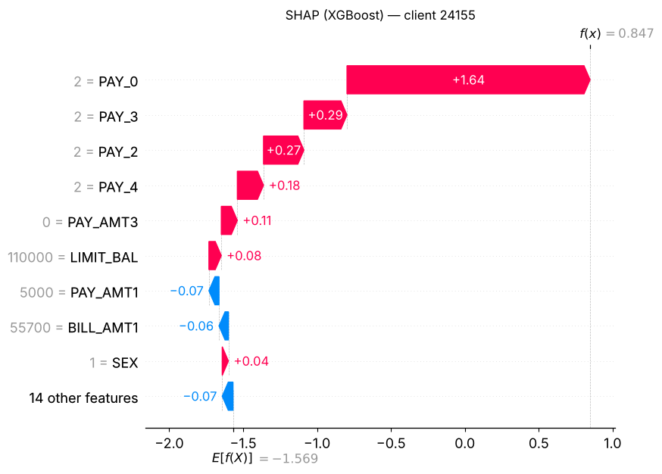
02 / SHAP
SHAP: split the prediction fairly
1
Features are players, the risk score is the payout.
2
Each feature’s share is its average marginal contribution over every order features could join (Shapley, 1953).
3
Shares add up exactly: average score + contributions = this applicant’s score.
Client 24155
Limit NT$110,000 · 2 months late on each of the last 4 bills · bill NT$55,700
P(default) 70% → declined
TreeSHAP on our XGBoost model. Red pushes toward default, blue toward repayment. Being late in September alone moves the score from the 17% average to 52%.
Explainable Credit Risk
06
Notes:
SHAP measures how much each input pushed one prediction up or down. It comes from game theory. Think of a group project that gets a grade. To split the credit fairly, you average what each teammate added over every order in which they could have joined. That’s the Shapley value. Here the features are the teammates and the risk is the grade. The key property: the pieces always add up exactly to the prediction.
Applied to our case: client 24155 has a limit of 110,000 and was two months late on each of the last four bills. XGBoost gives a 70% chance of default, so the client is declined, and they did default. The average client starts at 17%. Being late in September alone takes the score to 52%. The earlier late months add the rest.
Source note — not spoken: Concept slide from XAI_in_Finance_v4.pptx slide 4, restyled. The waterfall is the updated 05_xgboost_explainability.ipynb cell 6 (TreeSHAP, interventional, 100 background clients): base value −1.569 log-odds (17.2%); −1.569 + 1.645 = 0.076 (51.9%); f(x) = 0.847 (70.0%). The v4 waterfall and its 22% → 58% came from the earlier XGBoost run.

Slide 7
02 / SHAP
SHAP: same top reason, then the models split
Client 24155 · each input's push on the score, in log-odds · # = rank among 23 inputs
Input | XGBoost | Neural network
P(default) | 70.0% | 58.5%
Late, September | +1.64 #1 | +1.35 #1
Late, August | +0.27 #3 | < 0.02
Late, July | +0.29 #2 | +0.08 #4
Late, June | +0.18 #4 | +0.28 #2
Credit limit | +0.08 #6 | +0.09 #3
Exact
TreeSHAP reads XGBoost’s trees: the parts add up to its 70% exactly.
Estimated
The network can only be probed: Kernel SHAP samples it against 100 real clients. Five re-runs kept the same top 4.
Past the #1 reason, each model leans on different late months.
Explainable Credit Risk
07
Notes:
Source note — not spoken: XGBoost from 05_xgboost_explainability.ipynb cells 4 and 6: TreeSHAP, interventional, 100 background clients, additivity checked, P = 0.700, test AUC 0.7805. Network from NN_explainability.ipynb cells 28 and 42: Kernel SHAP, 100 background clients, logit link, P = 0.585, test AUC 0.771; five re-runs kept the same top 4, no value moved more than 0.015. The network's Late, August value is outside its top 10 (|SHAP| < 0.022).

Slide 8
02 / SHAP
Copy one input, and SHAP splits its credit
XGBoost retrained with an exact copy of PAY_0 (late, September) · client 24155
0.78 → 0.78
Test AUC. Same accuracy, no new information.
−23%
September’s own credit, now shared with a copy of itself.
Our late months and monthly bills overlap the same way, so how SHAP splits their credit is partly arbitrary.
Explainable Credit Risk
08
Notes:
Source note — not spoken: 05_xgboost_explainability.ipynb cell 10. Test AUC 0.78 with and without the copy; PAY_0 SHAP 1.645 → 1.261, the copy 0.437. −23% = 1.261 / 1.645 − 1. Monthly bill correlations of 0.80–0.95 are recorded in 01_logistic_regression.ipynb cell 43.

Slide 9
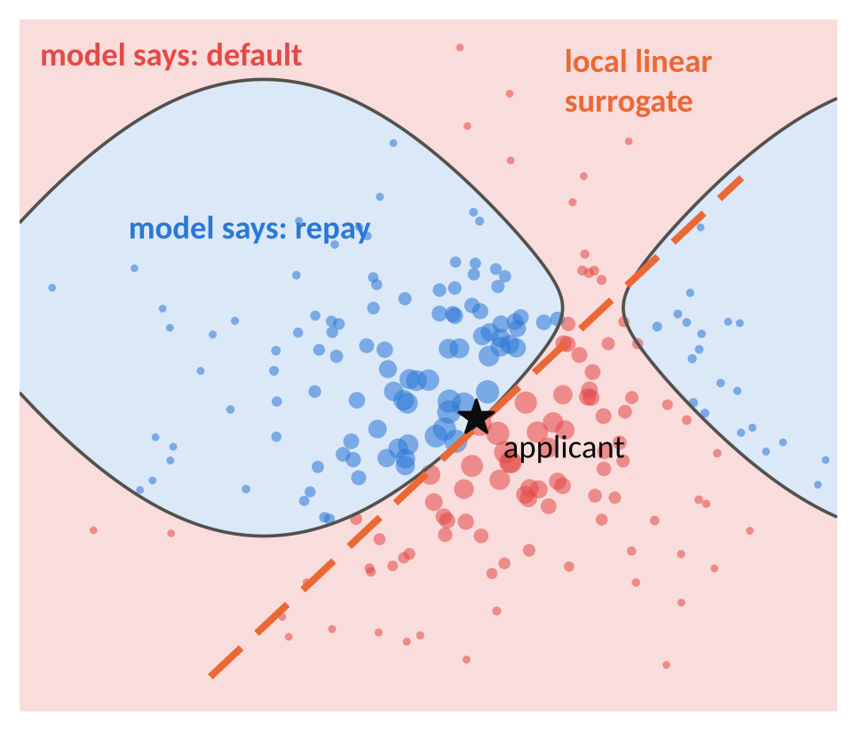


03 / LIME
LIME: zoom in and fit a simple model
1
Perturb Create ~5,000 fake neighbours of the applicant.
2
Ask Score every neighbour with the black box.
3
Weight Close neighbours count more than far ones.
4
Fit Fit a sparse linear model. Its weights are the explanation.
Works on any model, needs only predictions
Random sampling; arbitrary “closeness”; probes unrealistic points
Explainable Credit Risk
09
Notes:
LIME explains one prediction with a simple model that copies the black box only around that client. Four steps. It creates about 5,000 fake look-alikes by tweaking the client’s inputs. It asks the model to score each one. Closer look-alikes count more. Then it fits a straight line through them, and that line’s weights are the explanation. On the picture, the dashed line is that straight-line copy, valid only near the star.
Its advantage: it only needs predictions, so it works on any model. Two catches: the sampling is random, and many fake clients are combinations no real customer would have.
Source note — not spoken: Concept slide from XAI_in_Finance_v4.pptx slide 5, restyled; the picture is an illustration, not model output.

Slide 10
03 / LIME
LIME: a straight line fit around one client
ON XGBOOST, CLIENT 24155
36% vs 70%
R² = 0.29
LIME’s line predicts 36% where XGBoost says 70%.
The line explains under a third of how XGBoost’s score moves near this client.
Fit quality was not recorded for the network.
LIME’s reasons describe its line, not the model.
Explainable Credit Risk
10
Notes:
Source note — not spoken: 05_xgboost_explainability.ipynb cell 13: LIME, 5,000 samples, seed 42; local prediction 0.36 vs XGBoost 0.70; R² = 0.29 (LIME's score). The four-step description follows the LIME procedure (Ribeiro et al., 2016). The network notebook did not record LIME fit quality.

Slide 11
03 / LIME
Re-run LIME, and the network’s reasons drift
Client 24155 · share of 20 LIME runs (different seeds) where each input makes the top 4
Of 4 reasons | XGBoost | Network
Same across re-runs | 3.90 | 3.49
Same as SHAP | 4 | 3
On the network the fourth reason is a near tie (late August 0.029 vs credit limit 0.026), so the random seed decides.
On the network, LIME agrees less with itself and with SHAP.
Explainable Credit Risk
11
Notes:
Source note — not spoken: XGBoost from 05_xgboost_explainability.ipynb cells 15 and 17 (mean pairwise top-4 agreement 3.90 of 4 over 20 seeds; SHAP–LIME top-4 overlap 4/4). Network from NN_explainability.ipynb cells 39 and 42 (3.49 of 4; SHAP–LIME 3/4; mean LIME weights PAY_2 0.029, LIMIT_BAL 0.026). 5,000 samples per run, top 4 by absolute weight.

Slide 12
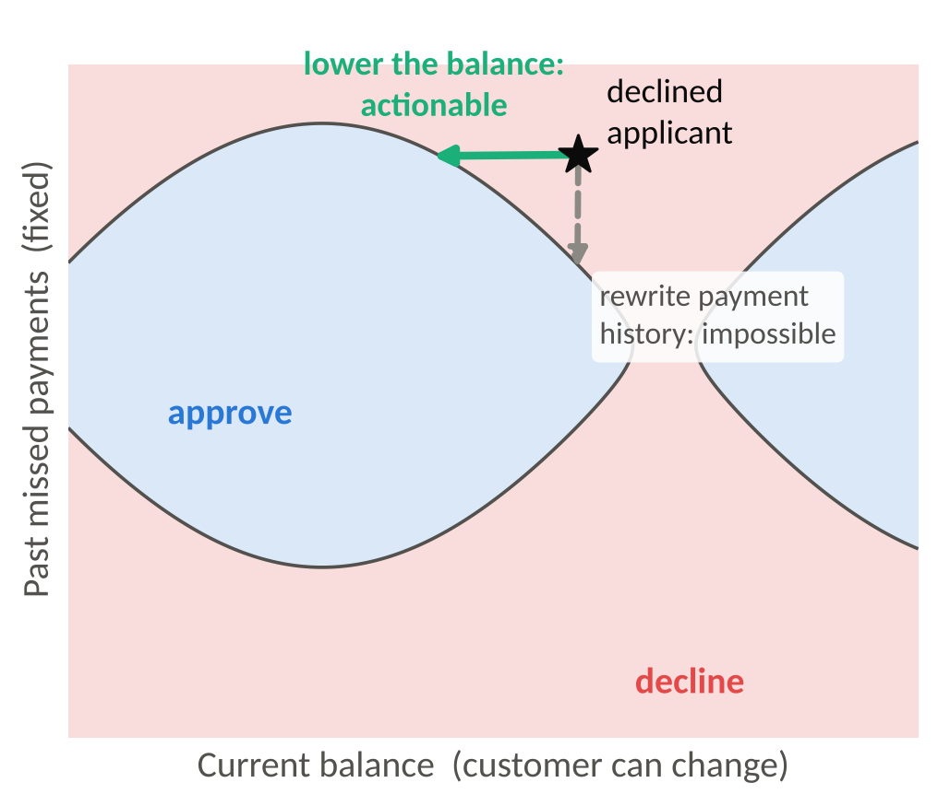
04 / COUNTERFACTUALS
Counterfactuals: what would change the answer?
Client 24155 on XGBoost today: 70%. Cut-off: 50%.
Get current this month
30%
September: 2 months late → paid on time
Pay on time and pay NT$35k
25%
DiCE, only this month’s changes allowed
Become 29 years older
41%
Unconstrained DiCE: an impossible change
Valid for the model is not the same as possible for the client.
Explainable Credit Risk
12
Notes:
A counterfactual is the smallest change that would flip the decision. It answers the client’s own question: what do I need to do? We used DiCE, which searches for changes until the risk drops below the 50% cut-off. On the picture, rewriting past payments would flip the decision, but it’s impossible. So we tell DiCE what the client can actually change.
For client 24155 on XGBoost, getting current on September’s payment drops the risk from 70% to 30%. Paying on time plus about 35,000 gives 25%. Without limits, DiCE suggests becoming 29 years older: valid for the model, useless as advice.
Source note — not spoken: Concept slide from XAI_in_Finance_v4.pptx slide 6, restyled; the picture is an illustration. Figures updated to 05_xgboost_explainability.ipynb: cell 25 (get current 0.296), cell 23 (PAY_0 → −1, PAY_AMT1 → 35,355: 0.246), cell 20 (AGE 29 → 58 with BILL_AMT1 → −145,764: 0.412). The v4 figures (24% for paying NT$41k, 43% for 8 months late in April, 69% after retraining) are not in the updated notebook.

Slide 13
04 / COUNTERFACTUALS
Counterfactuals: valid, but often impossible
Client 24155 · DiCE searches for changes that bring P(default) below 50%
Search | XGBoost | Neural network
Anything may change | Become 29 years older; September bill −NT$145,764 41% | Pay NT$134,508 in June, a month already past 49%
Anything may change | Get current; September bill NT$836,583 42% | Pay NT$1.08M over two past months, ~10× the limit 42%
Only September’s status, bill and payment | Pay on time and pay NT$35,355 25% | Catch up one month (2 → 1 month late) 39%
Constraints make the advice possible, but a person has to choose them, and every fix still rewrites September.
Explainable Credit Risk
13
Notes:
Source note — not spoken: XGBoost from 05_xgboost_explainability.ipynb cells 20 and 23 (DiCE random method, seed 42; probabilities 0.412, 0.417, 0.246). Network from NN_explainability.ipynb cells 45 and 47 (PAY_AMT4 134,508: 0.49; PAY_AMT2 791,971 + PAY_AMT4 291,999: 0.42; PAY_0 2 → 1: 0.39). Only network rows whose re-scored probability matches the displayed change are shown. Constrained search: PAY_0 and BILL_AMT1 may only fall, PAY_AMT1 may only rise (to the 99th percentile).

Slide 14
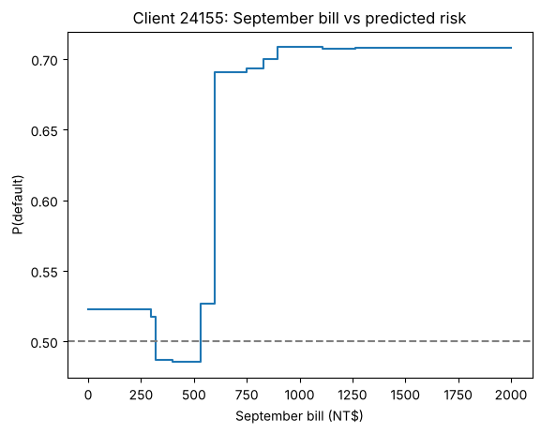
04 / COUNTERFACTUALS
A tree’s steps turn into strange advice
What if… | XGBoost | Network
Get current this month | 29.6% | 21.2%
Be 8 months late in April | 73.6% | 78.7%
Sensible advice holds on both models. The bill quirk belongs to one model, and only probing it reveals it.
XGBoost, client 24155: paying September’s bill off still gives 52.3%. Only a NT$320–525 bill is approved.
A glass box shows this in one coefficient; a black box hides it.
Explainable Credit Risk
14
Notes:
Source note — not spoken: 05_xgboost_explainability.ipynb cells 25–26: what-ifs (0.296, 0.523, 0.736) and P(default) over September bills NT$0–2,000 in steps of 5; approved only for NT$320–525. Network what-ifs from NN_explainability.ipynb (get current 0.212; 8 months late in April 0.787). The group's earlier slide gave XGBoost 0.43 for the April change; the updated notebook gives 0.736.

Slide 15
WHAT WE LEARNED
Where each tool falls short
The glass box
Logistic: the calculation is visible, but a large coefficient still needs interpretation.
SHAP
Exact on trees, only estimated on the network; correlated inputs split credit arbitrarily.
LIME
Matches SHAP on XGBoost (4/4), less on the network (3/4); its line fits poorly (R² 0.29).
Counterfactuals
Valid is not feasible: impossible changes on both models; constraints need human judgment.
Evidence about model behavior—not proof of a real-world cause.
Explainable Credit Risk
15
Notes:
Source note — not spoken: Summary of slides 3–10; figures as cited there.

