Slide 1
01 / READ THE MODEL
The model flags risk.
What can we explain?
Three model families. Different ways to understand a prediction.
Why this score?
Would reasons change?
What would flip it?
Logistic interpretation
and feature attribution
Importance definitions
and repeated explanations
Counterfactual search
and feasibility
Explainable Credit Risk · Speaker 1
01
Notes:
Imagine a credit analyst sees a high-risk score. Accuracy is only the first question. Why this score, would the reasons change, and what would change the decision?
Our group studied logistic regression, XGBoost and a neural network to see what their tools reveal. We compare explanations, not a competition between models.
Source note — not spoken: Motivation adapted from XAI_in_Finance_v4.pptx slides 2–3 and its presenter script; no regulatory claim or real lending decision is implied. Scientific scope: README.md and RESULTS.md. Notebooks 01–03 share Configuration A: 30,000 Excel rows, 23 predictors, stratified 80/20 split, seed 42. Notebook 04 separately trains Configuration B: 24,000 CSV rows, 21 predictors excluding SEX/MARRIAGE, stratified 75/25 split, seed 42. The talk compares types of explanation, not controlled effects across configurations.

Slide 2
01 / READ THE MODEL
Readable coefficients still need interpretation
Selected feature | Coefficient | exp(coefficient)
PAY_0 | 0.661 | 1.937
PAY_AMT1 | -0.200 | 0.819
BILL_AMT1 | -0.321 | 0.726
EDUCATION_5 | -1.040 | 0.353
MARRIAGE_0 | -0.995 | 0.370
PAY_0
×1.937
Conditional odds per
standard-deviation
increase
A large coefficient
is not automatically
a useful explanation.
Numeric inputs are standardized; category effects require contrasts.
Explainable Credit Risk · Speaker 1
02
Notes:
Logistic regression gives us a useful starting point: the fitted equation is readable. For standardized numeric inputs, a coefficient describes the change in log-odds for a one-standard-deviation increase, holding other inputs fixed.
The latest repayment status, PAY_0, has coefficient 0.661. Its exponential, 1.937, means that increase multiplies the model's conditional odds by about 1.94. The latest payment amount has a negative fitted association.
But the largest absolute coefficients belong to small, undocumented education and marriage categories. A large number is not automatically a meaningful financial reason. We retain every category, so category effects need within-variable contrasts. Correlated monthly bills add another difficulty. The model is transparent, but interpretation still needs judgment.
Source note — not spoken: 01_logistic_regression.ipynb cell 39, saved coefficient/exp(coefficient) table: PAY_0 0.661/1.937; PAY_AMT1 -0.200/0.819; BILL_AMT1 -0.321/0.726; EDUCATION_5 -1.040/0.353; MARRIAGE_0 -0.995/0.370. Cell 43 bill correlations: 0.80–0.95 off-diagonal. The editable table transcribes selected original rows. Numeric and binary coefficients have different scales. Category exponentials are not odds ratios against an absent reference category. These associations are not causal.

Slide 3
01 / READ THE MODEL
We can rebuild this prediction exactly
Selected contributions to log-odds · applicant 4387
P(default) = 0.9927
PAY_0
+4.717
PAY_2
+0.548
PAY_3
+0.488
SEX_1
-0.438
EDUCATION_2
+0.288
PAY_4
+0.275
BILL_AMT1
-0.269
0
1
2
3
4
Full equation reconstructs the probability. These seven terms are a selection, not the complete sum.
Explainable Credit Risk · Speaker 1
03
Notes:
For one test applicant, we can follow the calculation all the way through. Multiplying the transformed inputs by their coefficients, adding the intercept and converting to probability gives 0.9927, exactly matching the recorded model output at that precision.
In the local breakdown, PAY_0 contributes plus 4.717 to log-odds. Other repayment terms add risk, while some features offset it. This is more informative than a high-risk label: we see the calculation behind it.
Still, exact arithmetic does not make the explanation causal. The terms depend on coding and scaling, and this is the riskiest test case, not a typical applicant. Our second speaker now asks what we can learn when there is no short coefficient equation to read.
Source note — not spoken: 01_logistic_regression.ipynb cells 46, 48–49. Full original calculation: index 4387, probability 0.9927. Recorded local terms: PAY_0 4.717; PAY_2 0.548; PAY_3 0.488; SEX_1 -0.438; EDUCATION_2 0.288; PAY_4 0.275; BILL_AMT1 -0.269. The slide redraws these seven saved terms for readability; it is a selection, not the complete sum used to reconstruct probability. Original full local plot remains in cell 49. This intrinsic decomposition is not SHAP and uses a different case from the network. Prior verification reproduced the logistic outputs at recorded precision.

Slide 4
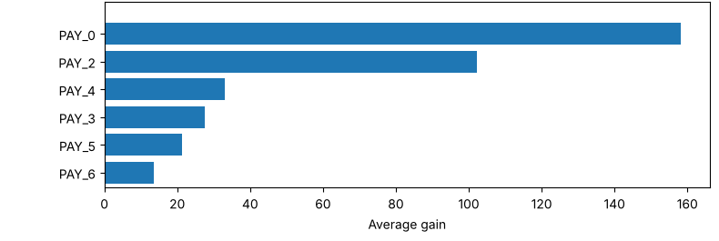
02 / QUESTION IMPORTANCE
Which features help XGBoost split the data?
Six highest-gain features · excerpt of the recorded plot
Gain
Weight
Cover
Average objective improvement
Split frequency
Hessian-based coverage
Explainable Credit Risk · Speaker 2
04
Notes:
XGBoost combines many trees. Our completed interpretation asks which features help those trees divide the training data, rather than trying to read one coefficient per input.
The original gain plot puts PAY_0 first, followed by other repayment-status variables. Gain measures the average improvement in the training objective when a feature is used for a split. So recent repayment history helps produce useful splits in this fitted ensemble.
But gain is only one definition. Weight counts how often a feature is used in splits. Cover summarizes the coverage of those splits; here it is based on the model's training curvature, or Hessians. A frequently used variable need not deliver the biggest average improvement.
This distinction matters for interpretation. Importance tells us something about the trees collectively, but it does not tell us whether a feature raised this applicant's risk. Next, we ask whether the three definitions even produce the same ranking.
Source note — not spoken: 03_xgboost.ipynb cells 27–29. The slide displays the six highest-gain rows from the stored plot in cell 29, retaining the original bar lengths and horizontal axis; no gain values were inferred or recomputed. PAY_0, PAY_2, PAY_4, PAY_3, PAY_5, PAY_6 lead. Gain is average loss reduction, weight split frequency, cover average Hessian-based coverage for binary logistic boosting. Training outcomes were not exactly reproduced: RESULTS.md records 284 historical best trees versus 328 in verification and a changed applicant. This presentation uses historical importance evidence only.

Slide 5
02 / QUESTION IMPORTANCE
Ask “important” three ways, get three rankings
Selected recorded ranks · 1 means highest importance
GAIN
WEIGHT
COVER
PAY_0
1
1
2
3
LIMIT_BAL
8
8
BILL_AMT1
10
11
15
Global importance is not a signed explanation of an individual prediction.
Explainable Credit Risk · Speaker 2
05
Notes:
The lines follow three features through gain, weight and cover. A smaller rank means greater importance. PAY_0 moves from first by gain to eighth by weight and third by cover. BILL_AMT1, the latest bill amount, moves from tenth to first to eleventh. Credit limit also changes substantially.
Nothing in this comparison says the model is contradicting itself. Each definition summarizes a different property: improvement, frequency or coverage. It does mean that reporting a feature as important without naming the definition can mislead.
Our XGBoost notebook prepares a prediction wrapper and selects an applicant, but does not complete SHAP, LIME or DiCE experiments. We cannot fill that gap with results from another presentation that lack supporting code. The historical fit also differed in verification, so these remain recorded rankings. Our third speaker now turns to the separate neural-network explanation study.
Source note — not spoken: 03_xgboost.ipynb cell 28. Editable rank plot transcribes original gain/weight/cover ranks: PAY_0 1/8/3; BILL_AMT1 10/1/11; LIMIT_BAL 8/2/15. Lines join definitions, not observations or a time trend. The plot is a readable rendering of saved data, not a new experiment. Cells 31–38 contain wrappers, applicant selection and correlations, not TreeSHAP, LIME or DiCE results. Teammate deck claims about XGBoost post-hoc experiments are excluded. Historic applicant index 24154, ID 24155; verification index 4366, ID 4367, as documented in RESULTS.md.

Slide 6
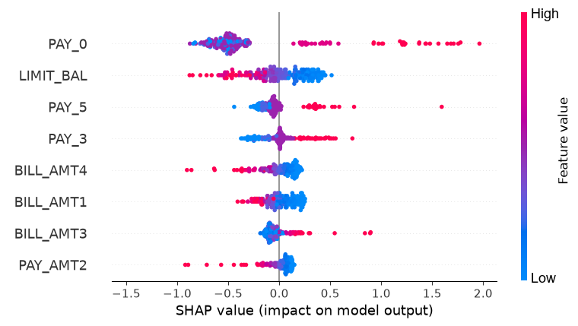
03 / ATTRIBUTE THE SCORE
Across 200 cases, recent repayment status stands out
200
sampled test
cases
PAY_0
≈ 0.602
mean absolute
SHAP value
First 8 feature rows shown · separate neural-network explanation study
Explainable Credit Risk · Speaker 3
06
Notes:
There is an important boundary here. The original network uses the thirty-thousand-row configuration shared with the other models. The explanation study trains a separate network on twenty-four thousand records, with fewer predictors and a seventy-five/twenty-five split. These explanations belong to that second network, not to every model in the project.
SHAP divides the difference from a reference expectation into feature contributions. This global view contains two hundred sampled test cases. Each dot is an applicant. Position shows the contribution in log-odds, and color shows the feature value.
Recent repayment status has the largest mean absolute attribution, about 0.602. Higher values generally sit on the risk-increasing side. Credit limit comes next. We learn which inputs matter across this sample, not just how well the model predicts. But a sample-level attribution is not a causal finding, and it is not the whole test population.
Source note — not spoken: Configuration A from 02_neural_network.ipynb; Configuration B from 04_neural_network_explainability.ipynb cells 2, 8–14. In B, SEX/MARRIAGE are excluded; 18,000 training and 6,000 test rows, seed 42. SHAP cell 30 uses 100 real background rows and a logit link. Cell 34: 200 sampled cases, 500 SHAP samples each. The slide enlarges the first eight rows of the saved beeswarm, preserving original points and horizontal axis; its existing color legend is resized. Cell 35: mean absolute PAY_0 0.601663, LIMIT_BAL 0.239477. No controlled cross-configuration comparison is claimed. PyCaret is only the CSV source.

Slide 7
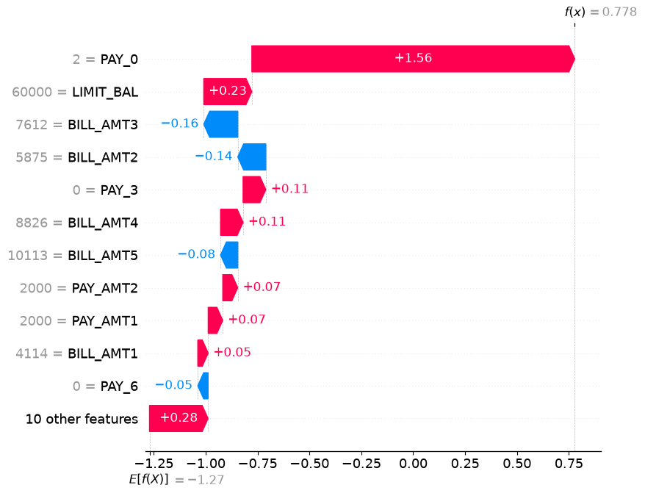
03 / ATTRIBUTE THE SCORE
One high-risk score, opposing contributions
Applicant 15110
P = 0.685
Reference
+ contributions
→ prediction
Final 0.778 is
log-odds, not
probability.
Explainable Credit Risk · Speaker 3
07
Notes:
For applicant 15110 in that CSV, the network's recorded default probability is 0.685. With our hypothetical 0.50 threshold, this case is classified as high risk.
Read the waterfall as a bridge from the reference expectation to this prediction. PAY_0 adds about 1.56 to log-odds; credit limit adds about 0.23. Two bill amounts push the other way. The final value of about 0.778 is log-odds, which corresponds to probability 0.685. It is not another probability.
So a high-risk score can contain both risk-increasing and offsetting contributions. SHAP makes that balance visible. However, the reference population matters, correlated histories complicate attribution, and the proposed correlated-feature stress test was not completed. This is also a selected real defaulter, not the earlier logistic case. Our fourth speaker will test whether the local explanation stays consistent, then ask what could change the predicted decision.
Source note — not spoken: 04_neural_network_explainability.ipynb cell 28 profile and recorded probability; original full saved waterfall in cell 31. Cell 42: PAY_0 1.556, LIMIT_BAL 0.232, BILL_AMT3 -0.164, BILL_AMT2 -0.135. Local Kernel SHAP: 2,000 samples, 100 real background rows, logit link. The diagram “reference + contributions → prediction” is a conceptual reading guide, not an extra experiment. CSV index 15110 is not a shared client ID. The teammate's “same client, different model” results are not substituted for this case.

Slide 8
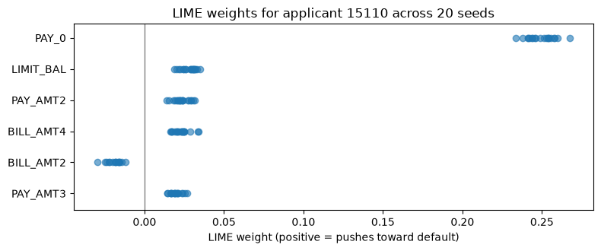
04 / TEST THE EXPLANATION
Ask again: which reasons stay?
Sample → Predict → Weight → Fit
2 / 4
SHAP–LIME agreement
2.61 / 4
LIME: all run pairs
4 / 4
SHAP: versus first run
One fixed model and applicant. Different stability definitions.
Explainable Credit Risk · Speaker 4
08
Notes:
LIME samples nearby profiles, obtains predictions, weights the neighborhood, then fits a simple local surrogate. PAY_0 is again its strongest positive term. Yet SHAP and the mean LIME explanation share only two of their top four features: repayment status and credit limit.
Repeat LIME with twenty seeds and the average pairwise overlap is 2.61 of four features. The plot shows weaker terms moving. Five SHAP runs keep the same top four against the first run; the maximum attribution range is 0.012.
These are different stability definitions for one fixed model and applicant. They establish no universal winner. We compare ranks, not incompatible weight magnitudes; LIME means exclude absent features. Its surrogate fidelity was not reported. Consistent reasons are useful evidence, not proof of truth.
Source note — not spoken: LIME conceptual four-step explanation adapted from teammate slide 5, applied only to the verified network study. 04_neural_network_explainability.ipynb cell 37: 5,000 samples, dominant PAY_0. Saved scatter cell 40; first six feature rows enlarged with original x-axis retained. Cells 33, 39, 42: SHAP [4,4,4,4,4] top-four overlaps vs run zero (including itself), max range 0.012; LIME 20 seeds, mean pairwise overlap 2.61/4; cross-method overlap 2/4, PAY_0 and LIMIT_BAL. Means omit runs absent from top-ten selection. These are not multi-applicant/retraining tests, and local fidelity is unreported.

Slide 9
04 / TEST THE EXPLANATION
A changed decision is not yet a feasible action
Same network and applicant · target: P(default) below 0.50
Search | Recorded change | P(default) | Unresolved
Unrestricted | BILL_AMT4: 8,826 → 795,321.9 | 0.025 | Old bill increases
Constrained | PAY_AMT1: 2,000 → 55,225.3 | 0.246 | Affordability
Constrained | PAY_0: 2 → −1 | 0.212 | Rewrites history
Five profiles from each search cross the boundary.
Crossing a model boundary does not establish a realistic intervention.
Explainable Credit Risk · Speaker 4
09
Notes:
DiCE asks what input profile would cross the model's boundary. It found five unrestricted and five constrained examples below the threshold.
One unrestricted example raises an older bill to almost eight hundred thousand Taiwan dollars, giving probability 0.025. Restricting the search produces alternatives such as raising the latest payment from two thousand to about fifty-five thousand, giving 0.246. Another changes historical repayment status, giving 0.212.
These are successful changes to model inputs, not established financial advice. We have not demonstrated affordability, consistency or causal effects, and past records cannot simply be rewritten. Two constrained probabilities differed slightly in verification; the table retains the recorded values. Constraints expose assumptions, but do not prove feasibility.
Source note — not spoken: 04_neural_network_explainability.ipynb cells 44–47; existing wrapper independently rescores the displayed DiCE rows. Free row 1: BILL_AMT4 8,826→795,321.9, probability 0.025. Constrained row 0: PAY_AMT1 2,000→55,225.3, probability 0.246. Constrained row 3: PAY_0 2→-1, probability 0.212. Constrained variables: PAY_0/BILL_AMT1 downward; PAY_AMT1/PAY_AMT2 upward with training-percentile caps; others frozen. RESULTS.md preserves [0.246,0.320,0.176,0.212,0.450] recorded vs [0.246,0.321,0.176,0.210,0.450] verification; all still below 0.50. No smallest-change optimality, real recourse or retraining robustness is established. Teammate conceptual question/contrast inspired the layout, not its unsupported numerical examples.

Slide 10
04 / TEST THE EXPLANATION
What the score alone could not tell us
How was the score formed?
Logistic: follow the fitted calculation.
Which importance definition?
XGBoost: name the definition.
Which reasons stay?
SHAP / LIME: compare views and variability.
What changes the decision?
DiCE: separate model alternatives from feasible action.
Evidence about model behavior—not proof of a real-world cause.
Explainable Credit Risk · Speaker 4
10
Notes:
To answer our opening questions: logistic regression exposes a calculation. XGBoost shows that importance depends on its definition. SHAP and LIME reveal contributions, local patterns and variation. DiCE finds alternative predictions and exposes feasibility assumptions. Together they provide evidence about model behavior, not proof of a real-world cause. Thank you.
Source note — not spoken: Full-project synthesis from notebooks 01–04, README.md and RESULTS.md. Closing “evidence, not proof” framing is adapted from teammate slide 13, with claims limited to verified experiments. No statistical significance, fairness audit, causality, calibration, population-wide robustness or production readiness is claimed. Unresolved issues include inner-validation preprocessing influence, ambiguous repayment codes, rare categories, correlated predictors and unassessed duplicate overlap. Four speakers have 150 scheduled seconds each; live delivery requires rehearsal.

