Slide 1
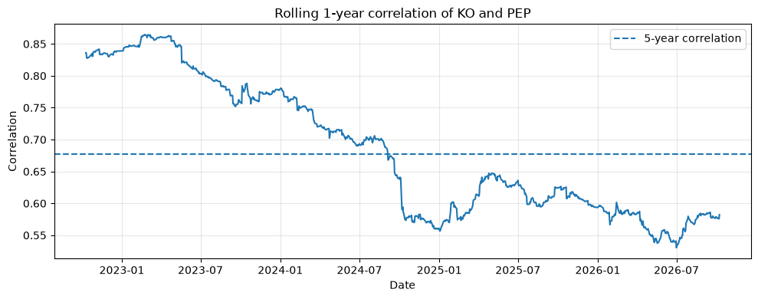
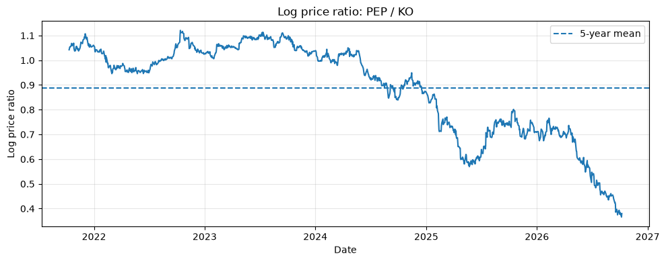
Pairs Trading: KO vs PEP
Historical evidence → model choice → 1,000,000-path Monte Carlo
TRADE SETUP
WHY THE CORRELATED RANDOM WALK IS THE BASELINE
LONG
$100k PEP
SHORT
$100k KO
CASH
$100k @ 5%
ρ = 0.677
≈ 0
p = 0.995
Entry: Oct 9, 2026 close
Forecast horizon: 60 trading days
Simulation: 1,000,000 paths
5-year KO–PEP return correlation
lag-1 return autocorrelation
ADF test on log price ratio
Correlation is strongly supported; stationarity around a fixed mean is not.
The assignment mentions Oct 12 elsewhere; I use Oct 9 consistently to answer the specific valuation question.
Baseline: correlated log-return random walk via Cholesky. Local OU is kept as an alternative scenario.

Slide 2
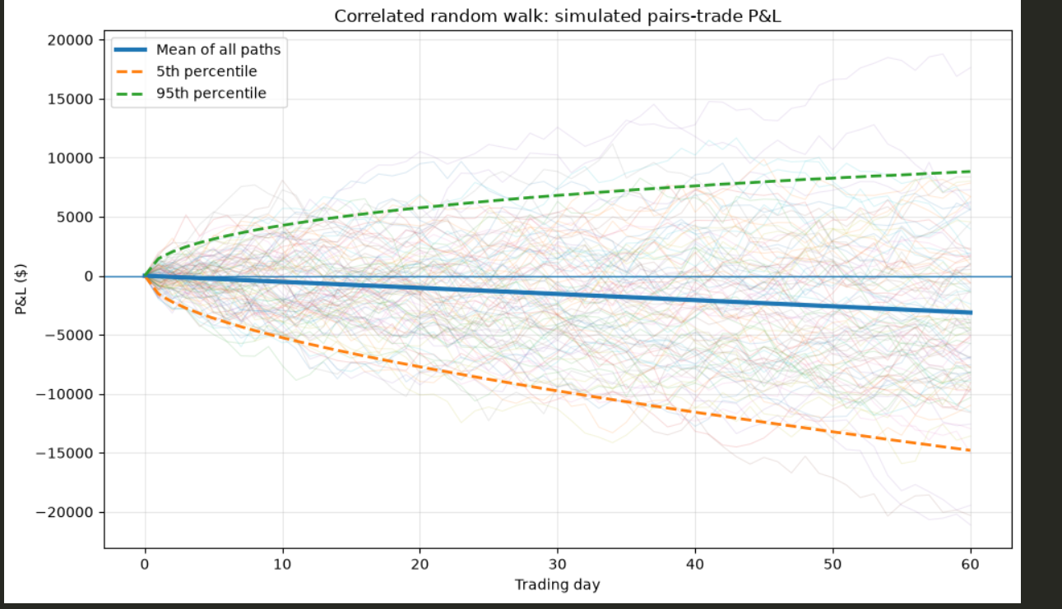
Monte Carlo result: correlation mainly changes the risk band
Baseline model · correlated random walk · 1,000,000 daily paths
PAIR P&L OVER 60 TRADING DAYS
OCT 16 VALUATION
Total P&L including cash interest
−$158
Expected total P&L
−$3.50k
5th percentile total P&L
+$3.21k
95th percentile total P&L
60-day pair P&L
Expected: −$3.12k
P5 / P95: −$14.8k / +$8.8k
Only 100 paths are shown for readability; mean and percentiles use all 1,000,000 simulations.
Positive correlation narrows the relative-return distribution.

Slide 3
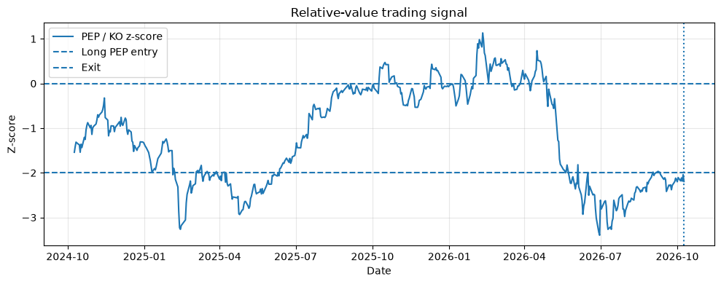
Entry / exit rule and the key model-risk conclusion
The trade has a relative-value signal, but profitability depends on the mean-reversion assumption
252-DAY RELATIVE-VALUE SIGNAL
TRADING RULE
ENTRY
z ≤ −2
Observed z = −2.20
Adjusted PEP/KO threshold: 1.465
Actual quoted ratio: 1.431
Equivalent entry differential: $40.95
Actual differential: $37.92
EXIT TARGET
Adjusted PEP/KO target: 1.868
Equivalent differential: $76.42*
z = 0
*Conditional on KO remaining at $88.05.
60-DAY EXPECTED PAIR P&L
Correlated RW
Local OU
OU half-life ≈ 150 trading days · ADF p = 0.995
−$3.12k
+$7.24k
Mean reversion makes the trade look attractive, but it is the least-supported assumption. → Keep the correlated RW as the forecast; treat OU as a scenario.

