Slide 1
Editorial Research Agent
PROJECT 3 · FINAL PRESENTATION
An author or topic → a verified book dossier for an independent bookshop
Jaime Garate Marquerie · Independent bookselling · Built with LangGraph
Notes:
[0:00–0:20] START THE AGENT NOW (open run_demo.py and press Run ▶). It takes 3–9 minutes, so in the demo show the backup dossier first and the live one if it has finished.
Hi, I'm Jaime. I built an AI research agent for independent bookshops. You give it an author or a topic, and it gives the bookseller a dossier of verified books, with sources. I've just started it, so we'll see the real result in the demo.

Slide 2
The problem, and who has it
WHY · THE PROBLEM
WHO
WHAT THEY DO TODAY
THE PAIN
Independent bookshop owner
Researches books by hand
~4 hours per dossier
E.g. the founder of La Insumisa, a new bookshop in Moscardó, Madrid.
Publisher sites, catalogues and reviews; checking editions and ISBNs one by one.
About 13 hours a month at 4 dossiers (estimate, to be measured).
Hours spent researching are hours not spent recommending books to readers.
Project 3 · Jaime Garate Marquerie
Notes:
[0:20–1:00] The user is a person: the owner or buyer of an independent bookshop. My case is La Insumisa, the bookshop I'm opening in Moscardó, Madrid. Today, to decide which books by an author to stock, the bookseller checks publisher websites and catalogues by hand, edition by edition. I estimate about four hours per dossier. It's an estimate I will measure in the first sprint. That's time taken away from what matters in a small bookshop: talking to readers.

Slide 3

How it works
HOW · THE DATA FLOW
A request and the bookshop's profile go in → a verified, sourced book dossier comes out
Step 1
Step 2
Step 3
Step 4
Step 5
Trigger
Collect
Check
Write
Deliver
Bookseller types an author
Web, 2 catalogues, publisher pages
Editions, ISBNs, genre checked
AI judges fit; facts from sources
Dossier + evidence file
If the first search isn't good enough, the agent rewrites it and tries once more, on its own.
Project 3 · Jaime Garate Marquerie
Notes:
[1:00–1:30] Five steps. The bookseller types a request. The agent collects data from three sources: web search, two book catalogues and the publishers' own pages. It checks every edition and ISBN. An AI model judges how well each book fits this bookshop's profile, but it never invents facts: every field comes from a source or says 'not verified'. And it decides by itself: if the first search finds too little, it rewrites the query and tries once more.

Slide 4
See it work.
HOW · LIVE DEMO
“Leila Guerriero” → a dossier of verified books for La Insumisa
1
2
3
4
Start it
Show it run
Open the report
Prove it
Launched at the start
Searches, checks, judges fit
Click a source link
Books, synopsis, genre
Backup: a saved dossier and a screen recording, in case an API fails.
Project 3 · Jaime Garate Marquerie
Notes:
[1:30–3:45] DEMO (2:15). Use case first: a customer asked La Insumisa for Leila Guerriero; the bookseller doesn't know her work well and wants to know which books fit the shop before ordering them.
1) Terminal: the run I started at the beginning. Point at the output lines: dossier and evidence paths.
2) Open the dossier. Show the 'Research' section: attempts, query, status 'sufficient', tools used, no failed tools.
3) Scroll to one book, e.g. 'Teoría de la gravedad': verified ISBN, most recent edition (2nd, 2020), synopsis with its source, genre or 'not verified', themes labelled as the agent's interpretation, and the judge's reason citing the shop profile.
4) Click one source link (Open Library or the publisher page).
5) Optional if time: show the self-correction run: 'works by Leila Guerriero' with no author → 0 books → the agent rewrote the query → 10 books.
IF SOMETHING FAILS: open samples/dossier_20261111_7a1a1973.md (or the newest good one) and say: 'Live APIs can fail, so here is a run from yesterday. When the AI judge fails, the agent marks the dossier NOT FINAL instead of guessing.'

Slide 5
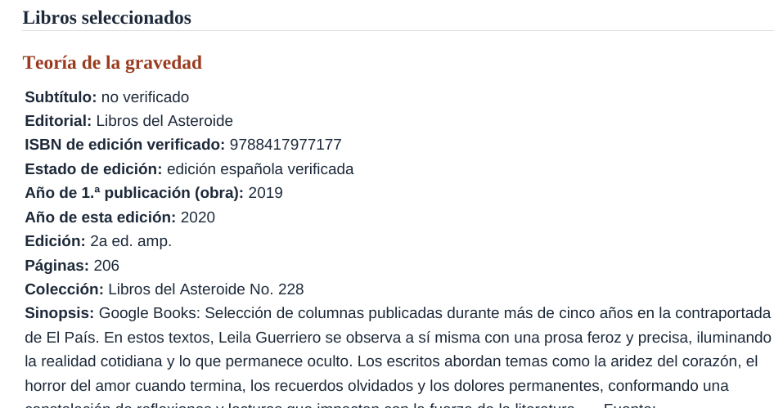
What the user gets
SO WHAT · THE RESULT
3–9 minutes
instead of ~4 hours by hand (estimate), plus review
Sources
Every book links to Open Library, Google Books or the publisher
Honest
Marks “not verified” or “NOT FINAL” instead of guessing
Project 3 · Jaime Garate Marquerie
Notes:
[3:45–4:15] This is the real output, not a mock-up. A run takes three to nine minutes, depending on how busy the free AI tier is, instead of an estimated four hours, and the bookseller still reviews it. Every key fact links to its source. And it's honest: if it can't verify something, it says 'not verified'; if the AI judge fails, the whole dossier is marked NOT FINAL. The bookseller decides.

Slide 6
Under the hood
SO WHAT · TECHNICAL SPECIFICATIONS
Part | What we use | Its job
Orchestration | LangGraph (Python) | Runs steps, decides to search again
AI model | Google Gemini (free tier) | Judges fit, drafts synopsis and genre
Data sources | Tavily · Open Library · Google Books | Web, editions & ISBNs, cross-check
Grounding | Source rules, no vector database | Each field sourced, or “not verified”
Delivery | Markdown dossier + JSON evidence | Saved in the repo for review
Error handling | Retries, fallback, max 2 searches | API fails → no crash, no guessing
Why LangGraph: the value is in decisions and checks, so I needed explicit state and tested Python.
COST PER REPORT
$0
TIME PER RUN
3–9 min
Project 3 · Jaime Garate Marquerie
Notes:
[4:15–4:55] Under the hood: LangGraph orchestrates the steps and the decision to search again. Gemini judges fit and proposes synopsis, genre and themes, but Python checks that the genre really appears in the publisher's text. Three data tools: Tavily, Open Library and Google Books. No vector database: every field needs a live source. Retries, a fallback model and a two-search limit, so it never crashes or loops. Cost per report today is zero on free tiers, about 12 search credits. A run takes 3 minutes, up to 9 when the free AI tier is busy and the agent has to retry. I chose LangGraph over n8n because the value is in the decisions and checks, which I can test in Python: 49 automated tests. n8n could be a light trigger later.

Slide 7
What’s next: go-to-market sprints
NEXT · GO-TO-MARKET
Sprint | Goal & audience | How we reach them | Deliverable | Success metric
1 | Validate with La Insumisa + 2 Madrid shops | Visits; free 4-week pilot | Shop profile, 4 dossiers, feedback form | ~4 h → ~45 min per dossier; ≥90% ISBNs right
2 | Demand + discovery: pilots + 3–5 new shops | Referrals; booksellers' association | Request log; discovery mode: new authors from new releases & prizes | % of discovered books the shop orders
3 | Paid offer for active pilot shops | Direct offer to pilot users | Pricing + impact report (with permission) | ≥30% of active shops pay
Each sprint reaches real bookshops and measures one number.
Project 3 · Jaime Garate Marquerie
Notes:
[4:55–5:25] Next: three go-to-market sprints, not features. Sprint 1: validate with my own bookshop and two others in Madrid, a free four-week pilot; success means a dossier in 45 minutes instead of four hours and at least 90% correct ISBNs. Sprint 2: understand demand with referrals and a booksellers' association, and add discovery mode: the agent proposes authors and books the bookseller doesn't know yet, from publishers' new releases and literary prizes; success is the share of discovered books the shop actually orders. Sprint 3: test a paid plan; success is 30% of active shops converting.

Slide 8
Thank you.
Questions?
Editorial Research Agent · github.com/jaimegmarquerie-ui/proyecto3-agente-editorial
Jaime Garate Marquerie
Notes:
[5:25–5:40] Thank you. The agent researches and recommends; the bookseller validates and decides. The code, the README and the demo recording are in the repository. Questions?

