Slide 1
Multimedia
Compression
Basics
T.Sharon-A.Frank

Slide 2
Compression Issues
Storage and Bandwidth Requirements
  Discrete media
  Continuous media
Compression Basics
  Entropy
  Source
  Hybrid
Compression Techniques
  Image (JPEG)
  Video (H.261, MPEG 1/2/4)
  Audio (G.7xx)
T.Sharon-A.Frank

Slide 3
Why Compress?
Uncompressed data requires considerable storage capacity.
Useful to compress static images.
But critical for efficient delivery of video and audio.
Without compression, not enough bandwidth to deliver a new screen image every 1/30 of a second.
T.Sharon-A.Frank

Slide 4
Compression Concepts
Compression ratio: size of original file divided by size of compressed file.
Data quality: Lossy compression ignores information that the viewer may not miss and therefore information may be lost. Lossless compression preserves original data precisely.
Compression speed: time it takes to compress/decompress.

Slide 5
Compression Requirements
low delay
Compression
Scalability
high quality
high compression ratio
Low complexity Efficient implementation
Hardware/Software Assist
T.Sharon-A.Frank

Slide 6
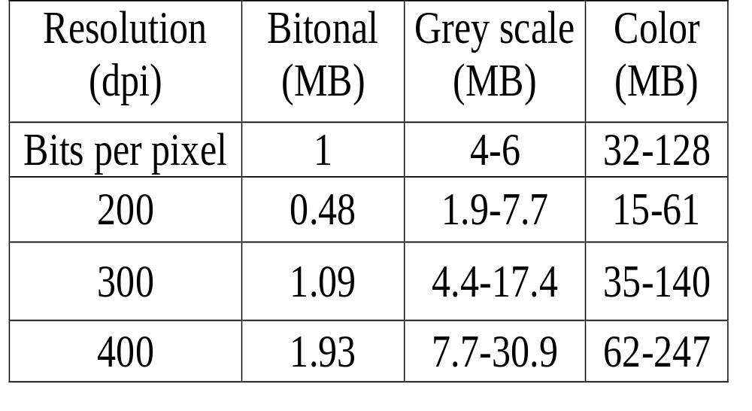
Storage Requirements for A4
A4 is 2.10 x 2.97 cm (8.27 x 11.69 Inch)
T.Sharon-A.Frank

Slide 7
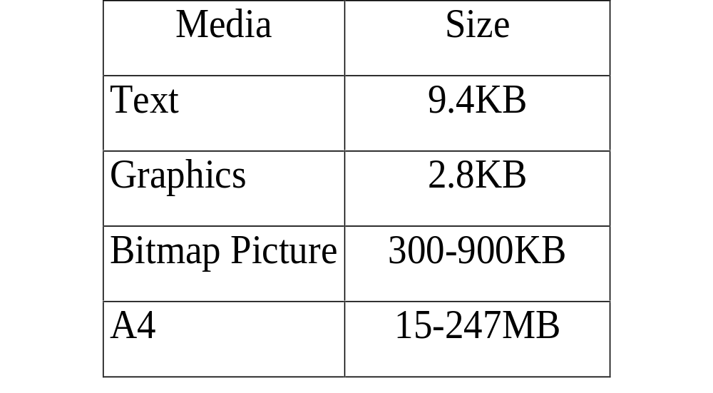
Discrete Media – Size per Page
T.Sharon-A.Frank

Slide 8
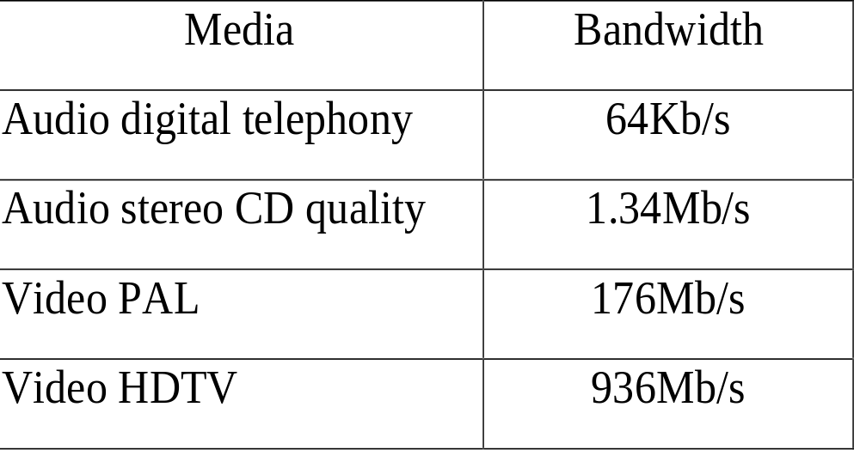
Continuous Media – Bandwidth
T.Sharon-A.Frank

Slide 9
Video Compression Example (1)
A full-screen 10-second video clip:
  at 30 frames/sec * 10 = 300 frames
  at 640x480 = .3072MB pixels per frame
  at “true” color = 3 bytes per pixel
  300 * .3072 * 3 = 276.48MB
  …but…276.48MB takes up a lot of space.
Cannot transfer 276MB in 10 seconds:
  32X CD-ROM rate ~ 48MB in 10 sec
  Hard disk rate ~ 330MB in 10 sec.
T.Sharon-A.Frank

Slide 10
Video Compression Example (2)
Therefore must compress:
  There is video compression hardware
  Most often, software is used.
Video lends itself to compression
  Small changes between images.
Therefore good compression ratios.
Thus in practice our 10 sec video clip takes up 14 MB or less.
T.Sharon-A.Frank

Slide 11
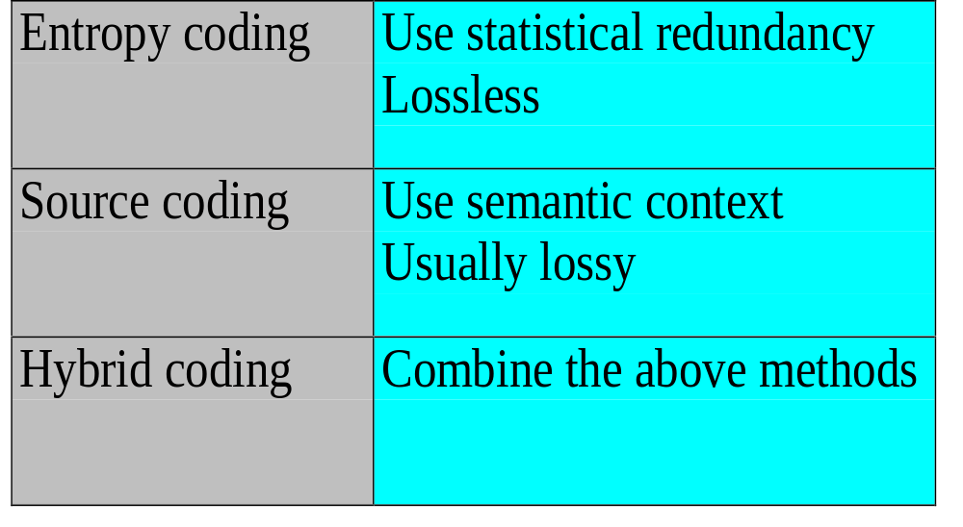
Compression Techniques
T.Sharon-A.Frank

Slide 12
Lossless Compression
Always possible to decompress compressed
data and obtain an exact copy of the original uncompressed data.
  Data is just more efficiently arranged, none discarded.
Run-length encoding (RLE)
Huffman coding
Arithmetic coding
Dictionary-based schemes – LZ77, LZ78, LZW (used in GIF)

Slide 13
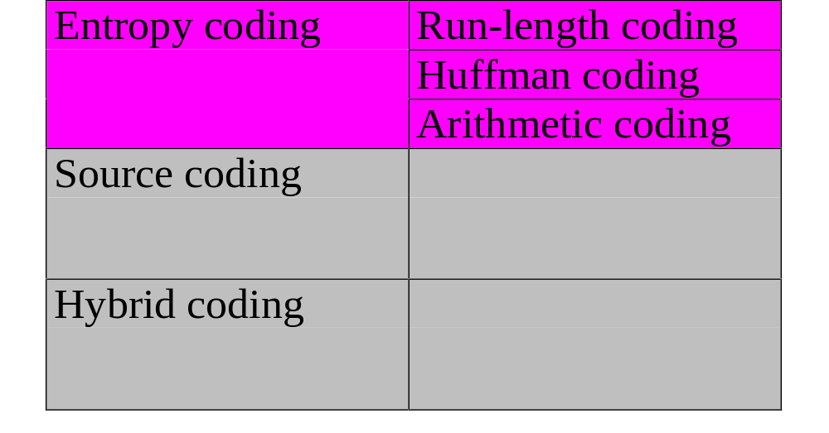
Coding Techniques – Entropy
T.Sharon-A.Frank

Slide 14
Entropy Coding
Data in data stream considered a simple digital sequence and semantics of data
are ignored.
Short Code words for frequently occurring symbols. Longer Code words for more infrequently occurring symbols
  For example: E occurs frequently in English, so we should give it a shorter code than Q.
T.Sharon-A.Frank
Notes:
Run-length Coding:

Slide 15
Run Length Encoding (RLE)
Generalization of Zero Suppression.
Runs (sequences) of data are stored as a single value and count, rather than the individual run.
Example:
  WWWWWWWWWWWWBWWWWWWWWWWWWBBBWWWWWW
  WWWWWWWWWWWWWWWWWWBWWWWWWWWWWWWWW
  Becomes: 12WB12W3B24WB14W
To avoid confusion, use flags + appearance counter
Example: ABCCCCCCCCDEFGGG
  Becomes: ABC!8DEFGGG
! is flag
T.Sharon-A.Frank

Slide 16
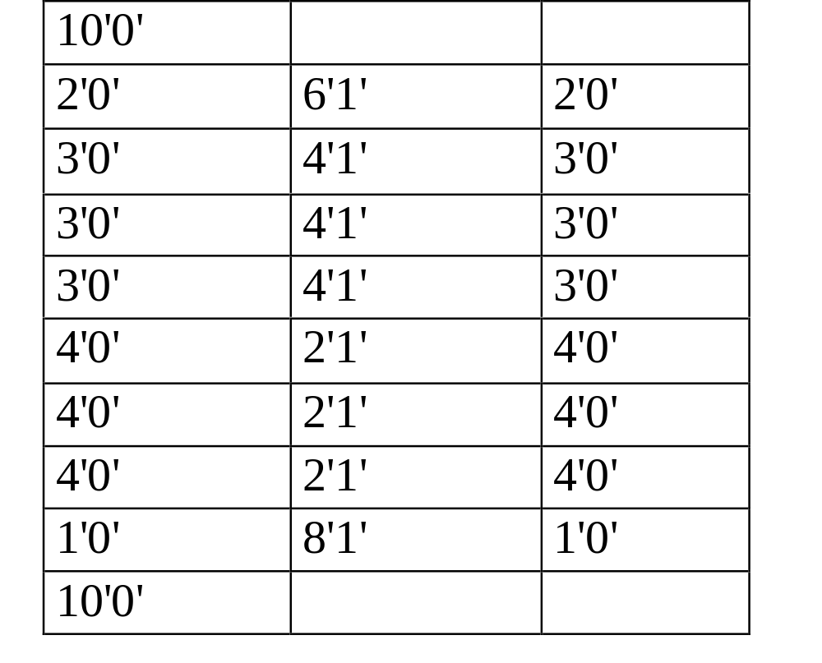
One-dimensional RLE
T.Sharon-A.Frank

Slide 17
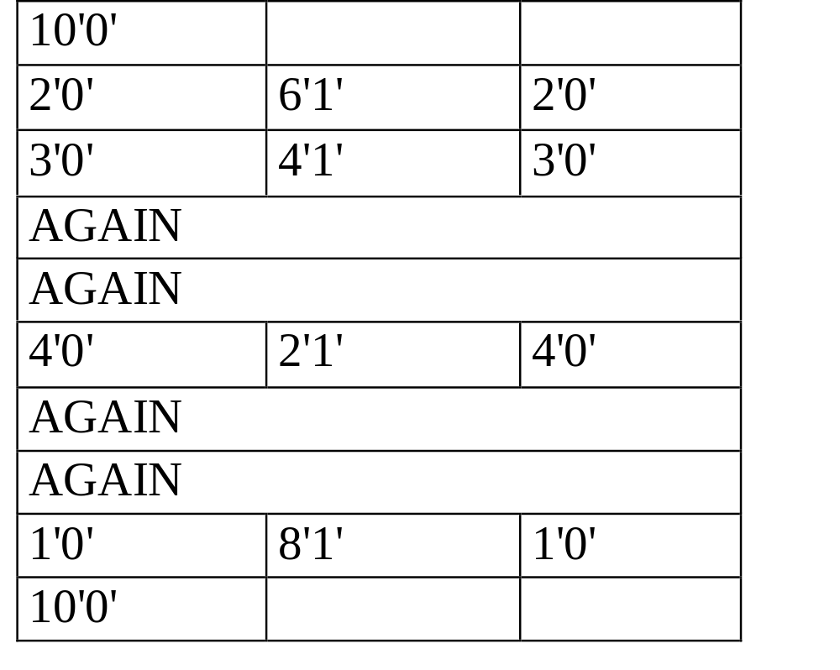
Two-dimensional RLE
T.Sharon-A.Frank

Slide 18
Huffman Coding
Huffman coding gives optimal code given:
  number of different symbols/characters
  probability of each symbol/character.
Shorter code is given to higher probability.
Results in variable code size.
Uses prefix code.
Allows decoding at any random location.
Commonly used as a final stage of compression.
T.Sharon-A.Frank

Slide 19
Arithmetic Coding
Encodes each symbol using previous ones.
Encodes symbols as intervals.
General method:
  Each symbol divides the previous interval
  Intervals are scaled.
Encodes the entire message into a single number, a fraction n where (0.0 ≤ n < 1.0).
Does not allow decoding at any random location.
Also optimal.
T.Sharon-A.Frank

Slide 20
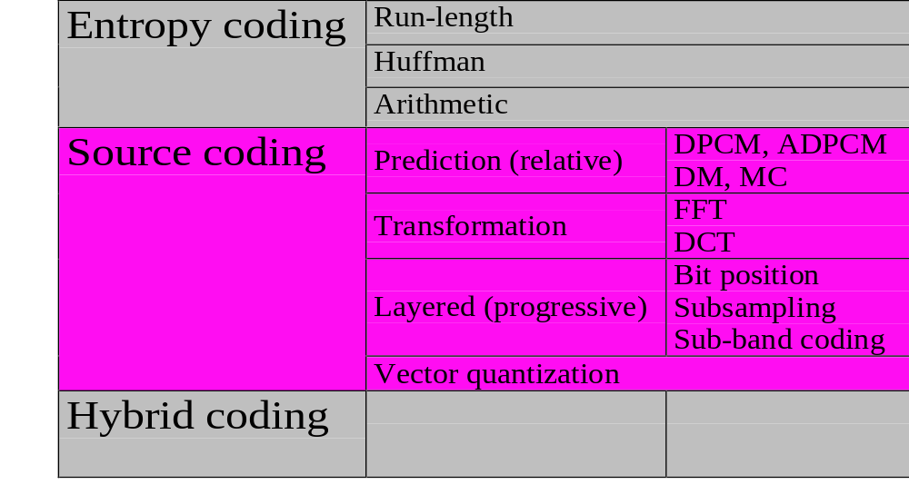
Coding Techniques – Source
T.Sharon-A.Frank

Slide 21
Source Encoding
Takes semantics of data into account – amount of compression depends on data contents.
This method is one where compressing data and then decompressing it retrieves data that may well be different from the original, but is "close enough" to be useful in some way.
Used frequently on the Internet and especially in streaming media and telephony applications.
T.Sharon-A.Frank

Slide 22
Prediction Coding
Current sampled signal can be predicted based on the previous neighborhood samples.
Prediction error has smaller entropy than original signal.
T.Sharon-A.Frank

Slide 23
Prediction Coding Techniques
Audio
  PCM: Pulse Code Modulation (digitizing algorithm using logarithmic coding)
  DPCM: Differential PCM
  ADPCM: Adaptive DPCM
  DM: Delta Modulation
Video
  MC: Motion Compensation
T.Sharon-A.Frank
Notes:
If the predicted value is derived from the preceding samples using a constant function it is DPCM.
If only one bit is used to code the difference of the predicted value, it is DM.
ADPCM – The predicted value is extrapolated from a series of values of preceding samples using a time varying function.

Slide 24
DPCM/ADPCM
DPCM
  Compute a predicted value for next sample, store the difference between prediction and actual value.
  Used in digital telephone systems.
  Also the standard form for digital audio
  in computers and various compact disk formats.
ADPCM
  Dynamically vary step size used to store quantized differences.

Slide 25
DPCM
Predicted value = last sampled value + difference
Signal
Differentially coded signal
t
t
T.Sharon-A.Frank

Slide 26
Adapted Encoding (ADPCM)
Predicted value extrapolated from previous values; prediction function is variable
Signal
Differentially coded signal
t
t
T.Sharon-A.Frank

Slide 27
Delta Modulation (DM)
Difference coded with 1 bit
Signal
Differentially coded signal
t
t
T.Sharon-A.Frank

Slide 28
Transformation Coding
FFT – Fast Fourier Transform
DCT – Discrete Cosine Transform
Transform time/spatial domain to frequency domain
Most significant coefficients possibly packed in lower frequencies with certain media types (e.g., images)
FDCT IDCT
a
c
T
x or t
f
Less significant coefficients
T.Sharon-A.Frank

Slide 29
Transformation Example
2x2 array of pixels
A
B
C
D
Transform
X0 = A
X1 = B – A
X2 = C – A
X3 = D – A
Inverse Transform
An = X0
Bn = X1 + X0
Cn = X2 + X0
Dn = X3 + X0
T.Sharon-A.Frank

Slide 30
Layered Coding
Encoding is done in/by layers
Techniques:
  Bit Position
  Sub-sampling
  Sub-band coding
T.Sharon-A.Frank
Notes:
Sub-sampling – sample in lower resolution.
Examples: QCIF is a sub-sample of CIF, using (4:2:2) for color-sub-sampling

Slide 31
Vector Quantization
The data stream is divided to blocks called vectors.
Table, called code-book
  contains a set of patterns
  may be predefined or dynamically constructed.
Find best matching pattern in the table.
Send table entry number instead of vector.
T.Sharon-A.Frank

Slide 32
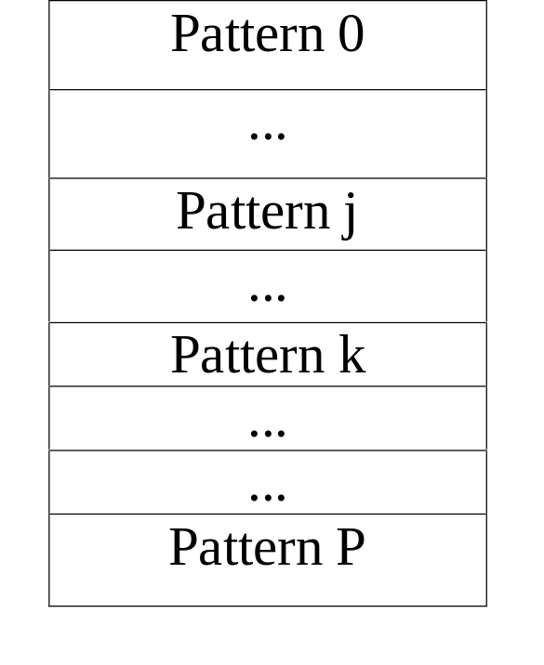
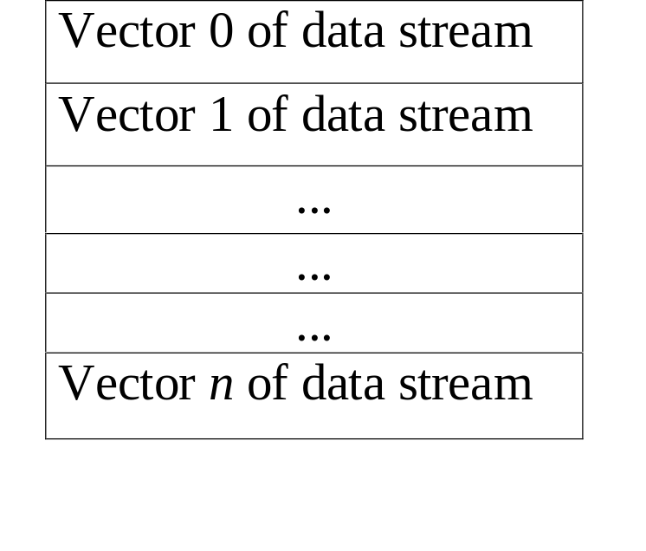
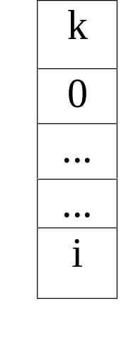
Principle of Vector Quantization
Original data stream
Code-book
Compressed data stream
T.Sharon-A.Frank

Slide 33
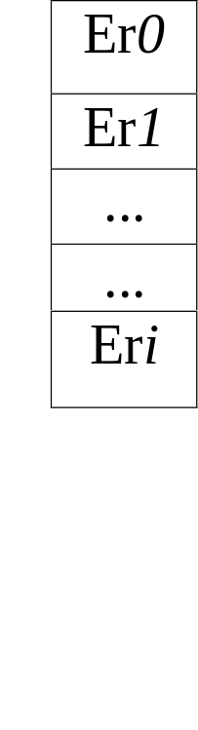
Vector Quantization with Error Transmission
Original data stream
Code-book
Compressed data stream
T.Sharon-A.Frank

