Slide 1
Problem Details For CoAP APIs & CoRAL API Discovery
27th October 2020

Slide 2
Overview
Problem Details: Provides a payload format for errors in CoAP-based APIs.
CoRAL descriptions.
“type” , “title”, “detail”, “instance”.
Issues: https://github.com/core-wg/core-problem-details/issues
Changes from -01 – not many. Spent time:
Study of the identifier problem (UUID, IANA, ISBN…), important to follow some criteria:
size/compactness , low barrier to entry, stability, private-public transitions, familiarity to REST API developers.
Study how the API context can be discovered and shared.
Study representation of API.
CBOR Map
Study simple interactions using API.
During this study we found we needed a mechanism to discover exchange the vocabulary first.
Notes:
Notes on criteria:
- low barrier is in conflict with compactness for compactness we need a central authority.
- use of a dictionary, can more readily be used by lorawan cases.
- we need to allocate short compact global unique ids for apis.
- Problem is how to know which API are we talking to. As soon as we get that we get other identifiers for free.

Slide 3
Advertising
New link attribute to be added to target links; ”rel=vocab”.
Allows to share the vocabulary relation
Link rel=hosts rt=temperature href=/temp1
{ Link rel=vocab href=/api-dict
… }

Slide 4
Discovery
Vocabulary relation exposed via /.well-known/core
GET /.well-known/core
2.05 Content
Link rel=hosts rt=humidity href=/hum {
Link rel=vocab href=/api-dict }
Link rel=hosts rt=configuration href=/config {
Link rel=vocab href=https://googley.eye/api-dict }
A new resource type “rt=core-api-dictionary” can also be used on the query.
GET /.well-known/core?rt=core-api-dictionary
2.05 Content
</api-dict>;rt=core-api-dictionary
[...]
Notes:
In a highly homogeneous environment, one can imagine that all endpoints (clients and servers) are pre-configured with the same vocab, so the following discovery step would not be needed. The inclusion of the vocab reference (including the version / etag / thumbprint) makes it possible, even in the above situation, to detect out-of-sync vocabs between peers.

Slide 5
Retrieval
Vocabulary retrieved directly from endpoint
GET /api-dict
2.05 Content
ETag: 12345
| Count | Namespace |
|:-----:|:-------------------------- |
| 100 | "ACE group management" |

Slide 6
Negotiation
Once resource is found clients can negotiate the vocabulary to be used using the “rel=vocab” link option.
POST /config
Link rel=vocab href=/api-dict etag=12345
Setting key=@72 value=false
Setting key=@73 value=15
Setting key=@74 value=@75
2.04 Changed
OR
5.xy I Don’t have the vocabulary

Slide 7
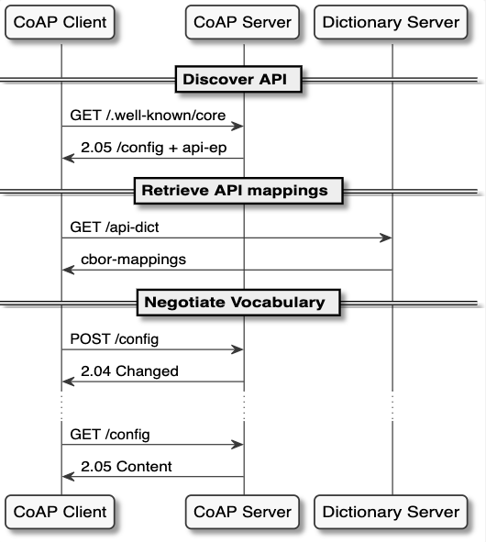
Full exchange

